Slide 1
Trust in Digital Repositories
International Digital Curation Conference (IDCC) 8, January 14-17, 2013 Amsterdam, Netherlands
Elizabeth Yakel, Ph.D.
Ixchel M. Faniel, Ph.D.
Adam Kriesberg
Ayoung Yoon
Professor University of Michigan
yakel@umich.edu
Postdoctoral Researcher OCLC Research
fanieli@oclc.org
Ph.D. Students University of Michigan and University of North Carolina
akriesbe@umich.edu
ayhounet@gmail.com

Slide 2
Outline
Introducing DIPIR
Trust Study
Theoretical underpinnings
Methodology
Findings
Discussion
Next Steps

Slide 3
IMLS-funded project led by Drs. Ixchel Faniel (PI) & Elizabeth Yakel (co-PI)
Studying the intersection between data reuse and digital preservation in three academic disciplines to identify how contextual information about the data that supports reuse can best be created and preserved.
Focuses on research data produced and used by quantitative social scientists, archaeologists, and zoologists.
The intended audiences of this project are researchers who use secondary data and the digital curators, digital repository managers, data center staff, and others who collect, manage, and store digital information.
For more information, please visit http://www.dipir.org

Slide 4
The Research Team
DIPIR Project
Nancy McGovern
ICPSR/MIT
Ixchel Faniel
OCLC Research
(PI)
Eric Kansa Open Context
William Fink UM Museum of Zoology
Elizabeth Yakel University of Michigan (Co-PI)

Slide 6
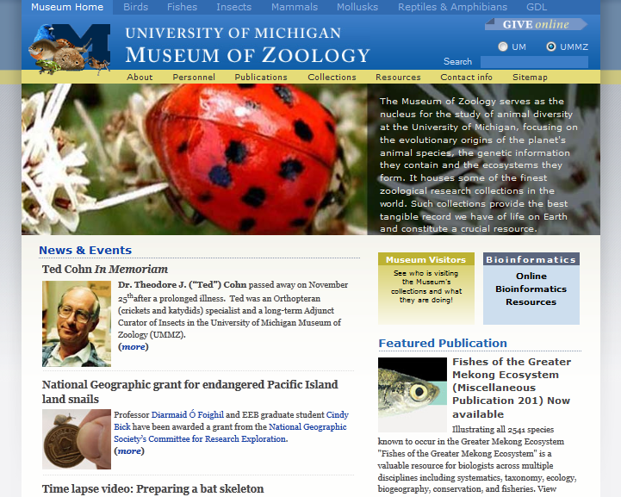

Slide 7
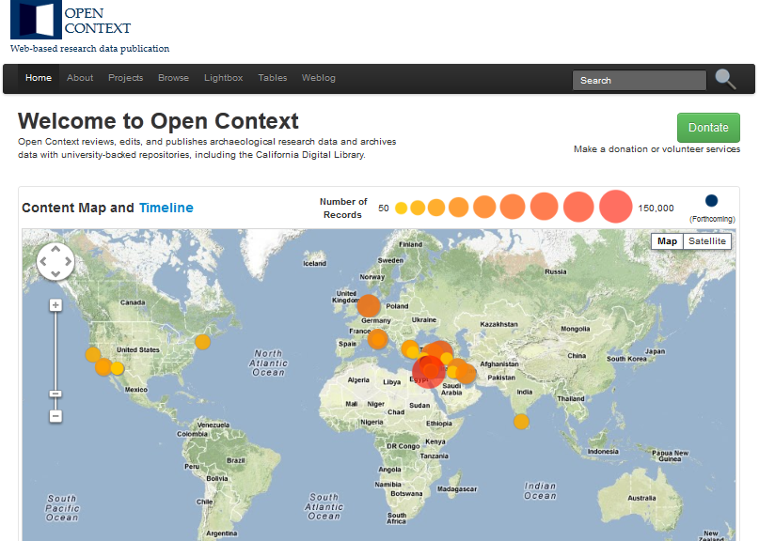

Slide 8
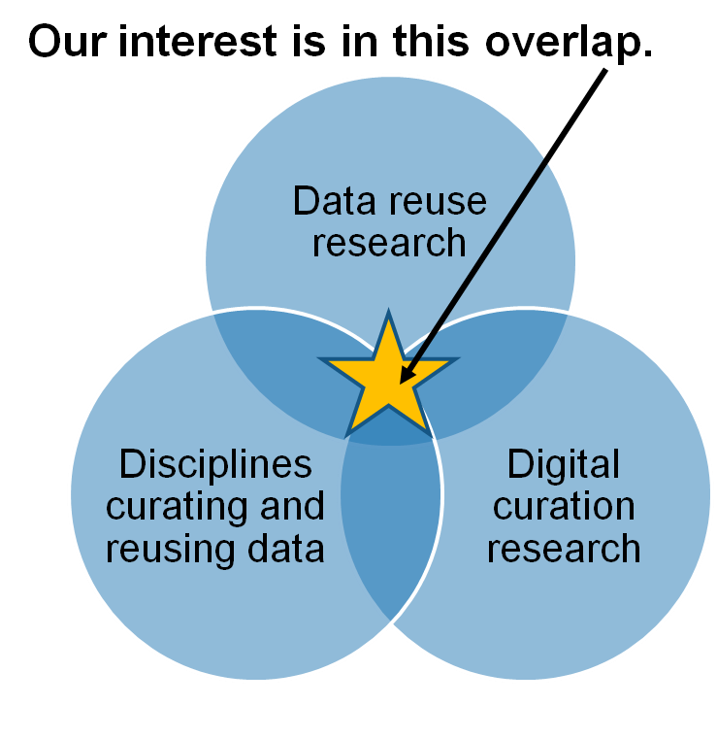
Research Motivations & Questions
What are the significant properties of quantitative social science, archaeological, and zoological data that facilitate reuse?
2. How can these significant properties be expressed as representation information to ensure the preservation of meaning and enable data reuse?
Faniel & Yakel 2011

Slide 9
Research Methodology
 | ICSPR | Open Context | UMMZ
Phase 1: Project Start up
Interviews Staff | 10 Winter 2011 | 4 Winter 2011 | 10 Spring 2011
Phase 2: Collecting and analyzing user data
Interviews data consumers | 44 Winter 2012 | 22 Winter 2012 | 27 Fall 2012
Survey data consumers | 2000 Summer 2012
Web analytics data consumers |  | Server logs Ongoing
Observations data consumers |  |  | 10 Spring 2013
Phase 3: Mapping significant properties as representation information

Slide 10
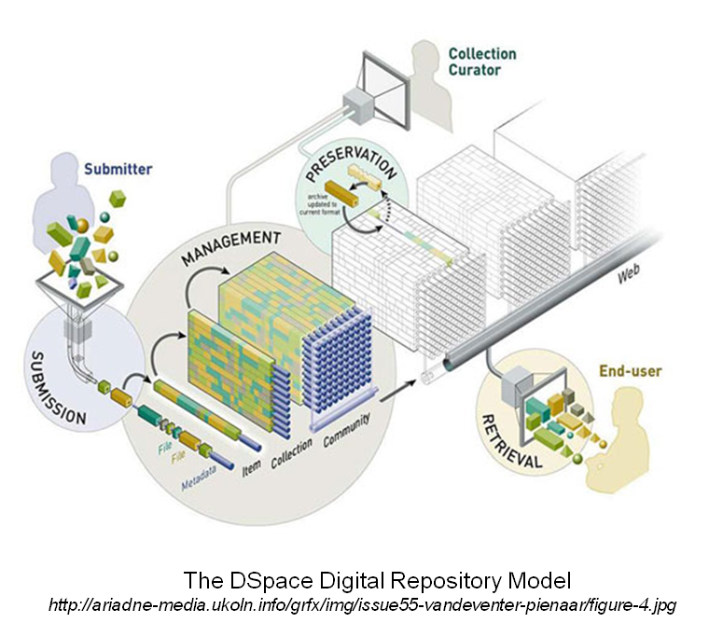
Trust in Digital Repositories
How do data consumers associate repository actions with trustworthiness?
How do data consumers conceive of trust in repositories?

Slide 11
Theoretical Framework
Construction of Trust
Trustworthy actions by repositories
Trust expressed by external stakeholders
Reciprocal nature of Trust
Prieto (2009) views “the digital repository as a trusted system” noting “user communities and their perceptions of trust” are key (p. 595).

Slide 12
Trustworthy Actions by Repositories
ISO 16363:2012: Space data and information transfer systems -- Audit and certification of trustworthy digital repositories (hereafter ISO TRAC)
Establishes functions for repositories to enact in order to be considered trustworthy (i.e. selection, data processing/cleaning, preservation).
Designated community – understanding
Transparency – underlying principal

Slide 13
Trust by External Stakeholders
Stakeholder trust in the organization (Pirson & Malhotra, 2011; Mayer, Davis, & Schoorman, 1995; Sitkin & Roth, 1993; Lewicki & Bunker, 1996)
Structural assurance (Gefen, Karahanna, & Straub, 2003; McKnight, Cummings, & Chervany, 1998)
Social factors (Venkatesh, Morris, Davis, & Davis, 2003; Thompson, Higgins, & Howell, 1991; Triandis, 1977)

Slide 14
Stakeholder Trust
Benevolence
The organization demonstrates goodwill toward the customer
Integrity
The organization is honest and treats stakeholders with respect
Identification
Understanding and internalization of stakeholder interests by the organization
ISO TRAC understanding the designated community (pp. 25-26)
Transparency
Sharing trust-relevant information with stakeholders
ISO TRAC sharing audit results (p. 19)

Slide 15
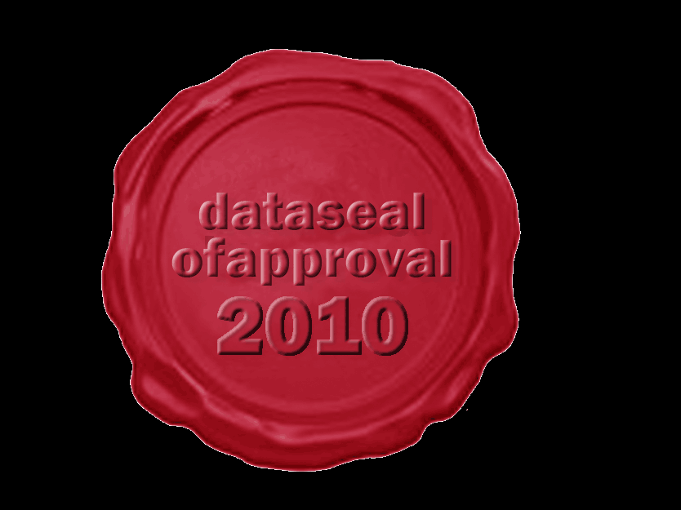
Structural Assurance
“Refers to one's sense of security from guarantees, safety nets, or other impersonal structures inherent in a specific context” (Gefen, Karahanna, & Straub, p. 64)
Third-party endorsement
Guarantees
Reputation

Slide 16
Social Factors
Positive reinforcement from
Peers
Mentors or senior colleague
Institutions
http://austinmccann.com/2012/06/06/mentoring-your-adult-volunteers

Slide 17
The Study
Data Collection
66 Interviews
22 Archaeologists
22 Novice quantitative social scientists
22 Expert quantitative social scientists
Data Analysis
Code set developed and expanded from interview protocol
http://www.english.sxu.edu

Slide 18
Findings: Repository Actions Matter
Recognizing Trustworthy Actions by Repositories
Metadata creation
‘They're very keen on producing the comprehensive metadata. And it's not that I trust each research … but I trust that the metadata is there for me to go back and check…on my own. I don't give [the archaeological repository] a sort of blanket trust that all the data in there is correct…they provide enough metadata for me to check that on my own…I sort of trust going there because I know that I can find the information I need to validate it’ (CCU02).
Selection
‘I mean I wouldn't use a scale from a very overtly conservative or overtly liberal organization that was involved in other kinds of political activities outside of collecting data because that would make you question what the goal is in collecting that data. So that would I think affect sort of the trustworthiness of repositories at least in my field’ (CBU14).

Slide 19
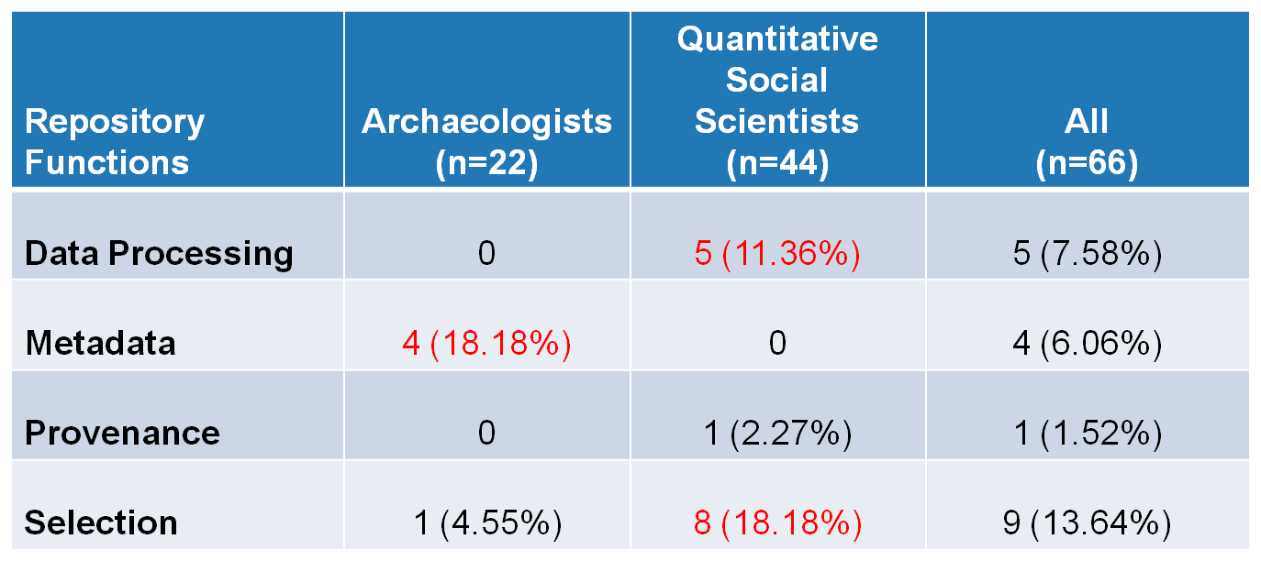
Frequency interviewees linked repository functions and trust
Yakel, Faniel, Kriesberg, & Yoon, IDCC 8, 2013

Slide 20
Engendering Trust
Identification
‘Data migration is critical…I believe, that a good repository has to be field-centric. That is to say, if you're going to put archaeological data into a repository, that repository has to understand archaeology. Because when the data must be migrated, they need to be able to look at it and to understand whether or not the migration is correct. It's one thing to say we got all the bits moved, it's another thing to say it still makes sense for archaeological data’ (CCU21).

Slide 21
Engendering Trust
Social factors: Disciplinary practice
‘I guess that's, well, trust …my own experience with using the data and then the organization’s long history, and then within the profession, it's very well spoken of. So, largely, informal mechanisms are why I trust [repository name]’ (CBU32).
Structural assurance and preservation
‘They're the only repository that I know around for individual investigator data. They've existed for a long time, they have incredible reputation for being able to maintain data, keep it well preserved, the issue of preservation is key, and that they go through extensive interrogation of the data to make sure that it is of high enough quality to be allowed to be part of their repository’ (CBU28).

Slide 22
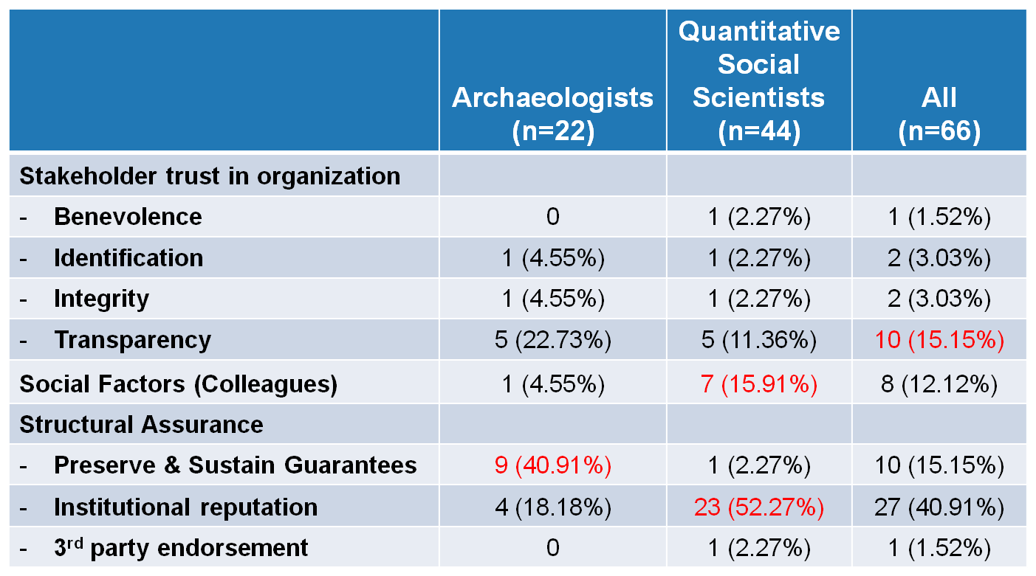
Frequency interviewees mentioned trust factors
Yakel, Faniel, Kriesberg, & Yoon, IDCC 8, 2013

Slide 23
Discussion
Repository functions are indicators of trust
Transparency is a trust factor
Discipline and level of expertise affect perceptions of trust
Preservation and sustainability should be considered structural assurance guarantees
Institutional reputation important

Slide 24
Next Steps
Interviews
Social scientists
Archaeologists
Zoologists
Survey
ICPSR Data Reusers
Observations
UMMZ Data Reusers
Web analytics
OpenContext.org transaction log analysis
Map significant properties of data as representation information

Slide 25
Survey of ICPSR Data Reusers
Data Collection
1,632 first authors of published journal articles 2008-2012 surveyed
The Survey
Part 1: inquire about data reuse experience
Part 2: inquire about experience using ICSPR repository and intention to continue use

Slide 26
ICPSR Survey of Data Reusers – Part I Data Reuse Experience
Data Producer Reputation
Data Quality
Completeness
Relevancy
Interpretability
Accessibility
Ease of Operation
Traceability
Credibility
Data Reuse Satisfaction
Faniel & Yakel for the DIPIR Project, 2010-2013
Documentation Quality
Other variables of interest: data scarcity, reuse experience, data scarcity, reuse dependence, data integrator, ICPSR contributor, data restrictions, journal impact factor.

Slide 27
ICPSR Survey of Data Reusers – Part II Data Repository Experience & Intention
Stakeholder Trust
in ICPSR
Integrity
Benevolence
Transparency
Identification
Structural Assurances
Trust in ICPSR
Intention to Continue Using ICPSR
Social Influence
Faniel & Yakel for the DIPIR Project, 2010-2013

Slide 28
Acknowledgements
Institute of Museum and Library Services
Partners: Nancy McGovern, Ph.D. (MIT), Eric Kansa, Ph.D. (Open Context), William Fink, Ph.D. (University of Michigan Museum of Zoology)
Students: Morgan Daniels, Rebecca Frank, Julianna Barrera-Gomez, Adam Kriesberg, Jessica Schaengold, Gavin Strassel, Michele DeLia, Kathleen Fear, Mallory Hood, Molly Haig, Annelise Doll, Monique Lowe

Slide 29
Questions?
Elizabeth Yakel Ixchel M. Faniel yakel@umich.edu fanieli@oclc.org
Notes:
29
29
29

