Slide 1
MissingMaterials.org: Bringing It All Back Home
Jennifer Schaffner, Merrilee Proffitt,
Katharine Kyes Leab, Richard W. Oram, Leab, Maria Holden, Prudence Backman Brittany Turner
May 11, 2010
Notes:
In this workshop, we will demonstrate how libraries and archives contribute information about stolen and missing books and manuscripts to a central blog and a union catalog.
Transparency about theft is essential in order to deter thieves, to prevent inadvertent purchase, and to recover valuable stolen cultural materials (rare books, manuscripts, archives, maps and other valuable materials). In June 2008, the RLG Partnership, the RBMS Security Committee, the ABAA and OCLC Research convened members of the cultural heritage collecting community to explore strategies to share reliable information about missing materials. The goal was to make it easy to register and broadcast information about missing materials.
(set your chat address on the pick list to ‘everyone’. Please send questions and comments. Everyone on the webinar can see them. We’ll collect questions and discuss them at the end.)

Slide 2
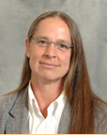
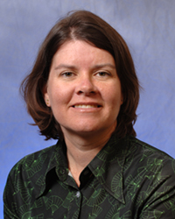
Your hosts
Jennifer Schaffner
Merrilee Proffitt
Notes:
[Jen] My name is…. Merrilee….
In this webinar we will first hear from Katherine Kyes Leab and Richard Oram, long-time advocates for cultural institutions to deter theft, to stand up and tell the truth. Both have extensive and unfortunate experiences with theft of cultural materials. Kathy will tell us why transparency has always been important, and Rich will talk about why he approached OCLC Research to provide infrastructure for transparency.
After Rich, I will describe why OCLC Research and the RLG Partnership built the MissingMaterials infrastructure and what the constraints were. My brave colleague Merrilee will demonstrate the procedure, “tagging” a book that is missing from her family’s collection.
After Merrilee’s demonstration of her commitment, we have three special-guest participants from the New York State Archives: Maria Holden, Prudence Backman and Brittany Turner. In the wake of high-profile and devastating thefts, New York has funded a project to provide centralized infrastructure to list everything missing throughout the state. Talk about commitment to transparency. Maria, Prudence and Brittany will talk about decisions they must make before they can broadcast information about New York State’s thefts, whether on MissingMaterials.org or on their own database.
Trying to get your stuff back can wreck your life. OCLC Research and the RLG Group together built MissingMaterials.org, a free method to notify the world of what you’re missing and that you want it back. MissingMaterials.org has many, many predecessors. Katherine Kyes Leab <click> built the first central register of stolen books in the 80s.
ABAA phone tree and pink slips, now central database/list (requires login for security pages)
LSO phone tree and then email list (contact Susan sallen@getty.edu)
RBMS Security Committee incidents of theft
messages on Ex-Libris and Archives lists
Blumberg incunables listed in the ISTC
BAMBAM, ARTLOSS Register, etc.
recent Missing and Stolen Map Database

Slide 3
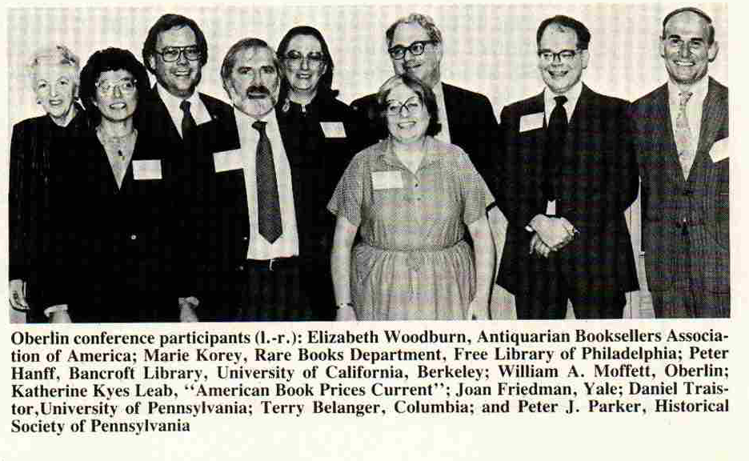
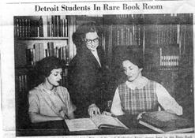
Katharine Kyes Leab
Notes:
[Jen]
KKL has been the editor (and fearless leader) of American Book Prices Current since 1972. American Book Prices Current is an annual record of books, manuscripts, autographs, maps and broadsides sold at auction. Kathy was also the mother of BAMBAM (Bookline Alert: Missing Books and Manuscripts), which she ran for 13 years. She has also written about about books and auctions for trade and scholarly journals as well as for such commercial publications as The Wall Street Journal, Town and Country, the Times Literary Supplement, and The New York Times Book Review. She delivered numerous lectures about books and manuscripts and served as an expert witness in legal cases. Served as head of the Publications Committee and Vice President of the Bibliographical Society of America. Along with her husband Daniel, she established the RBMS exhibition catalogue awards, known as the Leab awards.
(A self-described computer junkie…)

Slide 4
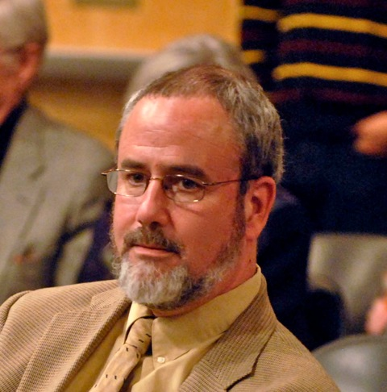
Richard Oram
Notes:
[Merrilee]
Richard W. Oram has been at the Ransom Center since 1991. He holds a doctorate in English from Cornell University and a Master of Library and Information Science degree from The University of Texas at Austin. Oram has written over 25 articles related to library history and nineteenth- and twentieth-century British literature. Previously, he was special collections librarian at Washington & Lee University, Director of the Canaday Center for Special Collections at the University of Toledo, and worked in the Ransom Center's manuscripts department from 1979 to 1981. He has held several positions in the Rare Books and Manuscripts Section of the American Library Association, serving as Chair, 1998 to 1999.

Slide 5
Got Missing Materials?
Have You
Seen Me?
Notes:
[Jen]
commitment – emerging and renewed commitment to a vision… of broadcasting information about missing materials globally, creating transparency to the community and to the public.
audience - information discoverable by law enforcement, booksellers and auction houses, Joe-public – not just archivists and librarians. (FirstSearch surprise)
policies and workflow - input from the working group
infrastructure - WorldCat is the world’s bibliographic database, but the web is where the world searches for information
(sensitivity to commitment of resources in the TETs)

Slide 6
MissingMaterials.org
RLG Partners working with OCLC Research:
Use available tools
Build a sustainable process
Prove the concept
Disclose stolen/missing rare and unique materials:
Low-touch, low cost, simple workflow
Web-scale for disclosure in search engines
Wide disclosure favors recovery
Notes:
PROOF OF CONCEPT
Transparency
*Missing Materials High Level Plan*
Experiment to create a systematic solution
Embed disclosure of missing materials in the ‘networkflow’
Significantly enhance the disclosure and discovery of missing and stolen valuable cultural materials
Constraints: very little access to development resources
Features: provide a single environment
[Read my lips - “No new workflow”]

Slide 7
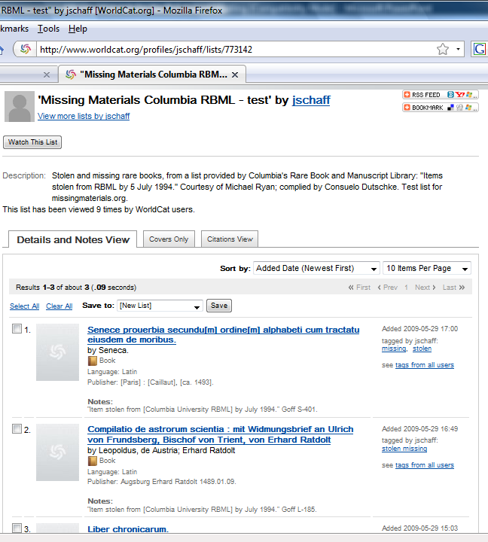
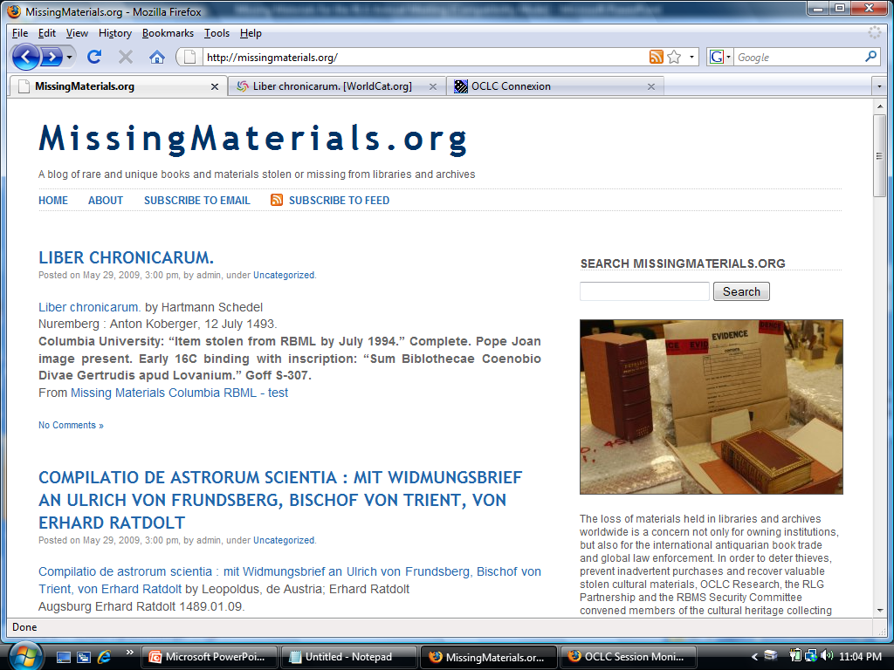
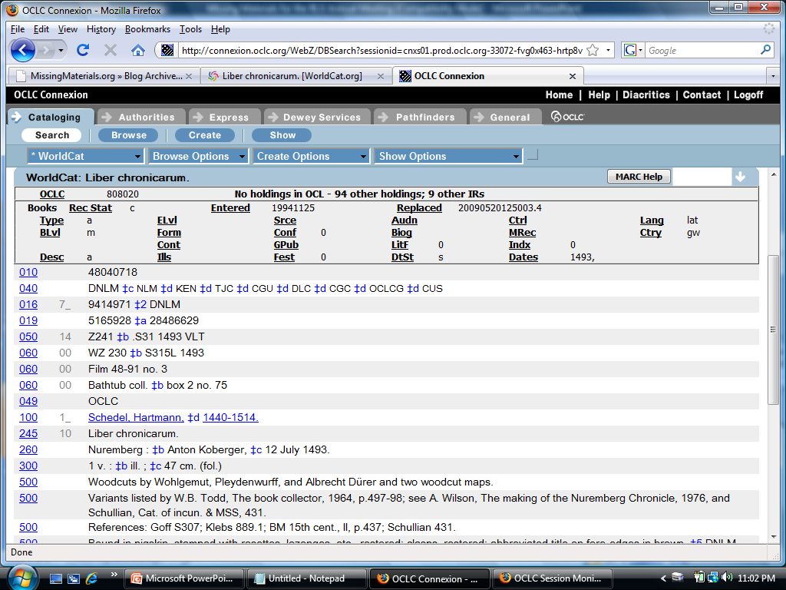
Missing Materials.org: The Process
Start with WorldCat record
Create Library’s MM WC list
Register list with MissingMaterials
Blog posts and holdings
MM system adds holdings symbol and blog posts ...
Publish
RSS feed
Searchable
Email subscriptions
FirstSearch & WorldCat.org
MM Blog
Add title to list
Setup
Build
Disclose
Notes:
[Jen]
- Start with a WorldCat.org record
Tag your missing material (use the free “list” function in WorldCat.org)
The tagged item posts automatically to the MissingMaterials.org blog and is embedded in OCLC’s catalog
Broadcast to the world -

Slide 8
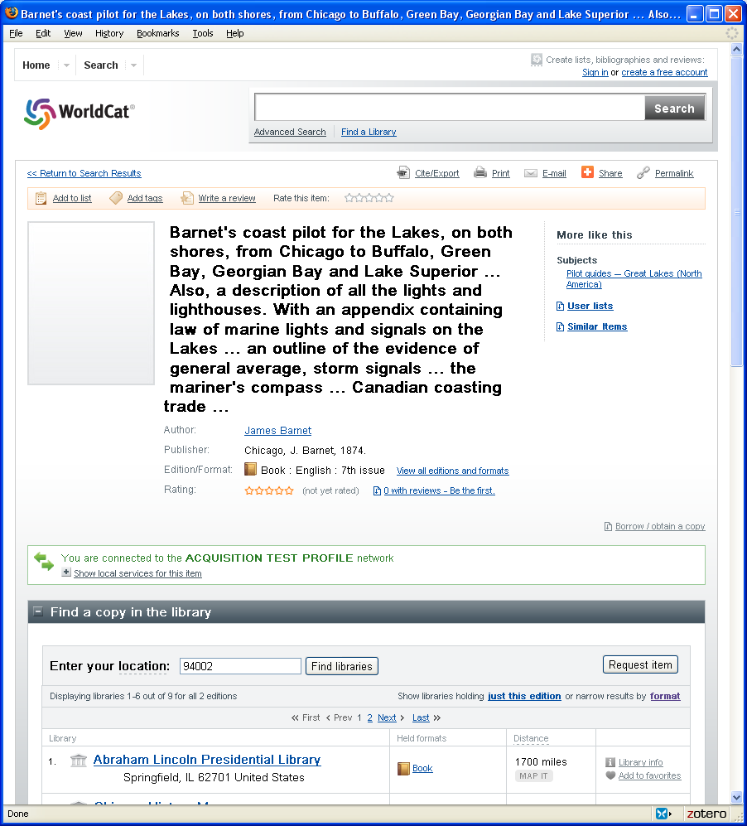
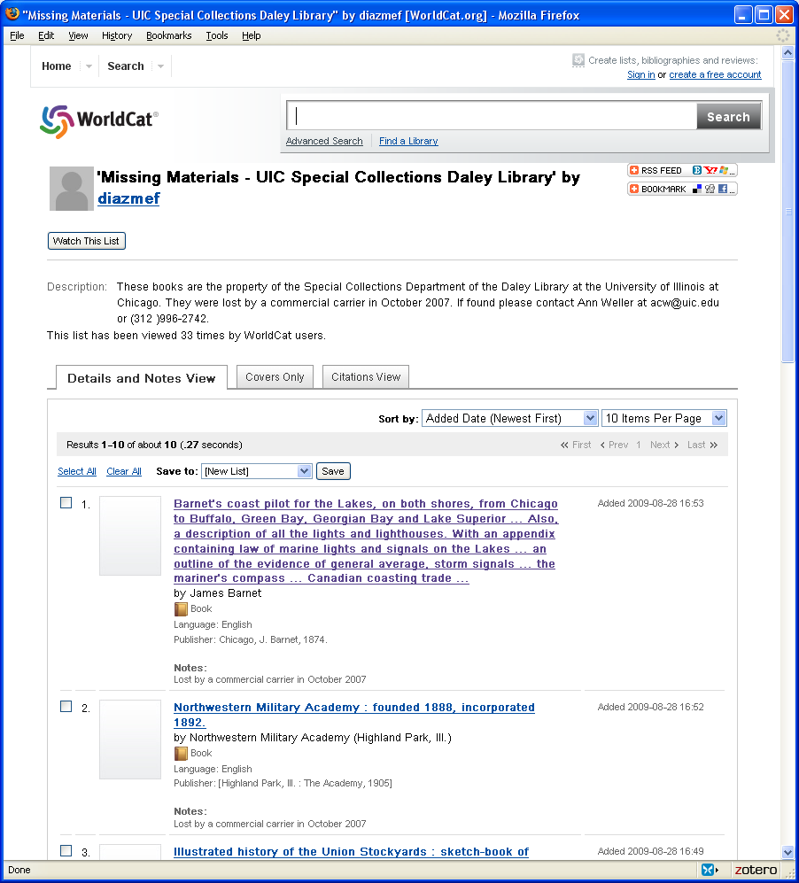
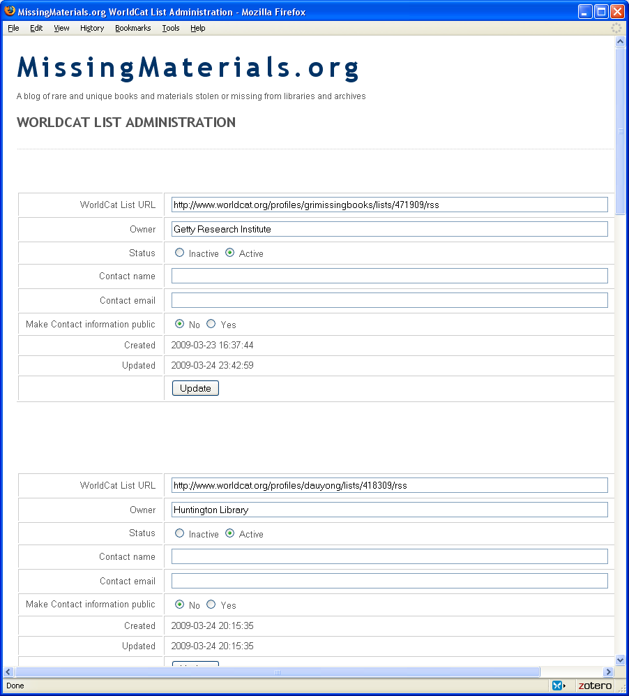
Setup
Find the title in WorldCat.org
Add the title to a Worldcat List
Register the list at MissingMaterials.org
Notes:
[Merrilee] I’m going to walk through this in a little bit, but these are the three basic steps to using missing materials…

Slide 9
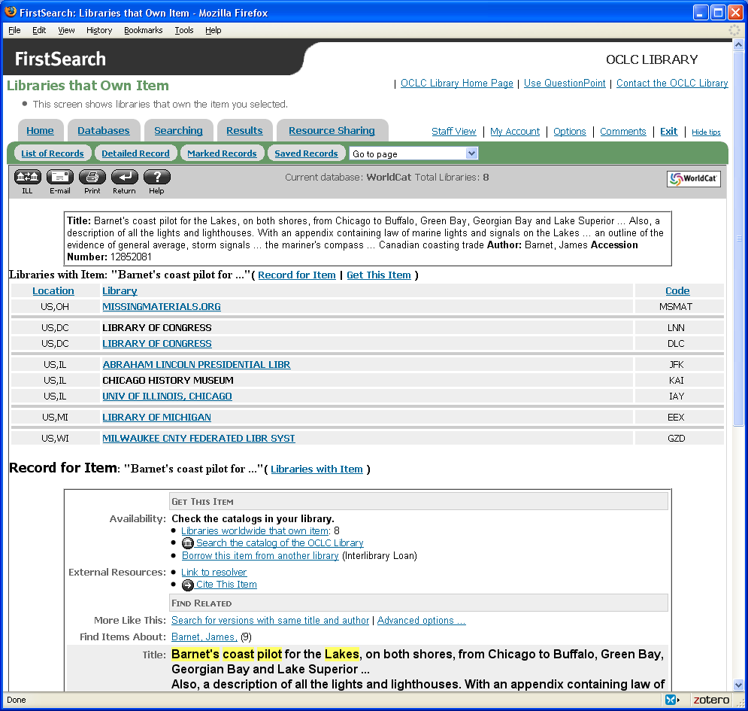
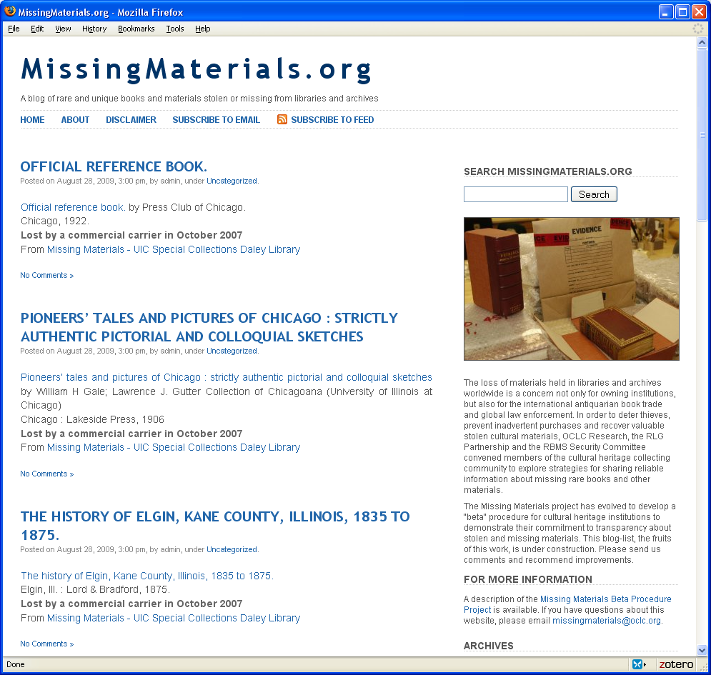
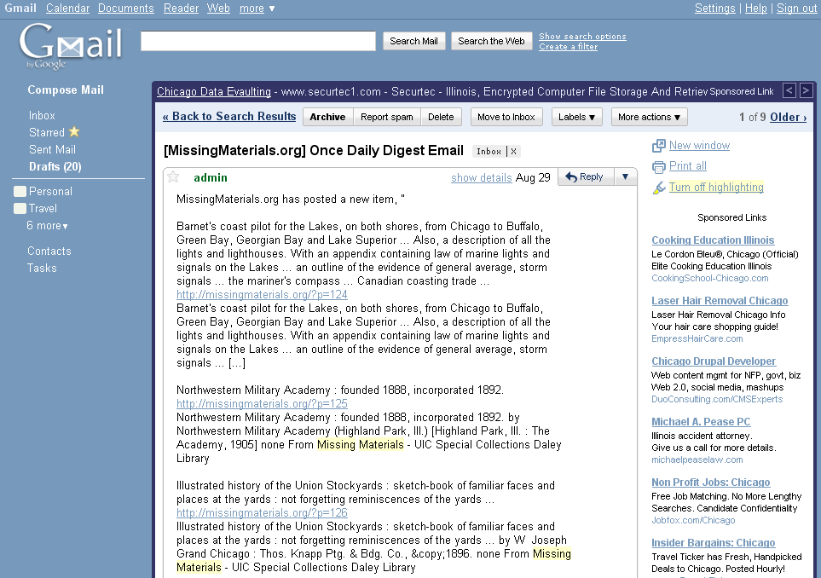
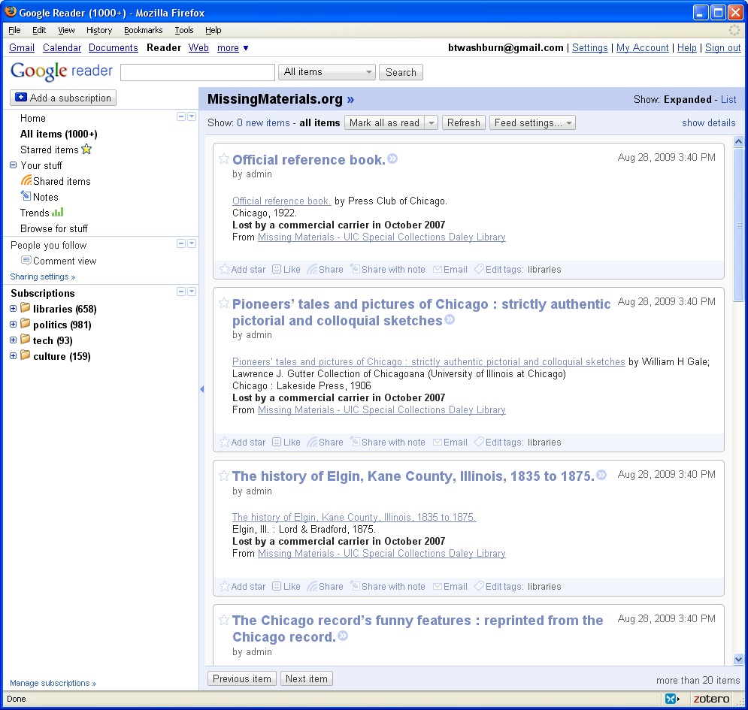
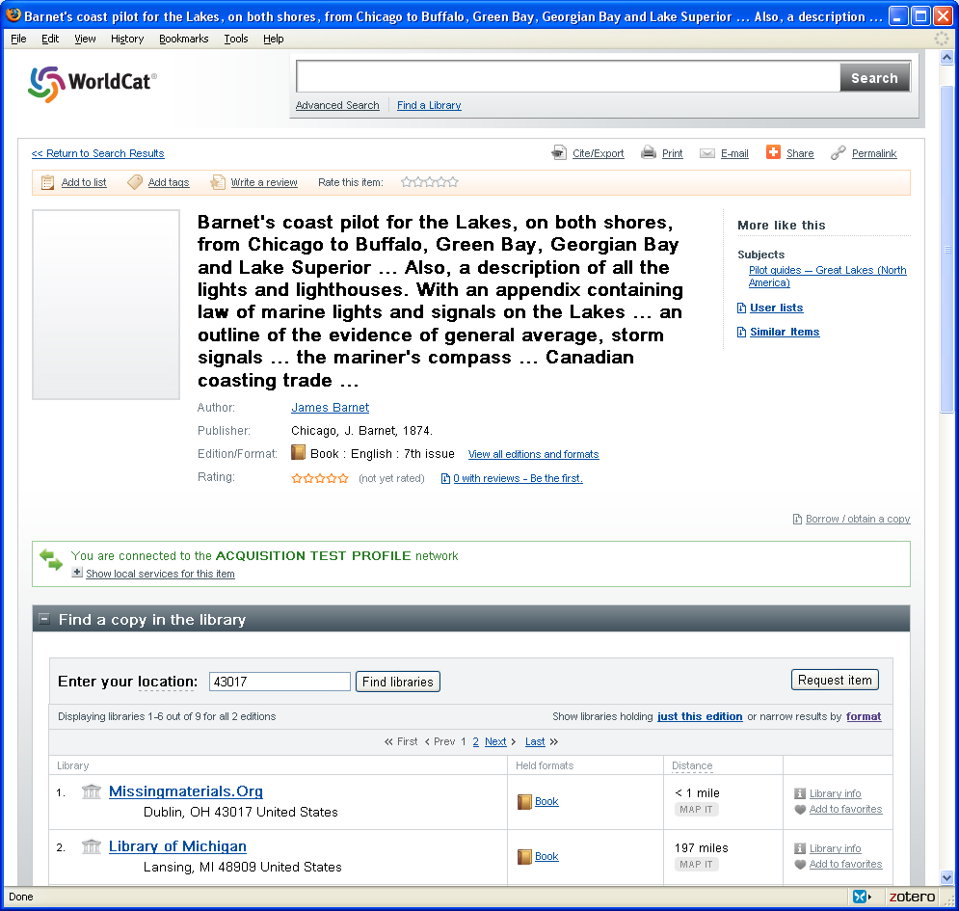
Disclose
Missing materials are now noted in FirstSearch, WorldCat.org, the MissingMaterials.org site on the web, in email to site subscribers, and in RSS readers.
Notes:
And the beauty thing is that once information is added to these lists and activated through filling out some information on the MissingMaterials.org website, then the information is available in FirstSearch, worldcat.org, missing materials.org, in email to subscribers, and in RSS readers to those that subscribe to the blog that way.
Availability in MissingMaterials.org also means that the information is picked up via Google and other search engines.

Slide 10
Missing Materials.org: The Tools
Add records to a list for your institution
Host blog posts, produce subscription emails
Generate blog posts from WorldCat lists
Hold missing materials records, track updates and notes
Produce RSS for blog readers, etc.
Automatically check for updated lists and manage the MySQL database
Add OCLC Holdings symbols to records for MissingMaterials.org
cron
OCLC Research
Z39.50 Script

Slide 11
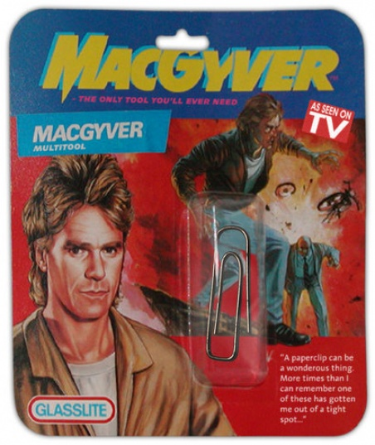
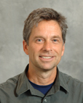
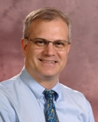
What’s under the hood?
Notes:
Although we built this on a shoe string, we had some pretty industrial strength thread to start with!
World Cat a key component – leveraging cataloging, means that even if you haven’t cataloged an item, there’s a good chance it’s there.
GoDaddy: registered the MissingMaterials.org domain
WordPress: Host blog posts, produce subscription emails
PHP: scripting language, used in WordPress, Bruce did some PHP hacking in order to generate blog posts from WorldCat lists
MYSQL: database, also a key component of WordPress, holds missing materials records, track updates and notes
RSS: XLM format used to push frequently updated content, like blogs, to the web.
On the MissingMaterials.org server, a cron task runs a PHP script each day
The script looks for all active WorldCat lists from its registry
Looks for new or updated entries (based on their OCLC number)
Creates or updates a MySQL database entry
Builds a WordPress blog post based on new/updated list entries
Sends the OCLC number to an OCLC Research server application to set the holdings

Slide 12
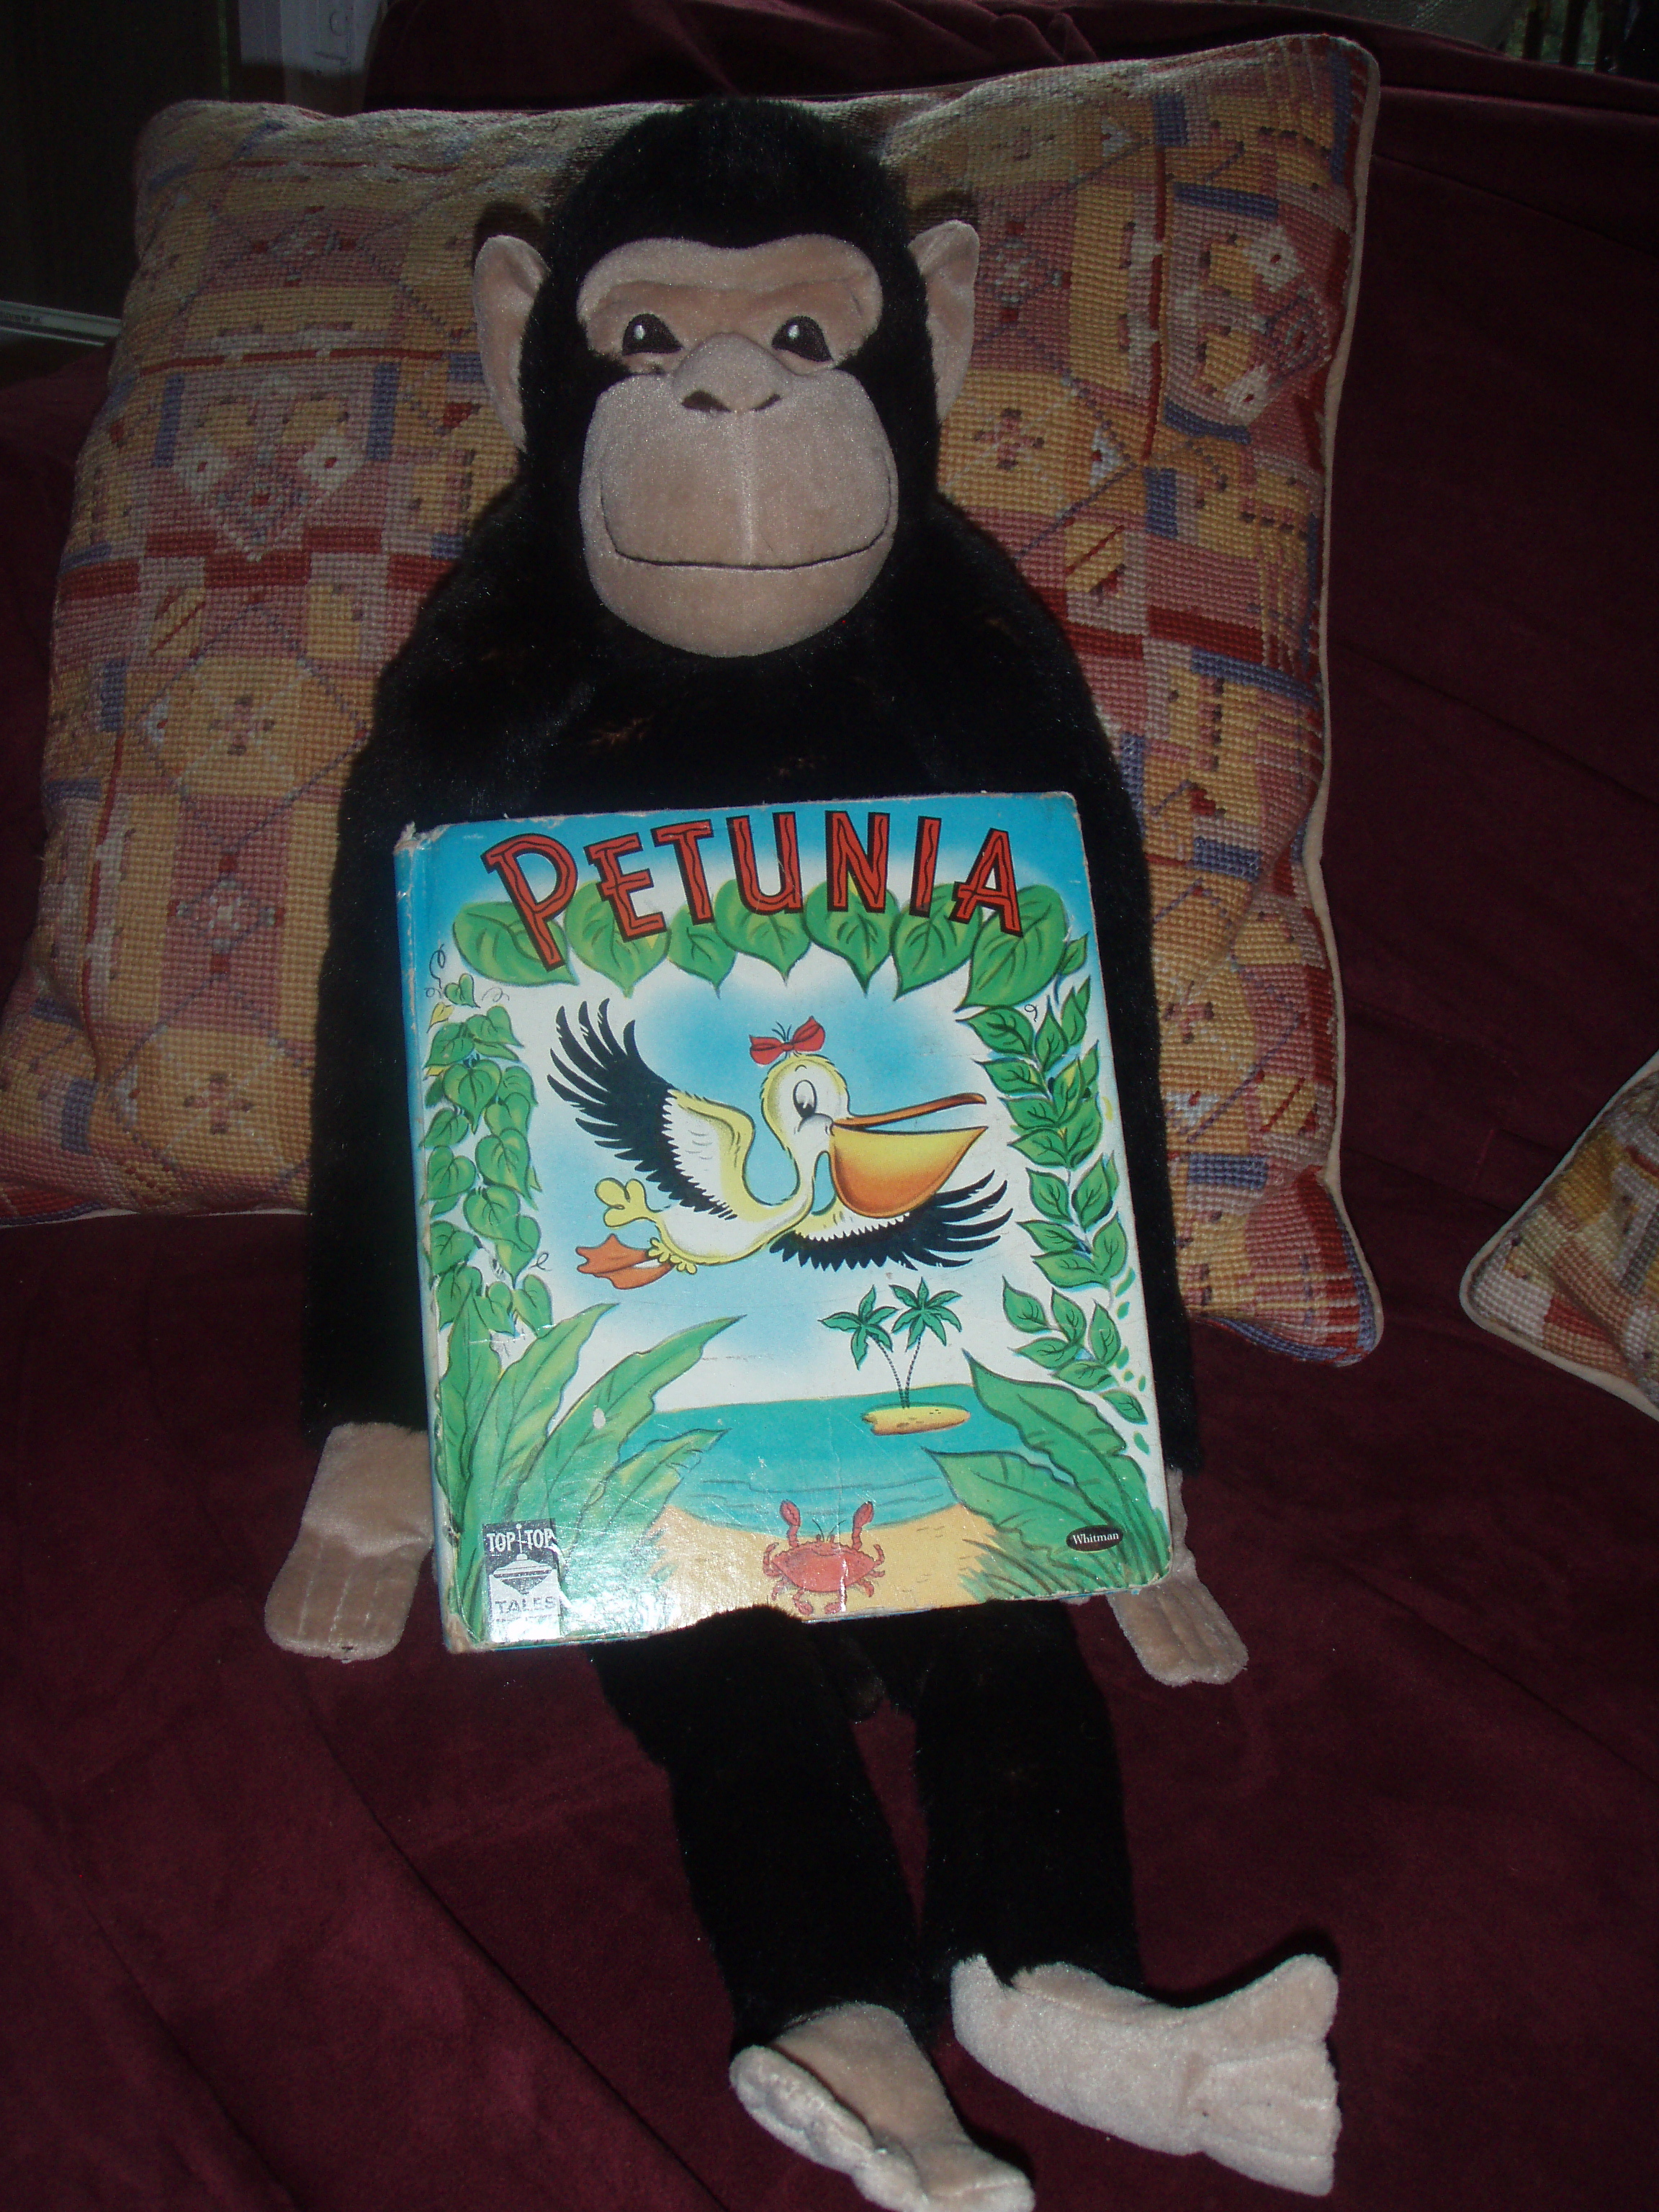
Notes:
Walk through the process of creating a list in WorldCat.org, and show you how to add items to it. I asked people who registered for this webinar to volunteer some real life items, but no one stepped forward, so I’m going to share my own sad story. Because I have so many friends and family who are bibliophiles, my 3 year old daughter has quite a collection of old and unusual children's books. One of her favorites is the book, Petunia, published in 1952. Sadly, our copy of Petunia has gone missing, and it was shortly after this character was looking at it, so while I don’t have any proof, I have my suspicions that it was stolen. This book is out of print, so I am very interested in recovery and our household is very committed to transparency around theft so I’m going to create a list in WorldCat.org, add Petunia to that list, then show you how you would add a WorldCat.org list to MissingMaterials. This is a simple process, absolutely free, and as you will see you do not need to be a WorldCat contributor in order to list an items as missing or stolen.

Slide 13
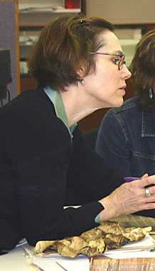
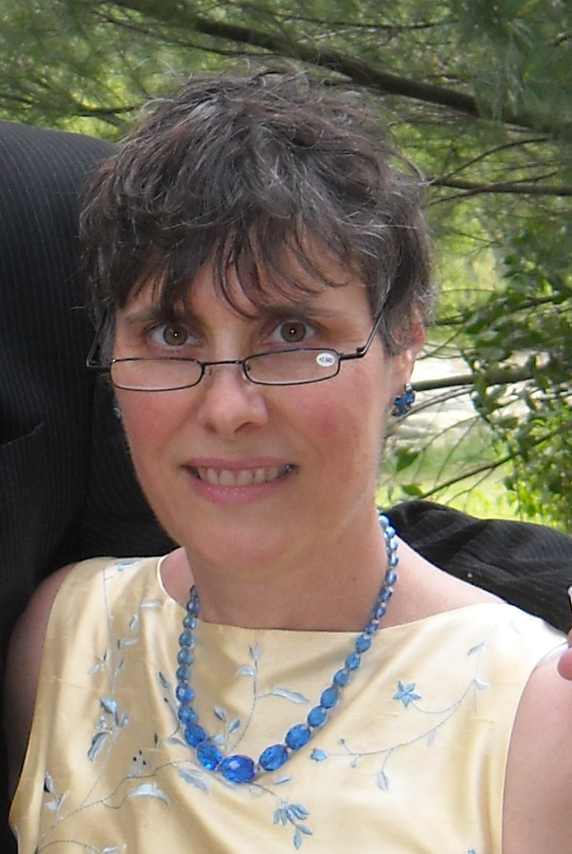
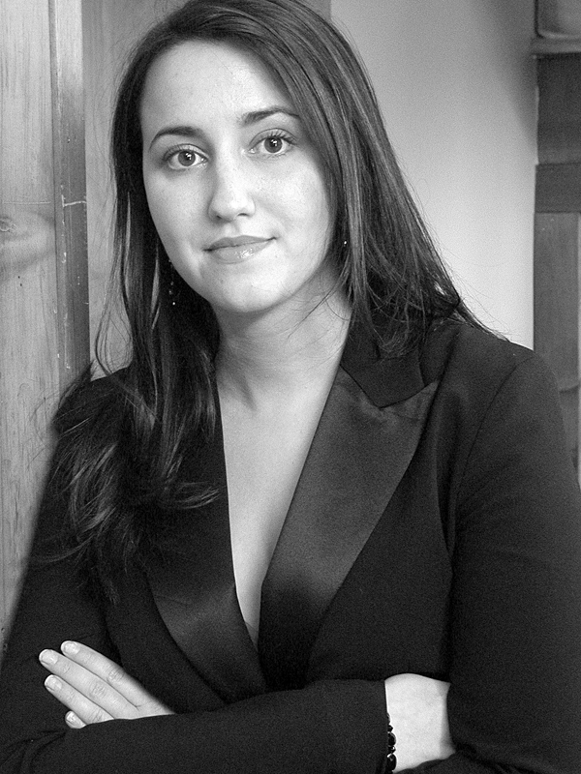
Maria Holden
Prudence Backman
Brittany Turner
Notes:
[Jen] Maria Holden is chief of Archival Services at the New York State Archives, where she manages the State Archives repository of the permanent records of state government and coordinates technical assistance and funding to New York’s historical records community. Since the insider theft at her institution, she has coordinated the Archives’ efforts to recover stolen collections and strengthen security systems. On behalf of the New York State Historical Records Advisory Board, she is leading their NHPRC grant project "Lessons from a Theft: Bringing Security Tools and Knowledge to New York's Historical Records Community.” She is current chair of the SAA Security Roundtable.
Prudence Backman has worked for the New York State Archives since November 1992. She is responsible for managing and providing access to information about and digitized images from the holdings of the State Archives as well as to historical records held in historical records repositories statewide. This includes development of online finding aids, metadata for digitized images, catalog records, statewide online directory of historical record repositories, and other access tools; applying current and emerging archival standards to access for holdings in New York State and development of web-content to support research and access to records.
Brittany Turner began working with the NYS Archives in March 2010 on a grant-funded project entitled "Lessons from a Theft: Bringing Security Tools and Knowledge to New York's Historical Records Community." Prior to her work at the Archives, she served as a project manager, a chief-of-staff, and a project coordinator. She is also a freelance columnist with her local newspaper. Ms. Turner has recently been accepted to the MLIS Online Cohort at the University of Alabama.

Slide 14
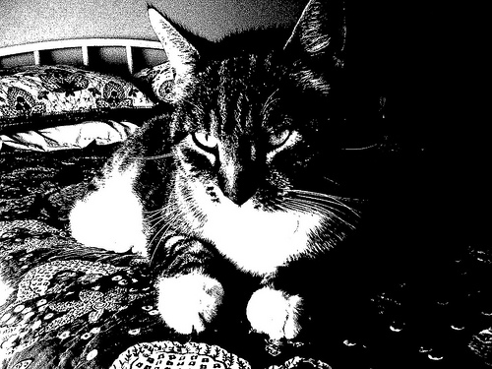
Pause

Slide 15
Merrilee and Jen – duct tape experts!
Notes:
[Jen] – safety pins, dental floss and a ski pole

Slide 16
This is more about procedures and policy than infrastructure Needs to fit with existing workflows How to get to critical mass? And who will step forward to get us there?
Notes:
[Merrilee]
Prioritizing
Procedures and policy
Critical Mass
Existing tools and workflow
Paper clips and duct tape – office supplies.

Slide 17
Contact info Merrilee_Proffitt@oclc.org Jennifer_Schaffner@oclc.org Shout out to the RLG Missing Materials Group - Kenneth Karmiole, Bookseller, Inc., ABAA - David Szewczyk, Philadelphia Rare Books and Manuscripts, ABAA - Richard Oram (Chair, RBMS Security Committee) and Ryan Hildebrand, Ransom Center, UT Austin - Detectives Don Hrycyk and Stephanie Lazarus, Los Angeles Police Department - Susan Allen and Andra Darlington, Getty Research Institute - Susan Pyzynski, Houghton Library, Harvard - E.C. Schroeder and Ellen Ellickson, Beinecke Library, Yale - Laura Stalker, Dorothy Auyong and David Zeidberg, Huntington Library - Eric Childress and Bruce Washburn, OCLC Research

