Slide 1
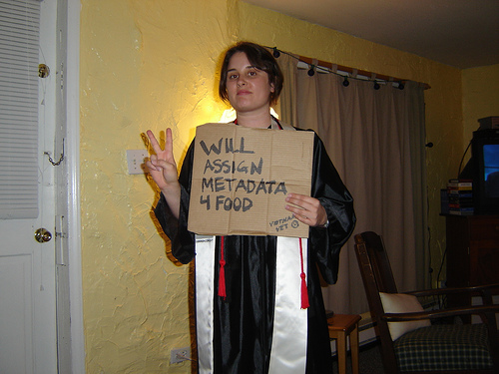

The Future of Library Metadata
Prepared for the Annual RLG Partnership Meeting, Chicago
June
2010
Karen Calhoun
Vice President, WorldCat and Metadata Services
By Angela Ben de Cosanostra
http://flickr.com/photos/amcclen/281983490/

Slide 2
Metadata: The outlook in 2003

Slide 3
A New Context for Catalogs and Cataloging
Adapted from Calhoun, Karen. Technology, productivity, and change
in library technical services. Library Collections, Acquisitions,
and Technical Services Volume 27, Issue 3, Autumn 2003, Pages 281-289
Notes:
Here is a chart from a 2003 article that I continue to find useful. Look at the four highlighted areas. We are moving to an environment in which there are many sources of metadata and the metadata is not so much produced by our staff members internally, record by record, by hand. Instead we use scripts and programs and external metadata providers to manipulate and reuse existing metadata.

Slide 4
Metadata Is Changing
B.W. (Before the Web)
  For finding and managing library materials (mostly print)
  Catalog records (well-understood rules and encoding conventions)
  Shared cooperative cataloging systems
  Usually handcrafted, one at a time
A.W. (After the Web)
  For finding and managing many types of materials, for many user communities
  Many types of records, many sources
  Loosely coupled metadata management, reuse and exchange services among multiple repositories
  Mix of manual and automated creation and metadata extract, conversion, mapping, ingest and transfer services
Notes:
We need to embrace how metadata has changed, how it has a social life, is more varied in its sources, more technology-based, and more important in more communities besides our own.

Slide 5



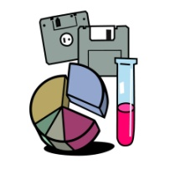
Library Metadata in an Expanding Information Universe
stewardship
Books
Journals
Newspapers
Gov. docs
CD, DVD
Maps
Scores
high
low
Freely-accessible web resources
Open source software
Newsgroup archives
low
uniqueness
Research, learning and administrative
materials,
ePrints/tech reports
Learning objects
Courseware
E-portfolios
Research data
Institutional records
Reports, newsletters, etc
Special
collections
Rare books
Local/Historical
newspapers
Local history materials
Archives & Manuscripts, Theses & dissertations
high
The domain of
library cataloging
and special collections
http://www.oclc.org/research/publications/archive/2004/dempsey-mslitaguide.pdf
Notes:
August 2008
5
There are many new types of information objects in which students and scholars take an interest, not just books and serials. Some are listed in this grid; there are more types of information appearing every day.
Yet, the domain of library technical services remains books and serials. This is what we are vested in in terms of staffing and budget. And many other organizations now provide discovery and access to the books, arguably better than we do.
I can imagine a world in which the organization of published books and serials is done outside libraries. To a certain extent, that world is already here. Yet libraries continue to allocate a large proportion of their staffing resources to buying and processing books, and to debate the fine points of describing them, leaving a small amount of staffing left over for organizing special collections, if they are lucky.
And, I have argued, it is the unique and special collections, and the local collections of faculty and other researchers, that are now more important for the library to concern itself with stewarding.

Slide 6
2010: To know the future of collections metadata, we need to know the future of collections

Slide 7
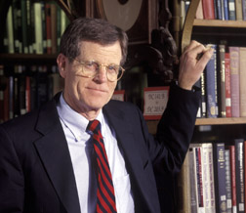
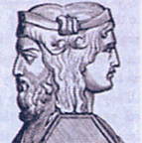
Ross Atkinson, 1946-2006
Community, Collaboration, and Collections
Why have we built collections?
Collection development means “to privilege particular objects as being more useful or reliable than others”
How is privileging possible when the universe is accessible in 5 seconds?
Do we know what the collection is?
Janus
Conference
http://ecommons.library.cornell.edu/bitstream/1813/2608/1/Atkinson_Talk.pdf
Notes:
Some of you may have known Ross Atkinson, who was my colleague at Cornell. He was an exceptional librarian and thought leader who helped to define research library collection development and then, how to transform it.
In late 2005 Ross convened the Janus conference, whose goal was to re-envision collection development in research libraries.
Click. The paper Ross gave at the Janus conference, cited here, was a kind of ‘last lecture”—in which he urged us to consider these fundamental challenges to building collections in the digital age.
He began with the recognition that collections are becoming more universally available and less institutionally focused.
Given the points on this slide, he wondered if we know any longer what the “collections” are that we are privileging on behalf of the communities we serve, and how much control and influence we really have over shaping them on behalf of those communities.

Slide 8
What Is “The Collection”? What Does Library Metadata Typically Cover?
[T]he stuff of cultural heritage collections, digital assets, pre-print
services and the open Web, research labs, and learning management
systems remains for the most part outside the scope of the catalog.
Scholarly information objects now include digitized rare and
historical materials, textual primary source materials, graphical images,
materials described in institutional and disciplinary repositories,
conference Web sites, scholarly Web sites … data sets, software,
simulations, a rising array of multimedia resources, learning objects
and courses—the list goes on.
Calhoun. LC report, p. 24
Notes:
Pushing those points a bit further, if we know that the collections of interest to our communities are greater in scope than what we have made available in our buildings or through licensing, then we know by extension that the metadata needed to describe and manage those collections is greater in scope than library metadata.
Ross asked, ‘do we know any longer what it means to build a library collection?’
I ask, ‘do we know any longer what it means to create and manage metadata for a library collection?’
I think that this question is a largely unexplored one in our profession.

Slide 9
We know what the collections have been, where they are, how much they are being used, and what kind of metadata describes them
Notes:
But we know pretty well where we have been, where we came from

Slide 10
The Library “Brand” Is Books
Source: Perceptions of Libraries and Information Resources, OCLC, 2005, question 807.
Note: The percentage is based on the number of comments received divided by the number of respondents. Some respondents chose to provide more than one response, and all responses were included.
http://www.oclc.org/reports/pdfs/Percept_pt3.pdf
Notes:
Another point to consider. Again in OCLC’s Perceptions of Libraries report, a key finding was that the library brand is books.
We know of course that the library is about much more than books, but ask members of the public what is the first thing they think of when they think of a library, and over two thirds will say “books.”
How can this be a bad thing?

Slide 11
WorldCat by Type of Material Described, 1999-2008
Source: data from OCLC annual reports describing WorldCat bibliographic and holdings data
Notes:
Taking WorldCat as a proxy for what is in typical library collections
Books – consistently 84%
Ebooks a v small proportion of this 84%

Slide 12
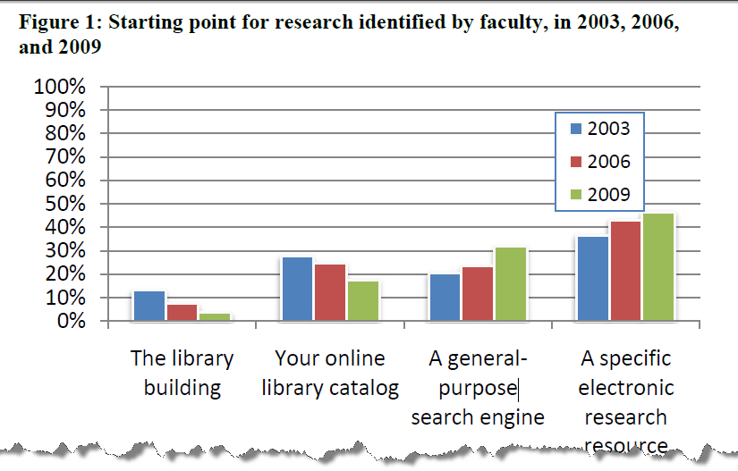
An Eroding Role for Library-Created Metadata: 2003-2009
Schonfeld, Roger C., and Ross Housewright. 2010. Faculty survey 2009 :key strategic insights
for libraries, publishers, and societies. [United States]: Ithaka S + R, p. 5
Available: http://www.ithaka.org/ithaka-s-r/research/faculty-surveys-2000-2009/faculty-survey-2009
Notes:
Library-created metadata is generally about books and journals
Library catalogs are, or at least have been, generally sources of information about books and journals. Now, they are beginning to represent the journal literature at the article level
The book-centeredness of library cataIogs is resulting in a erosion of interest in the catalog, and in library metadata, as a tool for research
Ithaka faculty survey 2003, 2006, 2009
Explain slide
The researchers looked at the responses by discipline. Scientists remain least likely to use library-specific starting points for their research (10%). Humanists remain more likely (30%), with social scientists in the middle (20%). (p. 6 of report)

Slide 13
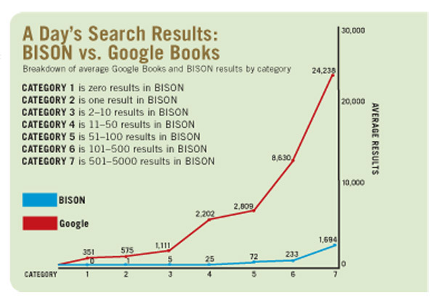
Will Google Books usurp the library catalog?
Ludwig, Mark J. and Margaret R. Wells. “Google Books vs. BISON.” Library
Journal, July 15, 2008. http://www.libraryjournal.com/article/CA6566451.html
Notes:
13
August 2008
Jay Jordan, Karen Calhoun - IFLA
13
Google Book Search is another new service that is having an impact on users prefer to use and the services they expect when they do use library catalogs. Some librarians at the University of Buffalo looked at the performance of Google Books for producing results from user queries compared to their own library catalog, called BISON.
They found that Google Books has deeper indexing and that its more advanced relevancy ranking usually works better than that of our local catalogs—and it always returns results. No zero hits, which of course are common in library catalogs.

Slide 14
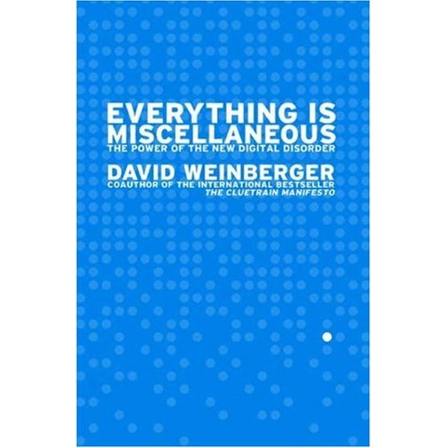
Not Your Mother’s Metadata
Library metadata
practices:
Title
Author(s)
Publication details
Pagination, etc.
Series
Knowledge
‘categories’:
  -Classification
  -Subject
ISBN
Etc.
Other attributes:
How/where to get it
Rights
How many sold
How many circulations
Banned anywhere?
Awards won?
Works cited by this one?
Reviews
-Publisher
-Reader
Author information
Other editions
Technical metadata
Identifiers
Related works
Blog conversations
User tags
Derivative works
And on and on …
Notes:
On the left is how we have typically thought about cataloging, or metadata in libraries.
But there are many attributes or aspects of a work that users can find important. The list on the right contains some of them.

Slide 15
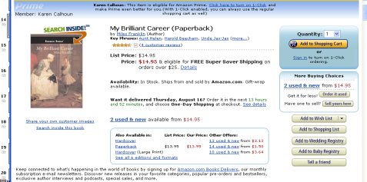
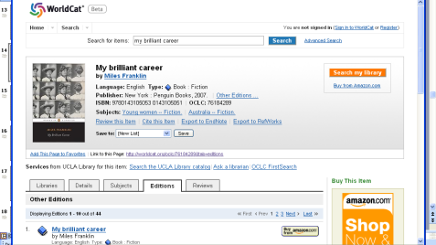
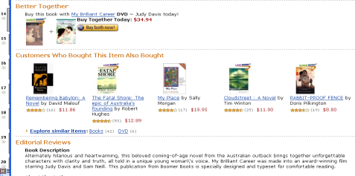
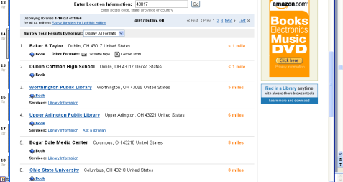
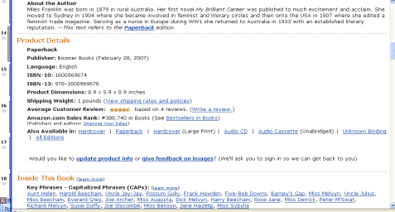
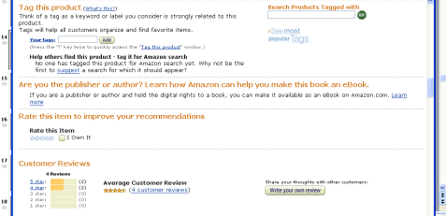
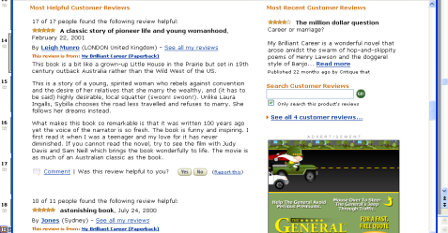
What is a “Full” Record?
What is Metadata “Quality’?
Product
Description
& Purchase
Information
More like this
Editorial
Reviews &
Author Info
Inside the Book
Tags, Ratings
Customer
Reviews
Lists
More
Bibliographic
Information
Library Holdings
Details
Subjects
Editions
Reviews (a few)
+ 3 more screens
Notes:
And, as much as we fuss inside our profession about encoding levels of records, the fullness and quality of library metadata, and how library metadata for books is “better”—is it really?
I would argue that library style metadata is pretty darn sparse compared to what can be done if one accepts and embraces the premise that lots of kinds of metadata, from lots of sources, is both useful and necessary.
Don’t worry that you can’t read these screen shots. It is the visual effect that is important.
These screen shots describe the novel ‘My Brilliant Career.’ The one on the left is from WorldCat, on the right from Amazon.
Now, from a user’s perspective – from a user’s perspective – which one is the “full” record? [pause and look at audience]

Slide 16
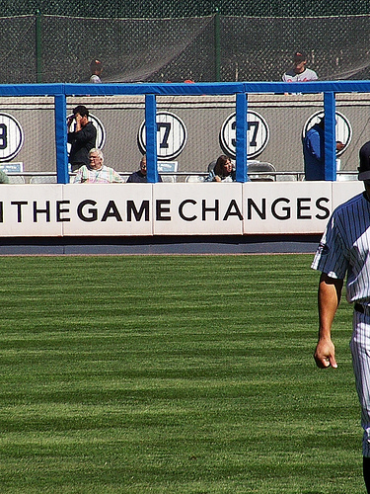
Why Change Is Critical
Library metadata has reached a point of discontinuous change
We must change how we think about it and what we do
Photo by: OMG Ventures
http://www.flickr.com/photos/imagebuilders/2877401212/
Notes:
We have come from a useful place, we know a lot about metadata and knowledge organization. But it is a mistake to fall in love with the library metadata methods we have used up to this point in the history of libraries.
We need to focus on the needs we meet rather the methods we have used.
We need to learn and commit to the needs that our metadata meets for the communities we serve, and not be afraid to start over with how we think about metadata and what we do with it.

Slide 17
A Widely Distributed E-Resource
Metadata Management Process
Adapted from Calhoun, Karen. 2000. “Redesign of Library Workflows: Experimental Models for Electronic Resource Description.” In: Bicentennial Conference on Bibliographic Control for the New Millennium: [Washington, D.C.]: Library of Congress. http://lcweb.loc.gov/catdir/bibcontrol/
Notes:
We can learn from the last decade of participating with many players in the effort to describe and provide access to licensed e-resources.
This illustration is adapted from an article I wrote in 2000 about new sources of metadata and redesigned workflows for e-resources.
Ten years after I drew this picture, libraries have by now basically outsourced the means for describing licensed electronic content at both the title and article level.

Slide 18
Expenditure on E-Resources: 2008 ARL Average
Notes:
Here is a quick look at the percentage of the materials budget spent on electronic resources – journals, aggregations of full text, and the like – comparing the average research library in North America with our hosts today. A great deal is now being invested in these types of materials.

Slide 19
The Impact of Article Level Metadata and Linking to Full Text
Access is increasingly at the journal article level, not the journal title level
  … Causing searches to often bypass the catalog
Notes:
The impact of large full text aggregations of articles has had a profound impact on the role of library metadata as well.
The ability to access the literature online at the article level, from a search engine, creates thousands and thousands of searches that bypass the catalog completely.
The pie chart shows where hits on a journal title in BioOne came from over the course of 7 months in 2005. Almost all of the hits came from Google. The small orange slice are the hits that came to this online journal from all library URLs—the catalog, the metasearch service, the library’s A to Z list. And this was at a university library that had records for all e-journals in its catalog, plus the other two services.
This is certainly not a statistically valid result—just a look at some available data—but it is likely to show another trend affecting the future relevance of traditional library metadata, which as we know describes journals at the title level.

Slide 20
Notes:
Another thing that has happened is that the framework for managing e-collections metadata is being redundantly created and maintained in thousands of libraries. The complexity and cost of what is being done is enormous.
This is a slide that Mackenzie Smith of MIT used recently to describe the complex, labor intensive infrastructure her library maintains behind the scenes. So many systems and interrelationships! So much effort and cost to create what is arguably a marginally useful system, given the Ithaka study results of what tools scholars use as starting points for their research.
I claim that the cost of keeping this framework going is unsustainable for the long term and it will soon, if it has not already, failed the test of benefit delivered for effort and dollars invested.
One piece of the puzzle is how we might take out complexity and reduce cost through cooperative effort. Research libraries have cooperated before, as we all know, but perhaps not at the scale that is now required.

Slide 21
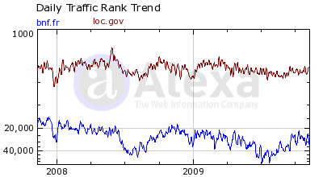
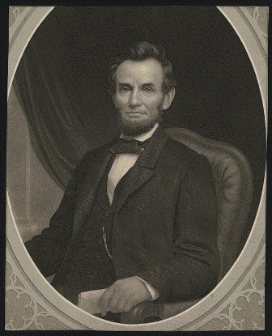

Rising Interest in Digital Collections on the BnF and LC Web Sites
Where do people go
on bnf.fr and loc.gov?
BnF:
Expositions: 30%
Catalogue: 26%
Gallica: 26%
LC:
American Memory: 41%
Catalog: 17%
Legislative information
(THOMAS): 6%
Source: Alexa.com, 15 Nov 2009
Notes:
Turning away from online licensed collections to digital collections. There are indications that digital library collections, for example, are attracting more attention than expected.
This is a chart from Alexa. com, a Web traffic analysis service, showing Web traffic to the bnf.fr and loc.gov domains. Alexa provides data about where users go once they are on a site.
In the case of those who visit bnf.fr, 30% visit the expositions pages—a virtual gallery of curated exhibits around the collections. More than 50% of the traffic is split between the BnF library catalog and Gallica—the digital library of France.
Over 40% of the visitors to the Library of Congress web site go to American Memory, which LC describes it as a digital record of American history and creativity.
Contrast this with the other two most popular destinations for loc.gov visitors—the catalog, at 17%, and federal legislative information at 6%.

Slide 22
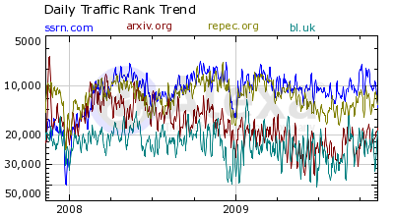
Open Access Repositories Gaining Visibility and Impact
2008-2009 Traffic
Compared:
*Social Science Research
Network
*arXiv.org
*Research Papers in
Economics
*British Library (bl.uk)
Sources: Alexa.com 15 Nov 2009
and the Cybermetrics Lab’s ranking of top
Repositories (disciplinary and institutional) at
http://repositories.webometrics.info/about.html
Notes:
Open access repositories, especially discipline-based ones, are also gaining in visibility and impact.
This chart, also from Alexa.com, tracks traffic in 2008 and 2009 to three of the top open access repositories, as ranked by the Cybermetrics Lab, against the traffic to bl.uk, the British Library’s domain, to give you a sense of the scope and scale of attention received by these repositories.

Slide 23
Where metadata comes from (and will come from)
Notes:
Ok there is a big pile of challenging news
There is better news to be had, but we need to step back and take a look at the metadata scene as a whole, not just library metadata

Slide 24
Where Metadata Comes From
(and will come from)
Professionally produced
Library cataloging
Author/User contributed
Institutional repositories
Tags, reviews, lists, etc.
Mined
Knowledge bases
Algorithmically produced, re-used, harvested
Facets for topics, places, events
Scholarly portals (e.g., arXiv.org)
Authority and classification data
Terminologies
WorldCat Identities
Author identity pages
Publishers, vendors, aggregators
Publication supply chain data
Abstracting and indexing services
Algorthmically-created indexes
FRBR Work Sets …
Notes:
There are a lot of metadata communities that professionally produce metadata. The web, and how end users are interacting with information on the web, are gradually erasing the lines between formerly clearly demarcated metadata communities, who’ve not needed or cared to know much about one another’s practices. One thing we can do is proactively reach out and study what other metadata communities are doing, what has worked, what the challenges are, and the possibilities for exchange, mapping, enrichment, interoperability.
We are beginning to see in addition a good deal of author and/or user contributed metadata which needs to be usefully folded into what we have in some way. Some call this “crowd sourcing” of metadata.
On top of that there is metadata being produced through large scale metadata mining and manipulation. Inside the library community, aggregations like WorldCat, for example to produce FRBR work sets and other new services like WorldCat Identifies, are good examples.

Slide 25
Swimming (as opposed to drowning) in a sea of metadata

Slide 26
Advice for Swimmers
Cooperate (don’t go it alone)
Use a blend of metadata techniques to:
  Create many paths to your collections (print, licensed, digital)
  Synchronize
  Syndicate
  Call attention to a wide array of collections on behalf of your communities (not just your own holdings)
  Manage metadata at the collection level when feasible and appropriate
Think of library metadata as one of many approaches
Notes:
Commit to and invest in collective action—it is the only way that library metadata can remain relevant over the long term. Our current approaches simply cannot and will not scale to what libraries need to do to serve researchers and students today.
Collaborate on information and knowledge organization with:
--other libraries and consortia
--OCLC
--like organizations (local museums, archives, historical societies, cultural organizations)
--vendors
--other metadata communities
--end users (your local communities

Slide 27
“Discoverability” Report: University of Minnesota Libraries, February 2009 http://conservancy.umn.edu/handle/48258
Users are discovering relevant resources outside library systems
Users expect discovery and delivery to coincide
Usage of portable devices is expanding
Discovery increasingly happens through recommending
Users increasingly rely on emerging nontraditional information objects
Trends
Notes:
Syndication and synchronization. A team at the University of Minnesota Libraries produced an excellent report called Discoverability that provides evidence for the importance of syndicating library collections in as many places as possible on the web.
These are the trends they uncovered in their investigation.
Their users find materials of interest on the larger network, esp search engines. The team is placing a lot of emphasis on tools that capture this traffic, for example from Google Scholar, and lead it back to the U of M collections.

Slide 28


Data Synchronization and Syndication
Flickr Commons
Data synch
WorldCat &
WorldCat Partners…
Other partners
Notes:
All over the world, libraries are working to capture as much attention on the Web outside their own system as they can. I’ve tried to illustrate this visually for the NLZ.
The NLZ puts a big digitized photo collection out on the Flickr Commons; they push their content out into the NZ library catalogue, and so on.
I’ve called this “outward integration” of the collections into the Web—Collections data is synchronized with other aggregations and syndicated in other Web environments.
As you know, one of the places that the NLZ is outwardly integrating its collections is WorldCat.org—and thus their collections show up in places like Google Book Search as well.

Slide 29
An OCLC metadata five-year plan
Notes:
Surprise: OCLC has been giving a lot of thought to library metadata
A few months ago, my team and I finished a five year plan for OCLC metadata management services—the future of the core cataloging service
Conclude with just a few words about it
Interested in your reactions and hope to talk further with some of you over the course of the day today and tomorrow
Would welcome your comments either in person or by email

Slide 30
What If …
We could collectively take better advantage of
  The metadata we have already produced?
  Metadata we can get from other places?
Notes:
Near and dear to my heart is what’s next for expanded library cooperation around metadata. What if …

Slide 31
Selection of initiatives already in play: OCLC deploying metadata to help members gain efficiencies, visibility and impact
Strategic direction | Results
“Everywhere the library” | WorldCat.org WorldCat Registry Syndication of your collections on other Web sites Synchronization with WorldCat
Representing the collection of member collections at Web scale | Global coverage of WorldCat More, and more up to date holdings information Print + digital collections OAIster in WorldCat Digital Collections Gateway
Making metadata work harder | ONIX to MARC and back again WorldCat Identities VIAF Work level records More …
Notes:
But before the five year plan, I think you can see traces of where OCLC is headed in what we are already doing
Embed member libraries in many places on the web and attract more attention to their collections
Begin to more accurately represent the collections of the global library network of OCLC members
And not just the bibliographic collections, but collections with new types of information content
And improve the value and utility of library metadata by creatively deploying it and by blending it with metadata from other communities, specifically publishers and vendors who use ONIX

Slide 32
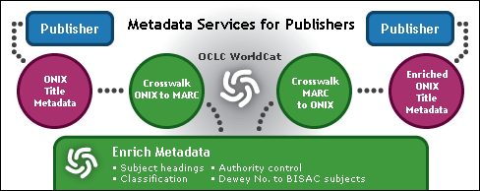

Re-Using Publisher/Vendor Metadata
Notes:
Publication data supply chain metadata can be re-used with library metadata and thus be more valuable to both metadata communities
My team’s new service, introduced last summer, takes in ONIX, enriches it through data mining of WorldCat,, and produces output for publishers and member libraries to use.

Slide 33
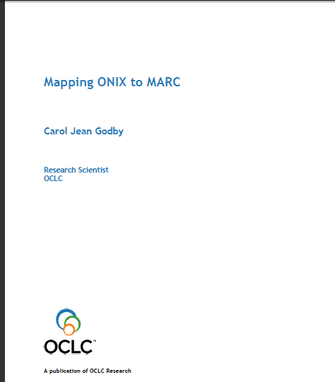
ONIX to MARC and Back Again
Godby, Carol Jean. 2010. Mapping ONIX to MARC. Dublin, Ohio: OCLC Research.
http://www.oclc.org/research/publications/library/2010/2010-14.pdf
Notes:
Jean Godby of OCLC’s office of research was a key team member of this project, and she has done us all the great favor of documenting what we learned. I commend her work to you.

Slide 34
OCLC Digital Collections Gateway
A Web-based, self-service tool to contribute digital repository metadata to WorldCat
OAI (Open Archives Initiative) compliant repositories (July 2010)
Two paths to WorldCat:
  Self-use of the Gateway
  OCLC harvesting
“The function of searching across collections is a dream frequently discussed but seldom realized at a robust level. This paper … discusses how we might move from isolated digital collections to interoperable digital libraries.”
—Howard Besser
Notes:
We have been aware for years of the publication metadata supply chain. Increasingly, there is now a metadata supply chain for digital library colledctions.
We have introduced the Digital Collections Gateway to make it easier to aggregate and syndicate metadata from OAI-harvestable collections into WorldCat, where it can be discovered more widely.
Our goal is to aggregate the metadata from a very large number of digital library repositories, to make them easier for students, citizens, and scholars around the world to find and connect to.
Next month, we introduce a version of the Digital Collections Gateway that can be used by anyone with an OAI-harvestable collection.

Slide 35
A Five Year Vision For OCLC Metadata Management and Collections Services
A service-neutral data platform
Integration with WorldCat apps and services
Integration with other, external applications
Metadata management services for the myriad collections now delivered by libraries to their communities (physical, licensed, digital)
Functionality to efficiently create, manage and share metadata both at the collection level and at the level of a single information object
-CONTINUED-
Notes:
So, after those two quick asides, back to the five year plan.
First, what we are calling the “platform” strategy. Up to now, with a few notable exceptions, if you want to get at WorldCat metadata or services, you need to have an OCLC application to do so.
A key part of the new plan is to introduce a service-neutral platform that exposes WorldCat metadata and services in OCLC applications, if that is what you want to use, but ALSO allows for the consumption of WorldCat data and services in external applications.
More specific to metadata, [go through rest of points]

Slide 36
Five Year Vision -2-
WorldCat Community Environment:
Shared metadata creation and management for individual titles and works, but also for people, places, concepts and other types of information objects
Easy, fast ways to ingest an OCLC member’s data and keep member holdings synchronized with WorldCat and syndicated on partner sites (e.g., Google Book Search)
Continuous improvement in quality and cohesiveness of WorldCat data for metadata experts, end-users and a variety of other constituencies

Slide 37
What Will It Mean “to Catalog”?
Many types of information objects (things, places, people, more)
Metadata production – manual and automated
Data mining
Metadata design and development
Metadata consulting
Metadata reuse/conversion/exchange
Metadata ‘mash-ups’
By Angela Ben de Cosanostra
http://flickr.com/photos/amcclen/281983490/
Notes:
I think library metadata can have a great future.
But, library metadata experts need to focus on what they know about how to organize information, and not so much on one library-centric set of rules and standards that they have become accustomed to using for books and journals. They need to be willing to use a blend of approaches and metadata tools and techniques.
To a degree, this is already happening. But, IMO, not fast enough to keep pace with the changing preferences and behaviors of the researchers and students that libraries have served so well for so long.

Slide 38
Much More Than Metadata Creation and Revision – Other Possible Job Duties
Knowledge organization consulting
Database moderator and support
Data analyst
Process engineering
Digital publishing specialist
Content and connections manager
Campus learning system coordinator / liaison
Metadata harvesting, ingest and conversion …
Notes:
But beyond moving from catalog record creation to metadata creation, there are many more new jobs to be done by metadata experts, now and into the future.
Some will contribute technically or procedurally by continuously improving how things get done.
Others will specialize in data analysis, harvesting, data mining and manipulation. Others in interoperability and crosswalks.
Others will be consultants to the research community, helping community members organize their content.
It would make an interesting publication if someone drafted and shared job descriptions for these kinds of positions.

Slide 39
The Gap is Closing
Metadata experts inside libraries
will be more like
metadata experts outside libraries.
Notes:
The lines between metadata communities, once drawn so firmly and clearly, are fading and need to fade. We need to know more about what works in other metadata communities, especially those approaches that have been so successful on the Web.
As this occurs, I believe that [read slide]

Slide 40
Thank You Merci Gracias
calhounk@oclc.org
http://community.oclc.org/metalogue
Calhoun, Karen. Being a librarian: metadata and metadata specialists in the 21st century. Library Hi Tech, Volume 25, Number 2, 2007 , pp. 174-187(14)
Open access preprint: http://ecommons.library.cornell.edu/bitstream/1813/2231/1/Calhoun-20041217-final-preprint1.pdf
Notes:
Thanks for your time and attention. I look forward to hearing your thoughts.
Here is my email and the URL of my blog. The citation is from an article that provides further detail about some of things I have been saying about metadata experts of the future.

