Slide 1

Yours, Mine, Ours:
Leadership Through Collaboration
Organized by the RLG Partnership & OCLC Research
Hosted by the Smithsonian Institution
Supported by the Institute of Museum and Library Services (IMLS) and the Gladys Krieble Delmas Foundation
Endorsed by the Joint SAA, ALA and AAM Committee on Archives, Libraries & Museums (CALM)
Museums
Archives
Libraries
Wireless: b@ck2sk00L

Slide 2
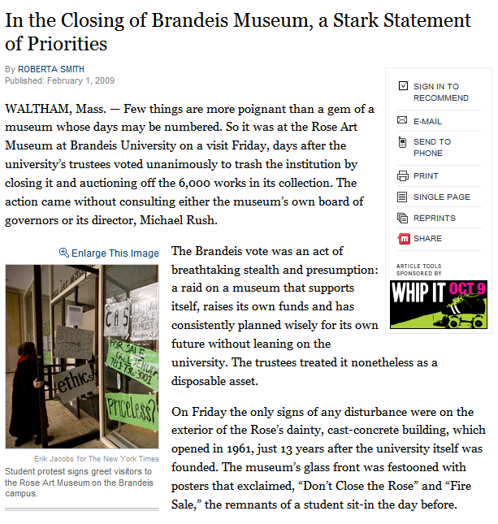
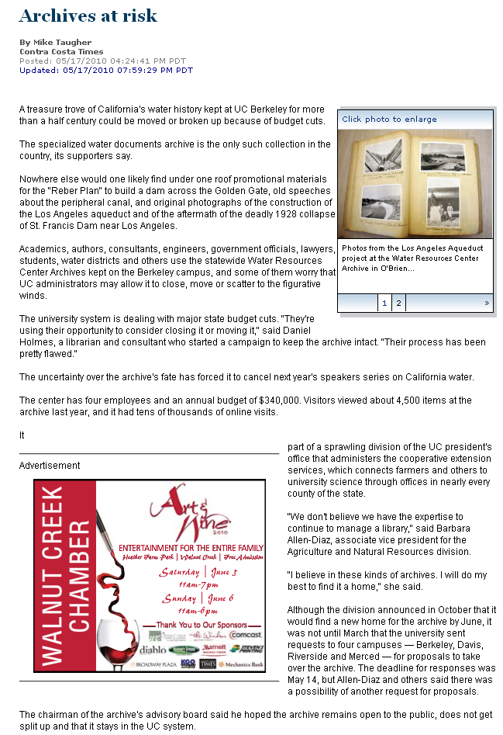
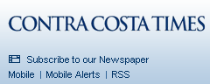
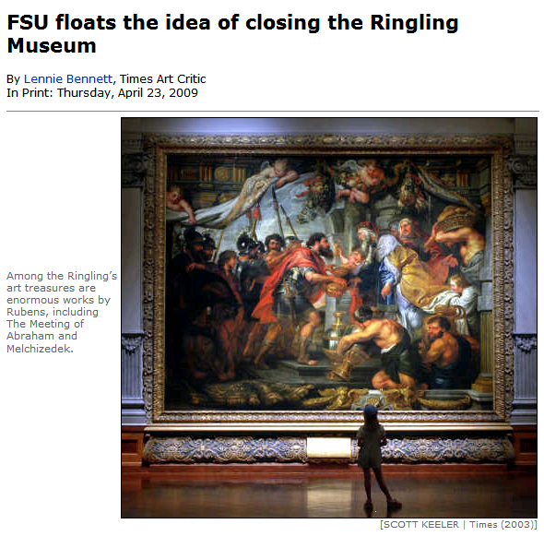
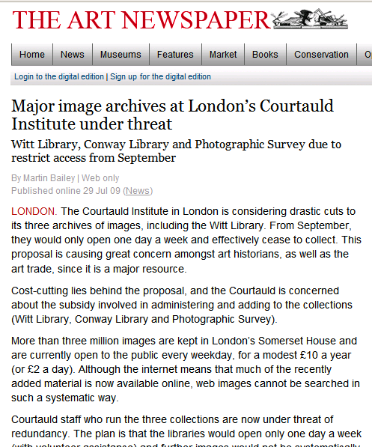
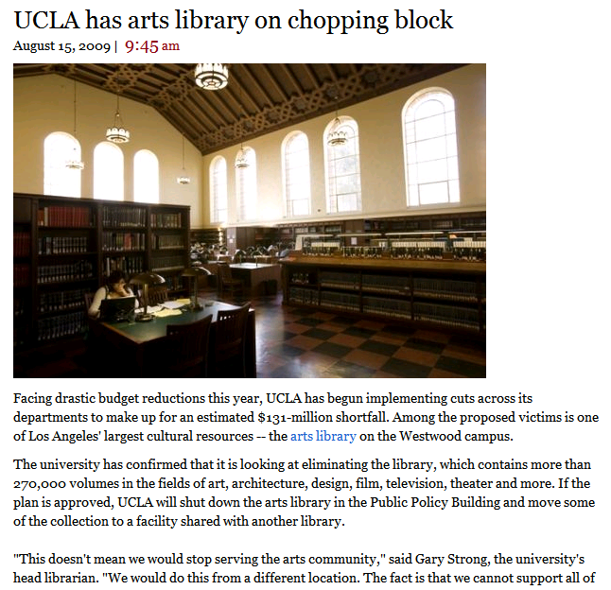
Notes:
I thought I’d set out by giving you an impressionistic view of what could be considered the bad news for Collections on Campus. Given the economic climate over the last couple of years, many institutions have seen themselves forced to re-evaluate their relationship to at least parts of their campus collections. These newspaper clippings document threatened closings of museums, archives, visual resources collections and libraries on university campuses.

Slide 3
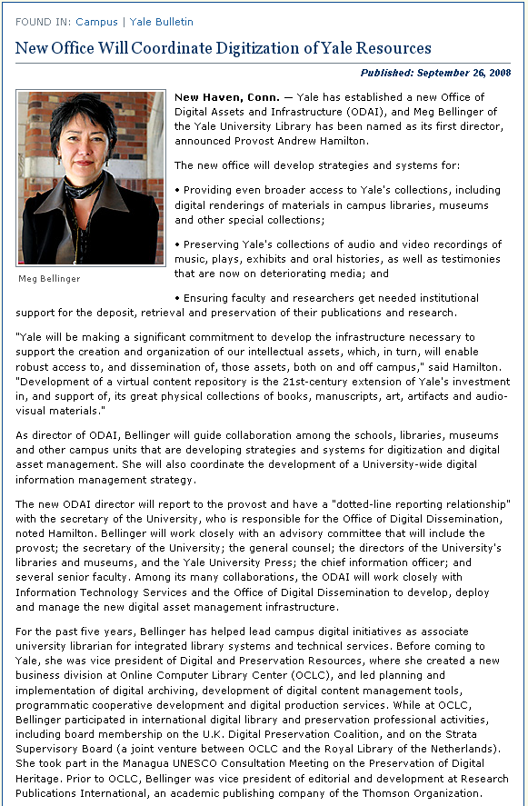
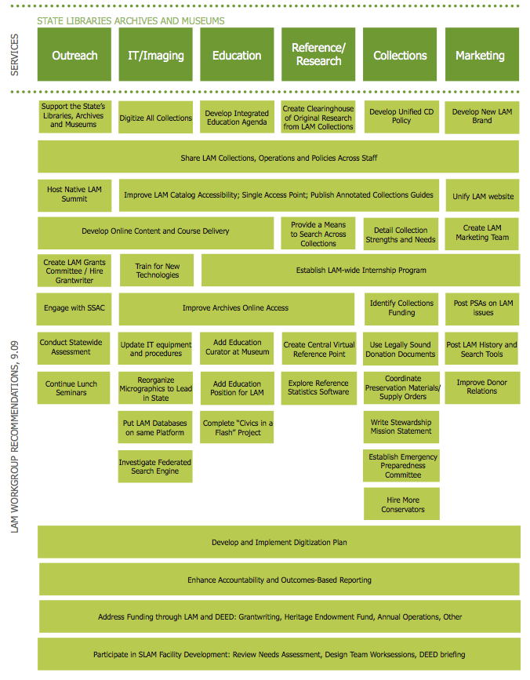
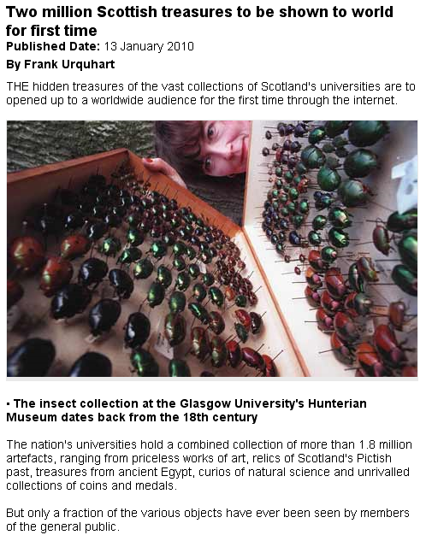
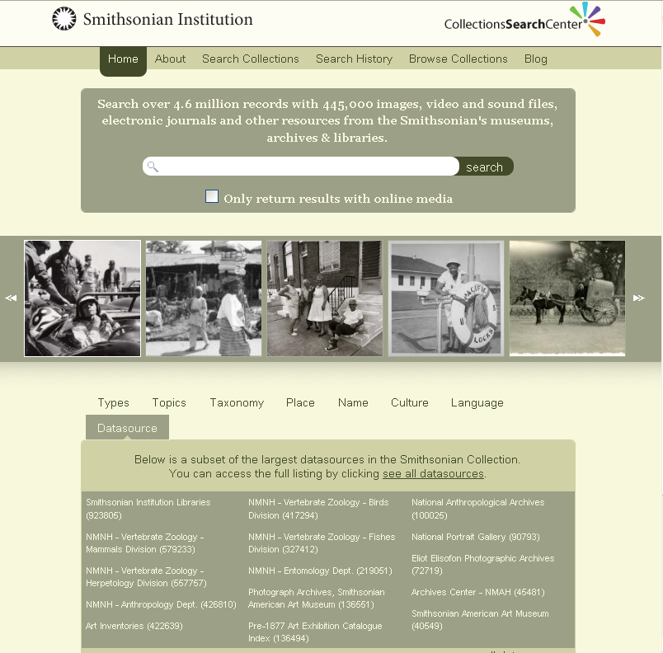

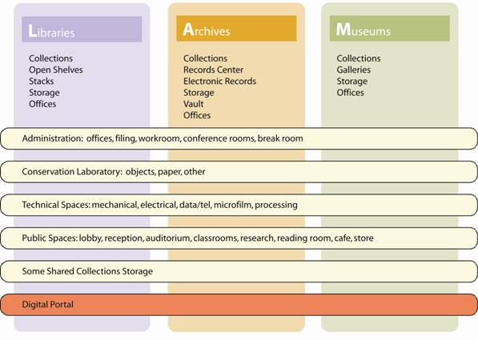
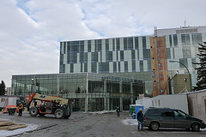
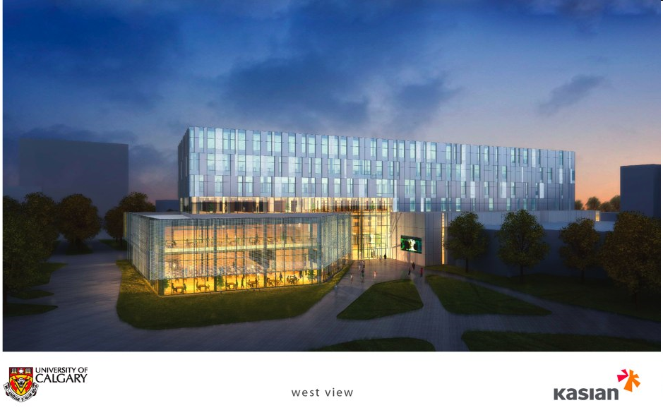
Notes:
In the same time-span when collections on campus have experienced sever budgetary pressure, new and more collaborative ways for supporting them and extracting value have emerged.

Slide 4
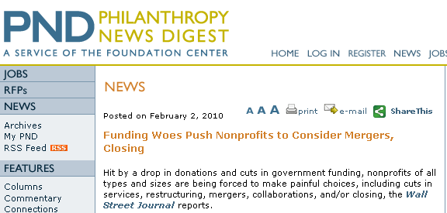

Slide 5
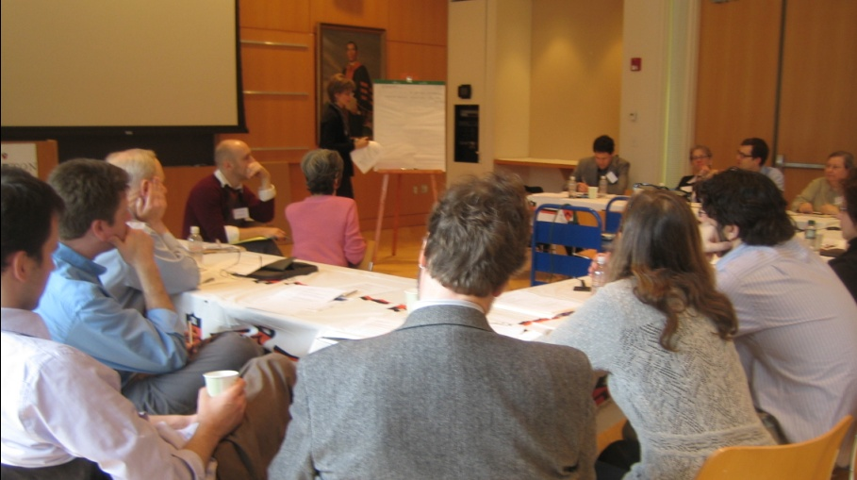
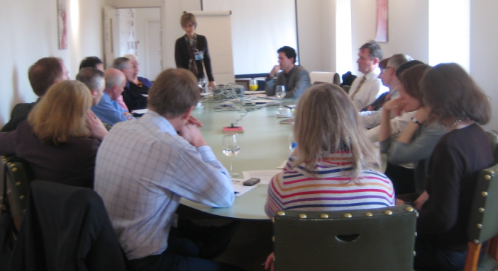
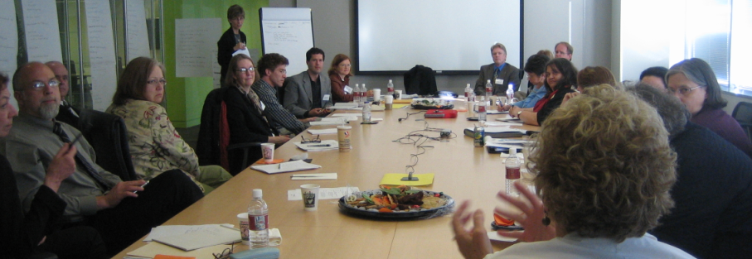
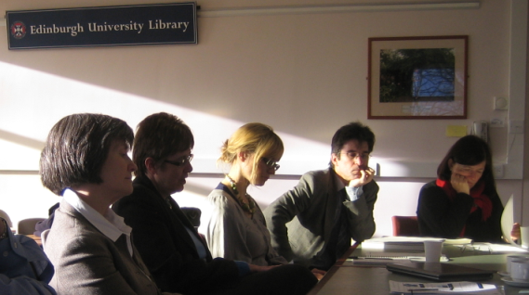
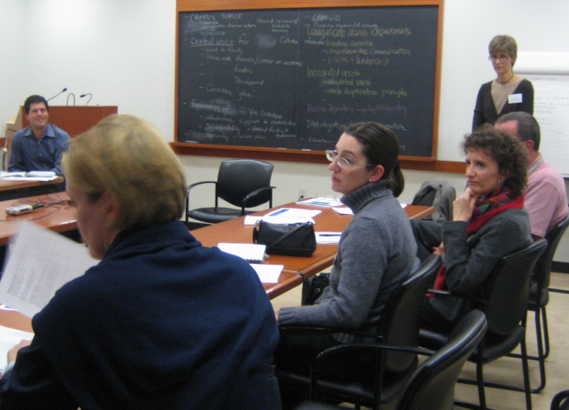
OCLC Research LAM Workshops
Princeton
Victoria & Albert
Smithsonian
U of Edinburgh
Yale
Notes:
Some of the developments I just spoke about were in part catalyzed by the Library, Archive and Museum workshops we held at five partner institutions in late 2007 / early 2008. During these day-long sessions with representatives from all three communities, we discussed existing collaborations as well as obstacles; we also defined a vision for the campus collections, from which specific projects flowed. The Smithsonian, for example, had already invested in cross-collection searching for some of its collections, but the workshop provided motivation and buy-in to go even further.

Slide 6
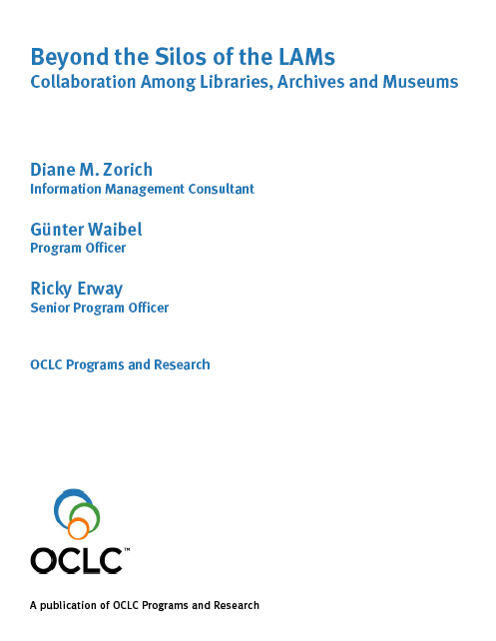
OCLC Research LAM Workshops
Princeton
Victoria & Albert
Smithsonian
U of Edinburgh
Yale
Notes:
Some of the developments I just spoke about were in part catalyzed by the Library, Archive and Museum workshops we held at five partner institutions in late 2007 / early 2008. During these day-long sessions with representatives from all three communities, we discussed existing collaborations as well as obstacles; we also defined a vision for the campus collections, from which specific projects flowed. The Smithsonian, for example, had already invested in cross-collection searching for some of its collections, but the workshop provided motivation and buy-in to go even further.

Slide 7







Broadening the Conversation
Local solutions - Common Administration
“We work together because we have the same employer”
Group Solutions - Common Interest
“We work together because we have common interests”
Global Solutions - Common Values
“Things work at scale because the community subscribes to the same values”
content
tools
standards
Notes:
With today’s event, we’d like to expand the conversation about collaboration in various dimensions: we’ll go beyond the local collaborations of the LAM workshops, and we’ll also put the emphasis a bit more on collaboration, and a bit less on LAM.
We’ve asked all of our speakers to focus on strategies for collaboration, both those that have failed and those that have succeeded, and only talk about their projects as an illustration for those strategies.

Slide 8
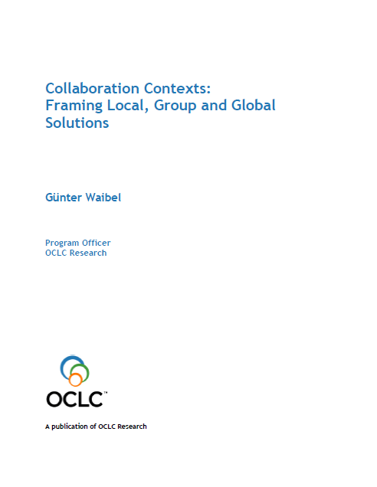
The scaffolding: Collaboration Contexts
Notes:
For more details, consult the short paper “Collaboration Contexts – Framing Local, Group and Global Solutions”.

Slide 9
For Inspiration…
Keynote 1: Collaborative Leadership
Allan R. Cohen, Professor of Global Leadership and Director of Corporate Entrepreneurship, Babson College
Keynote 2: Introducing an Inspirational Large-scale International Collaboration
Dave Remsen, Senior Programme Officer, Global Biodiversity Information Facility
Keynote 3: Communications Industries in Crisis
Dylan Tweney, Senior Editor, Wired.com

Slide 10
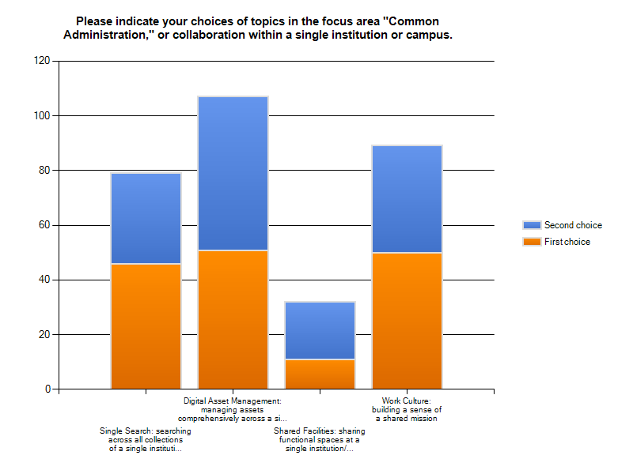
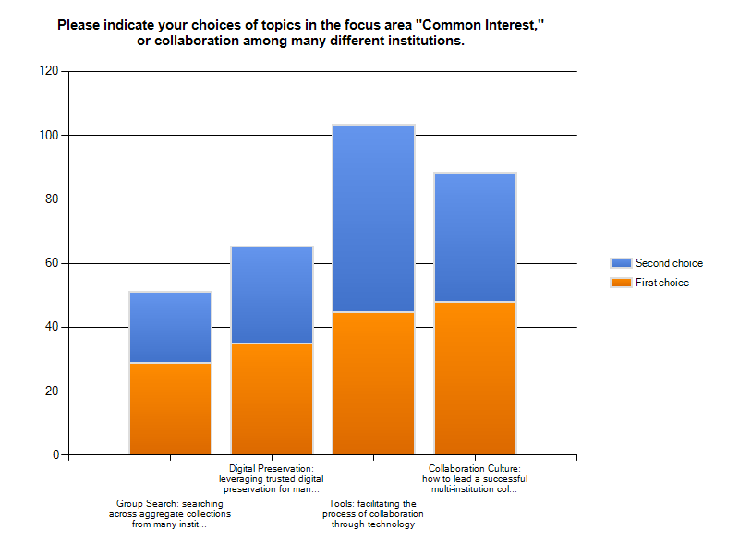
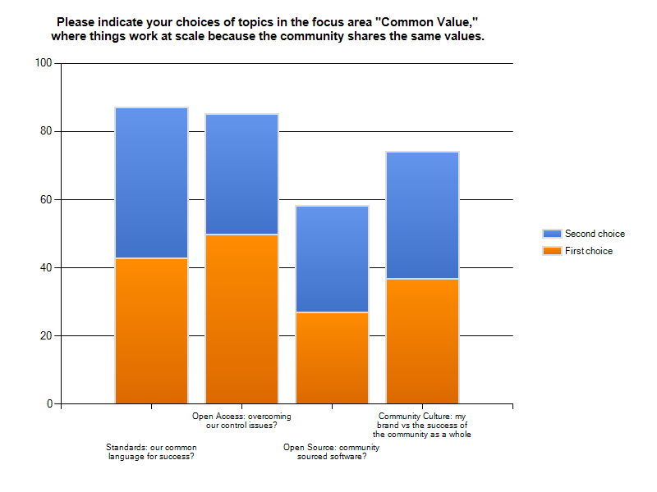
Tomorrow, it’s all about you…
Birds-of-a-Feather 1
Digital Asset Management: Managing Assets Comprehensively Across a Single Institution/Campus
Collaboration Culture: How to Lead a Successful Multi-institution Collaboration
Standards: Our Common Language for Success?
Birds-of-a-Feather 2
Work Culture: Building a Sense of a Shared Mission
Tools: Facilitating the Process of Collaboration Through Technology
Open Access: Overcoming Our Control Issues?
Lightning Round!
The "Take-aways" Fireside Chat

Slide 11
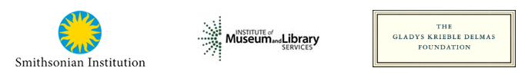
Smithsonian Institution Forum Sponsoring Committee
Elizabeth Broun, Director, Smithsonian American Art Museum
Anne Van Camp, Director, Smithsonian Institution Archives
Nancy E. Gwinn, Director Smithsonian Institution Libraries
Ann Speyer, Chief Information Officer, Smithsonian Institution
RLG Partnership Forum Planning Group
Marcia Adams, Smithsonian Institution Libraries
Jackie Bell, University of Calgary
Emmanuelle Delmas-Glass, Yale Center for British Art
Wendy Duff, University of Toronto
Christine Hennessey, Smithsonian American Art Museum
Steven K. Galbraith, Folger Shakespeare Library
Cathryn Goodwin, Manager, Princeton University Art Museum
Martin Kalfatovic, Smithsonian Institution Libraries
Dan Santamaria, Princeton University
Pam Smith, Smithsonian Institution
Sarah Stauderman, Smithsonian Archives
OCLC Research
Merrilee Proffitt, Senior Program Officer
Ricky Erway, Senior Program Officer
Jackie Dooley, Consulting Archivist
Jeanette McNichol, Executive Assistant
Melissa Renspie, Senior Communications Officer
Patrick Confer, Web Content Coordinator
Smithsonian Institution Logistics
Liz O'Brien, Public Relations/Special Events, Smithsonian Institution Libraries
Marc Bretzfelder, Streaming Media Webmaster, Office of the Chief Information Officer
Our host and supporters:
Thank You!

Slide 12
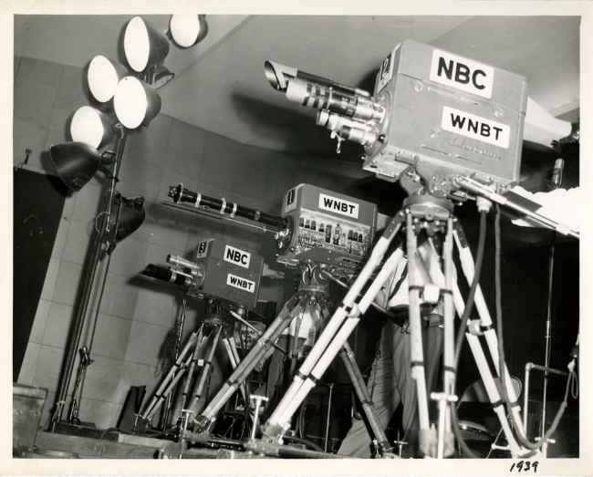
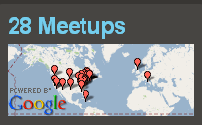
We are live-webcasting.
Recordings will be at http://www.oclc.org/research/ once they’re edited.
TV Cameras on the set
Edmund A. Laport Collection, ca. 1920-1950
Archives Center, National Museum of American History
More random announcements:
Thirsty or hungry? Room 3111
Feeling tweet-y? #CForum
Thank you!
waibelg@oclc.org
P.S.: FYI, that bulge in your name badge is a flashdrive.
Registration desk news:
Wednesday tours still have spaces!
List of lunch options available
Notes:
Half Way Tree, Jamaica

