Slide 1
Beyond the Dog and Pony Show:
Undergraduate Adventures in Archives and Special Collections
Suzy Taraba
Director of Special Collections & Archives
Wesleyan University
This work is licensed under a Creative Commons Attribution 3.0 Unported License. http://creativecommons.org/licenses/by/3.0/

Slide 2
What are we teaching?
And why?

Slide 3
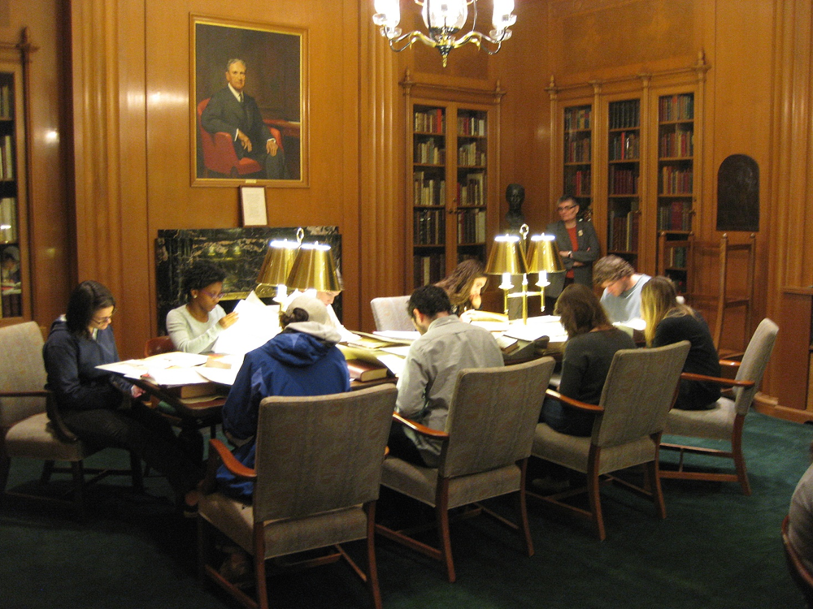

Slide 4
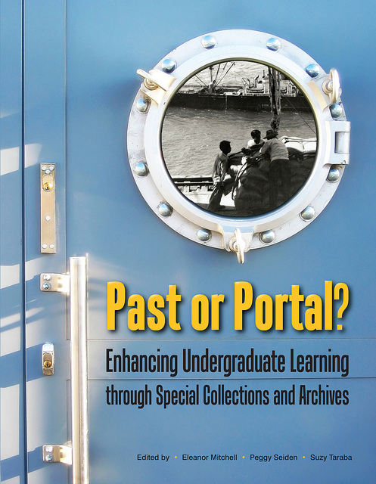

Slide 5
The Artifact:
“Speed Dating in Special Collections”
Julia Walworth
Merton College, Oxford University

Slide 6
The Pedagogy:
“Teaching Cultural Memory”
Robin M. Katz
University of Vermont

Slide 7
The Work:
“The American History Textbook Project”
Christina Connor and Steven P. Rice
Ramapo College of New Jersey

Slide 8
The Program:
Wesleyan University

Slide 9
The Mystery Book Exercise

Slide 10
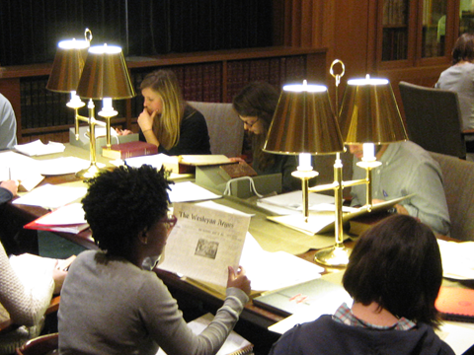

Slide 11
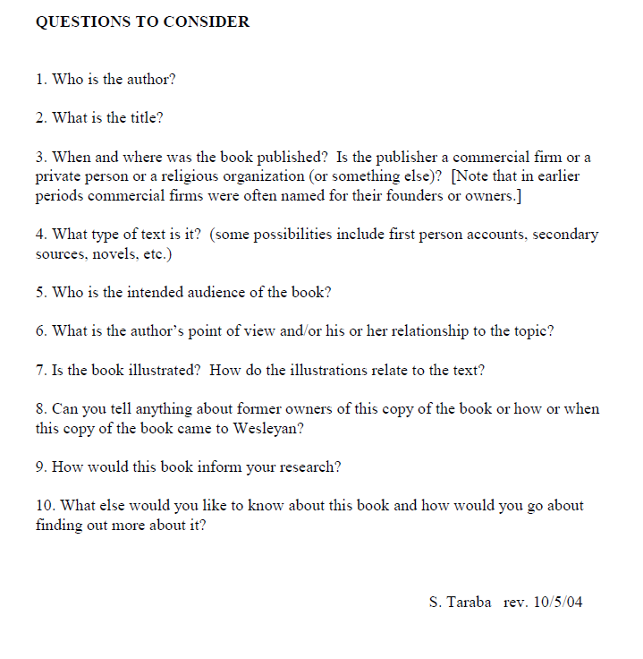

Slide 12
The Treasure Hunt

Slide 13
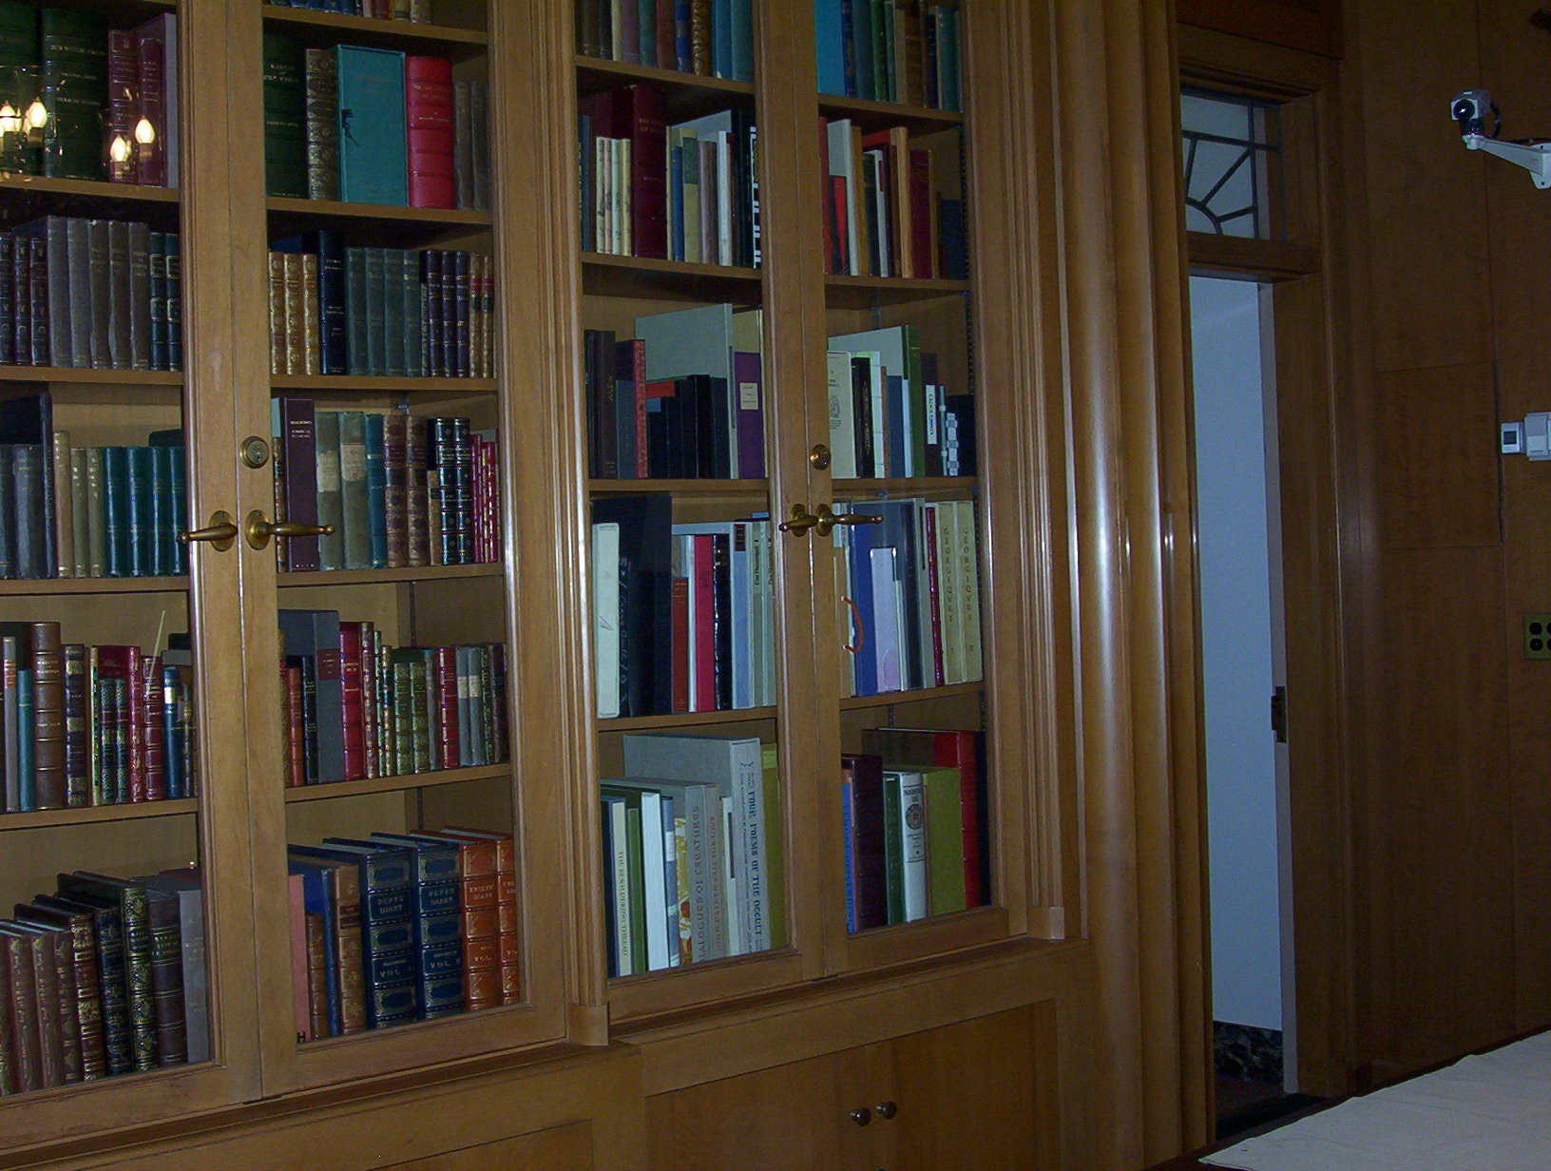

Slide 14
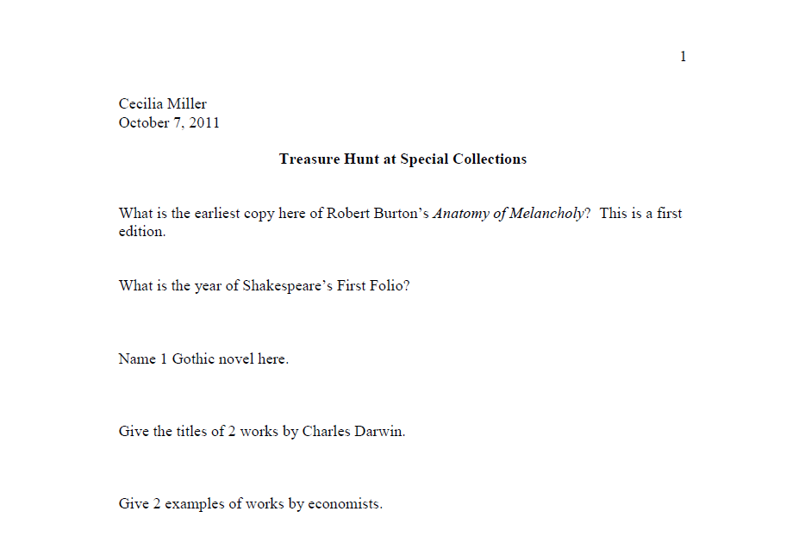

Slide 15
The Book as Artifact

Slide 16
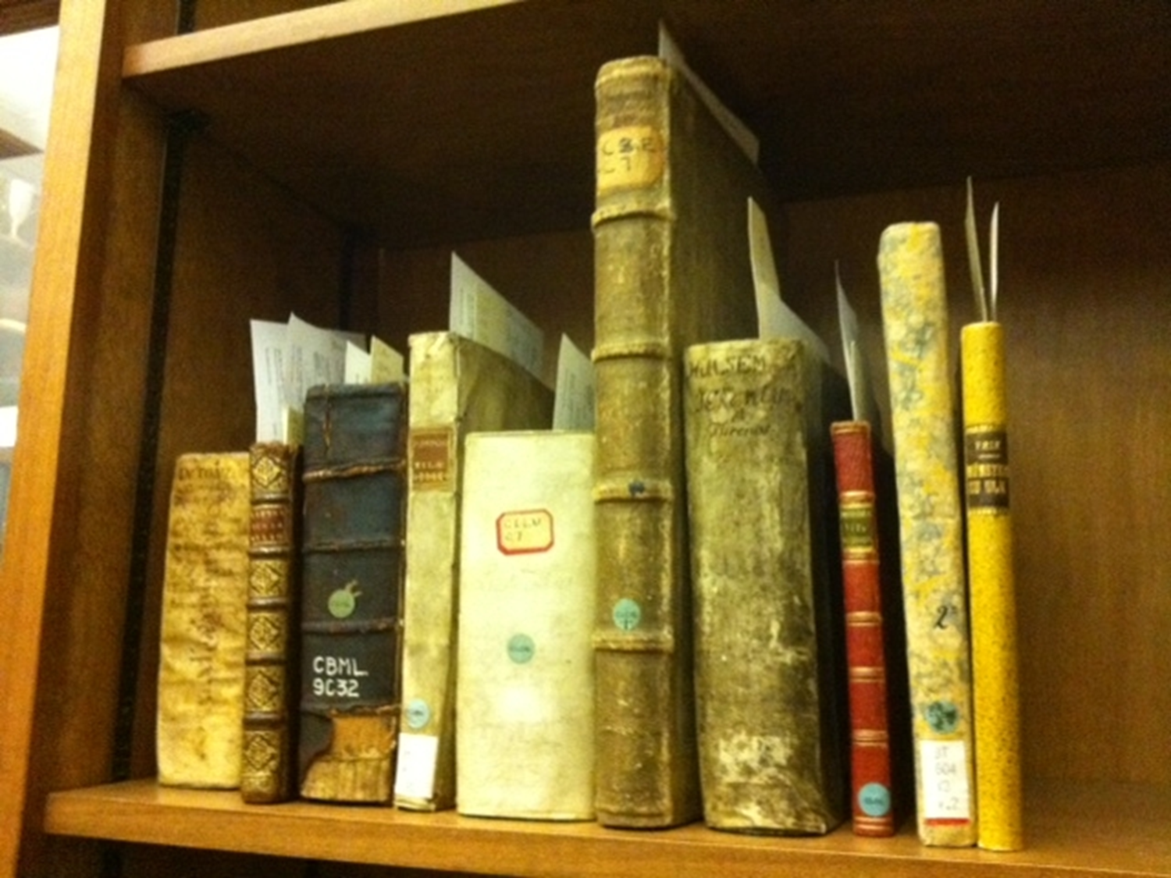

Slide 17
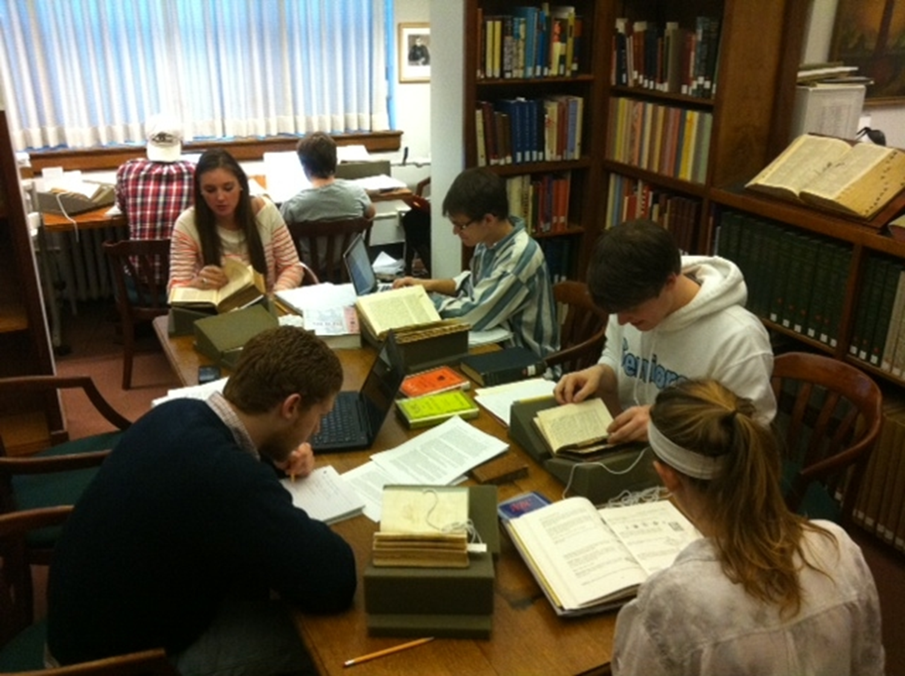

Slide 18
Creative Writing from Archives

Slide 19
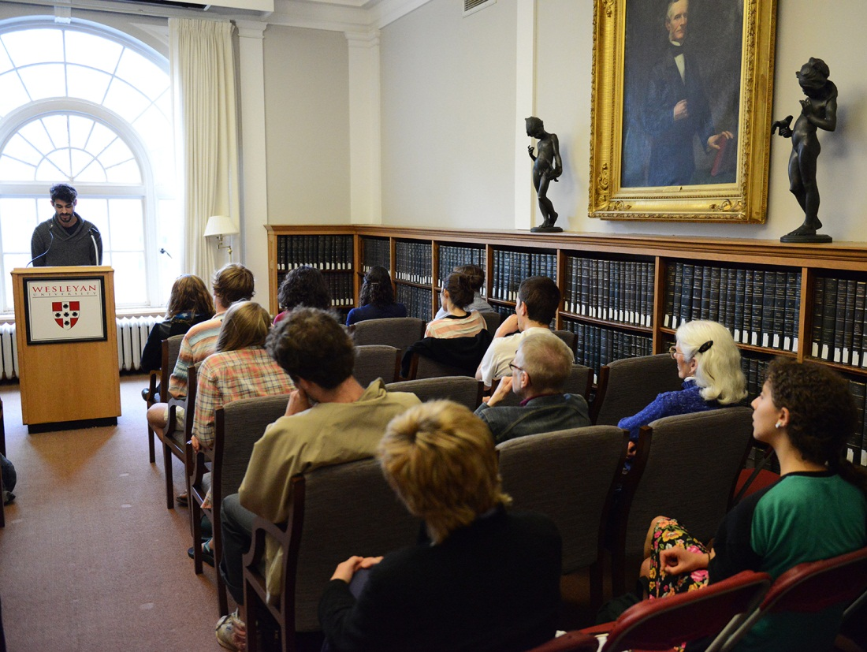

Slide 20
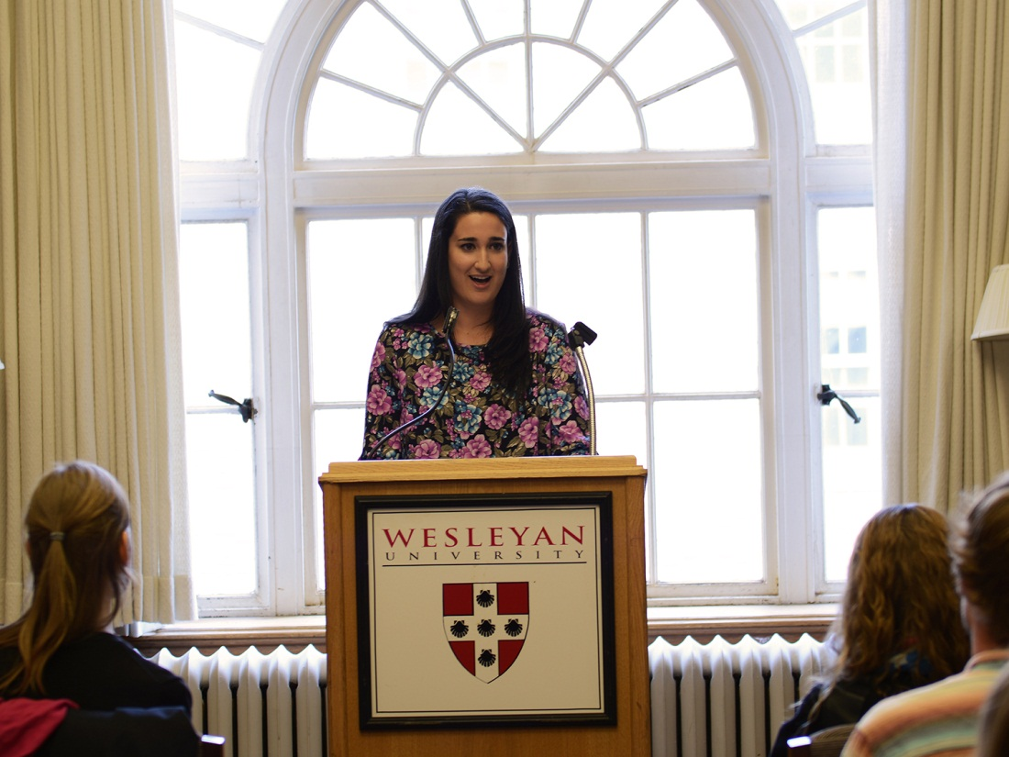

Slide 21
Thank you!

