Slide 1
Are We Reconfigured Yet? US Research Libraries: Priorities, Trends, Directions
OCLC Research Webinar
Featuring Jim Michalko, Vice President, OCLC Research Library Partnership 14 February 2013
#orlp
OCLC Research Technical Advances for Innovation in
Cultural Heritage Institutions (TAI CHI) Webinar
1 August 2012
OCLC Research
Exploration, innovation and community for libraries and archives.

Slide 2
Are We Reconfigured Yet? US Research Libraries: Priorities, Trends, Directions
An OCLC Research Library Partnership Webinar
14 February 2013
Jim Michalko
Vice President
With thanks to and borrowings from Bruce Crocco, Lorcan Dempsey,
Constance Malpas, Tito Sierra, Wendy Lougee

Slide 3
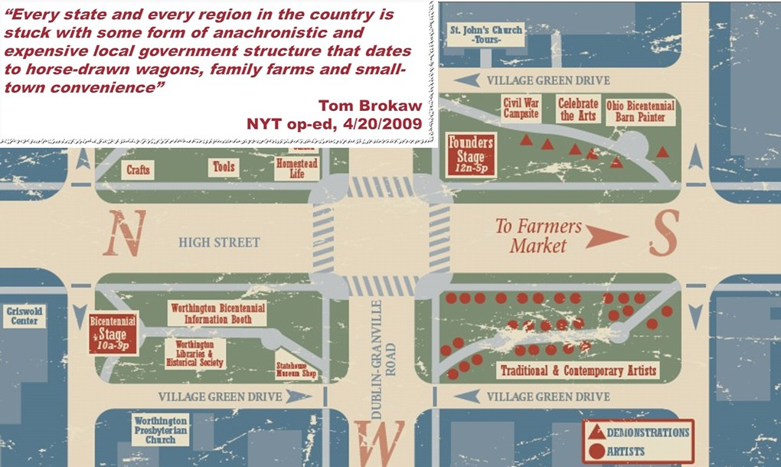
Place of the Library in University
Why do Universities have libraries?
It was more economical to have a physical collection than to send researchers or students to the information.
It was useful to locate all the needed information resources for research and learning physically close to the work.
Local collections were assets and contributed competitively to scholarly output
Consider the town square
in the United States…

Slide 4
The network changes everything
The network has reconfigured whole industries
Travel, News, Book Retailing
The network is now the first option for researchers and learners
Impact on the university library
changed the value of physical book collections and library space
changed the relevance of the library assets and services to the University’s outputs
We do not yet know what it will mean to reconfigure the library within the University

Slide 5
The Context – the current library environment
Information environment is increasingly flat
academic collections increasingly alike
discovery is increasingly done outside of library
information fulfillment comes to the desktop from many sources
Libraries value is challenged
reduce investment in redundant operations
redirect resources to a renovated library service portfolio
Library place is less about collections
More about client support and research engagement

Slide 6
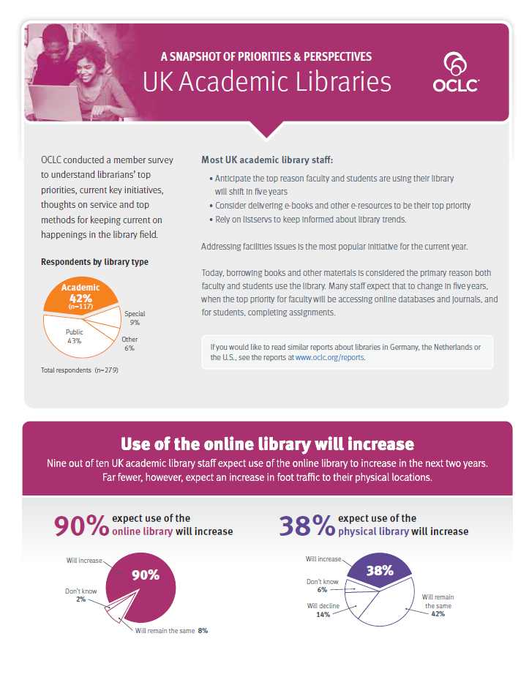
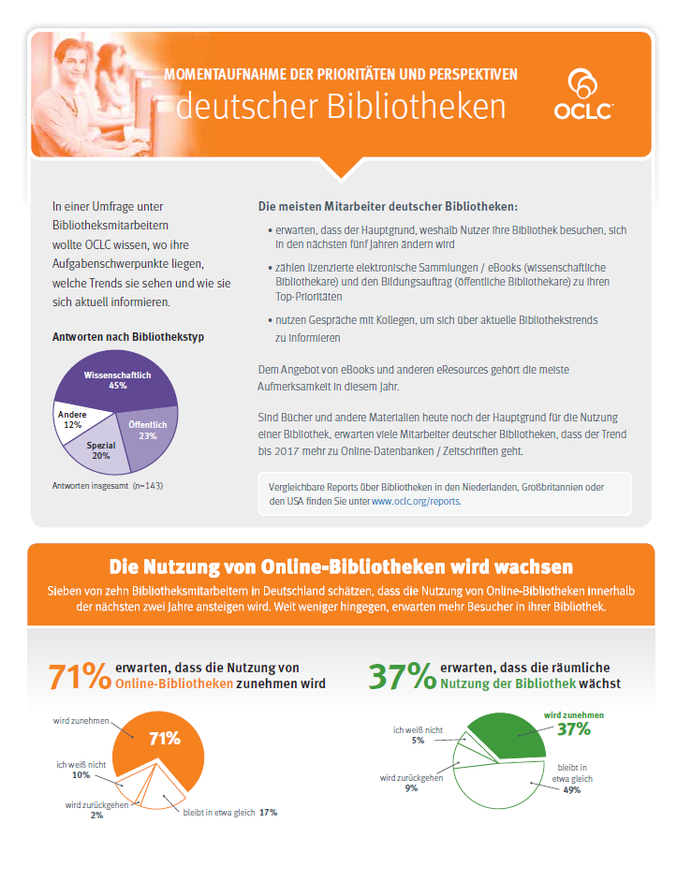
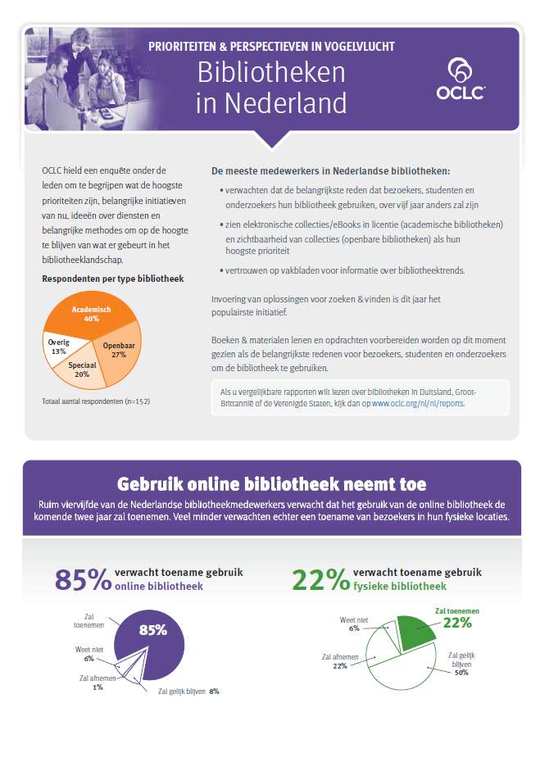
OCLC Market Surveys

Slide 7
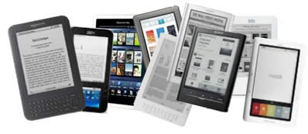
Top three priorities by country: ACADEMIC LIBRARIES
 | #1 Across All: | e-collections/e-books
 | Germany: | The future of education and the library Collection visibility
 | Netherlands: | Digitization projects Collection visibility
 | United Kingdom: | The future of education and the library Facilities
 | United States: | The future of education and the library Facilities

Slide 8
OCLC Research Library Partners - priorities and directions

Slide 9
Background –Research Library Partner Interviews
Purpose
Listen and synthesize
Top of Mind
Long-term trends and forces
Input to Research Agenda
Inject in OCLC enterprise discussions
What is Top of Mind represents Points of Engagement

Slide 10
Partners interviewed (66)
American Antiquarian Society British Library California Digital Library Chemical Heritage Foundation Cleveland Museum of Art Columbia Cornell Duke East Carolina U. Frick Art Reference Library Getty Research Institute Hagley Museum and Library Indiana University, Bloomington Keio University Kimbell Art Museum La Trobe University Linda Hall London School of Economics Metropolitan Museum of Art Miami U. (Ohio) Minnesota Historical Society Museum of Fine Arts, Houston Museum of Modern Art National Library of Australia National Library of Scotland Natural History Museum National Archives and Records Administration (US) New School New York Public Library New-York Historical Society Northwestern Ohio State Philadelphia Museum of Art Rockefeller University Saint Louis Art Museum Smithsonian Institution St Andrews Swiss National Library Trinity College Dublin U. Auckland U. Calgary UC Los Angeles U. Delaware U. Edinburgh U. Florida U. Hong Kong U. Houston U. Illinois, Urbana-Champaign U. Kansas U. Leeds U. Leicester U. Montréal U N. Carolina - Greensboro U N. Texas U. Notre Dame U. Oregon U. Oxford U. South Florida U. Tennessee, Knoxville U. Texas, San Antonio U. Utrecht U. Warwick U. Washington U. Wyoming Wellcome Library Western Kentucky

Slide 11
Partners interviewed (66)
American Antiquarian Society British Library California Digital Library Chemical Heritage Foundation Cleveland Museum of Art Columbia Cornell Duke East Carolina U. Frick Art Reference Library Getty Research Institute Hagley Museum and Library Indiana University, Bloomington Keio University Kimbell Art Museum La Trobe University Linda Hall London School of Economics Metropolitan Museum of Art Miami U. (Ohio) Minnesota Historical Society Museum of Fine Arts, Houston Museum of Modern Art National Library of Australia National Library of Scotland Natural History Museum National Archives and Records Administration (US) New School New York Public Library New-York Historical Society Northwestern Ohio State Philadelphia Museum of Art Rockefeller University Saint Louis Art Museum Smithsonian Institution St Andrews Swiss National Library Trinity College Dublin U. Auckland U. Calgary UC Los Angeles U. Delaware U. Edinburgh U. Florida U. Hong Kong U. Houston U. Illinois, Urbana-Champaign U. Kansas U. Leeds U. Leicester U. Montréal U N. Carolina - Greensboro U N. Texas U. Notre Dame U. Oregon U. Oxford U. South Florida U. Tennessee, Knoxville U. Texas, San Antonio U. Utrecht U. Warwick U. Washington U. Wyoming Wellcome Library Western Kentucky

Slide 12
Research Library Partner Interviews

Slide 13
Michalko for OCLC Research. 2013.

Slide 14
Top of Mind (25) High Concern Medium Low
Special & Archival Collections
Data Management
Shared Print Management
Staff realignment, development
Research Support
Space Usage
Partnerships Collaboration
Community Engagement
Digital Humanities
Distinctive Services
Born Digital
Collection Analysis
Shared Services
Social Media
Technology Infrastructure
Area Studies
Collaborative Collection Development
Curriculum Integration
Digital Aggregations
Digital Selection
Discovery Layer
E-resources
Embedded Librarians
Metadata Management
User Studies

Slide 15
Michalko for OCLC Research. 2013.

Slide 16
Top of Mind (25) High Concern Medium Low
Special & Archival Collections
Data Management
Shared Print
Staff realignment, development
Research Support
Space Usage
Partnerships Collaboration
Community Engagement
Digital Humanities
Distinctive Services
Born Digital
Collection Analysis
Shared Services
Social Media
Technology Infrastructure
Area Studies
Collaborative Collection Development
Curriculum Integration
Digital Aggregations
Digital Selection
Discovery Layer
E-resources
Embedded Librarians
Metadata Management
User Studies

Slide 17
Michalko for OCLC Research. 2013.

Slide 18
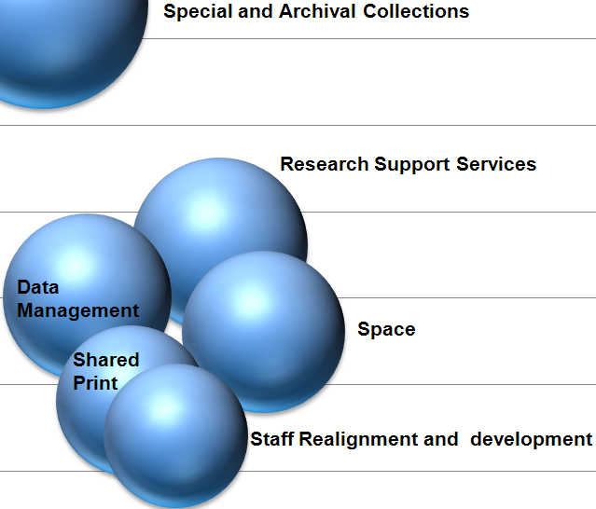
Priorities
1. Special Collections and Archives
Connected to support for new forms of scholarship in the humanities
Concerns
Discoverability
Not properly described or not indexed in search engines
Digitization
Scale is a challenge
No standard infrastructure
Usability locally
Support for a global audience

Slide 19
Priorities
2. Research Support Services
Provide expert services
Text and data mining
Global Positioning expertise
Virtual Research environments
Liaison Librarian
Proactive outreach to the faculty and departments
3. Data Management
Products of research
Preserved and maintained for re-use
Issues of storage, classification, skills
Infrastructure

Slide 20
Priorities
4. Shared Print Management
Rely on central shared print repositories
Leverage digital versions of texts
Issues of what to keep and discard
Policies, politics, services, fulfillment
5. Space – renovation and re-use
Expensive, desirable central space
Repurpose for people not collections
Group and collaboration spaces
Leverage for partnerships with departments and faculty

Slide 21
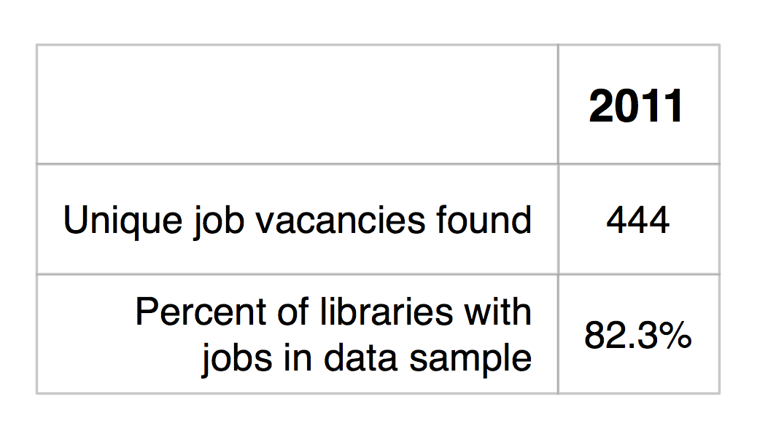
6. Staff Re-alignment and development
Type of Job Responsibility
Job Role Newness to the Organization

Slide 23
Tito Sierra, MIT Libraries ARL Fall Forum 2012

Slide 24
Job Titles: New Role
Tito Sierra, MIT Libraries ARL Fall Forum 2012

Slide 25
New Jobs - Titles
Digital Jobs
Digital Humanities Librarian (x2)
Librarian for Digital Research and Scholarship
Digital Humanities Technology Consultant
Digital Records Archivist
New Technology Jobs
Digital Humanities Technology Consultant
Director of Scholarly Technology
Innovation and User Technology Research Librarian
New Data and E-Science Jobs
Data Management Planning Consultant (x2)
Data Curation Librarian
E-Science Librarian (x3)
Tito Sierra, MIT Libraries ARL Fall Forum 2012

Slide 26
Digital jobs
New technology jobs
New data and e-science
Michalko for OCLC Research. 2013.

Slide 27
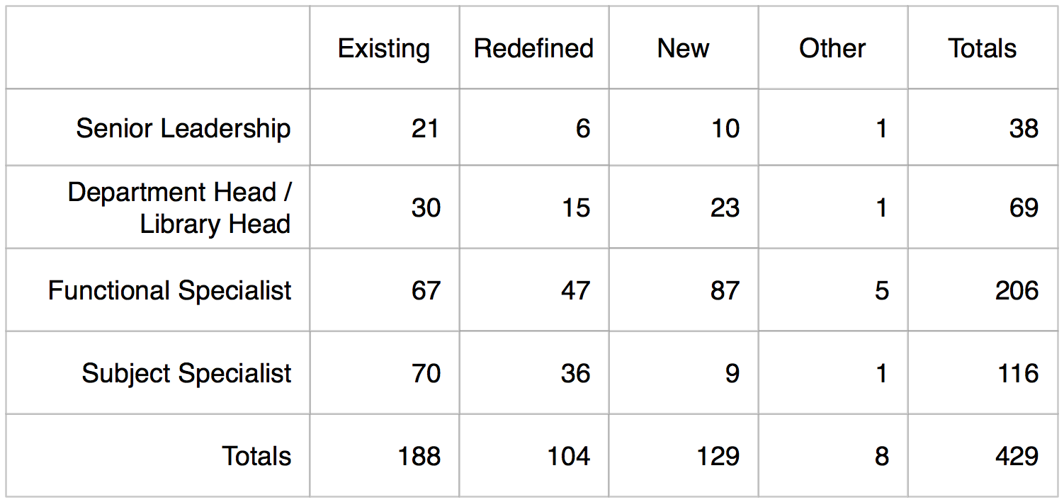
Progress?
233
Total ARL Staff ca. 26, 800
Total ARL Professional Staff ca. 9,750
Replacement rate of
0.9% or 2.4%

Slide 28
Digital jobs
New technology jobs
New data and e-science
Michalko for OCLC Research. 2013.

Slide 29
The new rules
http://www.arl.org/resources/pubs/mmproceedings/160mm-proceedings.shtml#colls
Wendy Lougee at the 4 May 2012 ARL Membership Meeting Chicago, IL

Slide 30
20th Century
21st Century
Library Organization
defined by
Local Collections
Local Stewardship
Local Discovery
Shared Collections
Cooperative Governance
Network Disclosure
supported by
Infrastructure
Warehouse of books
Preservation of what is ‘mine’
Local ILS
Collaboration spaces
Joint stewardship of what is ‘ours’
‘Cloud-based’ management svcs
assessed with
Metrics
Collection size
Gate count
Satisfaction
Support for research processes
Management of institutional IP
Impact
Malpas for OCLC Research

Slide 31
Thank you.
!
?

Slide 32
Where is OCLC Research active and investing?
Special & Archival Collections
ArchiveGrid, Survey work, Past Forward, Born Digital
Data Management
Model policy elements, criteria for selection, acq, deaccession (archival), how-to guide and toolkit for LMD, sustainability recommendations
Shared Print Management
print archives disclosure project, management at mega-scale,
Staff realignment and development
Research Support
names and identifiers (VIAF, ISNI, Registering Researchers)
Space Usage

Slide 33
Thank you again.
michalkj@oclc.org

Slide 34
Are We Reconfigured Yet? US Research Libraries: Priorities, Trends, Directions
OCLC Research Webinar
#orlp
Jim Michalko
michalkj@oclc.org
Cultural Webinar
1 August 2012
OCLC Research
http://www.oclc.org/research.html
Our Webinars
http://www.oclc.org/research/events/webinars.html
OCLC Research
Exploration, innovation and community for libraries and archives.

