Slide 1
Welcome to Amsterdam
Libraries University of Amsterdam (UvA)/Amsterdam University of Applies Sciences (HvA)
Maria Heijne
Director Libraries
Notes:
*note change the title?

Slide 2
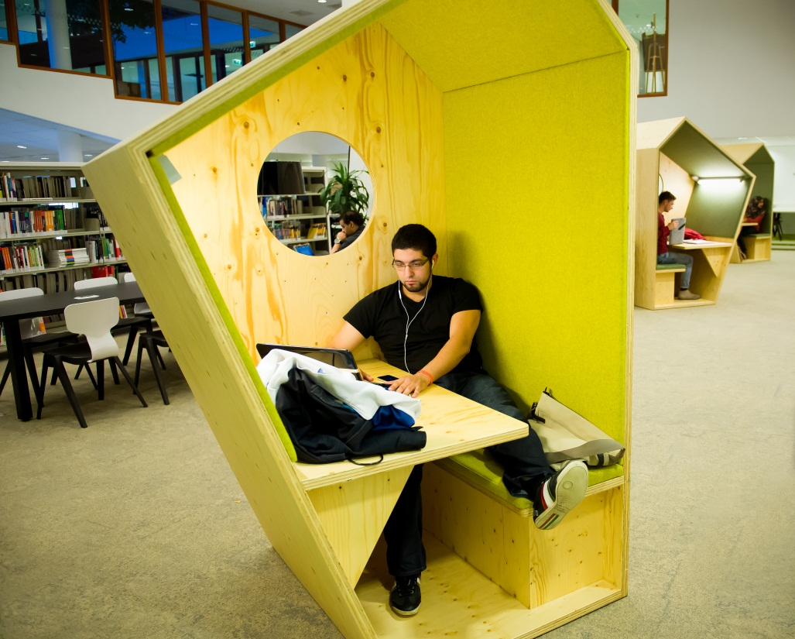
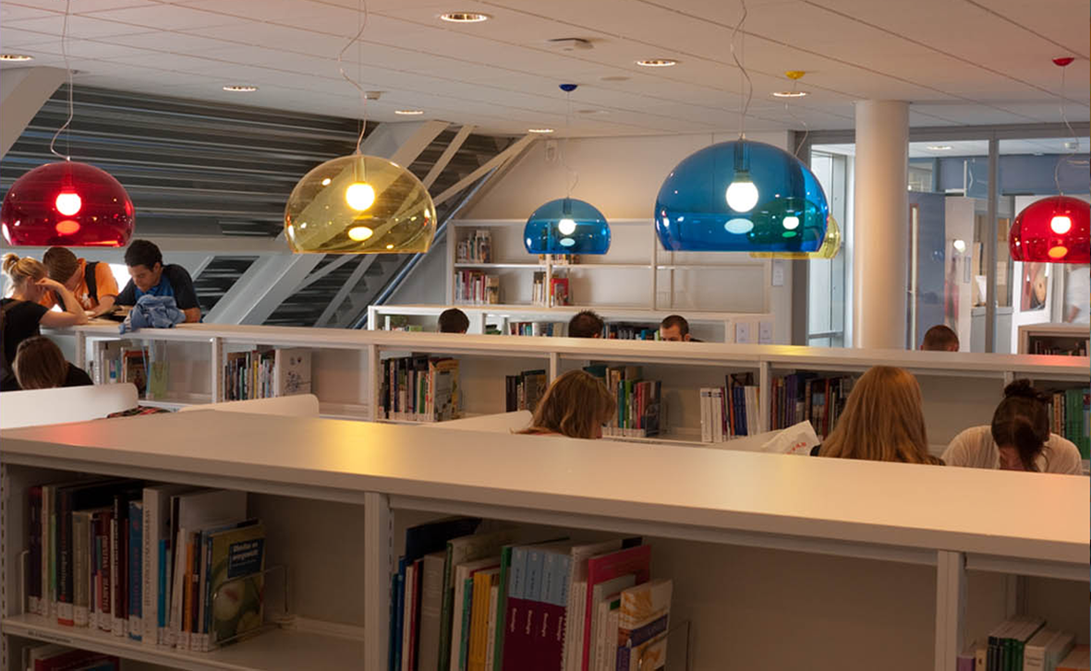
Hogeschool van Amsterdam Libraries
Photo: M. Kooijmans

Slide 3
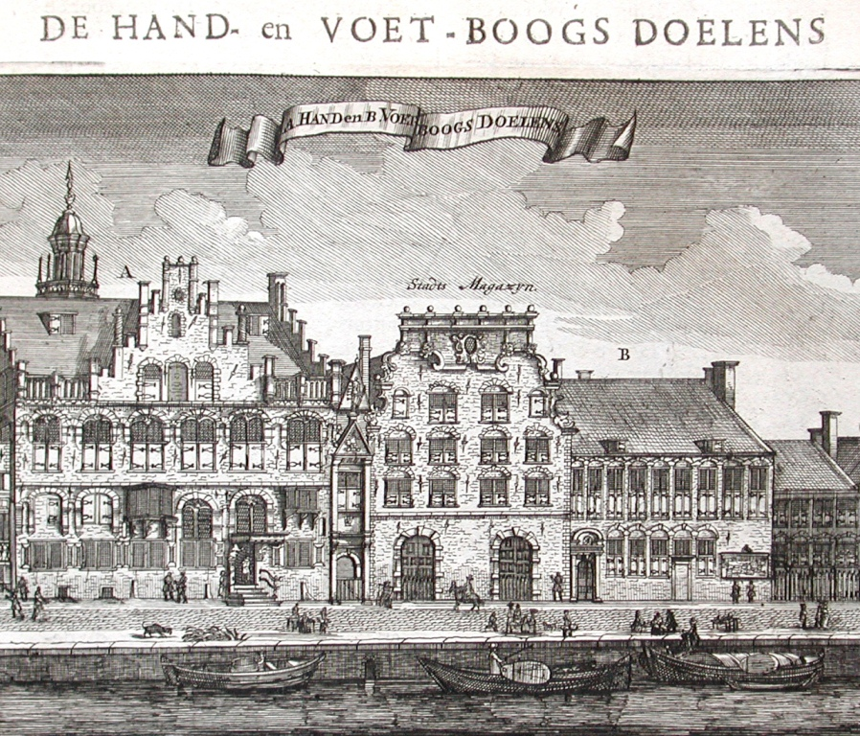
Around 1663

Slide 4
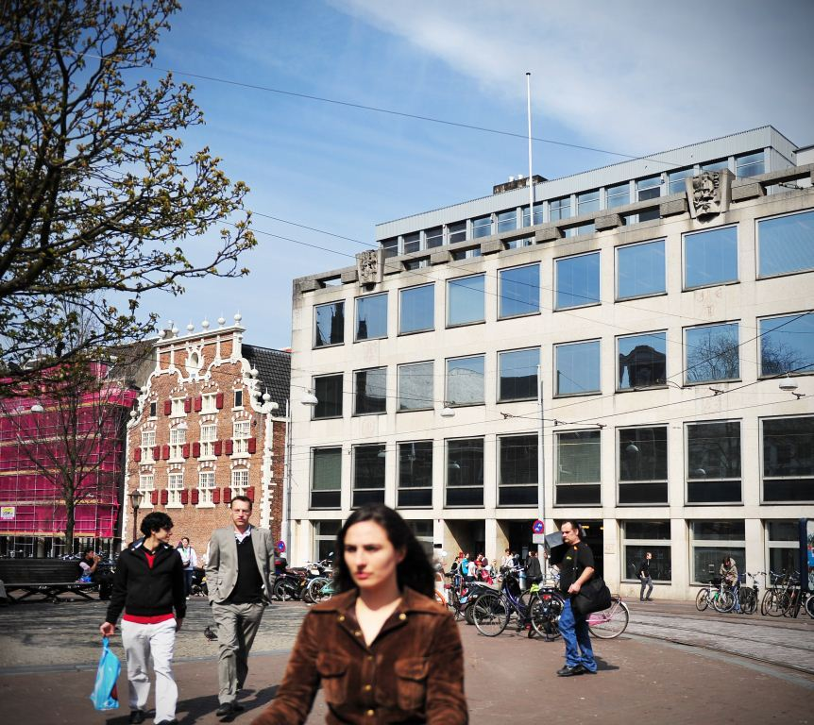
University Library City Centre 2014
Photo: M. Kooijmans

Slide 5
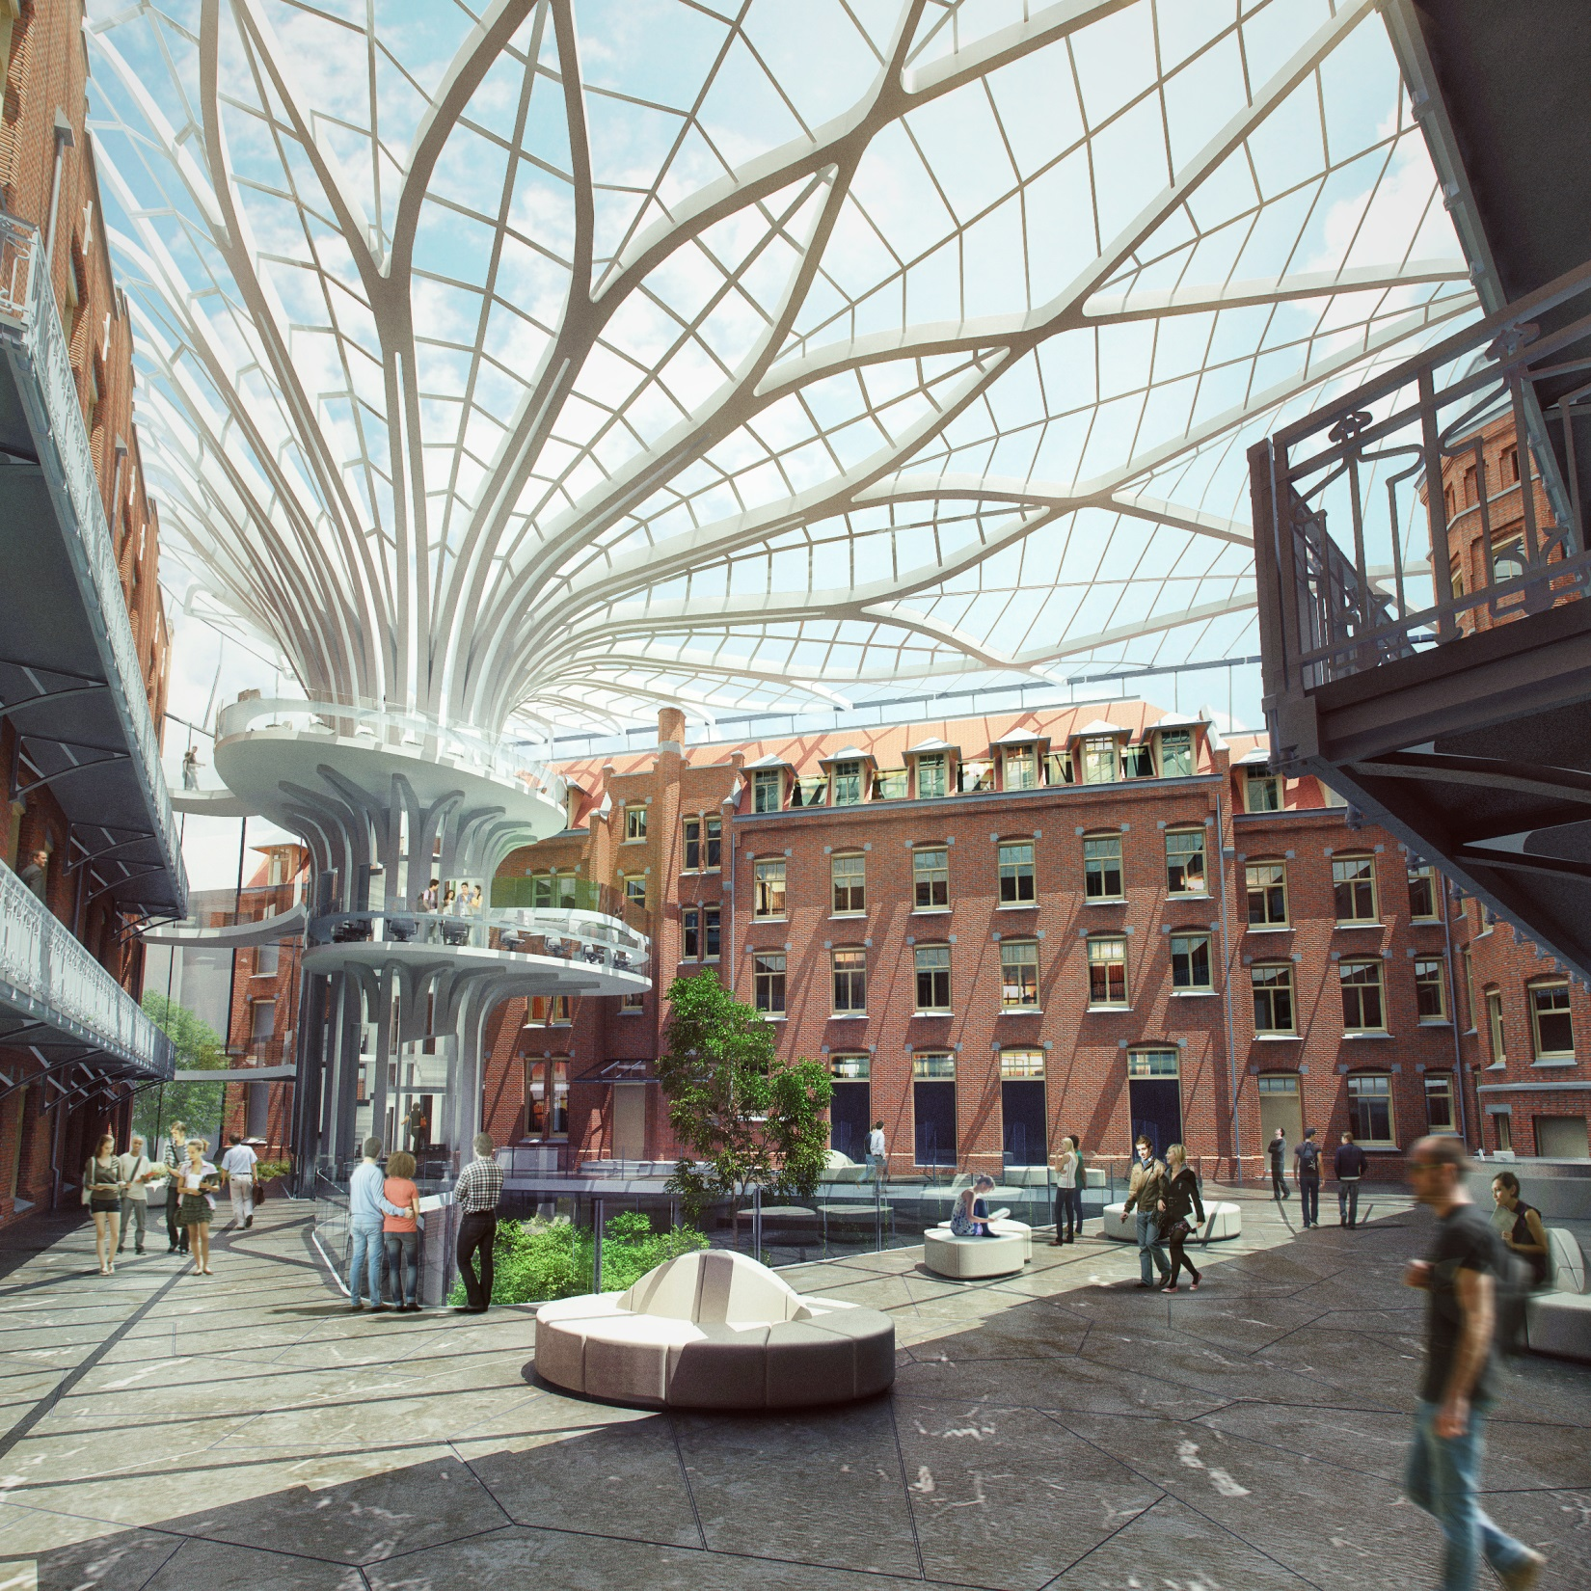
Impression Library City Centre Campus, planned 2018
Design MVSA Architects/Van Stigt Architecten

Slide 6
Special Collections/ Allard Pierson Museum
Photo: M. Kooijmans

Slide 7
©2014 Maria Heijne. This work is licensed under a Creative Commons Attribution 3.0 Unported License. Suggested attribution: “This work uses content from "Welcome to Amsterdam" © Maria Heijne, used under a Creative Commons Attribution license: http://creativecommons.org/licenses/by/3.0/”

