Slide 1
Impact of Open Source
Library Automation System
on Public Library Users
Barbara Albee
Hsin-liang Chen
SLIS, Indiana University

Slide 2
Studying Indiana Evergreen library users
Purpose:
To examine the implementation of an open source library automation system, Evergreen, in Indiana public libraries and its impact on library users.
Background of Evergreen:
Evergreen Indiana was implemented in 2008. The purpose of the Evergreen Indiana project is to provide public library users with effective and equitable library collections via a multi-library shared integrated library system (ILS).

Slide 3
Literature Review
1. Open source library automation systems
“it is flexible and has the ability to build a complex system at less cost,” Tennant (2007)
“the open source trend is strong and in order to survive it must compete with proprietary library systems,” Breeding (2008)
2. Collaboration and library consortia
“one of the main benefits of open source software is the commitment of the community to develop something that is interoperable and respects open standards,”
Moffatto (2006)

Slide 4
3. OPACs and library users in the Web platform era
“Delivery is equally important if not more so than discovery for the users” OCLC Report (2009)
According to the report, the top essential data elements recommended by library users are:
List of libraries that own the item,
Ability to see what is immediately available,
More item details,
Links to online content/full text
http://www.oclc.org/reports/onlinecatalogs/default.htm

Slide 5
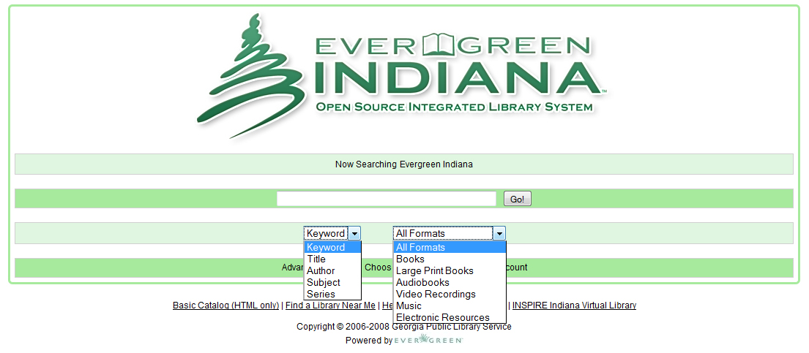
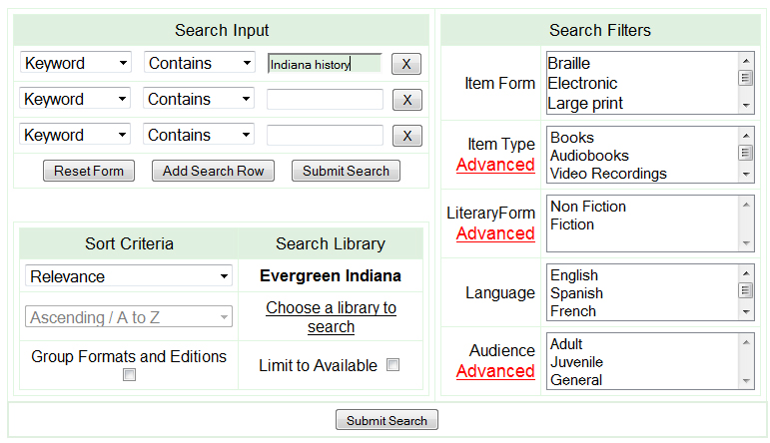

Slide 6
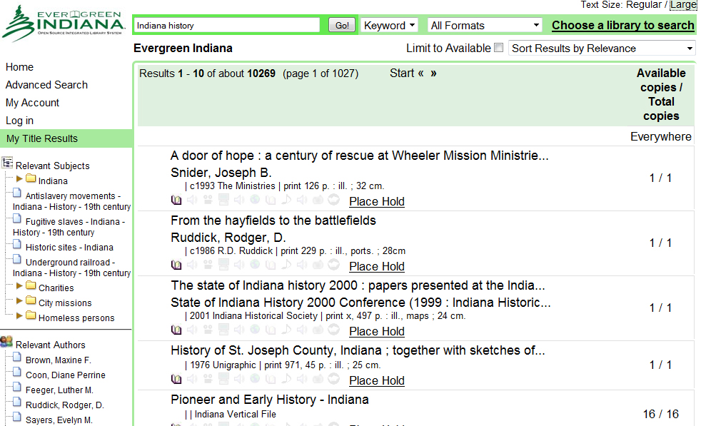
http://evergreen.lib.in.us/opac/en-US/skin/craftsman/xml/index.xml

Slide 7
Research questions
Are users at 9 Indiana public libraries using Evergreen OPAC since its implementation?
How do they use Evergreen OPAC?
Do they change the way they utilize library services and resources after the implementation of Evergreen OPAC?
If so, what are their changes?
What are their expectations about Evergreen OPAC since its implementation?

Slide 8
Methodology
Nine public libraries in Indiana
Quarterly meetings with library users
Questionnaires and focus group meetings
System data collection

Slide 9
Participant characteristics (N=349)
Characteristics | N
Age 18-24 25-59 60+ | 29 231 89
Gender Female Male | 250 99
Local library experience History Less than 1 year 1-5 years 6-10 yeas 10+ years Visit frequency More than once a week Once a week Once every other week Once a month Less often than once a month | 37 112 52 148 122 73 58 74 22

Slide 10
Participant characteristics (N=349), cont.
Characteristics | N
Previous OPAC experience Very frequently Frequently Occasionally Rarely Very rarely | 47 75 100 42 85
Evergreen OPAC experience Very frequently Frequently Occasionally Rarely Very rarely | 83 92 85 26 63

Slide 11
Library statistics data (Jan-Nov, 2010)
Monthly circulation total at the nine libraries by user status

Slide 12
Library statistics data (Jan-Nov, 2010)
Monthly circulation total at the nine libraries by material types

Slide 13
Library statistics data (Jan-Nov, 2010)
Monthly ILL total at the nine libraries

Slide 14
Library statistics data (Feb-Nov, 2010)
Consortium-wide daily Evergreen OPAC searches
*The server was down 2 days in Sep and one day in Oct

Slide 15
Findings:
Research question #1: Are users at the nine Indiana public libraries using Evergreen OPAC since its implementation?
Yes, 260 survey respondents (N=349, 74.5%) use Evergreen OPAC occasionally or more often.
The usage of Evergreen OPAC is related to the respondents’ history with their local libraries (r=0.147, p=0.006) and their previous OPAC experience (r=0.618, p=0.000).

Slide 16
Research question #2: How do they use Evergreen OPAC?
Use of Evergreen OPAC | N
Use of system functions “Basic Search” “Advanced Search” “Choose a library to search” “My Account” “Other” | 238 117 81 130 16
Use of basic search functions Keyword Subject Author Title Series Other | 170 150 215 200 56 8
Potential system functions to be used “Basic Search” “Advanced Search” “Choose a library to search” “My Account” “Other” | 39 92 83 78 10

Slide 17
Research question #3: Do they change the way they utilize library services and resources after the implementation of Evergreen OPAC?
Only 42.4 % of respondents reported that they have changed the way they utilize library resources and services (N=148).
According a logistic regression analysis, respondents’ behavioral changes are influenced by their previous OPAC experience (Exp(B)=1.33, p=0.011) and Evergreen experience (Exp(B)=1.95, p=0.000).

Slide 18
ILL experience | N
A public libraries access card (PLAC) holder Yes No Have used PLAC card before Yes No | 105 244 94 255
Aware of Evergreen’s ILL function Yes No Have used the function Yes No The number of ILL items 1-5 6-10 11-15 15-20 20+ | 242 107 167 182 119 21 8 4 15

Slide 19
Research question #4: If so, what are their changes?
Top three responses are:
Borrowing from other libraries (N=81)
Place more holds (N=29)
Easier to find materials (N=27)
Based on these figures, the ILL function is an important indication on the usage of Evergreen OPAC:
69.36% of respondents reported they were aware of the IIL function (N=242)
47.85% of respondents reported they used the function (N=167)
The use of the IIL function is related to their history with local libraries (r=0.236, p=0.000), previous OPAC experience (r=0.32, p=0.000), and the Evergreen experience (r=0.361, p=0.000).
No relationship is found with their PLAC experience.

Slide 20
Research question #5: What are their expectations about Evergreen OPAC since its implementation?
Future use of Evergreen OPAC | N
Very frequently Frequently Occasionally Rarely Very rarely | 84 111 87 17 50
80.80%
N=282
Respondents’ future use of Evergreen OPAC is related to their ILL experience:
Awareness of the ILL function: r=0.19, p=0.000; F=12.97, p=0.000
Use of the ILL function: r=0.29, p=0.000; F=31.66, p=0.000

Slide 21
Benefits of Evergreen OPAC
Borrowing from other libraries (N=80)
Fast and reliable searches (N=52)
Easy to use (N=37)
Ability to view availability (N=25)
Improvement:
Slow response time (N=37)

Slide 22
Discussion
User satisfactory with Evergreen OPAC is moderately higher
Users’ behavioral changes from local libraries to consortium-wide indicated by the ILL activities as well as their future use of Evergreen OPAC
Users’ use of Evergreen OPAC is related their experience with local libraries and previous OPAC experience
“Availability” is an important factor when using Evergreen OPAC
Use of system functions should be studied further (see limitations)
Decreasing daily use of Evergreen OPAC may be the results of the increasing number of member libraries and slow response time

Slide 23
Future open source library system implementation
Continued involvement of Indiana State Library
Technology, shared catalog cleanup, reports, training, budgeting
Growing consortia
Half of all Indiana Public Libraries expected by end of 2011
Collections, potential buying power
Standardized agreements among libraries
Increased interest in open source ILS
OLE

Slide 24
Limitations and challenges
Participant recruitment (e.g., 18-24, male, education level)
No representation from non-automated library
Collaborating with public libraries and their users
Search logs (i.e., search functions and queries)
Specific library data (e.g., individual library vs. Evergreen consortium)

Slide 25
Q&A

Slide 26
Acknowledgements
This project is supported by
OCLC/ALISE LIS Research Grant
IMLS LSTA Grant (through Indiana State Library)

