Slide 1
Just When the Caterpillar Thought the World was Over, It Became a Butterfly: Developing Educational Programs for an Emerging Profession
18th August, 2014
IFLA SET 40th Anniversary Summit
Lynn Silipigni Connaway, Ph.D.
Senior Research Scientist, OCLC Research
connawal@oclc.org
@LynnConnaway
Library and Information Education and Training: Confluence of Past and Present Toward a Strong Future

Slide 2
“Both the theory and practice of library and information science are caught between cultures—[the university and the profession].”
Notes:
Image: http://4.bp.blogspot.com/-lYhmHYXo7O4/Tm_9jetReCI/AAAAAAAACOM/5bViI0l9s0Q/s1600/Monarch%2BButterfly%2BCaterpillar.jpg
Raber, D., & Connaway, L. S. (1996). Two cultures, one faculty: Contradictions of library and information science education. Journal of Education for Library and Information Science, 37(2), 120-130.

Slide 3
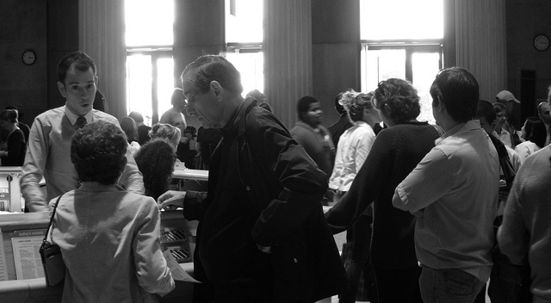
“…there has been a sustained interest in the theory versus practice issue throughout the history of LIS education…”
Notes:
Image: https://flic.kr/p/8Jnr86
“Since library and information science education is geared toward preparing professionals for practical positions, there has been a sustained interest in the theory versus practice issue throughout the history of library and information science education, especially in cataloging education” (Connaway 1997, 28-29).
Connaway, L. S. (1997). A model curriculum for cataloging education: The library and information services program at the University of Denver. Technical Services Quarterly,15 (1/2), 27-41.

Slide 4
“LIS education … must take place within a nexus of defining and dominant cultures—the culture of the university and [of the] practicing profession.”
Notes:
Image: http://www.onemanandhisblog.com/archives/2013/08/15/Library.jpg
“LIS education, taken as a set of cultural practices constituted by research, teaching, and service, must take place within a nexus of defining and dominant cultures—the culture of the university and [of the] practicing profession” (Raber and Connaway 1996, 121).
Raber, D., & Connaway, L. S. (1996). Two cultures, one faculty: Contradictions of library and information science education. Journal of Education for Library and Information Science, 37(2), 120-130.

Slide 5
Academy vs. Practicing Profession
Competing definitions of service
Applied vs. pure research
Theoretical vs. practical education
Notes:
Image: http://rack.3.mshcdn.com/media/ZgkyMDEyLzEyLzA0Lzc3L2hvd3RvbWFpbnRhLmJSUi5qcGcKcAl0aHVtYgkxMjAweDYyNyMKZQlqcGc/4d464e8b/22c/how-to-maintain-traditional-customer-service-in-the-social-media-age-4e5c7afd02.jpg
History of LIS Education
Collision of two cultures (120).
Cultural identity crisis of library—competing expectations (120).
While the need for a knowledge base is recognized, the central legitimating value of the profession is demonstrated utility in terms of service to users (120).
Systematic and structural problem (120).
Universities seek to define niches while libraries seek to serve customers (120).
Relationship with the University
Library as subculture of the university—LIS practiced in and through universities (122)
Close and insecure relation expected due to academic socialization in LIS, personal aspirations & fear of LIS might not meet universities criteria for acceptance as a “discipline” (122)
Model of scholarship that is no longer appropriate, dominant & in need of change (122).
Relative value of research compared to teaching (122)
Relationship with the Profession
Tension, hostility
LIS Ed expected to prepare qualified personnel for entry level positions
Changing conditions of profession (telecommunications) motivate practitioners to demand more conventional delivery of professional education.
Practitioners regard as irrelevant what educators regard as important
Research often challenged and ignored unless direct service to solution of practical problem.
Right of passage vs. meaningful educational experience (122)
Raber, D., & Connaway, L. S. (1996). Two cultures, one faculty: Contradictions of library and information science education. Journal of Education for Library and Information Science, 37(2), 120-130.

Slide 6
Crying Wolf about an Educational Crisis
Notes:
Image: http://images.publicradio.org/content/2012/01/31/20120131_wolf4_33.jpg
Dillon, A., & Norris, A. (2005). Crying Wolf: An Examination and Reconsideration of the Perception of Crisis in LIS Education. Journal of Education for Library and Information Science, 46(4), 280-298.

Slide 7
“Rather than raising optimism about the status of the field, critics continue to cite curricular problems, lack of relevant research, gender inequality, and an obsession with technology…”
Notes:
Image: http://www.gannett-cdn.com/-mm-/105488b15e78a7e3ab2b935fe88405d14dd0d2d7/c=0-26-336-279&r=x404&c=534x401/local/-/media/USATODAY/test/2013/11/06/1383750429000-criticism.jpg
“…We argue that the lack of formal definition is an indicator of the dynamic nature of the profession and that claims of a host-parasite relationship between librarianship and information science are misleading and represent a failure to recognize the shift in the practices and needs of librarianship within a technology-rich cultural environment” (Dillon and Norris 2005, 282).
“The quality facet of the crisis issue is far less discussed but no less important to understanding the state and status of LIS Ed at this time” (295).
By equating info. science with technology Gorman creates a self-fulfilling prophecy by arguing that we are witnessing a surge of teaching in technology-oriented courses (294).
“Crisis” can be positive when referring to turning points or decisive moments (295).
Andy Dillon & April Norris, Cry Wolf
Three Central themes for Current Crisis from Michael Gorman (former ALA president)
Librarianship has been pushed out by incursion of information studies
Lack of research of library issues
Gender divide exists which places female faculty on the library side of the scholarship divide (with potential for schools to become male-dominated as library education is replaced by information science/studies education)
LIS program fails to address adequately education of librarians
Dillon, A., & Norris, A. (2005). Crying Wolf: An Examination and Reconsideration of the Perception of Crisis in LIS Education. Journal of Education for Library and Information Science, 46(4), 280-298.

Slide 8
“There is a dearth of research in US LIS schools that is dedicated to the real needs of real libraries.”
Notes:
Image: http://www.renewableenergyworld.com/assets/images/story/2012/4/11/1332-crossing-the-valley-of-dearth.jpg
“There is a dearth of research in US LIS schools that is dedicated to the real needs of real libraries. This is the result both of the divorce between information science-oriented faculty and practicing librarians and of the fact that LIS schools in the USA tend to be part of large universities that value (and reward) pure research over applied research” (Gorman 2004, 6; Dillon and Norris 2005, 283-84).
Dillon, A., & Norris, A. (2005). Crying Wolf: An Examination and Reconsideration of the Perception of Crisis in LIS Education. Journal of Education for Library and Information Science, 46(4), 280-298.
Gorman, M. (2004). “Whither Library Education?” New Library World (105), 376-380.

Slide 9
Crisis as a Moment of Change
Contemporary Issue
Technological revolution
Longstanding Issue
Quality control
(Dillon and Norris 2005)
Notes:
Image: http://www.photo-dictionary.com/photofiles/list/488/869bulls_eye.jpg
“If any crisis exists, it is not reflected in these indices. However, the eternal existence, imaginary or otherwise, of crisis in LIS education must itself be indicative of some underlying state of affairs that show no signs of fading. It is the present authors’ view that at the heart of the current discourse lies two issues, one contemporary, relating to the technological revolution overtaking our field; the second longstanding, relating to quality control. In combination they offer two facets of the conception of crisis as it pertains to our field” (Dillon and Norris 2005, 294).
Dillon, A., & Norris, A. (2005). Crying Wolf: An Examination and Reconsideration of the Perception of Crisis in LIS Education. Journal of Education for Library and Information Science, 46(4), 280-298.

Slide 10
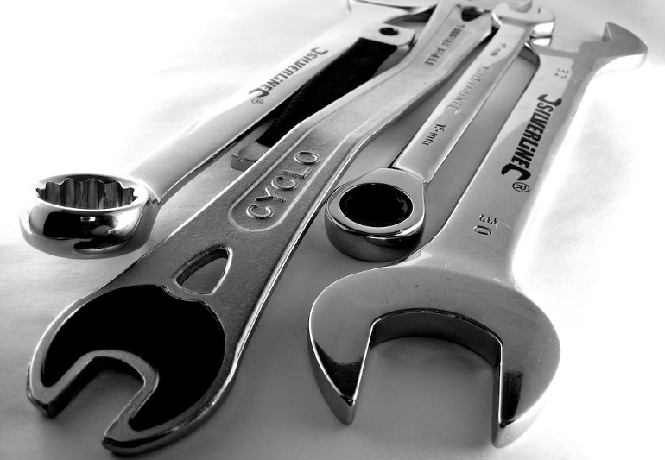
“…it would seem difficult to justify any other response from LIS programs than one of embracing the tools and opportunities for study and use they enable.”
Notes:
Image: http://www.timbalabs.com/wp-content/uploads/2013/01/08_Timbalabs_Technology_Services.jpeg
Internet has given rise to easy access of materials, from one’s location (294).
Cheap, widely available information & communication technologies (294).
Students arrive in LIS programs with skill in routine technologies (294).
“Technology has permeated all we do in this field; it is foundational for the discipline in the twenty-first century, not a component that can be ignored or taught separately, under the heading “information science,” in our schools” (Dillon and Norris 2005, 294).
Dillon, A., & Norris, A. (2005). Crying Wolf: An Examination and Reconsideration of the Perception of Crisis in LIS Education. Journal of Education for Library and Information Science, 46(4), 280-298.

Slide 11
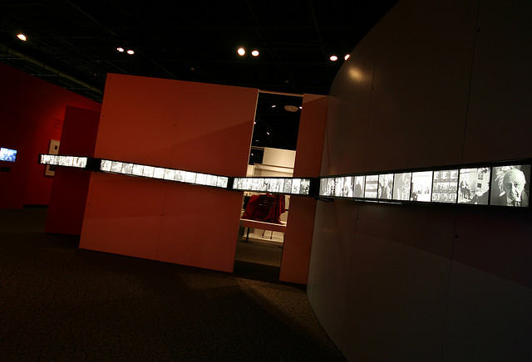
“…Casting the field into two divided camps is nothing new, but it is no longer clear that this division reflects the reality of many LIS programs.”
(Dillon and Norris 2005, 283)
Notes:
Image: Canada Science and Technology Museum, Karsh: Image Maker http://goo.gl/RhiIlE
Information science movement viewpoint: libraries are only part of the system
Superficial, paradigmatic differences
“The more complicated claim to unravel relates to paradigmatic dominance, which implies that information science has taken over library education, and in so doing, has pushed the concerns of libraries aside. This casting of the field into two divided camps is nothing new, but it is no longer clear that this division reflects the reality of many LIS programs” (Dillon and Norris 2005, 283).
Dalton, M. S. (1992). Change and challenge in library and information science education. Chicago: American Library Association.
Dillon, A., & Norris, A. (2005). Crying Wolf: An Examination and Reconsideration of the Perception of Crisis in LIS Education. Journal of Education for Library and Information Science, 46(4), 280-298.

Slide 12
“Profound changes in the information world call for profound changes in the education of those that will enter this new world.”
Notes:
Image: https://www.flickr.com/photos/praline3001/3602504196/in/photolist-7xYzD1-6ukLZj-2RFo-o6A3WF-dUZcA5-6U7L6n-9Qdr7E-9Qdr8d-9Qdr7j-9Qdr5U-aDTB3i-4cw3s-5svNUd-kdee1-7GPe8Y-5echyn-bL78cc-kUZvS-byEgPj-S2irG-S2pty-5zo7u3-9uVdLa-c1k3b-obpq7-q3JqY-2WgUbk-jGsmZ-7LCbU3-9CktE-awPw7u-6UpTcn-9PbGKK-6UpNNt-gv3DbZ-9rDekN-acdJc5-388UUr-bzpjnt-6HnQQu-aMY2c6-awLMA4-Aj8p5-6v1xT-9fN4c-7xw4z-c6juSA-9Tdb54-3xvU-5aXN5j/
Core Values:
Organization of information
Universal Access
Collaboration
Intellectual freedom
Self-directed learning and stewardship
Moran, B.; Marchionini, G. (2012). "Information professionals 2050: educating the next generation of information professionals". Information Services & Use, vol. 32: 95–100.

Slide 13
Current Information Environment
Reduced funds
Budget cuts
Hiring freezes
Alternative resources
Alternative services
(Connaway 2014)
Notes:
Image: http://www.trunews.com/wp-content/uploads/2014/03/ist2_6028516-pencil-eraser.jpeg
Reduced funds
Budget cuts
Hiring freezes
Alternative resources
Open web
Alternative services
Social question and answer sites
Membership services, such Netflix, Amazon, etc.
Connaway, L. S. (2014). Why libraries? A call for use-centered assessment. Textos Universitaris de Biblioteconomia I Documentacio, 32. [Available: http://bid.ub.edu/en/32/connaway3.htm]

Slide 14
Library directors rated less than half of entry-level librarians as adequately trained for the job.
Notes:
Image: http://static.guim.co.uk/sys-images/Guardian/Pix/pictures/2012/2/6/1328540927215/Rear-view-of-graduates-in-007.jpg
“Studies indicated that Library Directors rated less than half the entry-level librarians they hired as satisfactorily trained for their positions” (Connaway 1997, 29).
Education more theoretical than practical (Powell & Creth 1986)
Connaway, L. S. (1997). A model curriculum for cataloging education: The library and information services program at the University of Denver. Technical Services Quarterly,15 (1/2), 27-41.
Powell, R. R. & Creth, S.D. (1986). Knowledge bases and library education. College & Research Libraries 47: 16-27.

Slide 15
“[The library] can’t count on MLS/MLIS program[s] to deliver what is needed.”
-ARL Director
Notes:
Image: http://img.timeinc.net/time/daily/2009/0912/bad_schools_1203.jpg
ARL directors believed that the qualifications and preparation of the graduates of the LIS programs were uneven; some programs prepared students better than others, they felt. One director commented that the library, “can’t count on MLS/MLIS program[s] to deliver what is needed” (Mullins, 2012, p. 131).
Mullins, J.L. (2012). 'Are MLS graduates being prepared for the changing and emerging roles that librarians must now assume within research libraries?', Journal Of Library Administration, 52, (1): 124-132.

Slide 16
Qualified job candidates lack the requisite people skills that would allow them to serve as liaisons for the library
Notes:
Image: http://www.workopolis.com/wp-content/uploads/2013/06/4c98377947ed8f5ee3b5c41a6b1f.jpg
Nine ARL directors, which were hiring for new positions, were asked if they had a pool of qualified candidates (Mullins, 2012). They responded that candidates lacked the requisite people skills that would allow them to serve as liaisons for the library; they were unable to be proponents for the libraries with a department or with faculty. “Out of the number of positions identified by the respondents, approximately 75% were filled by satisfactory to outstanding candidates” (Mullins, 2012, p. 130).
Mullins, J.L. (2012). 'Are MLS graduates being prepared for the changing and emerging roles that librarians must now assume within research libraries?', Journal Of Library Administration, 52, (1): 124-132.

Slide 17
70% of professionals agree that recent MLS graduates are prepared for work in a public or school library
22% did not feel the graduates were prepared
Notes:
Image: http://thevouchershop.co.uk/wp-content/uploads/2013/09/BadEducation-589x328.jpg
MLS graduate students at St. John’s University surveyed professionals in public and school libraries to find their perceptions of student’s preparedness to enter the LIS field (Creel and Pollicino, 2012). They found that 70.4 percent of professionals agree that recent MLS graduates are prepared for work in a public library, or a school library, while 21.6 percent did not feel the graduates were prepared (Creel and Pollicino, 2012). They also found that “92.2 percent of the professionals and 87.3 percent of students (completely and somewhat agreeing) feel that recent MLS graduates bring technology expertise to their job” (Creel and Pollicino, 2012, p. 63).
However, it may be true that prior experience in library setting (schools and libraries) creates a higher perceived preparedness; public library students may feel “that dealing with problem situations is primarily learned on the job” (Creel and Pollicino, 2012, p. 66). The more time an MLS student spends gaining teaching experience, the less likely they are to think that recent graduates are prepared for the realities of working in the public or school library (Creel and Pollicino, 2012).
Creel, S. & Pollicino, E. (2012). 'Practitioners' & LIS students' perceptions on preparedness in the New York metropolitan area', Education For Information, 29(1):53-69

Slide 18
Students need leadership, customer service, public administration and human resources training
Notes:
Image: http://www.manjrasoft.com/images/manjrasoft_education_training.jpg
Rural librarians in TN report that students in LIS education need more training to work effectively (Mehra et al, 2011).
Students needed, “managerial and administrative topics, public services, and technical services” training (Mehra et al, 2011, p. 274).
One librarian commented, “"I think I need to have 25 hours in public administration. I need to know law, I need to know policies and procedures. I need to know more about how to work with government officials, organizational change. Of course, I've had a lot of experience now, but it would have helped if I had had some classes in that” (Mehra et al, 2011, p 274).
LIS coursework needs to be more practical, providing management/leadership development and knowledge/experience with ICTs (Mehra et al, 2011).
“…one professional noted: "one thing that I do fall back on the MLS degree gives me the theoretical understanding of why 1 do what I do. But, what I deal with every day in terms of administration, I've had 17 years of on the job training and it's been good, but it would have been nice -- we say all the time 'they didn't teach this in library school.' We need to have both the theoretical and the practical" (Mehra et al, 2011, p.275).
“A librarian summarized: "Because in the level 5 libraries what purpose is the MLS serving? Are you giving me the MLS that, if I didn't already know management skills, are you giving me the management skills that I could handle HR situations? The answer to that is no. Are you giving me the skills 1 would need in budgeting? The answer to that is no. I mean, what you're giving me is the library science world, and I can do that, I mean I'm learning that, but are you giving me the other things to make me the total professional I need to be?" (Mehra et al, 2011, p. 275).
Mehra et al.’s (2011) qualitative study identified critical information needs:
IT competencies and management skills
understanding the broader context in which local and regional events occur
practical training and computers
and more IT education (e.g., how to make short instructional podcasts) (276).
Mehra, B., Black, K., Singh, V. & Nolt, J. (2011). 'What is the value of LIS dducation? A qualitative study of the perspectives of Tennessee's rural librarians', Journal Of Education For Library & Information Science, 52(4): 265-278.

Slide 19
Current Expectations of Information Professionals
Demonstrate institutional value
Define outcomes
Measure attainment of goals
Notes:
Image: http://static.squarespace.com/static/507d1b2ce4b043a005873686/t/517ce038e4b065cfbf61f944/1367138362601/data-quality-assessment-user-guide
Librarians are increasingly called upon to document & articulate the value of academic & research libraries and their contribution to the institutions mission & goals (ACRL Value of Academic Libraries 2010, 6).
Emphasis has shifted from input & output assessment to quality assessment.
Input measures evaluate the library’s raw materials & output measures quantify the work done.
To demonstrate institutional value, librarians must "define outcomes of institutional relevance and then measure the degree to which they attain them” (Kaufman & Watstein 2008, 227).
Association of College and Research Libraries (ACRL) (2010). Value of Academic Libraries: a Comprehensive Research Review and Report. Researched by Megan Oakleaf. Chicago: Association of College and Research Libraries. - See more at: http://bid.ub.edu/en/32/connaway3.htm#sthash.4DW7ZhjK.dpuf
Connaway, L. S. (2014). Why libraries? A call for use-centered assessment. Textos Universitaris de Biblioteconomia I Documentacio, 32. [Available: http://bid.ub.edu/en/32/connaway3.htm]
Connaway, L. S. ; Radford, M. (2013). Academic library assessment: beyond the basics. [Powerpoint presentation], Raynor Memorial Libraries, Marquette University, [18 July 2013].
Hufford, J. (2013). "A review of the literature on assessment in academic and research libraries, 2005 to August 2011". Libraries & the Academy, 1: 5–35
Kaufman, P.; Watstein, S. B. (2008). "Library value (return on investment, ROI) and the challenge of placing a value on public services". Reference Services Review, 36(3): 226–231.
Pung, C.; Clarke A.; Patten, L. (2004). "Measuring the economic impact of the British Library". New Review of Academic Librarianship, vol. 10 (1): 79–102

Slide 20
“Courses in LIS curriculum should be based on identifying and meeting users' and prospective users' expectations and needs.”
Notes:
Image:https://www.flickr.com/photos/67769573@N00/125105125/in/photolist-zGf9x-c4coV-g6AcU-4X2Cov-GXwa5-77PDmR-6v61Qc-7pQSQ-mYAx8F-5nNg9d-9i9QUS-hzzdw-e6Cw1P-nWqW-bEiVMw-bQwjT8-Bh2X-2YqSEp-hyDf3-4z92tM-ChRp-ecTkhQ-7RYdBd-4uUZez-Ma4VN-bW9FyY-4RSiX7-5KS8Fa-47VSWb-5yoRuU-9WuVeh-sMGiY-9hbvmj-5qQvgh-9UynLq-72yNrw-a9p7AF-6vabe9-46kgBe-a6URXp-4wVccL-4RRB1L-6m6k8k-6gz3yq-chf4im-5hiMD1-a9rS4j-n5aif5-nZypy-5KS8nD/
“All courses offered in the LIS curriculum should be based on identifying and meeting users' and prospective users' expectations and needs. No service, system, or collection should be offered, developed, or made accessible without consideration of the intended users” (Connaway 2014).
Connaway, L. S. (2014). Why libraries? A call for use-centered assessment. Textos Universitaris de Biblioteconomia I Documentacio, 32. [Available: http://bid.ub.edu/en/32/connaway3.htm]

Slide 21
Why?
Notes:
Image: By William Sun https://flic.kr/p/8kjmJ6

Slide 22
LIS professionals must have knowledge & skills to lead formal assessment
Notes:
Image: https://www.flickr.com/photos/beantin/7649183772/in/photolist-dsatqq-cDW4QQ-fJ36Qb-6eKCzn-h9s7Sx-4eKvsb-5Wo9Ei-67XfDi-53k7zL-dbSbdC-hK4qbP-9YXQ53-48oXAw-ry54T-7hDmf1-dYHSv-a25Kam-73wGq9-382XJt-7tnTKo-5v8GVM-5j2AcV-75LjgC-kjjH9x-QGaM-sCjJb-dsEzbF-9oBvU-akHdhj-68xzF-auAY4T-9EZz2k-3K4zxR-v6a5U-8GDiVv-o1EPkw-hfNKc-5iLRQX-783LBs-3PkyNQ-mQ3y4n-6YuriA-hBGbbD-jKnHh-jDwYG-2RpAUr-763Kkr-vH3VV-9xfAyj-h6bbJ1/
Education & training have not kept pace with the need
Must be user-centered
LIS professionals can be distracted by day-to-day responsibilities & forget real reason for library existence—to meet needs of users
Connaway, L. S. (2014). Why libraries? A call for use-centered assessment. Textos Universitaris de Biblioteconomia I Documentacio, 32. [Available: http://bid.ub.edu/en/32/connaway3.htm]
Connaway, L. S.; Radford, M. (2013). Academic library assessment: beyond the basics. [Powerpoint presentation], Raynor Memorial Libraries, Marquette University, [18 July 2013].

Slide 23
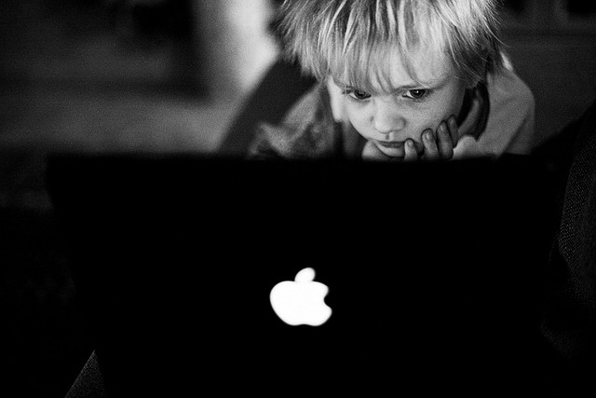
User-Centered Assessment
Library offerings
Services
Systems
Sources
Individual behaviors
Access
Use
Notes:
Image: https://www.flickr.com/photos/johnragai/14183700265/in/photolist-7Cg4kM-nBnaWi-5EbYHp-5Kwku8-8TJzKy-adyc5E-27xkVA-pkPNg-xcE8k-4z8WuM-qLniS-3xaF7f-mktnCr-9zAePZ-aycSBW-7U4PDk-61RweK-5Xk9qr-54459z-df7N3P-5UT2bk-avLhMr-u2M9Y-5Y15bt-a2Xd5F-8rXs42-3rbY1s-kfBhwV-iP9znn-63xusq-dQEWmS-eWJsD-a3SD8A-9tmvj-27xqiW-dyrwpr-3UAPjy-dzVKbf-8jYajY-2DGHqc-9GtjTT-o7vyhC-7ARCUQ-4G97Zi-o7qd44-o6ERTr-o7qPGt-o66jv6-o6juf7-6ADv4f/
Association of College and Research Libraries (ACRL) (2010). Value of Academic Libraries: a Comprehensive Research Review and Report. Researched by Megan Oakleaf. Chicago: Association of College and Research Libraries. - See more at: http://bid.ub.edu/en/32/connaway3.htm#sthash.4DW7ZhjK.dpuf
Connaway, L. S. (2014). Why libraries? A call for use-centered assessment. Textos Universitaris de Biblioteconomia I Documentacio, 32. [Available: http://bid.ub.edu/en/32/connaway3.htm]
Connaway, L. S. ; Radford, M. (2013). Academic library assessment: beyond the basics. [Powerpoint presentation], Raynor Memorial Libraries, Marquette University, [18 July 2013].
Hufford, J. (2013). "A review of the literature on assessment in academic and research libraries, 2005 to August 2011". Libraries & the Academy, 1: 5–35
Kaufman, P.; Watstein, S. B. (2008). "Library value (return on investment, ROI) and the challenge of placing a value on public services". Reference Services Review, 36(3): 226–231.
Pung, C.; Clarke A.; Patten, L. (2004). "Measuring the economic impact of the British Library". New Review of Academic Librarianship, vol. 10 (1): 79–102

Slide 24
Issues Affecting Curriculum Development
Fear technology leads to deprofessionalization
Increased dependence on networks
Notes:
Image: http://www.channel4.com/media/images/Channel4/4homes/diy-and-self-build/diy-building-advice/a-z-of-diy-building-guides/a-guide-to-diy-stores/hammer-nails-lg_A2.jpg
Issues & assumptions concerning bibliographic organization & control affect the development of the curriculum for education of future catalogers.
Increased dependence on networks has deprofessionalized cataloging
Assumption that a majority of library materials are cataloged on networks, enabling library assistants or clerks to adequately perform copy cataloging and diminishing the need for professional catalogers.
Belief that technical services remains a bureaucratic division of library operations (Stenstorm 1987).
Divisions within tech. services resulted in a perceived decrease in library performance (Younger 1990).
Connaway, L. S. (1997). A model curriculum for cataloging education: The library and information services program at the University of Denver. Technical Services Quarterly,15 (1/2), 27-41.
Stenstrom, P.F. (1987). Current management literature for technical services. Illinois Libraries, 69 (February): 96-103.
Younger, J. (1990). University library effectiveness: A case study of the perceived outcomes of structural change. PhD. Diss., University of Wisconsin.

Slide 25
LIS curriculum should include problem-solving that requires decision-making skills & flexibility—an intellectual exercise
Notes:
Image: https://flic.kr/p/5JVByJ by John McStravick
Theory & practice, neither can be ignored
Knowledge & skills
Cooperation of practitioners & educators
The University of Denver’s LIS program:
Interdisciplinary
Traditions should be retained & fostered
Curriculum should prepare students to appreciate global economies, diverse perspectives & multiculturalism in the workplace
Connaway, L. S. (1997). A model curriculum for cataloging education: The library and information services program at the University of Denver. Technical Services Quarterly,15 (1/2), 27-41.

Slide 26
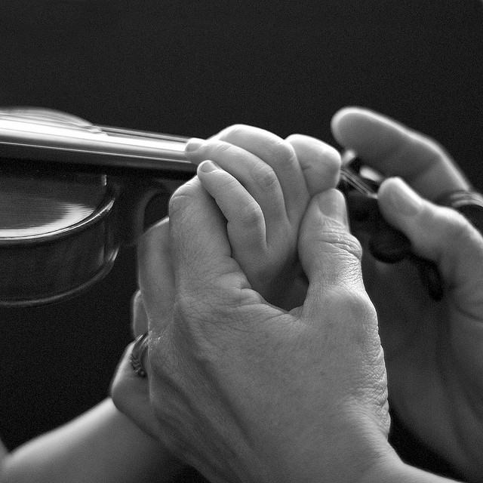
Teaching vs. Training
Notes:
Image: https://flic.kr/p/5x26iD by Nathan Russell
There is a difference between teaching and training
Faculty encourage to contribute directly and actively to the knowledge of the practicing profession (Raber and Connaway)
Applied research & services are encouraged & explicitly addressed in the contract that outlines faculty responsibilities & evaluation criteria (Raber and Connaway)
Teaching, research & service will be given equal value in faculty evaluations, conducted by peers & students (Raber and Connaway)
Information organizations have responsibility for on-the-job training
Academic institututions have responsibility for educating.
The two must work together.
Raber, D., & Connaway, L. S. (1996). Two cultures, one faculty: Contradictions of library and information science education. Journal of Education for Library and Information Science, 37(2), 120-130.

Slide 27
Research Methods
Skills & confidence to conduct research
Match questions to method
Theoretical foundation
Notes:
Image: http://www.google.com/url?sa=i&rct=j&q=&esrc=s&source=images&cd=&cad=rja&uact=8&docid=1w-MNsctD_OS5M&tbnid=S5DZeJ_E2MLU7M:&ved=0CAUQjRw&url=http%3A%2F%2Fagbeat.com%2Fentrepreneur%2Fentrepreneurs-often-lack-empathy-and-organization-skills%2F&ei=WOTXU5auHYfqoASKkoLoCg&bvm=bv.71778758,d.b2U&psig=AFQjCNEeRiz_ldcuK63QENBlC8sXWAaAJg&ust=1406744021168176
Courses on assessment of services
Lack of skills to conduct research & inadequate education in research methods
Research method courses provide theoretical foundation & confidence for practicing librarians
Importance of matching research questions to the appropriate research method
Berg, S.A.; Jacobs, H.; Cornwall, D. (2013). "Academic librarians and research: a study of Canadian Library administrator perspectives". College & Research Libraries, (74)6: 560–572
Connaway, L. S. (2014). Why libraries? A call for use-centered assessment. Textos Universitaris de Biblioteconomia I Documentacio, 32. [Available: http://bid.ub.edu/en/32/connaway3.htm]
Connaway, L. S.; Radford, M. (2013). Academic library assessment: beyond the basics. [Powerpoint presentation], Raynor Memorial Libraries, Marquette University, [18 July 2013].
Powell, R.; Baker, L.; Mika, J. (2002). "Library and Information Science Practitioners and Research". Library and Information Science Research, (21)1: 49–72

Slide 28
Opportunities for Librarians
Asses value of services
Develop new services based on assessment
Narrative-based marketing
Reinforce value propositions
(Connaway 2014)
(Germano, 2010)
Notes:
Image: http://4.bp.blogspot.com/-zdFmCFSvdSY/UjpC9nP9YiI/AAAAAAAAIKc/9TacctuC3dM/s1600/Opportunity.jpg
Time of economic hardship can provide opportunity for libraries to:
Assess current services & systems an develop new and better ones
New narrative-based marketing strategies, making individuals more aware of services (Germano, 2010).
Reinforce consistent value propositions
In order to accomplish this, LIS professionals must know how to assess the value and use of these services and systems” (Connaway 2014).
Connaway, L. S. (2014). Why libraries? A call for use-centered assessment. Textos Universitaris de Biblioteconomia I Documentacio, 32. [Available: http://bid.ub.edu/en/32/connaway3.htm].
Germano, M. (2010). "Narrative-based library marketing: selling your library's value during tough economic times". Bottom Line: Managing Library Finances, 23(1): 5–17.

Slide 29
“A mixed economy of institutional and national data management capabilities is emerging.”
Notes:
Image: https://c1.staticflickr.com/9/8446/7943659180_9e2c43d454_z.jpg
Hyams, E., Martinez-Uribe, L., & Macdonald, S. (2008). Data librarianship: a gap in the market. CILIP Update.

Slide 30
New Opportunities: Data Librarianship
Notes:
Image: http://laus.la.psu.edu/network/global/research/shutterstock_99385463.jpg

Slide 31
“[Data Librarians] deal with selection, acquisition and management of a multi-disciplinary collection of electronic data resources.”
Notes:
Image: https://flic.kr/p/i3N6NQ by Bob Mical
Hyams, E., Martinez-Uribe, L., & Macdonald, S. (2008). Data librarianship: a gap in the market. CILIP Update.

Slide 32
Data Librarianship
Data Deluge
Manage
Share Data
Fluidity
Harvesting, curating & facilitating access to datasets
Support research
(Hyams, Martinez-Uribe and Macdonald 2008)
Notes:
Image: https://flic.kr/p/54QttY by Blaise Alleyne
Recognized capacity of digital technology for sharing
Data is more than just statistics
Adding data curation to their curricula
Open data movement has put data librarians in the spotlight
Hyams, E., Martinez-Uribe, L., & Macdonald, S. (2008). Data librarianship: a gap in the market. CILIP Update.

Slide 33
Data Librarianship
Adequate training
Funding
Growing Infrastructure
(Hyams, Martinez-Uribe and Macdonald 2008)
Notes:
Image: https://flic.kr/p/6SbT95 by Kevin Dooley
Adequate training
Disc-UK
UK data Librarians
Diverse backgrounds
Stumbled into field
Funding
Pressured political climate
Pressure from funding councils for progress
UK’s library schools adapt to the political climate and follow the Universities of California at Berkeley and Illinoise at Urbana Champagne in including data management modules in LIS courses
Growing Infrastructure
Canada: six data libraries
Canadian government
RDS (Research Data Services) as a new set of strategic services (Association of Research Libraries 2010)
75% of ARL Librarians (US & Canada) said RDS not as an integral part of librarian job responsibilities but believe they know knowledge, skills & opportunities to provide RDS in the future (Tenopir et al., 2013)
Disk-UK is a small group of specialist data librarians that hope to set up a programme with a data provider to train more trainers—those whose role it is to support individual institutions’ own data providers.
Hyams, E., Martinez-Uribe, L., & Macdonald, S. (2008). Data librarianship: a gap in the market. CILIP Update.
Tenopir, C., Allard, S., Birch, B., & Sandusky, R. J. (2013). Academic librarians and research data services: Preparation and attitudes. Ifla Journal, 39, 1, 70-78.

Slide 34
“…challenges evolve as technology and information practices changed.”
Notes:
Image: http://img.gawkerassets.com/img/18qm7mlihns27jpg/original.jpg
Data Librarians Initiative (DIL) is a program introduced in the mid-1990’s between Statistics Canada and post-secondary institutions in Canada.
Provides access to large volume of quantitative and spatial data through university libraries
Implemented and supported by academic libraries
DLI illustrates the value of peer-to-peer training in building a national baseline level of service skills for a specific collection
Boyko, E.S.; Hamilton, E.; Humphrey, C. & Watkins, W. (2003). Lifting ourselves by our bootstraps: Developing a national peer-to-peer training program for data librarians in Canada. In Best Practices in Government Information: A Global Perspective, Walter de Gruyter GmbH & Co. KG, Saur Verlag, Muchen.

Slide 35
“Data Librarian (HEW Level 6)”
The Data Librarian position is responsible for investigating and assisting with implementation of Library support services relating to description, storage and sharing of research metadata and datasets.
Main Duties:
Analyse information requirements relating to research data management by academics and assist with documentation of system specifications to meet these needs.
• Liaise extensively with research and Library staff to identify and collect information about data collections at the University.
Notes:
Image: http://timhorvath.com/files/2013/03/No-News-Today-Picture1.jpg
JOB TITLE: Data Librarian (HEW Level 6)
JOB PURPOSE
The Data Librarian position is responsible for investigating and assisting with implementation of Library support services relating to description, storage and sharing of research metadata and datasets.
MAIN DUTIES
• Analyse information requirements relating to research data management by academics and assist with documentation of system specifications to meet these needs.
• Liaise extensively with research and Library staff to identify and collect information about data collections at the University.
• Assist with administration, analysis and reporting on Library study of academic research data management practices at the University.
• Develop, package, test and evaluate training resources for academic and Library staff to support standards‐based research data management practices at the University.
• Investigate, document and assist with development of a register of metadata schemas for research dataset management.
• Create and edit metadata records for data collections to meet quality standards defined by the Australian National Data Service (ANDS).
• Assist with development, testing and documentation of services for registering and storing research metadata and datasets.
• Cooperate with all health and safety policies and procedures of the University and take all reasonable care that their actions or omissions do not impact on the health and safety of others in the University.
• Other duties as required, appropriate to the level of the position.

Slide 36
g
“Integrating a user-centered focus into …core values will prepare LIS professionals to play a major role in the development and assessment of library services and systems.”
Notes:
Image: http://katiaraina.files.wordpress.com/2012/11/butterfly.jpg
Connaway, L. S. (2014). Why libraries? A call for use-centered assessment. Textos Universitaris de Biblioteconomia I Documentacio, 32. [Available: http://bid.ub.edu/en/32/connaway3.htm]

Slide 37
“With basic research knowledge and a user-centered theoretical foundation, LIS professionals will be able to articulate the value of libraries.”
Notes:
Image: https://flic.kr/p/f94Lhf by Yuri Levchenko
They will have the knowledge, skills, and confidence to create an awareness of the existence of library services & systems
Articulate their benefits to users and prospective users.
Fulfilling Ranganathan's 5th law of library science —a library is a growing organism (Ranganathan, 1931)— by adapting and changing library services & systems to meet the ever-changing needs & expectations of users
There is no future without user behavior studies
Educators & practitioners have to work together
Instant & on the job training
Connaway, L. S. (2014). Why libraries? A call for use-centered assessment. Textos Universitaris de Biblioteconomia I Documentacio, 32. [Available: http://bid.ub.edu/en/32/connaway3.htm]
Ranganathan, S. (1931). The five laws of library science. London: Edward Goldston, Ltd.

Slide 38
References
Association of College and Research Libraries (ACRL) (2010). Value of Academic Libraries: a Comprehensive Research Review and Report. Researched by Megan Oakleaf. Chicago: Association of College and Research Libraries.
Berg, S.A.; Jacobs, H.; Cornwall, D. (2013). "Academic librarians and research: a study of Canadian Library administrator perspectives". College & Research Libraries, (74)6: 560–572
Boyko, E.S.; Hamilton, E.; Humphrey, C. & Watkins, W. (2003). Lifting ourselves by our bootstraps: Developing a national peer-to-peer training program for data librarians in Canada. In Best Practices in Government Information: A Global Perspective, Walter de Gruyter GmbH & Co. KG, Saur Verlag, Muchen.
Connaway, L. S. (1997). A model curriculum for cataloging education: The library and information services program at the University of Denver. Technical Services Quarterly,15 (1/2), 27-41.
Connaway, L. S. (2014). Why libraries? A call for use-centered assessment. Textos Universitaris de Biblioteconomia I Documentacio, 32. [Available: http://bid.ub.edu/en/32/connaway3.htm]
Connaway, L. S. ; Radford, M. (2013). Academic library assessment: beyond the basics. [Powerpoint presentation], Raynor Memorial Libraries, Marquette University, [18 July 2013].
Creel, S. & Pollicino, E. (2012). 'Practitioners' & LIS students' perceptions on preparedness in the New York metropolitan area', Education For Information, 29(1):53-69.
Dalton, M. S. (1992). Change and challenge in library and information science education. Chicago: American Library Association.
Dillon, A., & Norris, A. (2005). Crying Wolf: An Examination and Reconsideration of the Perception of Crisis in LIS Education. Journal of Education for Library and Information Science, 46(4), 280-298.
Germano, M. (2010). "Narrative-based library marketing: selling your library's value during tough economic times". Bottom Line: Managing Library Finances, 23(1): 5–17.
Gorman, M. (2004). “Whither Library Education?” New Library World (105), 376-380.

Slide 39
References
Hufford, J. (2013). "A review of the literature on assessment in academic and research libraries, 2005 to August 2011". Libraries & the Academy, 1: 5–35
Hyams, E., Martinez-Uribe, L., & Macdonald, S. (2008). Data librarianship: a gap in the market. CILIP Update.
Kaufman, P.; Watstein, S. B. (2008). "Library value (return on investment, ROI) and the challenge of placing a value on public services". Reference Services Review, 36(3): 226–231.
Mehra, B., Black, K., Singh, V. & Nolt, J. (2011). 'What is the value of LIS dducation? A qualitative study of the perspectives of Tennessee's rural librarians', Journal Of Education For Library & Information Science, 52(4): 265-278.
Moran, B.; Marchionini, G. (2012). "Information professionals 2050: educating the next generation of information professionals". Information Services & Use, vol. 32: 95–100.
Mullins, J.L. (2012). 'Are MLS graduates being prepared for the changing and emerging roles that librarians must now assume within research libraries?', Journal Of Library Administration, 52, (1): 124-132.
Powell, R.; Baker, L.; Mika, J. (2002). "Library and Information Science Practitioners and Research". Library and Information Science Research, (21)1: 49–72
Powell, R. R. & Creth, S.D. (1986). Knowledge bases and library education. College & Research Libraries 47: 16-27.
Pung, C.; Clarke A.; Patten, L. (2004). "Measuring the economic impact of the British Library". New Review of Academic Librarianship, vol. 10 (1): 79–102
Raber, D., & Connaway, L. S. (1996). Two cultures, one faculty: Contradictions of library and information science education. Journal of Education for Library and Information Science, 37(2), 120-130.
Ranganathan, S. (1931). The five laws of library science. London: Edward Goldston, Ltd.
Stenstrom, P.F. (1987). Current management literature for technical services. Illinois Libraries, 69 (February): 96-103.
Tenopir, C., Allard, S., Birch, B., & Sandusky, R. J. (2013). Academic librarians and research data services: Preparation and attitudes. Ifla Journal, 39, 1, 70-78.
Younger, J. (1990). University library effectiveness: A case study of the perceived outcomes of structural change. PhD. Diss., University of Wisconsin.

