Slide 1



Evaluating online behaviours
15/07/2014
#vandr
A visitors and residents approach

Slide 2


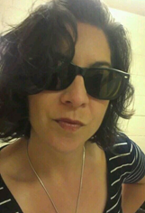
Welcome!
Lynn Silipigni Connaway, Ph.D.
Senior Research Scientist
OCLC Research
connawal@oclc.org
@LynnConnaway
David White
Head of Technology Enhanced Learning
University of Arts London
david.white@arts.ac.uk
@daveowhite
Donna M. Lanclos, Ph.D.
Associate Professor for
Anthropological Research
University of North Carolina, Charlotte
dlanclos@uncc.edu
@DonnaLanclos
#vandr
Visitors and Residents resources http://goo.gl/vxUMRD

Slide 3

About Digital Visitors and Residents
Identify how individuals engage
How they acquire their information
Why they make their choices
#vandr
Visitors and Residents resources http://goo.gl/vxUMRD
(White, Connaway, Lanclos, Hood, and Vass 2014)
Notes:
Image: https://www.flickr.com/photos/ameteorshower/7003279005/
V&R project
identify how individuals engage with technology and sources
how they acquire their information
why they make the choices that they do.
Understand the contexts that surround engagement with digital resources, spaces, and tools
(InfoKit Intro)
White, David S., and Lynn Silipigni Connaway. 2011-2014. Visitors & Residents: What Motivates Engagement with the Digital Information Environment. Funded by JISC, OCLC, and Oxford University. http://www.oclc.org/research/activities/vandr/.
White, David, Lynn Silipigni Connaway, Donna Lanclos, Erin M. Hood, and Carrie Vass. 2014. Evaluating Digital Services: A Visitors and Residents Approach. http://www.jiscinfonet.ac.uk/infokits/evaluating-services/.

Slide 4
V&R Framework
(White and Le Cornu 2011)
#vandr
Visitors and Residents resources http://goo.gl/vxUMRD
Notes:
This is a continuum and individuals may be display visitor or resident characteristics in different contexts and situations.
Visitors
functional use of technology
often linked to formal need
less visible/more passive online presence
more likely to favor face- to- face interactions
Residents
significant online presence and usage
high level of collaborative activity online
contributions to the online environment in the form of uploading materials, photos, videos.
White, David S., and Lynn Silipigni Connaway. 2011-2014. Visitors & Residents: What Motivates Engagement with the Digital Information Environment. Funded by JISC, OCLC, and Oxford University. http://www.oclc.org/research/activities/vandr/.

Slide 5
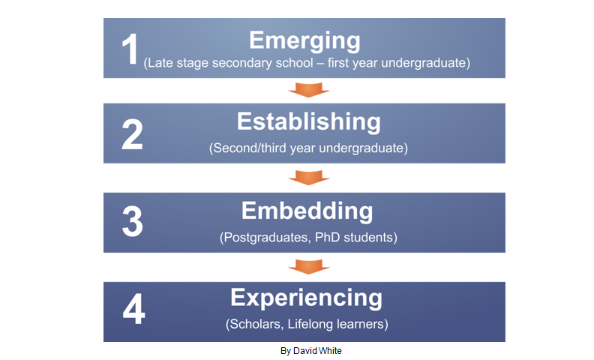
Educational Stages
Notes:
1. Emerging (Late stage secondary school/First year undergraduate);
2. Establishing (Second/third or third/fourth year undergraduate);
3. Embedding (Postgraduates, PhD students);
4. Experienced (Scholars).
White, David S., and Lynn Silipigni Connaway. 2011-2014. Visitors & Residents: What Motivates Engagement with the Digital Information Environment. Funded by JISC, OCLC, and Oxford University. http://www.oclc.org/research/activities/vandr/.

Slide 6
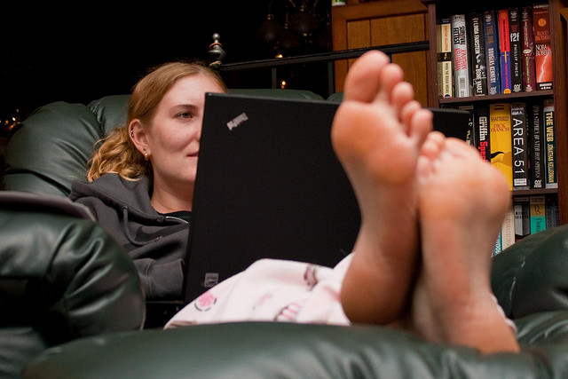
Data Collection Tools
4 Project Phases
  Semi-structured interviews
  Diaries/monthly semi-structured interviews
      Written
      Video
      Skype or telephone
  Second group of semi-structured interviews
  Online survey
(White and Connaway 2011-2014)
Notes:
Image: https://www.flickr.com/photos/colorblindpicaso/3399410617/
Data Collection Tools
Semi-structured interviews (initial interviews)
Diaries/monthly semi-structured interviews by Skype or telephone
Online survey (on-going)
White, David S., and Lynn Silipigni Connaway. 2011-2014. Visitors & Residents: What Motivates Engagement with the Digital Information Environment. Funded by JISC, OCLC, and Oxford University. http://www.oclc.org/research/activities/vandr/.

Slide 7
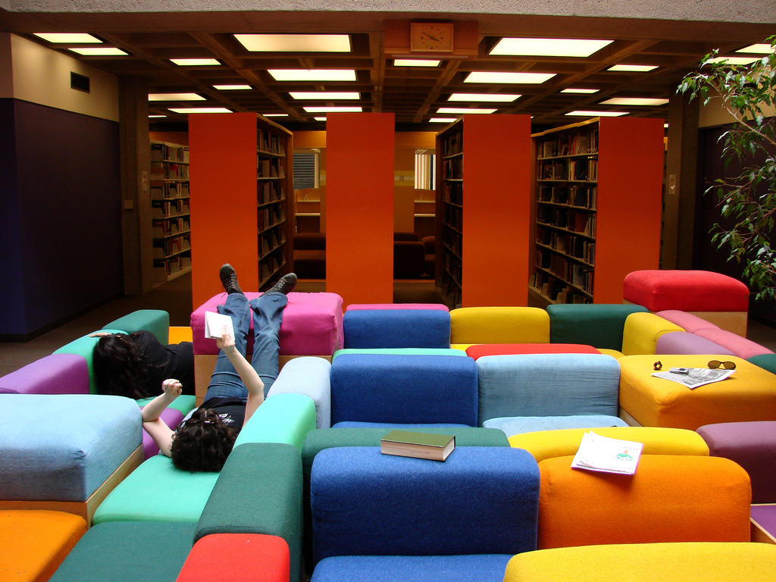
Project Phases
Phase 1: Interviews
  31 (16 US/15 UK) Emerging (Last year of secondary/high school & first year of university)
  10 (5 US, 5 UK) Establishing (2nd-3rd year undergraduates)
  10 (5 US, 5 UK) Embedding (Postgraduates, PhD students)
  10 (5 US, 5 UK) Experiencing (scholars)
  Some Phase 1 participants agreed to submit monthly diaries
(White and Connaway 2011-2014)
Notes:
Image: https://www.flickr.com/photos/istolethetv/519756811/
Phase 1
Individual Interviews
Emerging (secondary school/1st year undergraduates: 31 (16 US, 15 UK)
Establishing (2nd-3rd year undergraduates): 10 (5 US, 5 UK)
Embedding (postgraduates, PhD students): 10 (5 US, 5 UK)
Experiencing (scholars): 10 (5 US, 5 UK)
Phases 1 & 2: Participant Demographics
61 participants: 15 secondary students/46 university students & faculty
34 females/27 males
38 Caucasian/5 African-American/2 Multi-racial/1 Asian/2 Hispanic/13 Unidentified
White, David S., and Lynn Silipigni Connaway. 2011-2014. Visitors & Residents: What Motivates Engagement with the Digital Information Environment. Funded by JISC, OCLC, and Oxford University. http://www.oclc.org/research/activities/vandr/.

Slide 8

Participant Interview Questions
Selected Questions
2. Think of the ways you have used technology and the web for your studies. Describe a typical week.
4. Think of a time when you had a situation where you needed answers or solutions and you did a quick search and made do with it. You knew there were other sources but you decided not to use them. Please include sources such as friends, family, teachers, coaches, etc.
(White and Connaway 2011-2014)
Notes:
Image: https://www.flickr.com/photos/3ammo/12490957864/
1. Describe the things you enjoy doing with technology and the web each week.
2. Think of the ways you have used technology and the web for your studies. Describe a typical week.
3. Think about the next stage of your education. Tell me what you think this will be like.
4. Think of a time when you had a situation where you needed answers or solutions and you did a quick search and made do with it. You knew there were other sources but you decided not to use them. Please include sources such as friends, family, teachers, coaches, etc.
5. Have there been times when you were told to use a library or virtual learning environment (or learning platform), and used other source(s) instead?
6. If you had a magic wand, what would your ideal way of getting information be? How would you go about using the systems and services? When? Where? How?
White, David S., and Lynn Silipigni Connaway. 2011-2014. Visitors & Residents: What Motivates Engagement with the Digital Information Environment. Funded by JISC, OCLC, and Oxford University. http://www.oclc.org/research/activities/vandr/.

Slide 9

Diarists
Phase 2: Diaries & Follow-Up Interviews
22 Diarists (10UK/12 US):
66 diaries collected
53 follow-up diarist interviews conducted
Conducted and collected from April 2011 through October 2013
(White and Connaway 2011-2014)
Notes:
Image: https://www.flickr.com/photos/nalbertini/6317803326/
22 Diarists (10 UK/12 US)
Initially, email and Google Docs. Vague lists were returned.
More structure/better information:
Semi-structured interviews by Skype and phone or explicit questions to be addressed in the written diaries.
66 Diaries Collected
51 self-conducted diaries
5 written diary forms
6 Google diaries
4 video diaries
53 Follow-up Diarist Interviews Conducted
Conducted and collected from April 2011 through October 2013
White, David S., and Lynn Silipigni Connaway. 2011-2014. Visitors & Residents: What Motivates Engagement with the Digital Information Environment. Funded by JISC, OCLC, and Oxford University. http://www.oclc.org/research/activities/vandr/.

Slide 10

Diarist Monthly Interview Questions
Selected Questions
2. Think of a time fairly recently when you struggled to find appropriate resources to help you complete an ACADEMIC assignment. What happened?
3. Explain a time in the past month when you were successful in getting what you needed in a PERSONAL situation. What steps did you take?
(White and Connaway 2011-2014)
Notes:
Image: https://www.flickr.com/photos/couragextoxlive/3054488331/
Explain a time in the past month when you were SUCCESSFUL in completing an ACADEMIC assignment. What steps did you take?
Think of a time fairly recently when you struggled to find appropriate resources to help you complete an ACADEMIC assignment. What happened?
Explain a time in the past month when you were successful in getting what you needed in a PERSONAL situation. What steps did you take?
Explain a time in the past month when you were NOT successful in getting what you needed in a PERSONAL situation. What steps did you take?
Tell me something interesting that has happened in the past month in the social media that you used for ACADEMIC purposes.
Tell me something interesting that has happened in the past month in the social media that you used for PERSONAL situations.
What do you have to add to our discussion today about how you got information in the past month for both PERSONAL and ACADEMIC situations?
White, David S., and Lynn Silipigni Connaway. 2011-2014. Visitors & Residents: What Motivates Engagement with the Digital Information Environment. Funded by JISC, OCLC, and Oxford University. http://www.oclc.org/research/activities/vandr/.

Slide 11

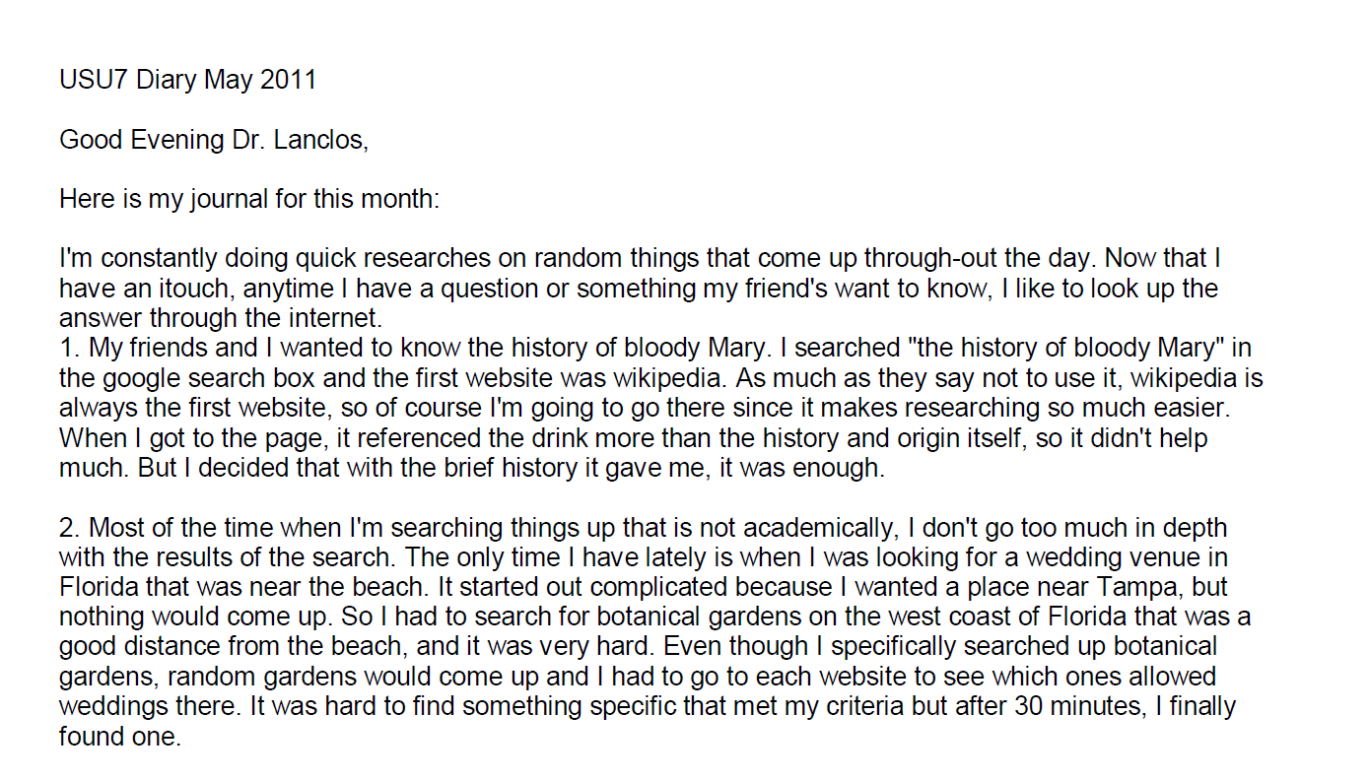
Diary Submission Example
(White and Connaway 2011-2014)
Notes:
Image: https://www.flickr.com/photos/limeflyphotography/14352660977/
Screenshot: USU7 Emg Dry1 Ph1 (Digital Visitors and Residents, USU7, Female, Age 19, Political Science)
“March was a little more serious. We’re nearing election time and all that jazz, and this is the first election I’ll be able to vote in, so I’ve been doing a bit of reading on a few of the candidates (not much, mind you). As a side note, I’m kind of debating whether or not I should actually vote in this election since I have such little knowledge on the candidates.” (Digital Visitors and Residents, USU12, Male, Age 19) USU12 Est Dry2 Ph2
“Um they do have a search box but I didn’t—I didn’t use that. Um I pretty much just, I pretty much just clicked links.” (Digital Visitors and Residents, USU12, Male, Age 19, 30:37) USU12 Est Follup Int1 Ph3
White, David S., and Lynn Silipigni Connaway. 2011-2014. Visitors & Residents: What Motivates Engagement with the Digital Information Environment. Funded by JISC, OCLC, and Oxford University. http://www.oclc.org/research/activities/vandr/.

Slide 12

Project Phases
Phase 3
  Interviews of second group of 12 Emerging stage students (6 US/6 UK)
Phase 4
  In-depth online survey
    50 participants representing each educational stage (100 US/100 UK)
(White and Connaway 2011-2014)
Notes:
Image: https://www.flickr.com/photos/hjl/7623844908/
Phase 3
Interviewed second group of 12 (6 US/6 UK) students in the Emerging stage
This will help to determine if methods of engagement are changing over time
Phase 4
In-depth online survey
50 participants representing each educational stage in both US & UK (100 US/100 UK)
White, David S., and Lynn Silipigni Connaway. 2011-2014. Visitors & Residents: What Motivates Engagement with the Digital Information Environment. Funded by JISC, OCLC, and Oxford University. http://www.oclc.org/research/activities/vandr/.

Slide 13
Phases 1-3 Demographics
Ages of Interview and Diary Participants
(White and Connaway 2011-2014)
Notes:
Discipline Type of Interview and Diary Participants
73 Interview Participants
21 secondary/high school students
22 Sciences
12 Arts/Humanities
16 Social Sciences
2 Undeclared
Age of Interview and Diary Participants
12-18 years old 12 UK/14 US
19-25 years old 11 UK/14 US
26-34 years old 3 UK/3 US
35-44 years old 4 UK/1 US
45-54 years old 3 UK/5 US
55-64 years old 3 UK/0 US
Ethnicity of Interview and Diary Participants
41 Caucasian
5 African-American
3 Hispanic
2 Multi-racial
21 Undeclared
White, David S., and Lynn Silipigni Connaway. 2011-2014. Visitors & Residents: What Motivates Engagement with the Digital Information Environment. Funded by JISC, OCLC, and Oxford University. http://www.oclc.org/research/activities/vandr/.

Slide 14
Phase 4 Demographics
Ages of Online Survey Participants
(White and Connaway 2011-2014)
Notes:
As of July 2014:
Online Survey
158 out of 200 collected to-date
Academic Discipline
15 High School (11 UK/4 US)
24 Social Sciences (5 UK/19 US)
12 Natural Sciences (3 UK/9 US)
28 Formal Sciences (20 UK/8 US)
56 Professions & Applied Sciences (25 UK/ 31 US)
23 Humanities (5 UK/18 US)
Gender
84 Female (24 UK/60 US)
74 Male (45 UK/29 US)
Age
24 12-18 years old (14 UK/10 US)
78 19-25 years old (38 UK/40 US)
23 26-34 years old (10 UK/13 US)
16 35-44 years old (6 UK/10 US)
7 45-54 years old (1 UK/6 US)
7 55-64 years old (0 UK/7 US)
3 64+ years old (0 UK/3 US)
White, David S., and Lynn Silipigni Connaway. 2011-2014. Visitors & Residents: What Motivates Engagement with the Digital Information Environment. Funded by JISC, OCLC, and Oxford University. http://www.oclc.org/research/activities/vandr/.

Slide 15

Why is this important?
Traditional stats don’t tell whole story
Answers questions:
  What do users/stakeholders want & need?
  How can services/programs better meet needs?
  Is what we do working?
  Could we do better?
  What are problem areas?
Notes:
Image: http://www.flickr.com/photos/moriza/96724309/
Traditional stats don’t describe performance
Training in assessment has not kept pace with needs.
Big time, effort, planning & $$ investment in formal evaluation.
Support & buy in from all.

Slide 16
infoKit
What is it?
    Contains advice on evaluating digital/online services within the broader context of traditional services.
Why did we create it?
    To understand the contexts surrounding individual engagement with digital resources, spaces and tools.
Who will use it?
    Librarians and information technology staff
Notes:
Image: Microsoft Clip Art
contains advice on evaluating the services offered
focus primarily is on digital/online services
set within the broader context of traditional services
lead to more effective engagement between individuals and institutions
identifying how individuals engage with technology
how they acquire their information
why they make the choices that they do
designed to help practitioners generate their own qualitative inquiries
to inform their own policy needs
to frame the organisation and its services within the institutional agendas surrounding student experience and engagement.
White, D., Connaway, L. S., Lanclos, D., Hood, E. M., & Vass, C. (2014). Evaluating digital services: A Visitors and Residents approach. Retrieved from http://www.jiscinfonet.ac.uk/infokits/evaluating-services/

Slide 17
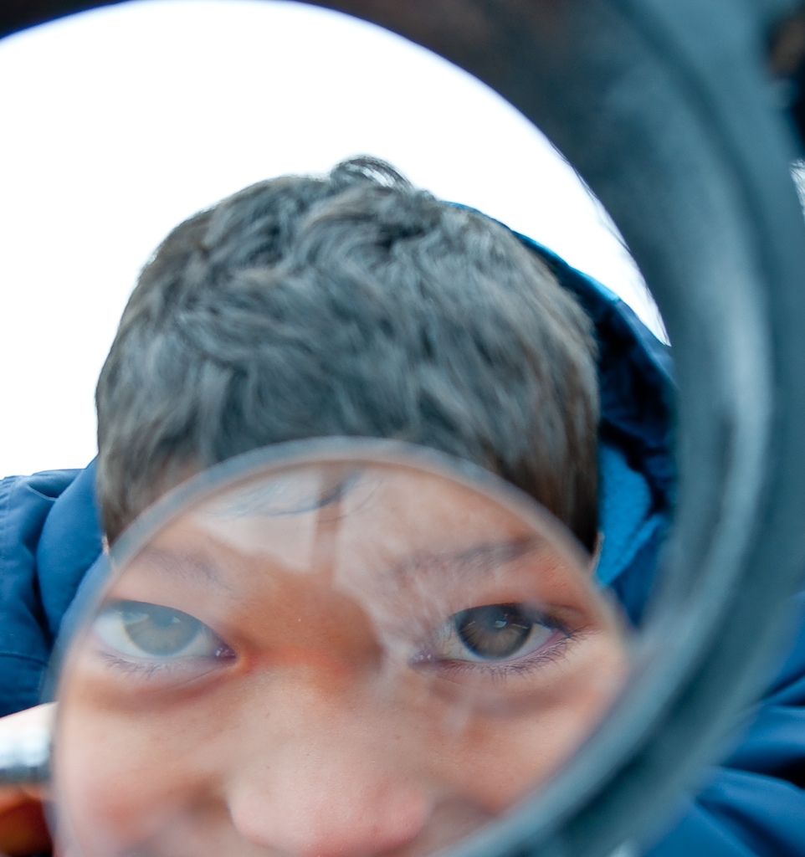
Selected Findings
Notes:
Image: https://www.flickr.com/photos/lazyartist/5524220595/
Lynn hands it over to Donna, to talk about a couple of specific themes coming out of the research.

Slide 18

Assessing Non-Traditional Sources:
Determining Credibility and Authority
“Like, if two of them say the same thing then that must be right.”
(Digital Visitors and Residents, USS4, Male, Age 17, High School Student)
Notes:
Image: http://www.microtekcorporation.com/wp-content/uploads/2011/04/how-to-gain-online-credibility1.jpg
I want to start with the problem of how to deal with non-traditional sources like those found on the web. We find generally that people’s personal networks are crucial parts of their evaluation framework.
When people need to evaluate a source independent from their personal network, they can be challenged if they do not already have the expertise to evaluate the credibility of particular sources. What many students describe themselves doing is not the critical evaluation of the content of the sources they need to use. Rather, they are describing the evaluation of the provenance of the sources, looking in particular for signifiers of credibility (.com vs .edu, perceptions of clean web design, etc). They are not, particularly in early, Emerging educational stages, capable of evaluating the content critically, because they do not know enough about any given academic field.

Slide 19

The Learning Black Market
“It’s like a taboo I guess with all teachers, they just all say – you know, when they explain the paper they always say, ‘Don’t use Wikipedia.’”
(Digital Visitors and Residents, USU7, Female, Age 19, Political Science)
Notes:
But lack of experience in a field is not the only thing that drives people to use resources such as Wikipedia.
The perception that Wikipedia is an illegitimate source is in direct conflict with people’s everyday experiences with Wikipedia’s general reliability as a starting point, and as an effective place for quick facts. Instructors and Institutions risk fostering covert online study habits, what we are calling a “learning black market,” if they discount the effective information-seeking behavior of students (and faculty) simply because they are not institutionally affiliated (and officially authoritative) resources. Wikipedia has a grass-roots authority based on effectiveness. In our research, people in later educational stages were quite open about the ways they used Wikipedia, in the UK and in the US, with most indicating that they use it as a good starting point and that it’s reliable enough for basic information.
A few indicated that they found it a less biased source and just as reliable as textbooks precisetly because it is authored by so many people.
Wikipedia wouldn’t exist if it weren’t open to anyone contributing content—this is not just about the information that gets consumed, but about the potential for the web, and for open practice on the web, to produce stuff. Producing and engaging in knowledge is more possible for non-experts than ever. This has implications for pedagogy, for teaching and learning. We need to think about this.

Slide 20

“Convenient” Isn’t Always Simple
Convenience
Convenience trumps all other reasons for selecting and using a source
(Connaway, Lanclos, & Hood 2013)
Notes:
Image: http://www.organiclifestylemagazine.com/green/images/issue-6/convenience.jpg
Convenience:
Wikipedia is described not just as effective, but also as “convenient,” and convenience is a key reason expressed for the choices that people make about technology, and about the information and other resources they end up using.
Digging down into the interviews allows us to talk about convenience in complicated ways—convenience is contextual, and is not the same for all people, or even for the same person in different situations.
It can be, for instance, about available time.
It can be about usability, perceptions of how easy resources are to use.
It can be about what is familiar, most physically convenient, too, even if it takes more time to use/access.
The fact is, perceptions of convenience, and about what is involved in effective searches for information and resources include digital as well as physical places now. It is easy to find information online, and it is easier than ever to produce content and put it on line. Resident modes of practice, engagement with social media, open practices like blogging, are already transforming notions not just of convenience, but also of authority, of what constitutes legitimate scholarly modes of communication, and the sorts of places in which such communication can and should take place.

Slide 21
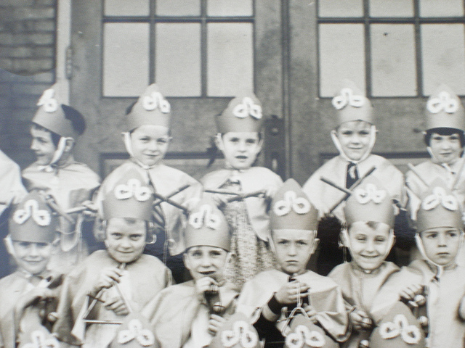
“And so like my parents will always go, ‘Well look it up in a book, go to the library.’ And I’ll go, ‘Well there’s the internet just there.’”
(Digital Visitors and Residents, UKU5, Emerging, Female, Age 19, Chemistry)
Notes:
Image: http://goo.gl/owsfzE/
This quote expresses it in terms of generational differences, but our data shows that engaging in online resident modes is not necessarily an age-related trait.
The Internet is a place where things happen, things that used to only happen face to face. A holistic picture of academic behavior, of information seeking behavior, has to include these digital places, and should pay attention to resident practices.
People use social media tools and spaces like Twitter and Facebook to connect. This is not a surprising or new thing, but needs to be kept in mind. It’s not going away.
Also keep in mind that not everyone is excited by Twitter or Facebook or Instagram. Awareness of these social media places is not dependent on a generational identity. It is about personal preferences and individual motivations to engage. Cannot assume monolithic attitudes towards these places and tools.
Digital places like YouTube and Facebook and Twitter are not easily classed as only “entertainment” or “academic”, because all of those activities now occur in those spaces. Knowing that someone goes to YouTube doesn’t tell you why.

Slide 22

Graduate School
Image CC http://goo.gl/KbRY9W
Notes:
I want to end my part of this webinar with a story about grad students.

Slide 23

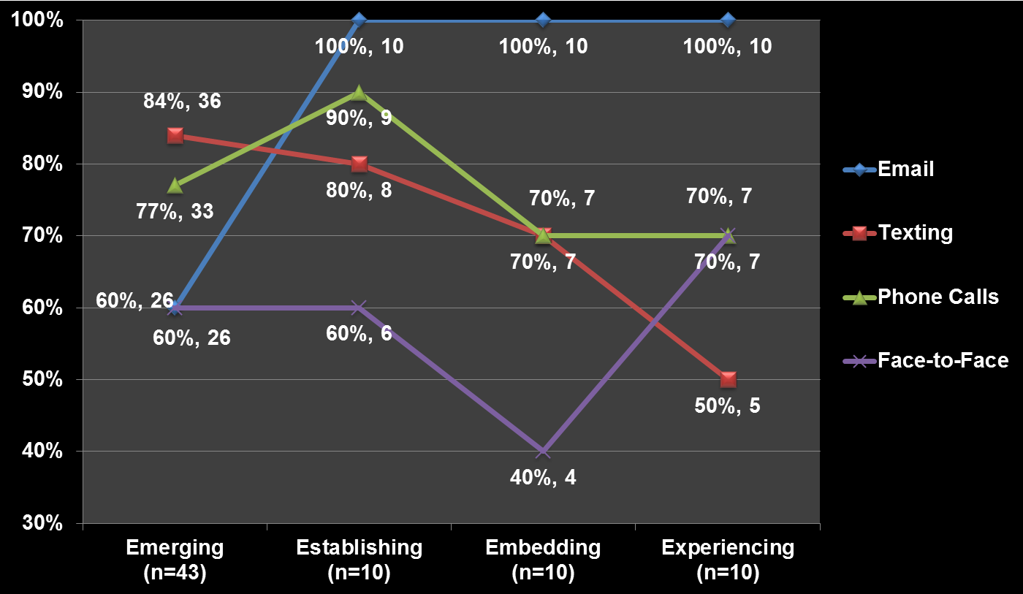
Contact and Educational Stages
Notes:
I’m using these graphs to point to patterns we see in our interview data. I’ve put a red oval around the post-graduate/ grad student category, Embedding.
Notice here the purple line for face to face contact. Notice in particular how low (comparatively) the mentions of face to face contact are for grad students. They are texting with people, making phone calls, and in particular emailing far more than engaging face to face.

Slide 24
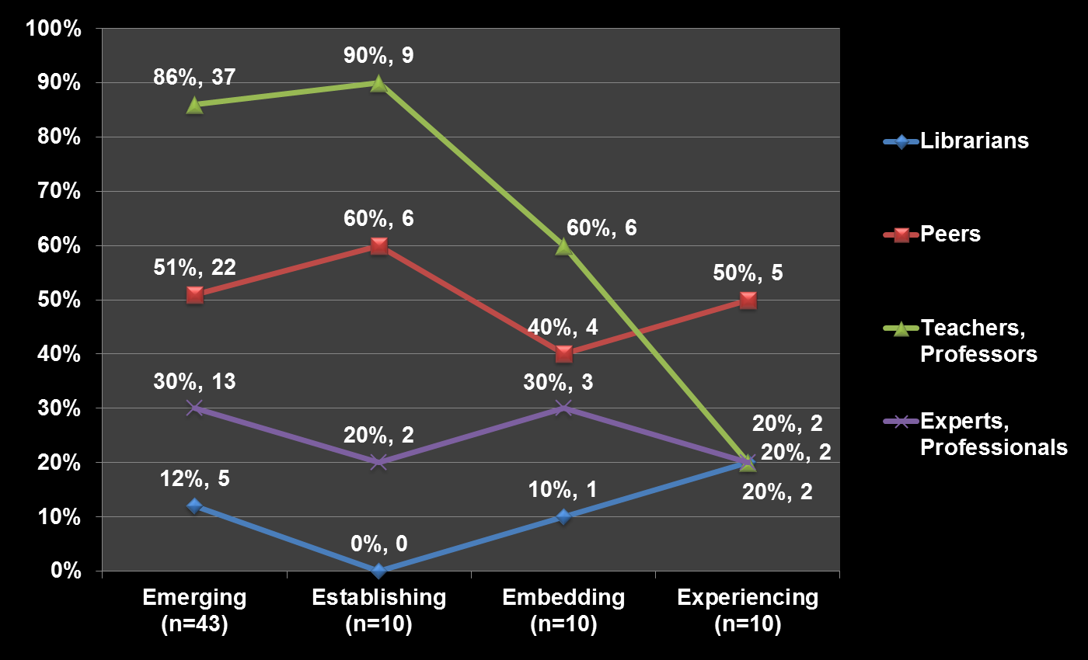
Human Sources and Educational Stages
Notes:
Notice here who graduate students are in most contact with-professors, then peers. For Professors, it’s the reverse order—they are in touch with peers and then with experts, mentors, and librarians at similarly low rates.
Think about future of graduate students, of them as future (and current) practitioners in their fields. Contact with professors makes sense, of course, but contact with peers seems crucial.

Slide 25
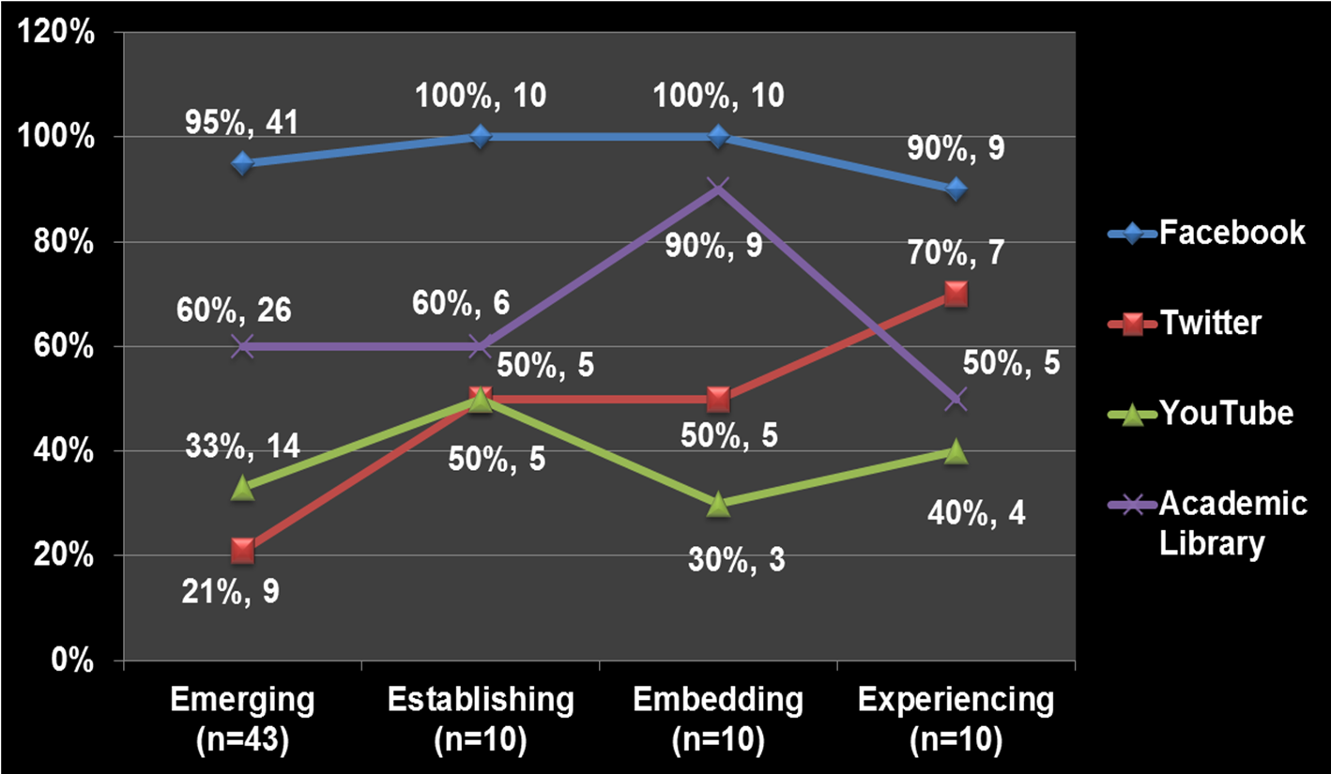
Place and Educational Stages
Notes:
The Blue line is FB, red is Twitter, purple line is Academic Libraries (physical spaces)
Graduate students narrow contact that they have with people, and are also physically isolated, working in the library, offices or labs. I see this in the other ethnographic work that I do as well, the maps that graduate students, particularly in the sciences, produce of their learning landscapes are restricted to one or two places, in sharp contrast to the wide-ranging maps of undergraduates and professors.
But when we look at the places they go, in addition to really high rates of academic libraries physical spaces, graduate students are present in high rates on Facebook, and Twitter.
We need to think about implications of online resident practices for grad students. Their presence on FB and Twitter might be an opportunity for them to facilitate contact in the isolating environment of graduate school .We see a radical difference in the role of academic library spaces in our interviews with graduate students, compared to other educational stages. This is something we need to look at further—what is happening as they transition from student to practitioner in their field? How are their experiences in physical spaces like libraries related to the academic work they do in digital places like Twitter, Facebook, and YouTube? Where are they resident, where are they visitors? If resident practices are those that facilitate the finding of voice, and the production of scholarship (in a variety of modes), what can it look like in grad school?

Slide 26
Response?
Notes:
Donna hands it over to Dave

Slide 27
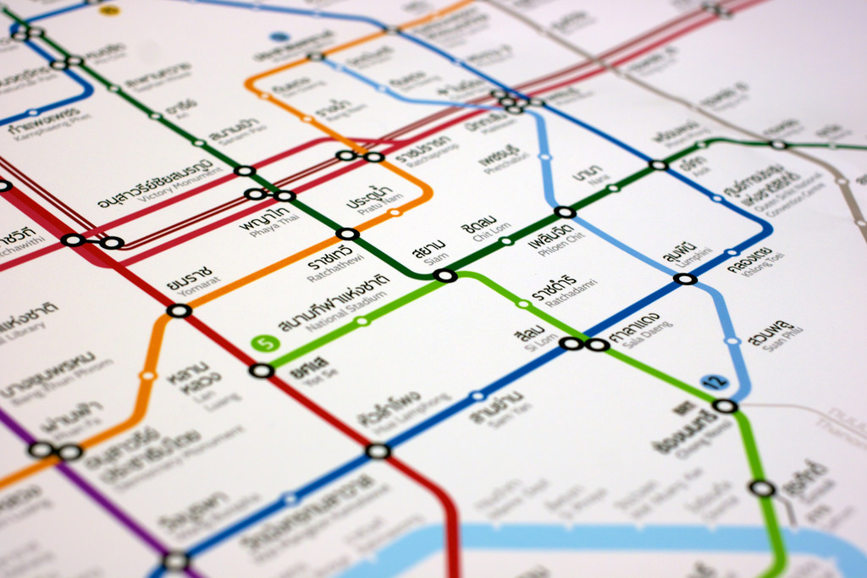
Mapping Visitor and Resident Behavior
Notes:
Image: https://www.flickr.com/photos/viriyincy/12943013575/

Slide 28
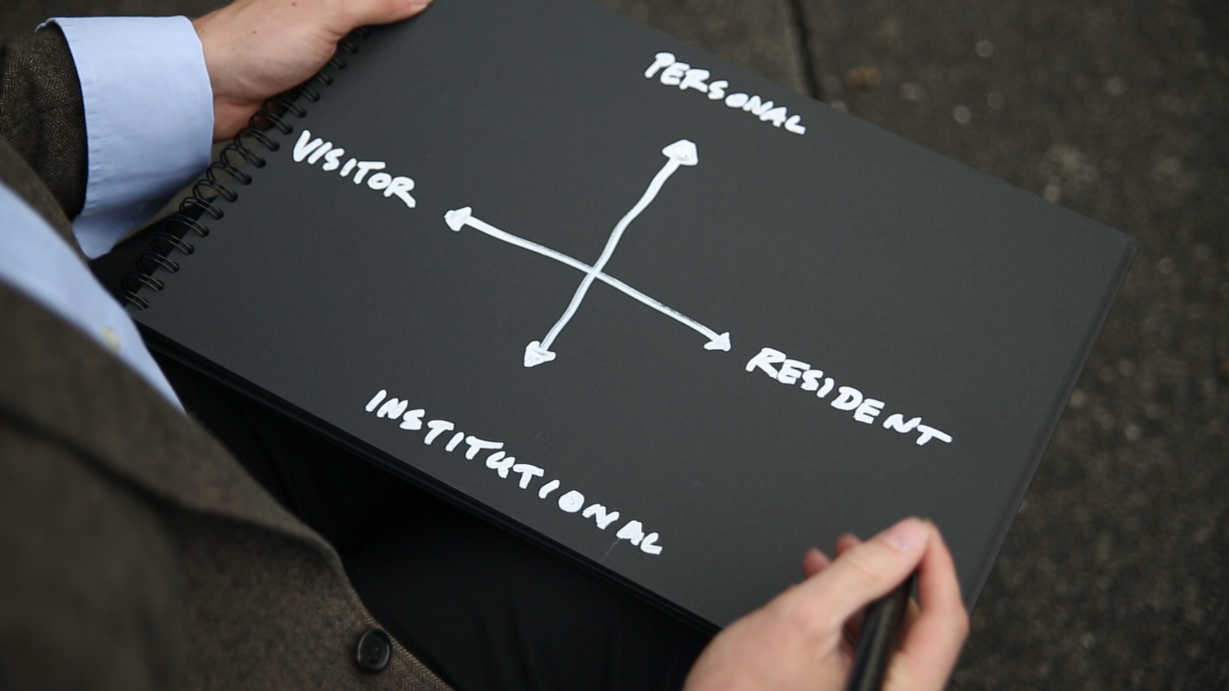
Mapping

Slide 29
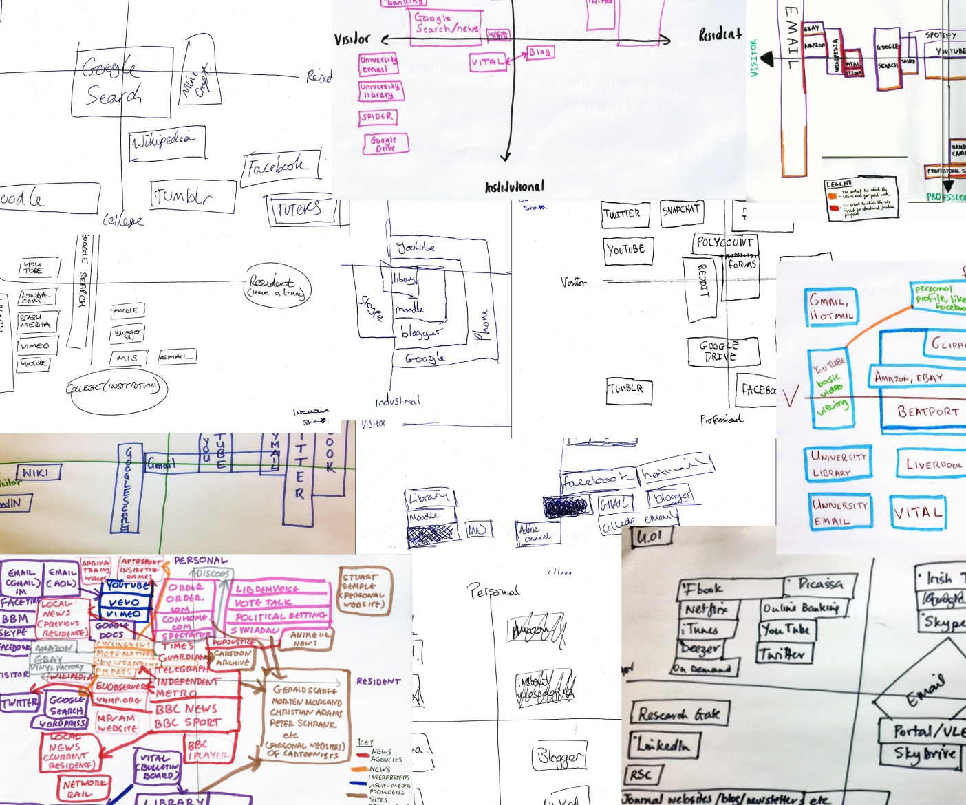
Mapping

Slide 30
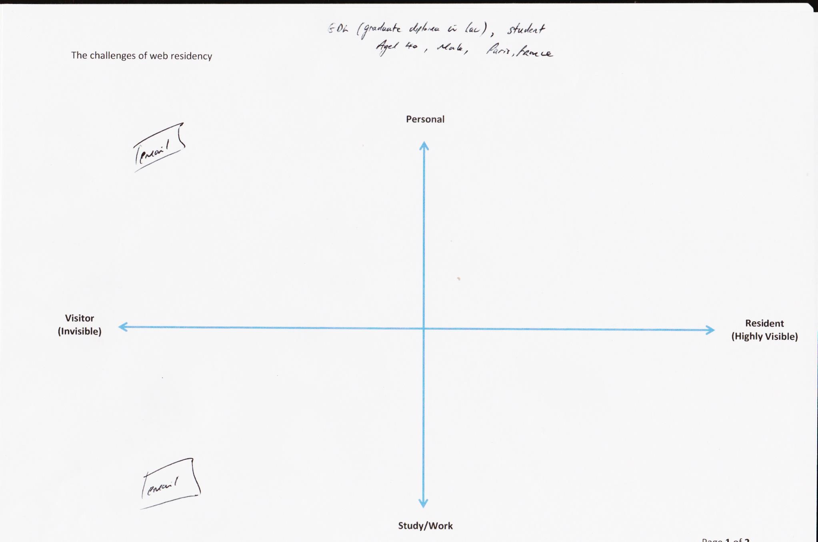
Mapping

Slide 31
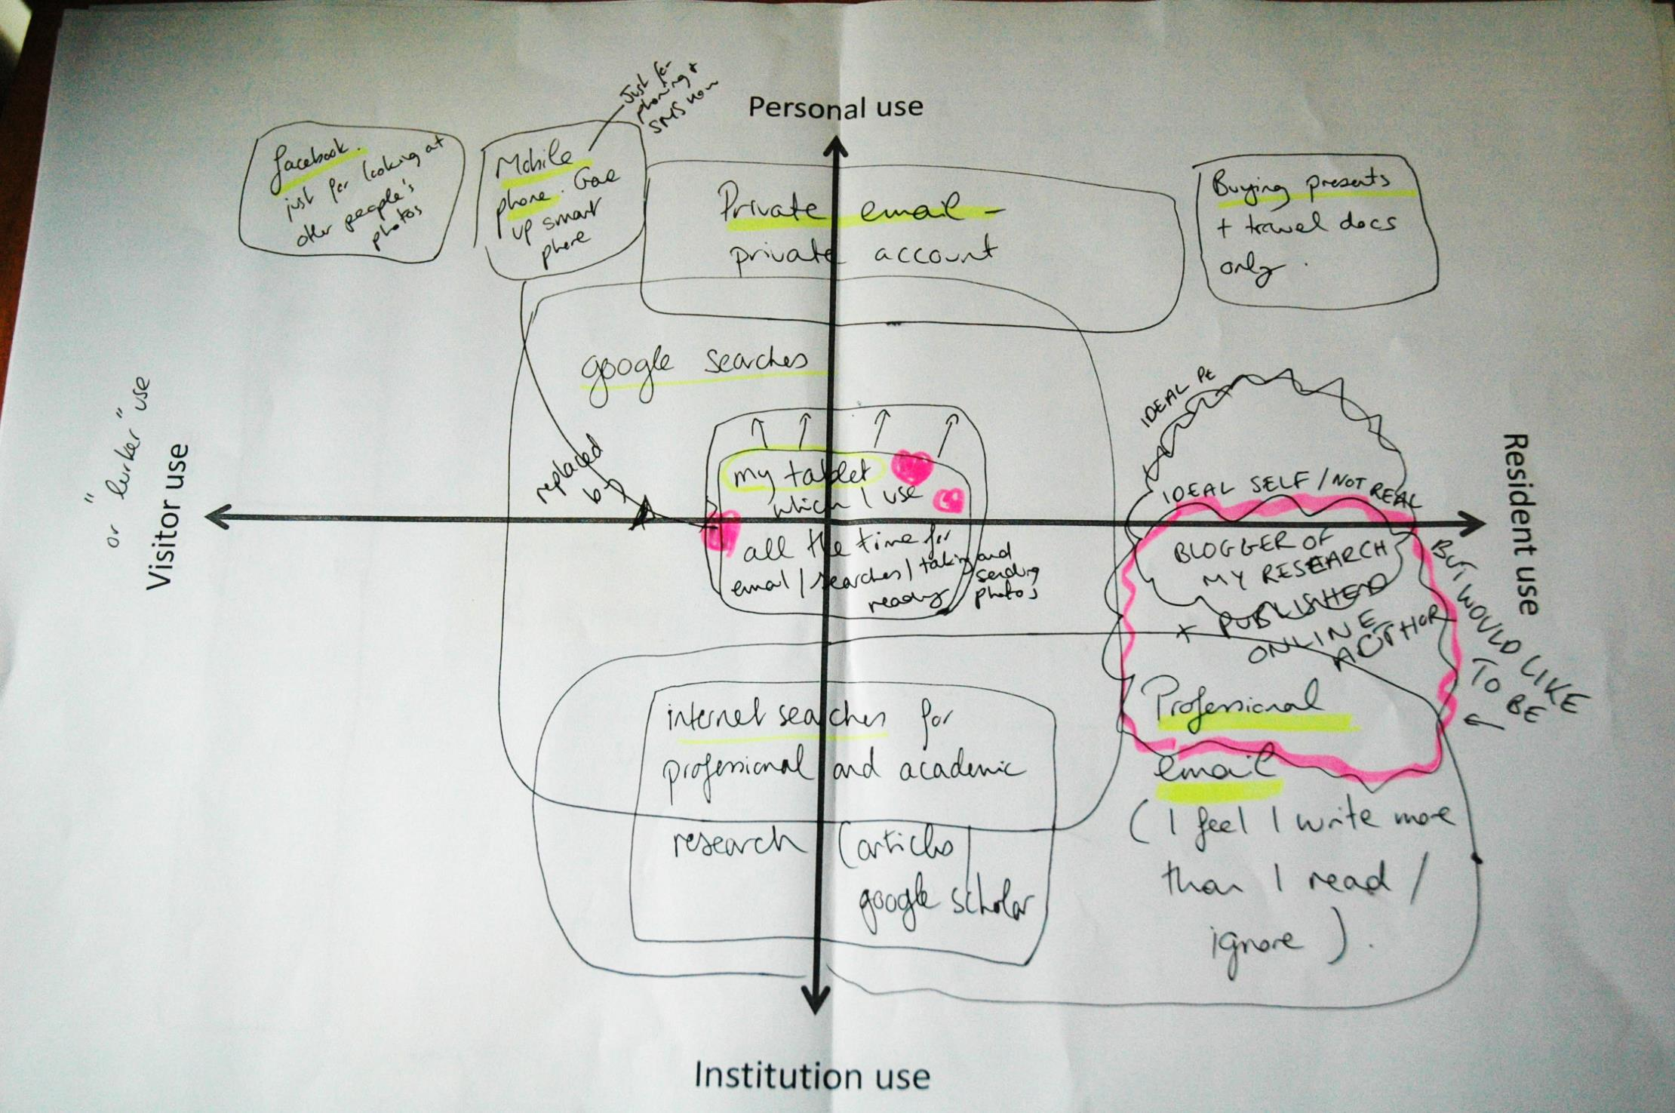
Mapping

Slide 32
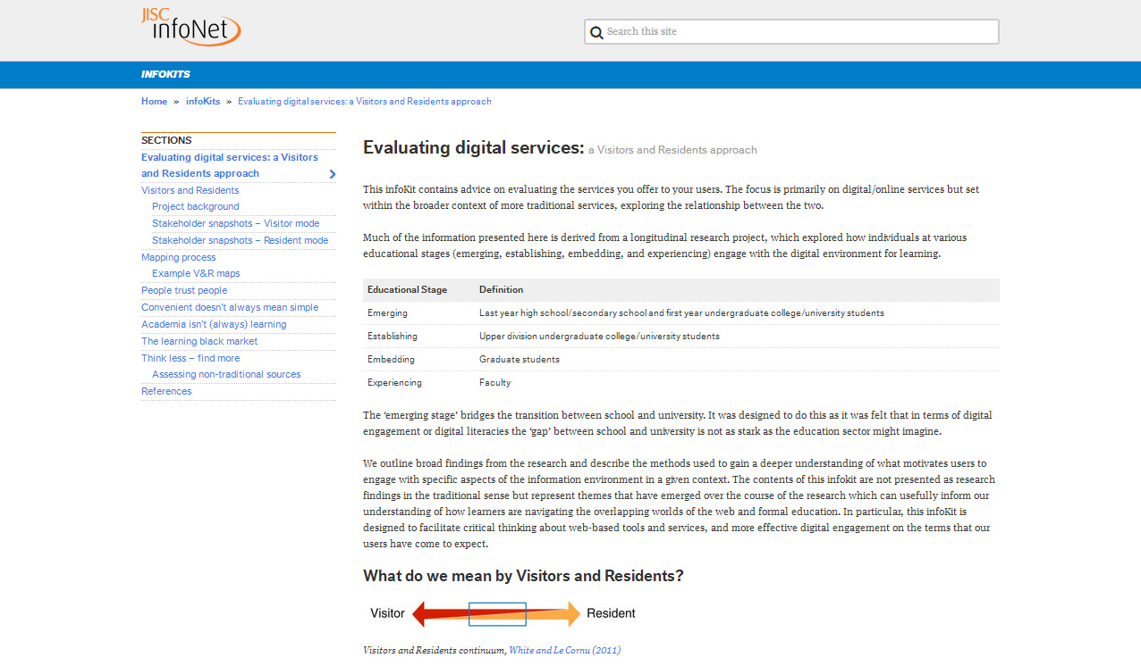
Infokit
http://bit.ly/evaldigservs-infokit

Slide 33
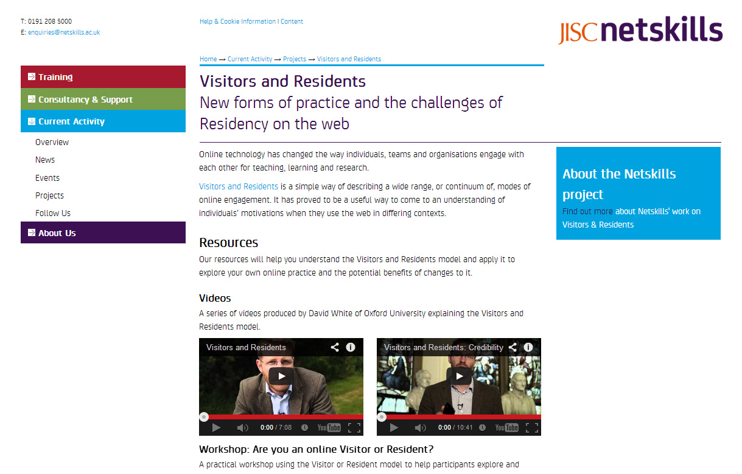
Workshops
http://goo.gl/KfrbrY

Slide 34
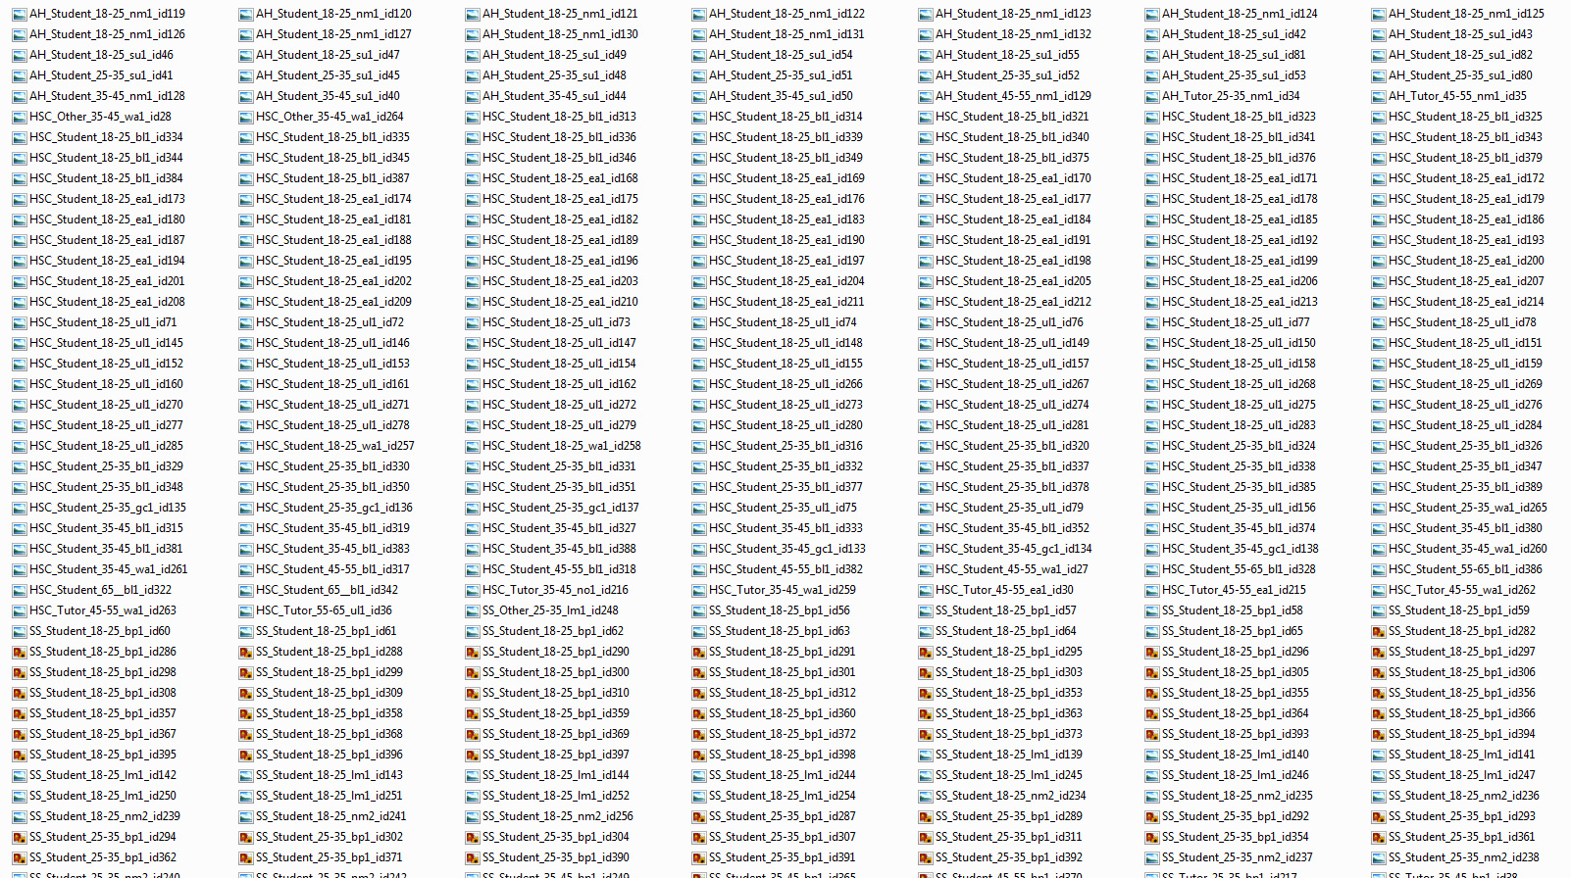

Slide 35
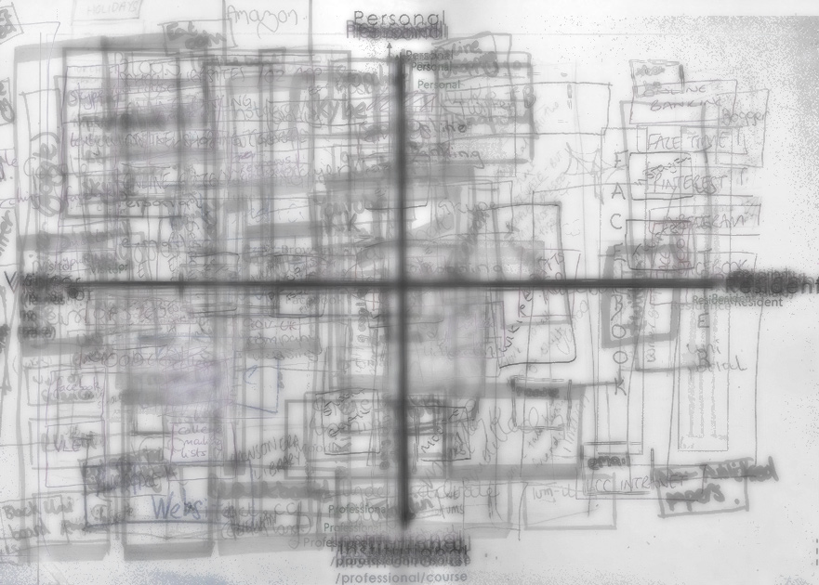
Younger students (18-25) layered map

Slide 36
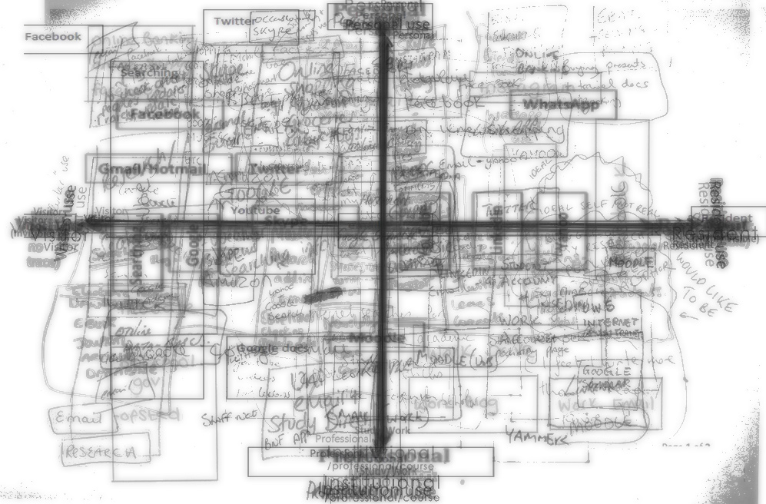
Older students (35-45) layered map

Slide 37
“We would like to use this exercise as a tool in the induction of all new students beginning in September 2014. This will allow us to monitor any changes in technologies and use this to enhance both communications with the students as well as our teaching strategies.”
“We would be interested in exploring more comprehensively how web residency can inform modern pedagogies and vice versa.”
“It has already had a massive impact on students within PR and Marketing. The challenge is now to roll out in other disciplines.”
“A project aim is to set up a means of scoring future staff job descriptions for their digital literacy requirements. Mapping current activity/knowledge this way would be an excellent start.”
Notes:
“We have already used the mapping technique as an icebreaker exercise during a cross-university away day” Glasgow Caledonian
“We would like to use this exercise as a tool in the induction of all new students beginning in September 2014. This will allow us to monitor any changes in technologies and use this to enhance both communications with the students as well as our teaching strategies.” Ulster
“We will also adopt the mapping exercise as a week 1 ‘introductory’ task for the module we run entirely via the VLE – we hope that including this task will help students to better understand their current online usage and provide us with an opportunity to discuss the benefits of developing their experience in the ‘resident/professional’ quadrant.” Newman (English)
“Leading by example i.e. more resident behavior by staff (blogs; articles; new judgments; changes in the law; twitter feeds for each module; recent updates et al). This should help students in their 'visitor' learning and it may also encourage some to progress to resident learning activity.” BPP
“It has already had a massive impact on students within PR and Marketing. The challenge is now to roll out in other disciplines.”
“…the plan is to embed the exercise into the assessment of a professional module and provide more opportunity for students to explore the concepts and reflect on them, and to be assessed on their critiquing and development of online engagement moving from a social user to a professional web resident. Context is already provided in lectures on the role and importance of online profiles, the HEA template and supporting material will support strategic development of the module and a framework for student to develop their understanding of how they use social channels.”
“the practical mapping exercise within the project will become a fundamental part of all Marketing student’s personal portfolio that they develop as they build a professional online identity, or brand. The V and R map will be conducted as a first activity to facilitate discussion about online behavior and identity before moving on to helping students understand the importance of a credible and professional online public brand image. This, in turn, is expected to support them in their placement applications for their third year of studies on our Sandwich degree.” Leeds Met
“A project aim is to set up a means of scoring future staff job descriptions for their digital literacy requirements. Mapping current activity/knowledge this way would be an excellent start.”
“…investigating how the mapping exercise could be incorporated as a learning tool for students, especially those at earlier stages, to reflect on the relationship between their online activity and their available skills. This is especially important at levels 3-4 where learners are establishing patterns of time management and strategies for independent learning, as well as navigating a new peer group.” Cardiff Met
“We would be interested in exploring more comprehensively how web residency can inform modern pedagogies and vice versa.” University of the West of Scotland
“This project has been useful to understand that students use a variety of tools that could be embedded into teaching, learning and assessment. It’s also important to engage with students where and when they want to engage, which has been informed by their maps. As a programme team in curriculum design we need to cater for both resident and visitor needs in terms of support, platform and direction.” Derby
“This process provided us with clear "added value". We feel that completion of the
mapping task enabled students to better appreciate their own web use and to compare
it to that of their peers. It is our intention therefore to build the exercise into a second
year module” Hull

Slide 38
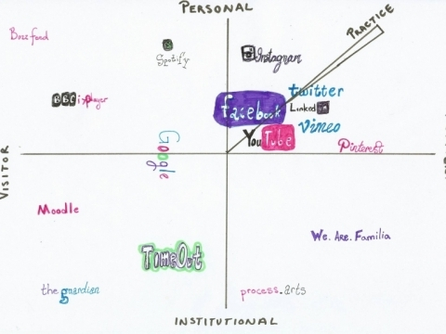
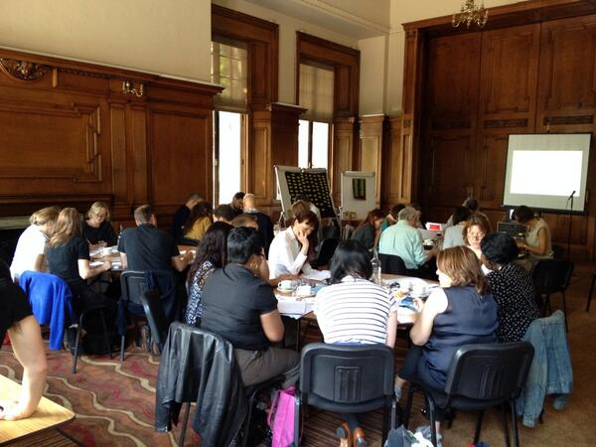
University of the Arts London

Slide 39

Questions and Discussion
Lynn Silipigni Connaway
connawal@oclc.org
@LynnConnaway
David White
david.white@arts.ac.uk
@daveowhite
Donna M. Lanclos
dlanclos@uncc.edu
@DonnaLanclos
#vandr
Visitors and Residents resources http://goo.gl/vxUMRD
Notes:
Image: Microsoft Clip Art

Slide 40
References
    White, David S., and Lynn Silipigni Connaway. 2011-2014. Visitors & Residents: What Motivates Engagement with the Digital Information Environment. Funded by JISC, OCLC, and Oxford University. http://www.oclc.org/research/activities/vandr/.
White, David, Lynn Silipigni Connaway, Donna Lanclos, Erin M. Hood, and Carrie Vass. 2014. Evaluating Digital Services: A Visitors and Residents Approach. http://www.jiscinfonet.ac.uk/infokits/evaluating-services/.

