Slide 1
Collaboration and Crowdsourcing: Synergistic Solutions for Sustainable Virtual Reference, an Analysis of Critical Incidents
Marie L. Radford, Ph.D., Rutgers University
Lynn Silipigni Connaway, Ph.D., OCLC
Stephanie Mikitish, Rutgers University
Library Research Seminar VI
October 7-9, 2014
University of Illinois at Urbana-Champaign

Slide 2
Cyber Synergy
$250K Grant from IMLS
Rutgers University & OCLC Collaboration
Research Questions:
How can Virtual Reference Service (VRS) become more collaborative, within/between libraries, & tap more effectively into librarian’s subject expertise?
In what ways could VRS become more sustainable through collaboration with Social Question & Answer (SQA) services?
Notes:
Image: http://cerasis.com/author/chuckintrieri/
These are 2 of 4 research questions from Cyber Synergy
RQ1: What is the current state of VRS quality compared to longitudinal data and to Q&A sites?
RQ2: How can VRS become more collaborative, within and between libraries, and tap more effectively into librarian’s subject expertise?
RQ3: Can VRS be more sustainable through collaboration with SQA services?
RQ4: How can we design systems and services within and between VRS and SQA for better quality and sustainability?

Slide 3
Virtual Reference Services (VRS)
Free services via library websites
Librarians answer questions, sometimes only available to affiliated members
Enabled by technology
Threatened by budget cuts
Reduction in reference hours & staff
Greater strain on remaining librarians & consortia
Possible solutions
Wider participation in reference services, similar to SQA sites
Notes:
Image: http://calgary-executive-coaching.com/wp-content/uploads/2011/12/develop-interview-questions-answers.jpg

Slide 4
Social Question & Answer (SQA)
SQA are free social reference websites where anyone may answer questions (Schachaf, 2009)
Ex. Yahoo! Answers, WikiAnswers, AnswerBag
SQA research usually focuses on answer quality & user satisfaction
Notes:
Yahoo Image: http://2.bp.blogspot.com/-zZIk3M1fIHI/TZGPM6Q01fI/AAAAAAAARqA/suYWUCTzzdE/s1600/Yahoo+Y+logo.JPG
Wiki Image: http://img2.wikia.nocookie.net/__cb20121014011703/logopedia/images/1/10/Images_jh.jpg
AnswerBag Image: http://media-cache-ec0.pinimg.com/avatars/answerbag_1344540149_140.jpg

Slide 5
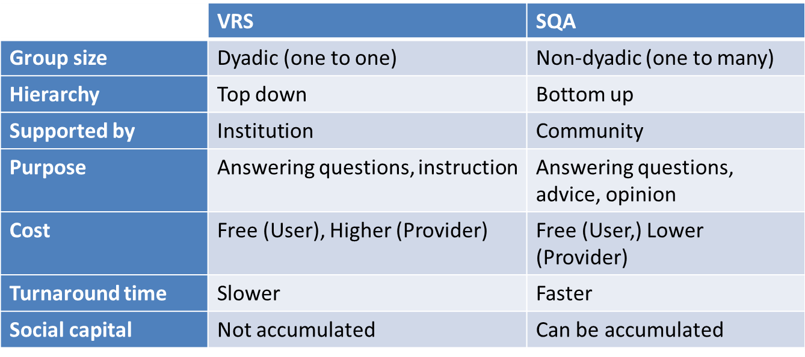
VRS & SQA Compared
Different paradigms for answering questions (Schachaf, 2009; Horowitz & Kamvar, 2012; Mansilla & Esteva, 2013)

Slide 6
Data Collection
In-depth phone interviews
50 VRS librarians & 52 VRS/SQA users
Recruited via LIS listservs, personal contacts, OCLC’s QuestionPoint blog
Demographics, direct quotations, & notes recorded in Survey Monkey
Notes:
Image: http://jobs.theguardian.com/getasset/?uiAssetID=732c1776-d8f7-4c20-bddc-a0475b62a939

Slide 7
Methodology - Critical Incident Technique (CIT)
Critical Incident Technique (CIT) (Flanagan, 1954; Radford, 2006)
Qualitative technique
Focuses on most memorable event/experience of participants.
Allows categories or themes to emerge rather than to be imposed.
CIs sorted into themes via constant comparative method
Themes expanded & merged into CI Coding Scheme
Notes:
Flanagan, J.C. (1954). The critical incident technique, Psychological Bulletin, 51(4), 327
358. Radford, M. L. (summer, 2006). The critical incident technique and the qualitative evaluation of the Connecting Libraries and Schools Project. Library Trends 54(1), 46-64.

Slide 8
Demographics - Librarians
Notes:
Image: http://elearningtemplates.com/files/2013/12/wholer_business_people.png

Slide 9
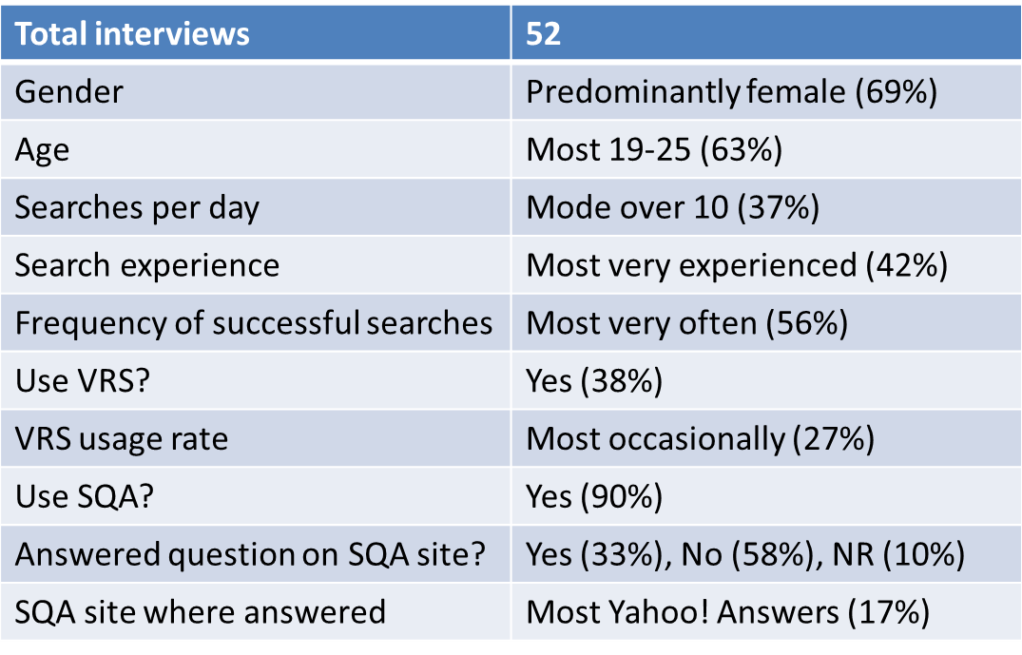
Demographics - VRS & SQA users

Slide 10
CIT Questions re: Successful Interactions
Notes:
Image: http://regmedia.co.uk/2014/03/07/woman_computer_happy_shutterstock.jpg
Remember a time when you had a difficult face-to-face or virtual reference question that required subject knowledge within your expertise that you successfully answered. Describe this interaction and why you felt it was successful.”
“Please recall one specific virtual reference interaction that was in an area outside of your expertise that you would consider successful and describe. What in particular made this interaction successful for you?”

Slide 11
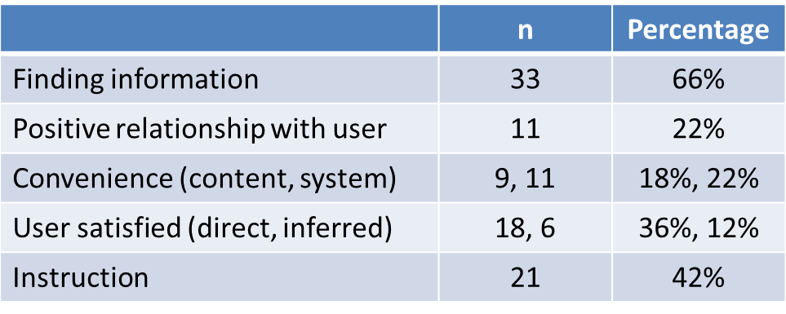
CIT Results - Successful VRS
Librarian themes (n = 50 CIs)
Notes:
Image: http://blog.cerge-ei.cz/wp-content/uploads/2013/02/magnifying-glass-1024x768.jpg
Librarian:
Finding info, positive relationship, convenience (content), user satisfied (direct):
“It was successful because I was able to answer the question with my personal background on the subject and with the databases we had in our collection. He was a business student and had to do a paper on merger and acquisition activities, and I knew we had an M&A database, but the New York Times also published a M&A activities page, so he could get trended data back and very current information from the New York times. I explained to him he could find a current topic of interest from New York Times and historical perspective from the database. I knew it was successful because the student told me that was exactly what he wanted. This guy was adamant that it was exactly what he wanted.” (L-38)
Convenience (system) & instruction:
“I felt like because I was familiar with the resource beforehand and show them pretty early on in the chat how to navigate and find what they were looking for. Because it took me less time to locate the information, I was able to spend more time in the teaching. “ (L-3)
Positive relationship:
“The patron appreciated that his question was difficult and it received time and attention up until he was able to walk away with an answer” (L-1)
User satisfied (indirect):
“There were lots of happy faces, so the user seemed pleased” (L-09)

Slide 12
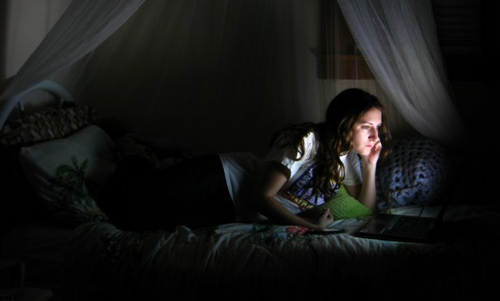
CIT Results - Successful VRS
User themes (n = 20 Successful CIs, 38% of 52 interviewed)
Notes:
User:
Convenience (fast, easy, good hours):
“very successful because it’s so fast rather than searching on Google” (VS22)
“the fact that it was late at night and I was in a bind and it was quick and convenient” (VS66)
Instruction:
“was successful because [the librarian] wouldn’t stop helping me until I understood it and could reiterate it back to [the librarian]” (VS6)

Slide 13
CIT Questions re: Difficult/unsuccessful Interactions
Notes:
Image: http://thecatutoringsolution.com/wp-content/uploads/2013/01/failing-student1.jpg
“Remember a time when you had a difficult face-to-face or virtual reference question which was outside of your area of expertise. Describe this encounter and what you did in this situation. What alternatives did you have, how did you decide to handle this question, and why?”
“Please recall one specific virtual reference interaction that was in an area outside of your subject expertise that you would consider unsuccessful and describe. What in particular made this interaction unsuccessful for you?”

Slide 14
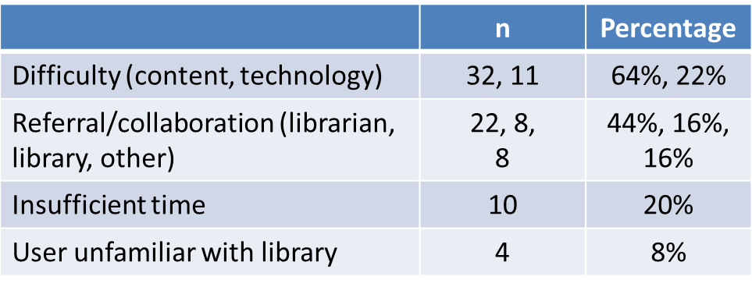
CIT Results Difficult/unsuccessful interactions
Key themes for librarians (n = 50)
Key themes for users (n = 20, 38% of 52 interviewed)
Notes:
Librarian:
Difficulty (content), collaboration (librarian)
“[A] student had an invention and had successfully patented it. [They were] ready to pitch the invention to a company and needed information about the industry, the market, etc. I was able to give the student detailed data about the industry, companies in the industry, competing products, etc…The market information, however, required some very specific statistics from the medical/health care fields. I did a little searching, but decided that my colleagues at the Health Sciences Library would be better able to provide this information. I consulted with the director of the library, who is also an expert reference librarian, and she came through with exactly what the student needed.” (L-20)
Difficulty (technology), insufficient time, user unfamiliar with library:
A student “came in frustrated, had been having trouble even logging in, [so] when he finally got in, he had a real sense of immediacy, [and] what he was looking for was going to require some effort on his part. He was irate and obnoxious all the way through. I brought him around. He was not very kind. It went on for so long I thought I'd lose him, but he stayed on. It’s kind of challenging when the students don't even know how to use the databases and they’re chatting with the librarian. They can become impatient” (L-45).
User:
10 (50%) of users said that all VRS interactions were successful:
“I don’t think I’ve had an unsuccessful experience. There’s been times where it’s taken more time, but in the end it was successful.” (VS52)
Question not answered:
“I tried to ask them how I should refer to multiple authors of different works and they brought me to the page but they didn’t really explain it or answer my quetsion. I kep trying to ask them my question in different words, but they still wouldn’t answer it.” (VS45)
Wait time:
“I typed in something regarding ASL books and a librarian came and said something like “one second, pending your request,” but it took a little bit.” (VS55)

Slide 15
CIT Questions re: Answering Questions
Notes:
Image: http://www.unlockourminds.com/wp-content/uploads/2010/12/door-knock.jpg
“Remember a time when you successfully sought help via collaboration with a colleague in answering a difficult reference question (either face-to-face or in VR). Describe what happened and what were the important factors that helped you decide that it was successful?”
“Think of a time when you answered a question online. Where was it? Why did you decide to answer in this particular incident?”

Slide 16
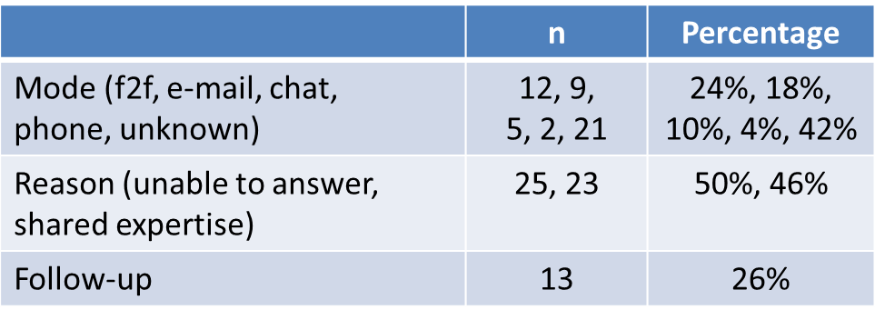
CIT Results Answering Questions
Key themes for librarians (n = 50)
Notes:
Image: http://lawyernomics.avvo.com/files/2012/06/chat.jpg
Librarian:
Social media/networking (eg Twitter) not mentioned in CI questions, but was mentioned in other parts of the interview
On unknown modes of communication:
“I called in this colleague” (L-11)
On collaboration:
“We kind of play off of each other so we come up with new things to try. I think it's successful because we understand the need, the question, and trying different sources and keywords. It's been my experience that if you bring in another reference librarian on a question, they won't quit either” (L-61)
Unable to answer:
“I had a request from a student trying to find these citations to articles and wanted to find the articles. Unfortunately, one article was in Russian, one was in Japanese. I wound up talking to another librarian here and she showed me how to use the CASSI Index, and from that we could determine that at least the Russian article had a translation as part of another journal series. The Japanese article not so much, these were from the 60s and 70s. This particular colleague showed me how to use CASI to see if the translation was available, [and] then get…the ISSN number and OCLC number to put it into ILL to get the patron the article. Getting the patron what they needed was the success. Success to me is if I can't get them the exact information they want, to get them the information of someone that can help them.” (L-42)
Shared expertise:
“I did get a question not too long ago from a staff member at the university who was researching something in the field of education, and I had to email our education librarian to get her to collaborate with me because it kind of bridged something both of us should answer (because of what I do at the university) and it just so happened that our education librarian was unavailable at that time. I think what was successful was remaining in contact with the patron, I'd done some education librarian stuff before in a previous job so I knew the databases, and I was able to email the patron and CC the education librarian with some tips and help to get her started, but told her she needed to talk with the subject librarian. It was pretty straightforward, but it was all done by email.” (L-33)
User:
Most questions answered on Yahoo!Answers (9, 53%)
Altruism (practical):
Practical altruism refers to the answer’s desire to “help the [asker] out” (VS17) because they are certain that they know the answer (VS22, VS17). A few also mentioned that they posted because another answerer had provided “the wrong answer” (VS68).
Altruism (emotional):
“I just thought, ‘This is so awful! This poor girl!’ and I thought just maybe she’d listen to my answer reassuring her” (VS26).
Belongingness (site):
“[return] the favor and [help] someone with their questions” (VS50) and answer to “[try] to be a part of the community” (VS32)
Belongingness (topic):
aviation history buffs (VS3) and new mothers (VS42)

Slide 17
CIT Results Answering questions
Key themes for users (n = 20, 38% of 52 interviewed)
Notes:
Image: http://imconfident.files.wordpress.com/2013/02/1-hand.jpg

Slide 18
Future Steps
Notes:
Image: http://smallbiztrends.com/wp-content/uploads/2010/06/five-steps.jpg

Slide 19
Cyber SynergySeeking Sustainability through Collaboration between Virtual Reference & Social Q & A Sites
This research is one outcome from the Cyber Synergy grant project.
$250,000 grant funded by IMLS, OCLC, & Rutgers University
Co-PIs
Marie L. Radford, Rutgers University
Lynn Silipigni Connaway, OCLC
Chirag Shah, Rutgers University

Slide 20
Questions?
Marie L. Radford, Ph.D.
Director, Ph.D. Program, Rutgers University, NJ
mradford@rutgers.edu
@MarieLRadford
Lynn Silipigni Connaway, Ph.D.
Senior Research Scientist, OCLC
connawal@oclc.org
@LynnConnaway
Stephanie E. Mikitish, M.L.I.S.
Doctoral Candidate, Ph.D. Program, Rutgers University, NJ
mikitish@rutgers.edu

