Slide 1
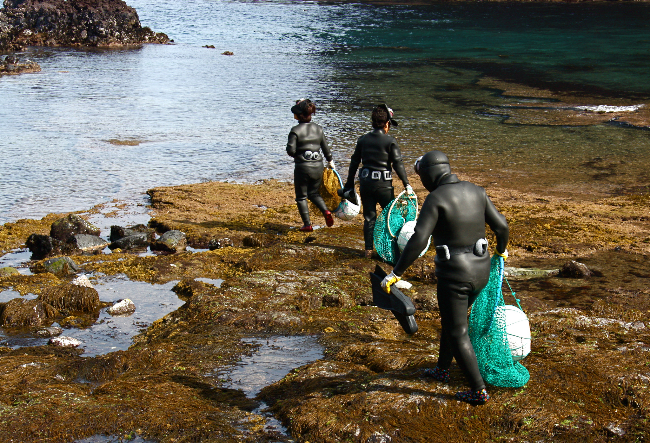
CollectionDirections:
Towards the collective (print) collection
@LorcanD
Lorcan Dempsey
OCLC
13 – 14 October 2014
Asia Pacific Regional Council 2014 Membership Conference
Jeju City, Republic of Korea
eLjeProks Grandma divers head out to sea. CC BY-NC 2.0

Slide 2
Preamble
Collection directions

Slide 3
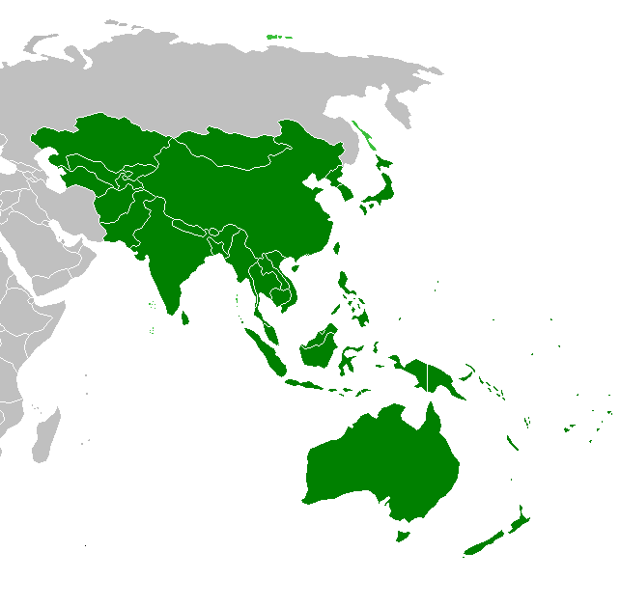
Asia-Pacific Membership
in WorldCat
Collective collection:
120.3 million holdings
on
41.5 million distinct publications
in
462 languages
(Top 5 non-English: Chinese, Japanese,
German, French, Thai)
Contribution:
19.5 million contributed records
supporting
37.4 million global holdings
Data current as of July 2014

Slide 4
At the movies … Most widely-held Chinese-Japanese-Korean-language materials published within Asia-Pacific region
臥虎藏龍
Crouching Tiger, Hidden Dragon
Chinese
[1]
もののけ姫
Princess Mononoke
Japanese
[2]
おくりびと
Departures
Japanese
滿城盡帶黃金甲
Curse of the Golden Flower
Chinese
봄 여름 가을 겨울 그리고 봄
Spring, Summer, Fall, Winter … and Spring
Korean
[1] Image source: http://en.wikipedia.org/wiki/Princess_Mononoke#mediaviewer/File:Princess_Mononoke_Japanese_Poster_%28Movie%29.jpg
[2] Image source: http://en.wikipedia.org/wiki/Departures_%28film%29#mediaviewer/File:Okuribito_%282008%29.jpg
Notes:
These are the most widely-held (globally popular) Chinese-Japanese-Korean-language materials that were published within the Asia-Pacific region.
As it turned out, all five are films.
All were originally released in either Chinese, Japanese, or Korean.
[Note: these are distinct manifestations , not works; in other words, the ranking is based on individual WorldCat records, not clusters. A work-based ranking may be different.]

Slide 5
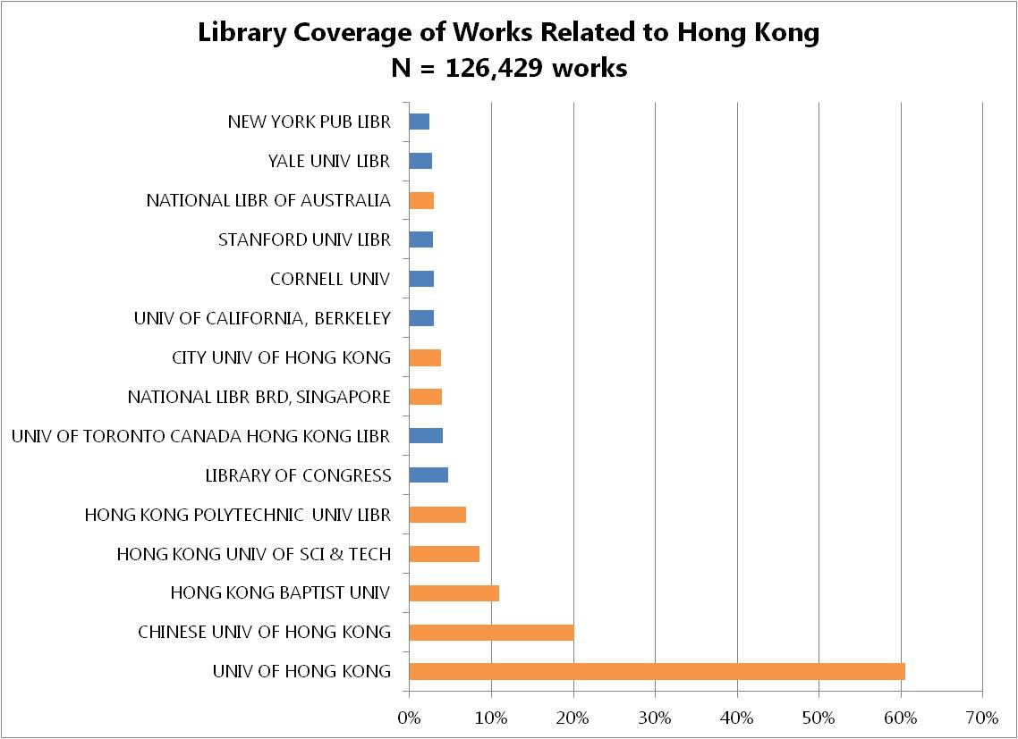
North America
Asia Pacific
Notes:
Evidence of strong Asia Pacific engagement with OCLC (contributions to WorldCat) in robust regional coverage of literature related to Hong Kong.

Slide 6
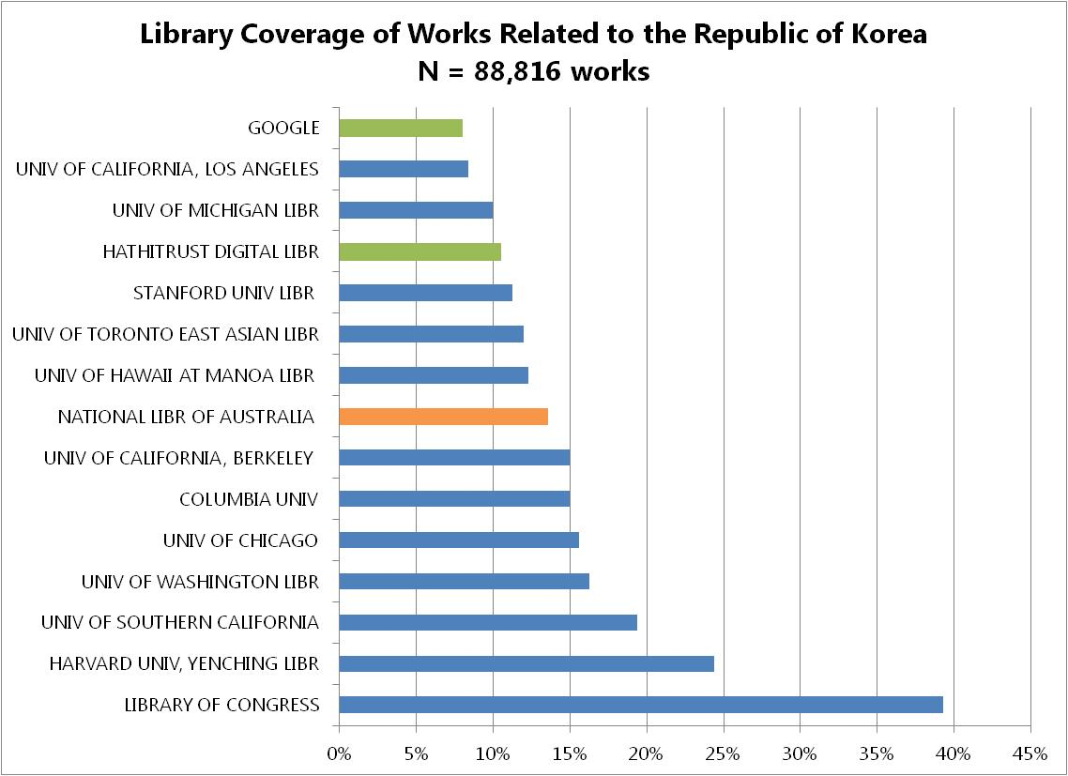
North America
Asia Pacific
Digital Libraries
Notes:
Note that most of the North American university libraries on this list are known centers for scholarship on East Asia, particularly Korea. They are part of a network of federally funded area studies centers that receiving support for acquiring and cataloging East Asian collections.
The deep holdings at Library of Congress reflect political interests of US.
With increased participation of Korean libraries in OCLC and growth in Korean contributions to WorldCat, we expect to see this balance shift. (At present, Korean libraries are mostly cataloging Western language materials in WorldCat).

Slide 7
University of Hong Kong Library Centers of Distinction
Topic | Titles
China | 300,785
Hong Kong | 90,200
Taiwan | 31,558
Chinese medicine | 17,604
Chinese literature | 17,248
Chinese poetry | 14,499
Chinese language | 8,830
Chinese fiction | 8,588
Zhongguo gong chan dang | 8,017
Calligraphy, Chinese | 7,542
Hong Kong College of Medicine for Chinese, est. 1887, absorbed by HKU in 1910
Fung Ping Shan Library of Chinese language materials, est. 1932, a cornerstone of HKU history- HKUL is the largest contributor of original cataloging in WorldCat for Chinese materials
Notes:
These are topics for which HKU holds more related titles than any other library in WorldCat.
HKU Library is the oldest academic library in Hong Kong (est. 1912).
[Zhongguo gong chan dang = Chinese Communist Party]

Slide 8
Overview
Collection directions

Slide 9
1
Collections
Collection directions
The evolving scholarly record
Collection attention: collections grid
Trends
Inside-out collections
Collections as a service
From curation to creation
Workflow is the new content
2
3
Towards the collective (print) collection How we will manage print collections … differently.

Slide 10
The evolving scholarly record
Collection directions

Slide 11
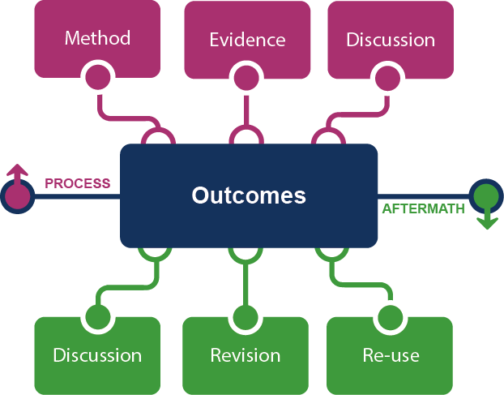
Framing the Scholarly Record …

Slide 12
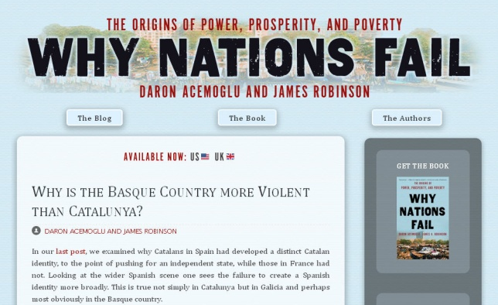

Slide 13
Grid: collection attention
Collection directions

Slide 14
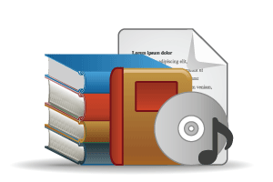
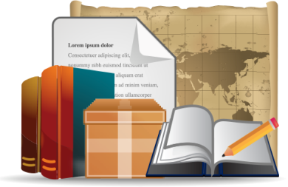
Open Web Resources
‘Published’ materials
In many collections
Licensed
Purchased
Low Stewardship
High Stewardship
Research & Learning Materials
Institutional In few collections
Special Collections
Local Digitization

Slide 15
Monographs
Emergence of ‘e’ (platform)
Shift to demand driven acquisition
Digital corpora
Disciplinary differences
Growing difference beween commodity and non-commodity (e.g. area studies)
Managing down print - shared print
Journals
Licensed materials are now the larger part of academic library budgets
Publishers looking to research workflow (Elsevier – Mendeley, Pure)
National science/research policy and open access
A part only of the scholarly record.

Slide 16
Research and learning material
Evolving scholarly record: research data, eprints, ..
IR – role and content?
Research information management (profiles, outputs, …)
Support for digital scholarship
Support for open access publishing
Special collections, archives, …
Release more value through digitization, exhibitions, …
Streamlining processing, production, …
Network level aggregation for scale and utility – DPLA, Europeana, Pacific rim digital library,

Slide 17
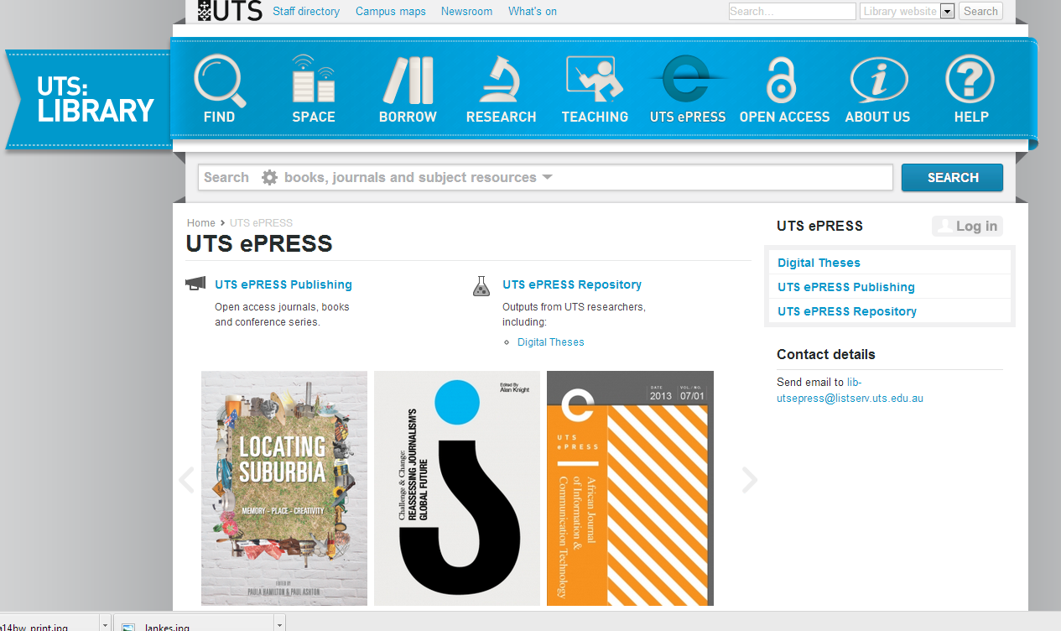

Slide 18
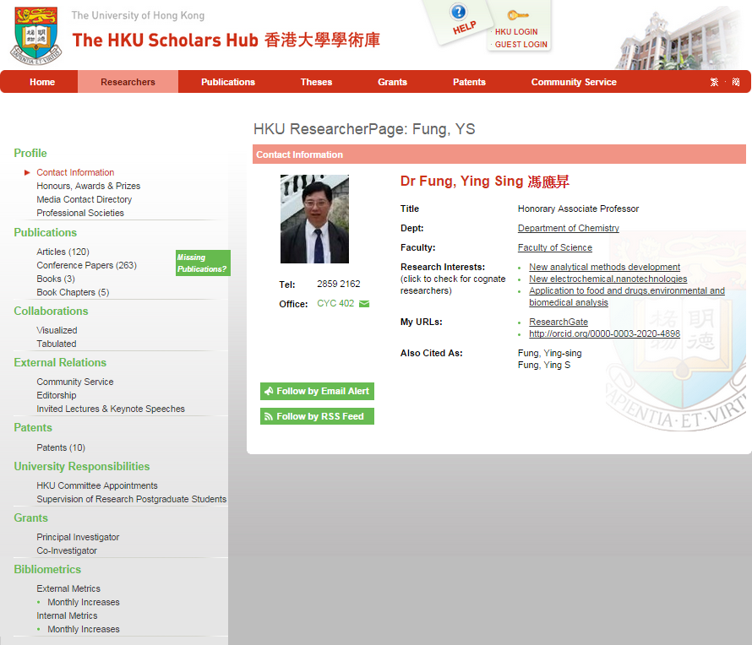
Compare: Kenning Arlitsch “New knowledge work”.

Slide 19
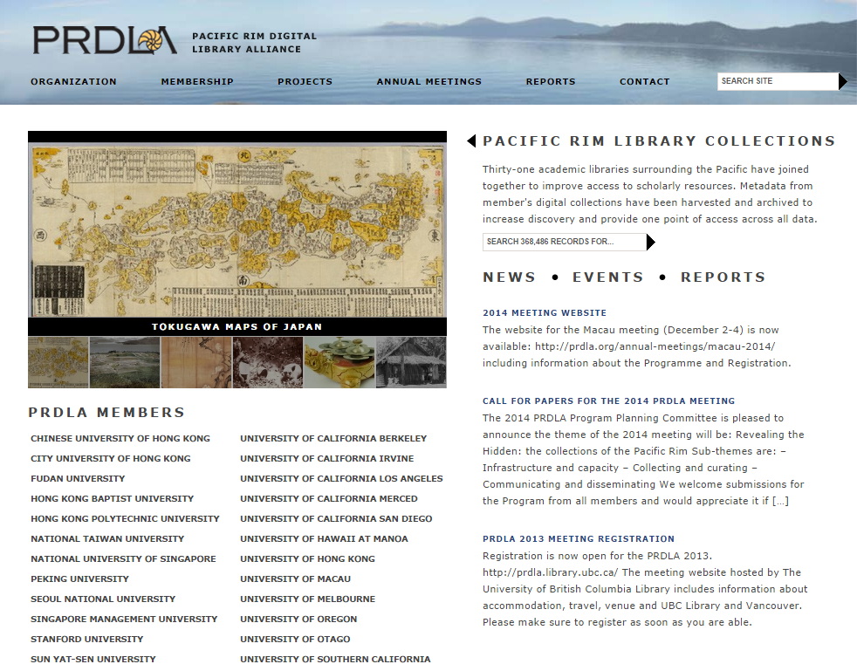

Slide 20
Collections as a service
Collection directions

Slide 21
The ‘owned’ collection
The ‘facilitated’ collection
The ‘borrowed’ collection
The ‘demand-driven’ collection
A collections spectrum
The ‘licensed’ collection
The ‘shared print’ collection
Purchased and physically stored
Pointing people at Google Scholar
Including freely available ebooks in the catalog
Creating resource guides for web resources

Slide 22
Workflow is the new content
Collection directions

Slide 23
arXiv, SSRN, RePEc, PubMed Central (disciplinary repositories that have become important discovery hubs);
Google Scholar, Google Books, Amazon (ubiquitous discovery and fulfillment hubs);
Mendeley, ResearchGate (services for social discovery and scholarly reputation management);
Goodreads, LibraryThing (social description/reading sites);
Wikipedia, Yahoo Answers, Khan Academy (hubs for open research, reference, and teaching materials).
GalaxyZoo, FigShare, OpenRefine (data storage and manipulation tools)
Github (software management)

Slide 24
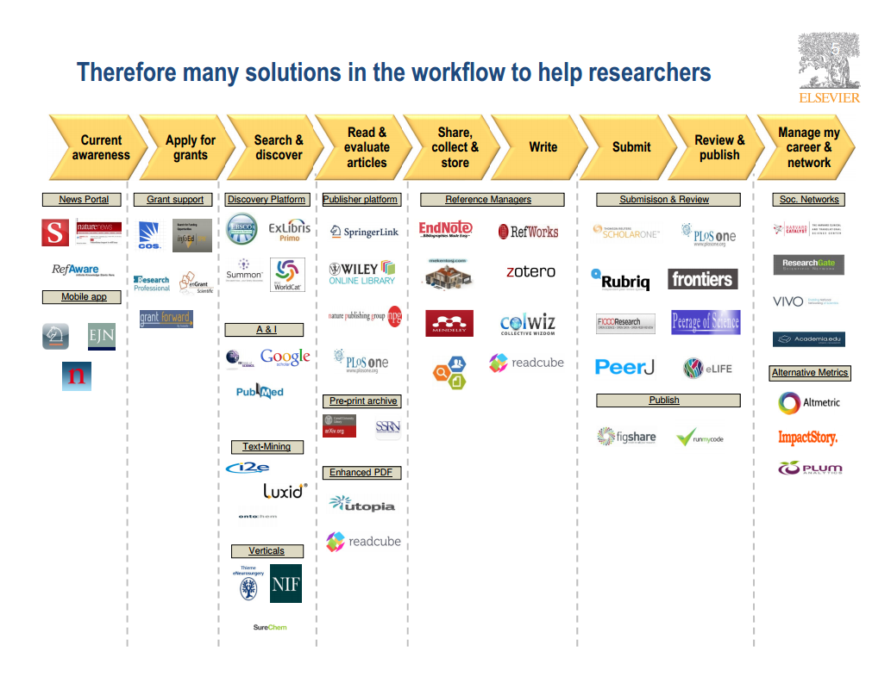
Wouter Haak
Elsevier, VP Product Strategy
LIBER, Riga, 2014

Slide 25
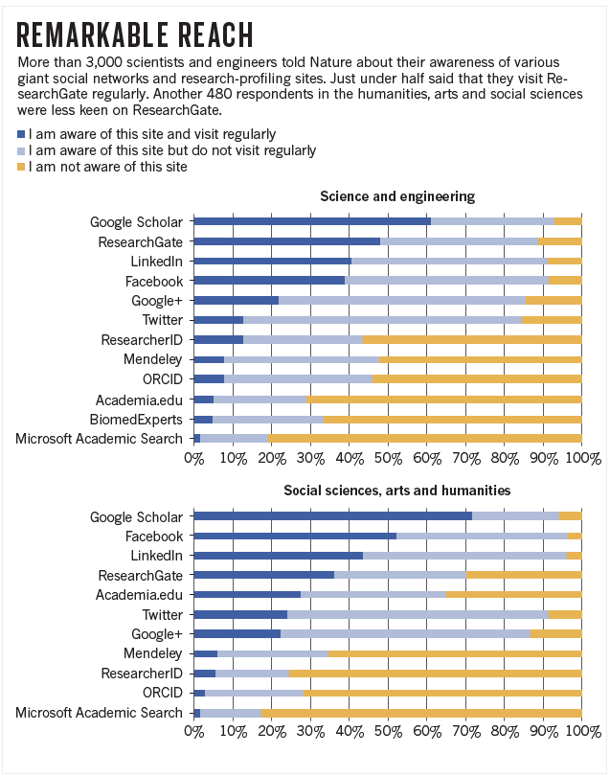

Slide 26
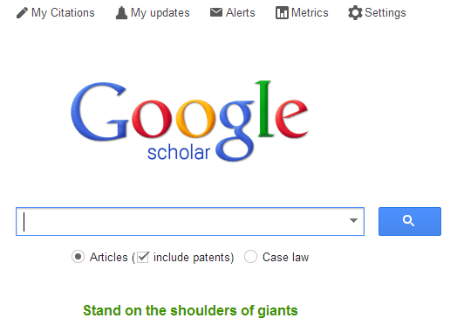

Slide 27
Visitors & Residents Framework
(White and Le Cornu 2011)
#vandr
Visitors and Residents resources http://goo.gl/vxUMRD
Notes:
This is a continuum and individuals may be display visitor or resident characteristics in different contexts and situations.
Visitors
functional use of technology
often linked to formal need
less visible/more passive online presence
more likely to favor face- to- face interactions
Residents
significant online presence and usage
high level of collaborative activity online
contributions to the online environment in the form of uploading materials, photos, videos.
White, David S., and Lynn Silipigni Connaway. 2011-2014. Visitors & Residents: What Motivates Engagement with the Digital Information Environment. Funded by JISC, OCLC, and Oxford University. http://www.oclc.org/research/activities/vandr/.

Slide 29
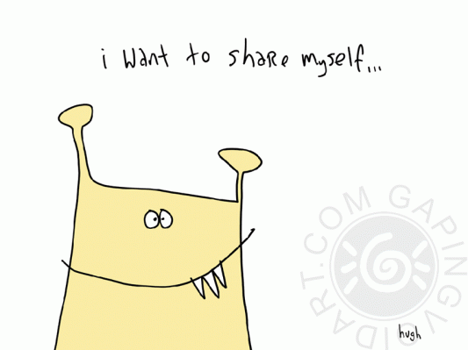

Slide 30
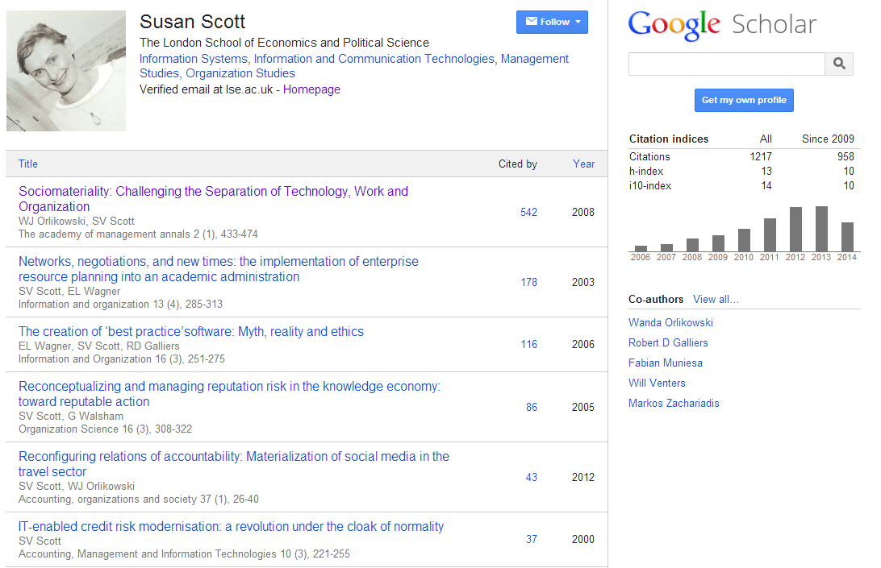
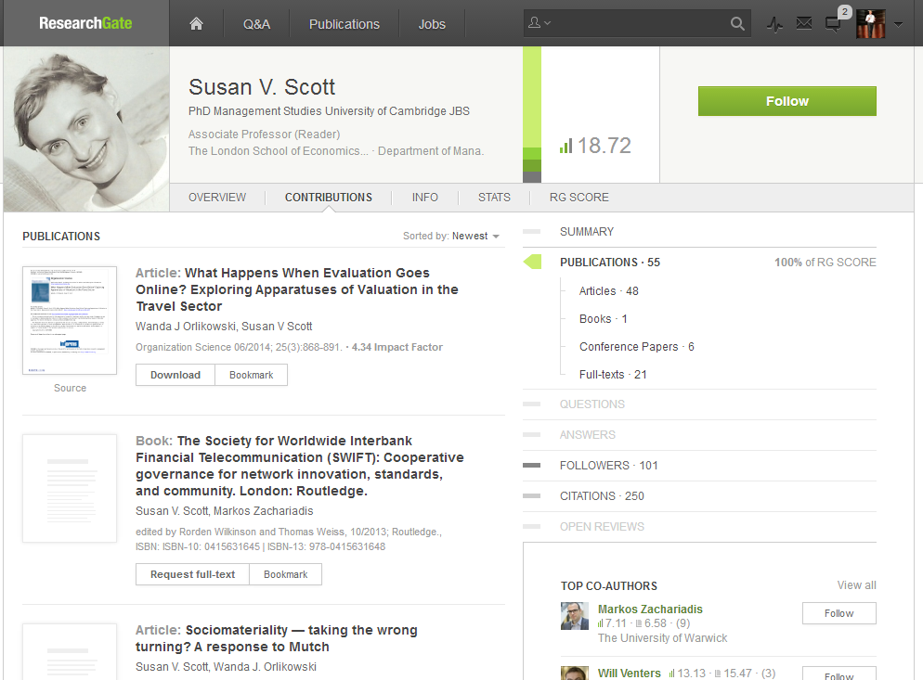

Slide 31
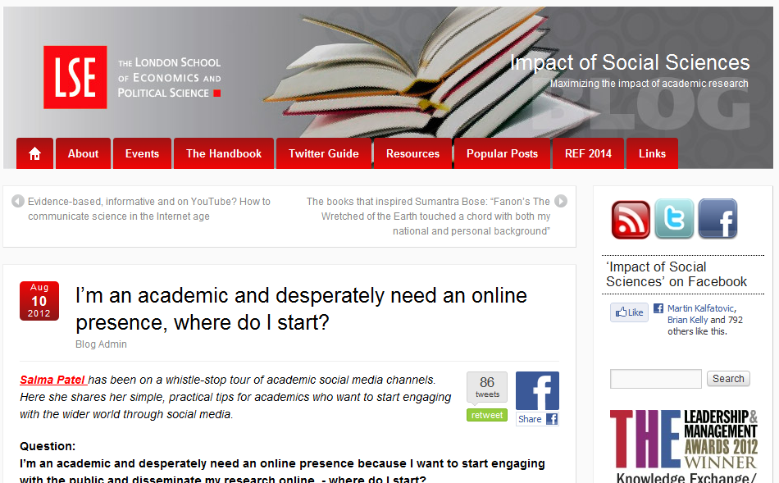

Slide 32
Workflow is the new content
In a print world, researchers and learners organized their workflow around the library.
The library had limited interaction with the full process.
In a digital world, the library needs to organize itself around the workflows of research and learners.
Workflows generate and consume information resources.

Slide 33
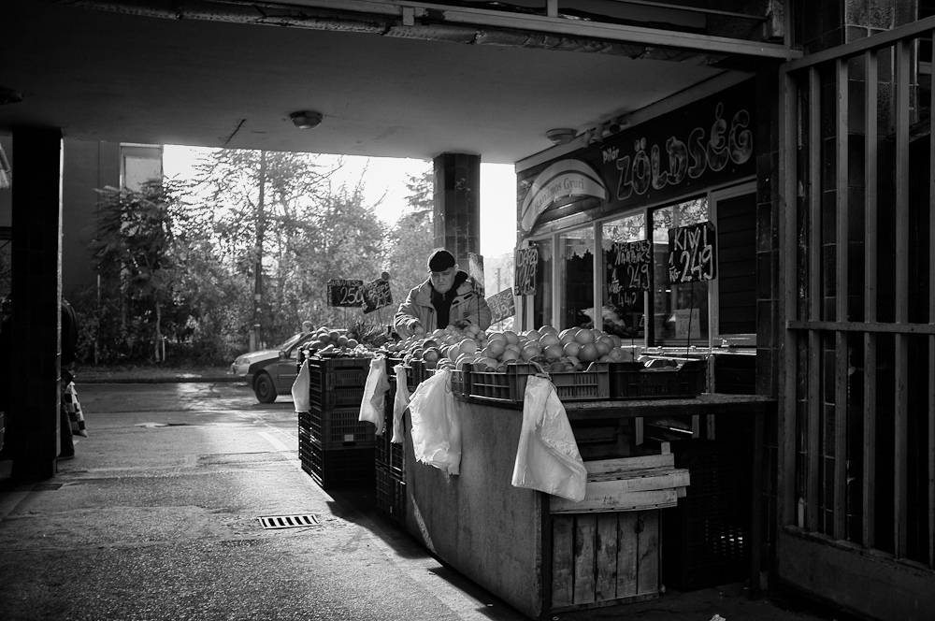
The Learning Black Market
“It’s like a taboo I guess with all teachers, they just all say – you know, when they explain the paper they always say, ‘Don’t use Wikipedia.’”
(USU7, Female, Age 19, Political Science)
Notes:
Image: http://www.deviantart.com/morelikethis/211376699
Covert online study habits
Wikipedia
Don’t cite
Widely used
Guilt
Students & teachers disagree
Quality sources
There is a “Learning Black Market”: learners use non-traditional sources but feel they cannot talk about them in an institutional context. Wikipedia usage is an example of this. (White & Connaway, 2011)
Connaway, Lynn Silipigni, Donna Lanclos, and Erin M. Hood. 2013. “I find Google a lot easier than going to the library website.” Imagine ways to innovate and inspire students to use the academic library. Proceedings of the Association of College & Research Libraries (ACRL) 2013 conference, April 10-13, 2013, Indianapolis, IN. http://www.ala.org/acrl/sites/ala.org.acrl/files/content/conferences/confsandpreconfs/2013/papers/Connaway_Google.pdf.
White, David. 2008. Not “natives’”& “immigrants” but “visitors’ & “residents.” TALL Blog: Online Education with the University of Oxford, April 23, http://tallblog.conted.ox.ac.uk/index.php/2008/07/23/not-natives-immigrants-but-visitors-residents/.
Saunders also found that faculty are “concerned with students’ reliance on Google and Wikipedia for information.” This may help to explain why many of the Emerging stage participants expressed a reluctance to acknowledge or cite Wikipedia in their work for fear of being ridiculed by faculty, or be given a lower grade. This is referred to as the Learning Black Market, which is discussed in more detail in Connaway, Lanclos, and Hood and White’s 2011 blog entry.
Saunders, Laura. 2012. Faculty perspectives on information literacy as a student learning outcome. The Journal of Academic Librarianship 38, no. 4 (2012): 231.

Slide 34
The inside out collection
Collection directions

Slide 35
OCLC Collections Grid
Purchased Materials
Licensed E-Resources
In many collections
Open Web Resources
Licensed
Abundance
Purchased
High Stewardship
Low Stewardship
Scarcity
Special Collections
Local Digitization
Research & Learning Materials
In few collections

Slide 36
OCLC Collections Grid
Then
Outside, in
In many collections
Library as broker
Maximise efficiency
A
Licensed
Commodity
Purchased
Low Stewardship
High Stewardship
Distinctive
Library as provider
Maximise discoverability
Inside, out
In few collections
Now
Notes:
Not just about ‘special’ collections

Slide 37
From curation to creation
Collection directions

Slide 38
U Minnesota, ARL Institutional profile
“In alignment with the University's strategic positioning, the University Libraries have re-conceived goals, shifting from a collection-centric focus to one that is engagement-based.”
http://umcf.umn.edu/awards/2006/images/margo_library_lg.jpg

Slide 39
Transformation of the academic library
Kurt de Belder
http://www.oclc.org/content/dam/research/events/dss/ppt/dss_debelder.pptx

Slide 40
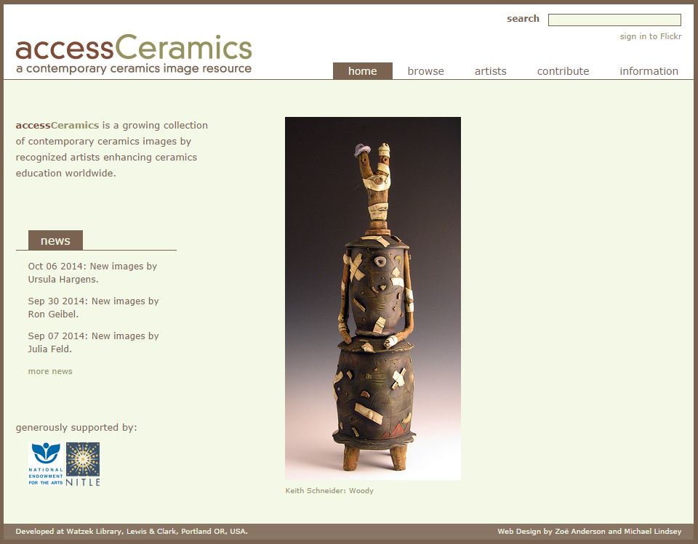

Slide 41
By Ardfern (Own work) [CC-BY-SA-3.0 (http://creativecommons.org/licenses/by-sa/3.0) via Wikimedia Commons
People should think not so much of the books that have gone into the … Library but rather of the books that have come out of it. Seán O'Faoláin

Slide 42
Towards the collective (print) collection
Collection directions

Slide 43
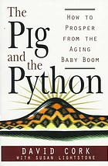
Warning:
Provocation
ahead

Slide 44
Institution: opportunity costs
Growing misalignment between level of investment in print collections and their use within changing practices of research and learning
Reconfigure space around engagement rather than around collections
Stewardship and efficient access remain important.
Systemwide: balance contributions
Manage down institutional collections
Collectively manage regional, national collections based on existing/emerging infrastructure
Recognizebbbbbbb different obligations – different levels of ‘responsibility’ to print record
Recognize distinctive contributions.

Slide 45
Shared print- collective collection Then: Value relates to depth and breadth of local collection. Now: Value relates to systemwide curation of and access to print collections – ‘rightscaling’.
Decision support through shared data.

Slide 46
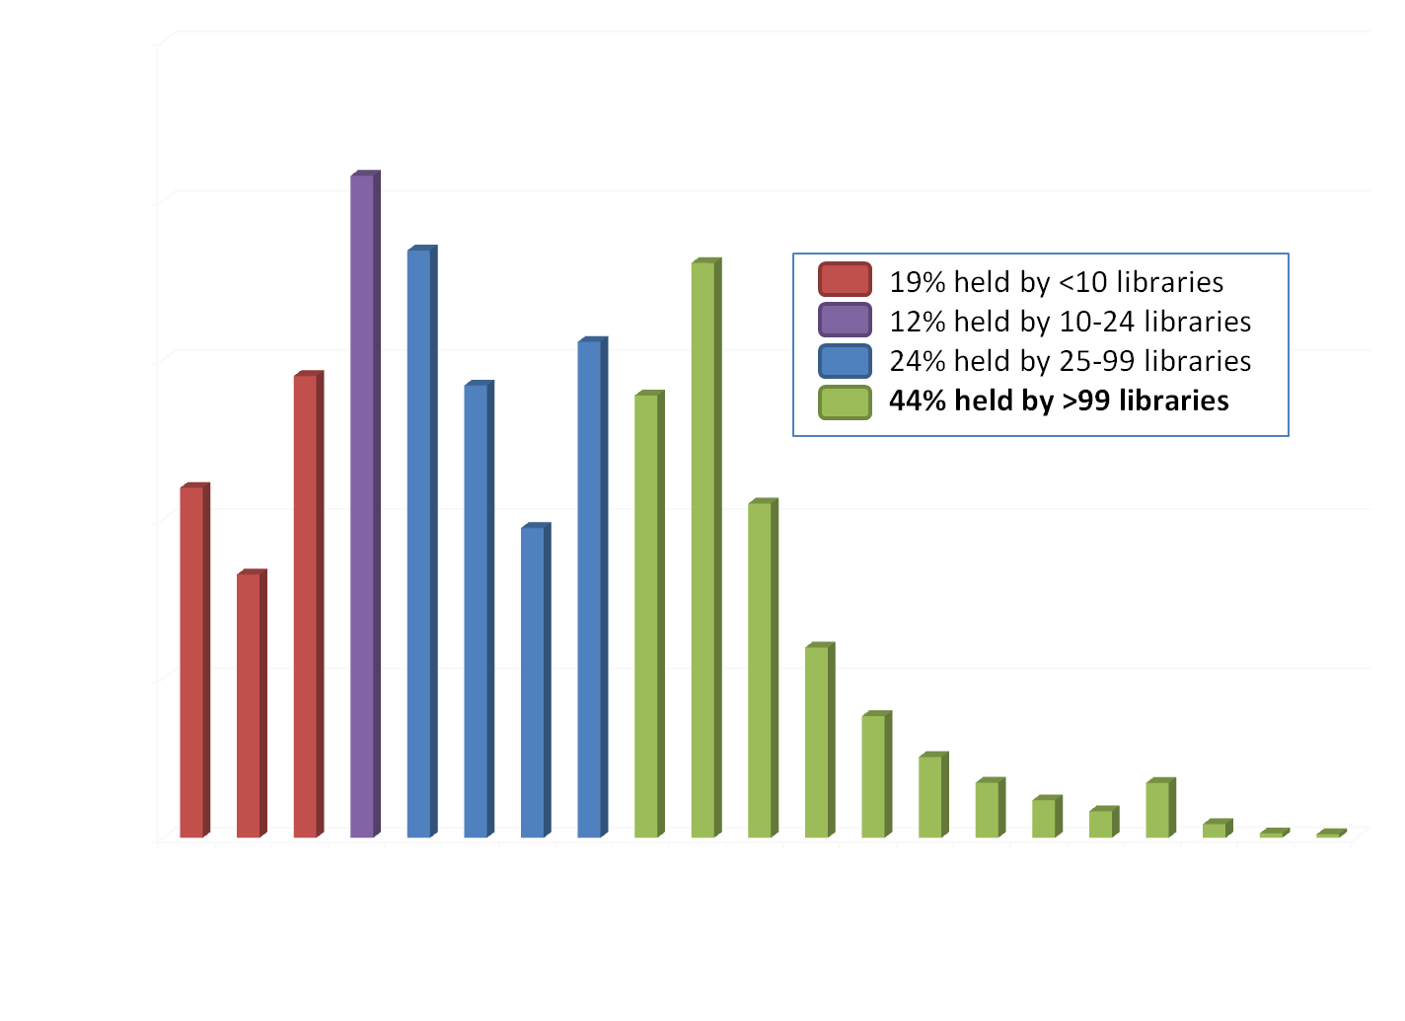
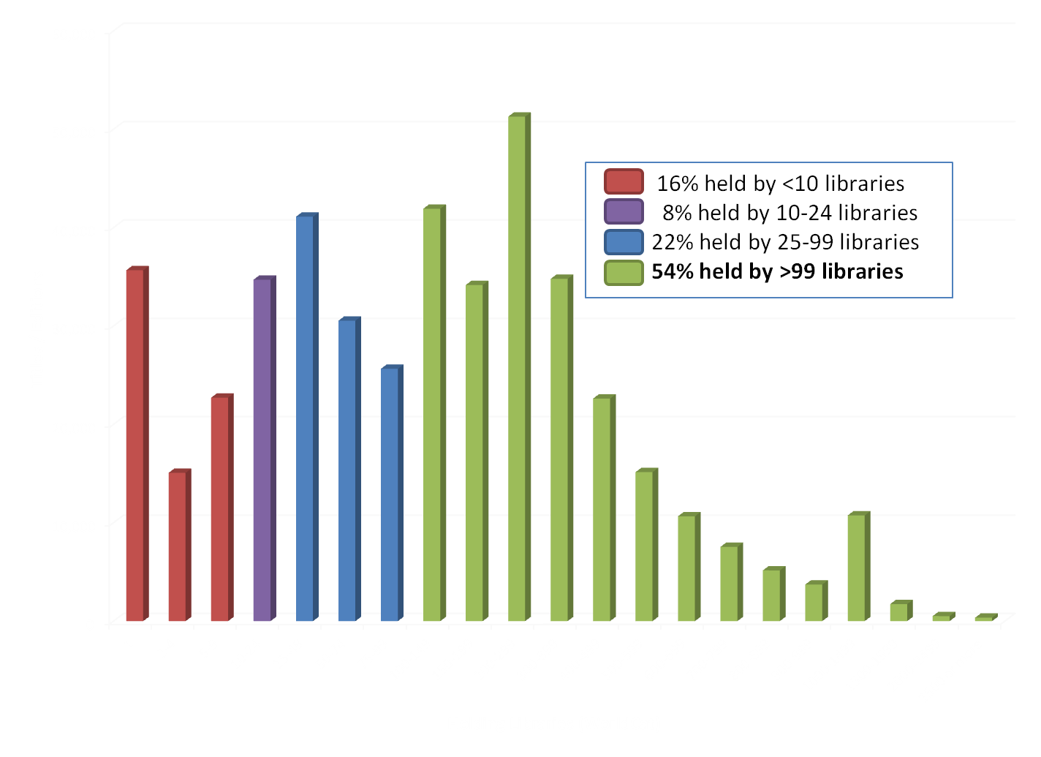
WorldCat Holdings Distribution for Titles Held by
the University of Melbourne Library (UMV) - March 2013
WorldCat Holdings Distribution for Titles Held by
the University of Tasmania Library (LT0) - March 2013

Slide 47
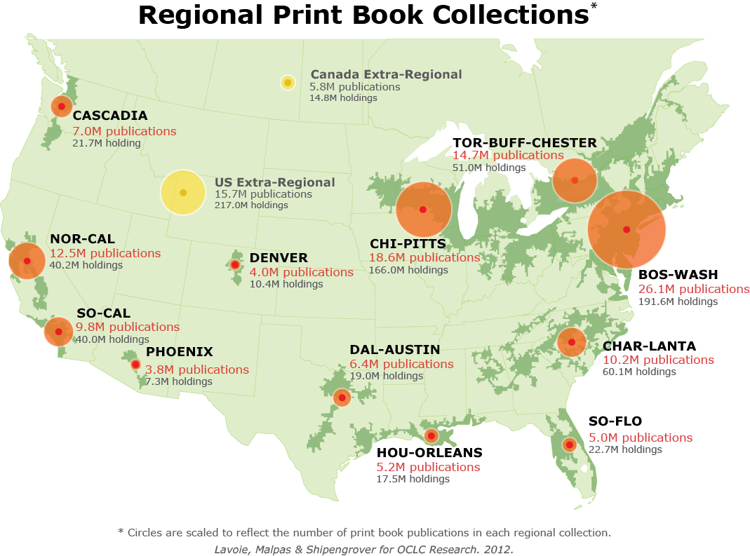
North American print book resource:
45.7 million distinct publications
889.5 million total library holdings
OCLC Research, 2013

Slide 48
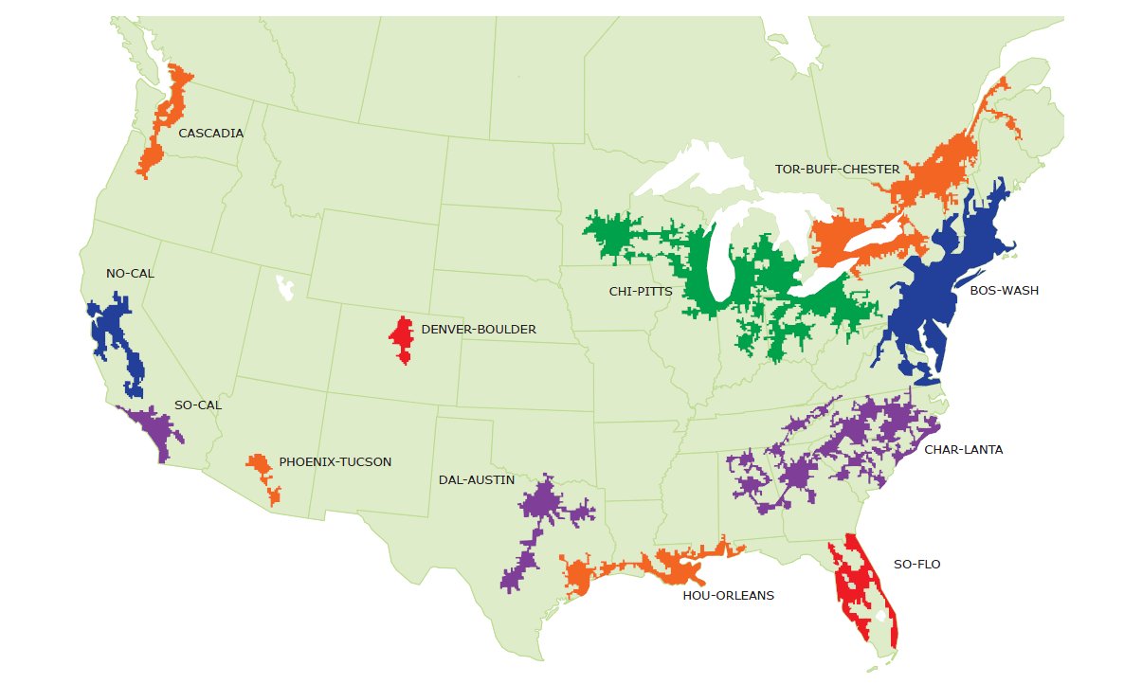
Mega-regions & Shared Print Initiatives
Orbis-Cascade
OCUL
MSCS
WEST
CIC
SCELC
WRLC
GWLA
ASERL
FLARE
We expect that in 5-7 years the larger part of the North American ‘collective collection’ will have moved into shared management.
OCLC Research, 2013

Slide 49
Shared Print in Asia Pacific
Joint Universities Research Archive
http://www.julac.org/?page_id=258
CONZUL Shared Print Journal Archive
http://www.universitiesnz.ac.nz/node/683
CARM Shared Storage and Shared Collection
http://www.caval.edu.au/carm.html
In Japan…
Shared Journal Archive (Springer)
Tokai Regional Shared Print Program
Notes:
JULAC Jura – U Hong Kong is the lead organization. Shared ASRS storage facility completion anticipated in 2017.
CONZUL – single copy shared journal archive with preservation and access assured by Crown Records Management.
CAVAL CARM offers shared collections storage and also a shared ownership collection of early 20C titles contributed by member libraries.
Several efforts underway in Japan – Chiba, Ochanomizu and Yokohama Universities (3 national, i.e. public universities) have established a shared journal archive of Springer titles. A group of public and private universities in Tokyo is currently developing plans for a regional shared print program. Additional initiatives are taking shape in other regions of Japan.

Slide 50
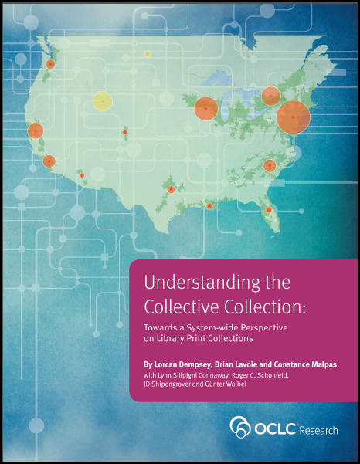
@LorcanD
http://www.oclc.org/research

Slide 51
Credits
My thinking here is based on ongoing shared work and discussion with colleagues, in particular in this area with Constance Malpas and Brian Lavoie (who provide some of the data analysis). Thanks to my colleague JD Shipengrover for graphics.
The evolving scholarly record http://oclc.org/content/dam/research/publications/library/2014/oclcresearch-evolving-scholarly-record-2014.pdf
Collective collection http://oclc.org/research/publications/library/2013/2013-09r.html
Collection Directions http://www.oclc.org/content/dam/research/publications/library/2014/oclcresearch-collection-directions-preprint-2014.pdf
Visitors and residents http://oclc.org/research/activities/vandr.html

