Slide 1
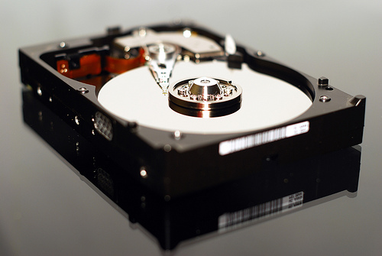
Demystifying Born Digital
ARLIS/NA, Pasadena, 27 April 2013
Jackie Dooley
Program Officer
OCLC Research

Slide 2
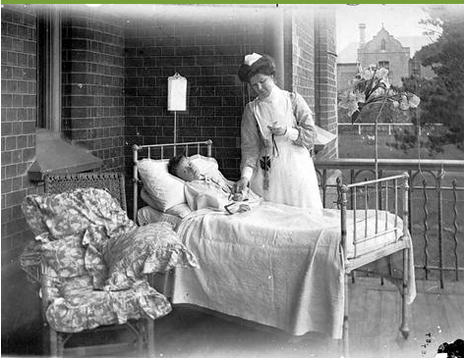
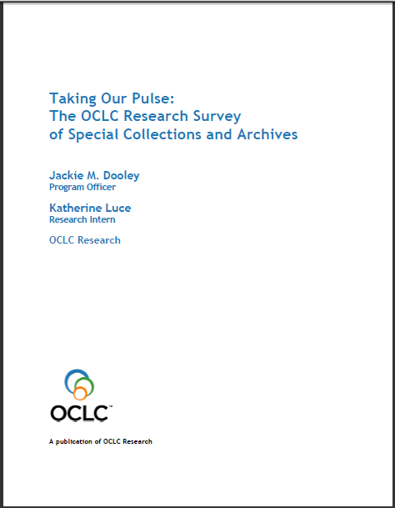
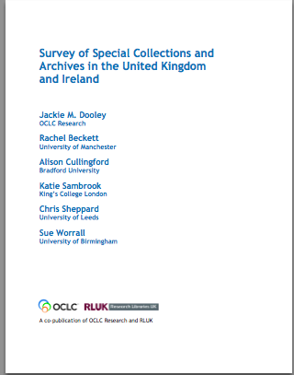
Taking Our Pulse(s)
Notes:
A 2009 survey of special collections and archives in the US and Canada shows that digitization of special collections and increasing user access to those collections are of critical importance to research libraries.
The survey was a follow up to the 1998 ARL survey led directly to many high-profile initiatives to "expose hidden collections.“
We updated ARL’s survey instrument and extended the subject population to encompass the 275 libraries in the following five overlapping membership organizations:
• Association of Research Libraries (124 universities and others)
• Canadian Academic and Research Libraries (30 universities and others)
• Independent Research Libraries Association (19 private research libraries)
• Oberlin Group (80 liberal arts colleges)
• RLG Partnership, U.S. and Canadian members (85 research institutions)
The rate of response was 61% (169 responses).
http://commons.wikimedia.org/wiki/File:Stethoscope_1.jpg
Stethoscope. Public domain.

Slide 3
Top education and training needs
Born-digital materials: 83%
Information technology: 65%
Intellectual property: 56%
Cataloging and metadata: 51%

Slide 4
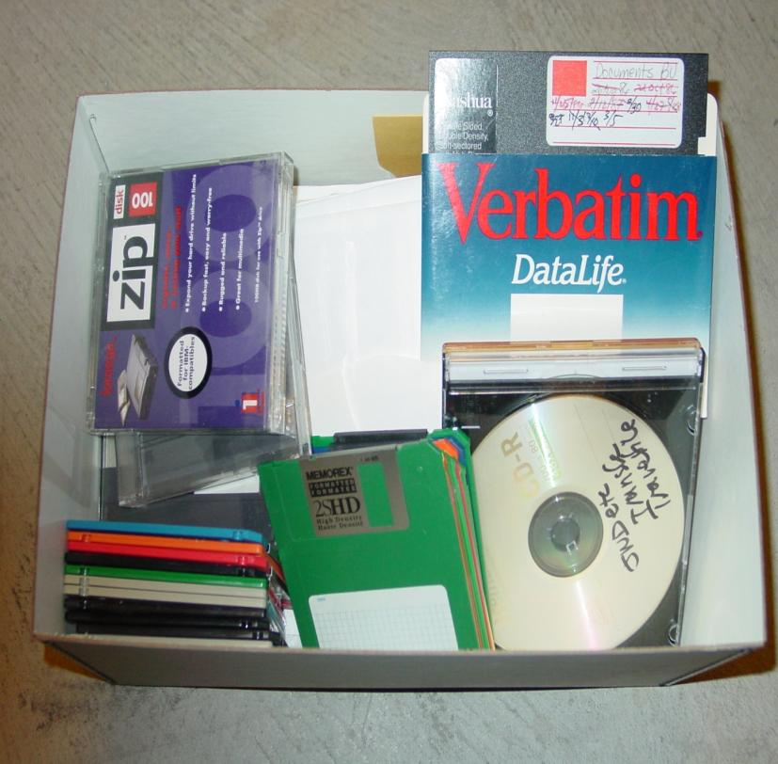
Born-digital materials are …
Undercollected
Undercounted
Undermanaged
Unpreserved
Inaccessible
American Heritage Center

Slide 5
In response, we launched …
In response, we launched …
Demystifying Born Digital

Slide 6
"Make things as simple as possible, but not simpler.”
--Albert Einstein

Slide 7
Target audiences
Research library directors and institutional administration
Archivists and special collections librarians
Other specialists
Collection development
Curatorial
Digital library
Information technology
Metadata
Records management

Slide 8
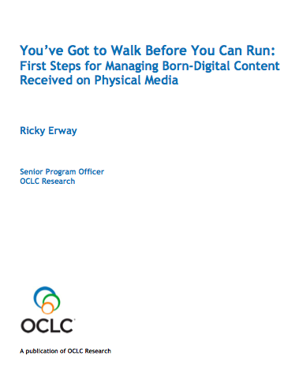
First Steps for Managing Born-Digital Physical Media (Published August 2012)

Slide 9
Intent of First Steps
Seek confidence building rather than overwhelming novices with complex information and procedures.
Knowing what you have (i.e., do an inventory) and taking some simple technical steps can allay the fear factor.
Archivist may have to begin alone without help from IT staff.
Having taken first steps, it’s then easier to continue learning.

Slide 10
Part 1: Inventory & prioritize
Inventory what you have
Types & quantities of physical media
File formats
Estimated number of gigabytes
Prioritize materials for processing
Anticipated level/nature of use
Level of significance/uniqueness
Potential loss due to age or type of media
Unique content not replicated elsewhere

Slide 11
Part 2: Technical steps
1. Use a “clean” computer.
2. Use a write blocker.
3. Insert source media. Do not attempt to open any files.
4. Create a disk directory.
5. Copy files from media to the directory. Consider copying as a disk image.
6. Generate a copy of the directory.
7. Generate and record a checksum.
8. Create a readme file.
9. Copy the directory to trustworthy archival storage.
10. Return the original physical media to storage.
11. Create or update any associated descriptive tool(s).

Slide 12
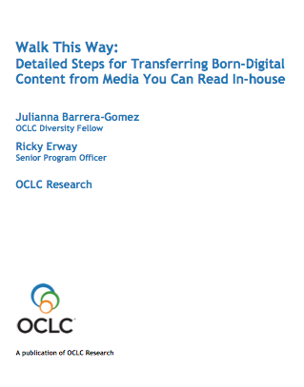
Detailed Steps
for Managing Born-Digital Physical Media
Coming spring 2013!

Slide 13
First Steps: Checksums
7. Generate and record a checksum (a unique value based on the contents of a file) on the disk image. Alternatively, if you copied the files instead of copying a disk image, generate and record a checksum on each file in the subdirectory.

Slide 14
Detailed Steps: Checksums
Level of Difficulty: Easy to Complex
Desirability: Highly Recommended
A checksum, or hash, is a unique value based on the contents of a file and is generated by specific algorithms (e.g., MD5 or SHA-256). Comparison of checksums generated from the same file at different times identifies whether and when the file has changed. Creating checksums is not difficult and may be done during several processes described earlier (such as creating a disk image, generating a directory list, or using the Duke Data Accessioner). It is very easy to create a hash for a single file and then to compare that hash to one generated for another copy of the file. An automated technique is necessary, however, when processing a large number of files.
It is important to note that while a changed checksum can alert a repository to the fact that something in a file or folder has changed, it cannot indicate what exactly has changed, nor can it reverse the change. Regularly hashing the file or image you have copied and checking those new hashes against the hashes made at the time of the transfer should be part of your digital curation workflow. During the lifecycle of your digital collections you will need to periodically verify the checksums to ensure that files remain unchanged.

Slide 15
Detailed Steps: Checksums, cont.
Disk imaging or Disk copying tools that incorporate checksums (see the Copy the Files or Create a Disk Image section for more details on these tools):
BitCurator: http://www.bitcurator.net/
FTK Imager (Forensic ToolKit Imager): http://accessdata.com/support/adownloads
Duke Data Accessioner: http://library.duke.edu/uarchives/about/tools/data-accessioner.html
File directory printing tools that incorporate checksums (see the Record the File Directory section for more details on these tools):
Karen's Directory Printer: http://www.karenware.com/powertools/ptdirprn.asp
Beyond Compare: http://www.scootersoftware.com/
NARA File Analyzer and Metadata Harvester: https://github.com/usnationalarchives/File-Analyzer
Collection management tools that incorporate checksums:
Archivematica: https://www.archivematica.org/wiki/Main_Page
From the website: “A free and open-source digital preservation system that is designed to maintain standards-based, long-term access to collections of digital objects. Archivematica uses a micro-services design pattern to provide an integrated suite of software tools that allows users to process digital objects from ingest to access …

Slide 16
Detailed Steps: Checksums, cont.
Curator’s Workbench: http://www.lib.unc.edu/blogs/cdr/index.php/about-the-curators-workbench
From the website: “The Workbench helps archivists manage files before they are stored in an institutional repository or dark archive. As the files are selected, arranged, and described, a METS file is generated by the software that documents these processes. In addition, checksums and UUIDs are generated for each object and MODS descriptive metadata elements can be mapped to individual objects and folders.” Developed at the University of North Carolina, Chapel Hill.
Standalone checksum tools:
Jacksum: http://www.jonelo.de/java/jacksum/
Md5summer: http://ww.md5summer.org
Md5deep: http://md5deep.sourceforge.net, command line tool that can also be used as a directory printer
Further Resources:
“Checksum Verification Tools: Guest Post by Carol Kussmann” Practical E-Records http://e-records.chrisprom.com/checksum-verification-tools/ (accessed December 2012) This blog maintained by Christopher Prom reviewed five checksum generating and verification tools.

Slide 17
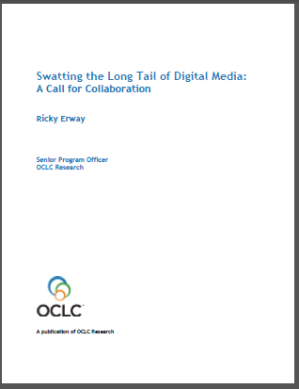
Swatting the Long Tail of obsolete media
Notes:
The second report, Swatting the Long Tail of Digital Media: A Call for Collaboration, urges a collaborative approach for conversion of content on various types of digital media. As with First Steps, the document refers only to born-digital material on physical media. This essay is intended for managers who are making decisions on where to invest their born-digital time and money. It should help them understand that any expectations that local staff will be able to handle everything are probably impractical. We hope it’ll also help archivists (and others) in the trenches breathe a sigh of relief to think that perhaps they won’t have to deal with an array of obsolete media all on their own.

Slide 18
Collaboration for converting obsolete media
“A call for a network of hubs to enable cost-effective outsourcing of the transfer of various types of physical media, particularly obsolete formats. We seek to reduce the need for everyone to figure everything out on their own, and instead set up a network of expert sites that have the necessary equipment and experience.”
“A community-based approach would use SWAT sites wherein a few self-selected institutions acquire and maintain the gear and expertise to read data and transfer content from particular types of obsolete media. The SWAT sites would provide transfer services for institutions that don’t have the capacity to read a particular medium ...”

Slide 19
Our next two reports will …
Articulate the relevant skills and expertise of archivists
Describe how these pertain to various types of born-digital material and how special collections and archives intersect with “born digital”

Slide 20
Thank you!
Demystifying Born Digital
http://www.oclc.org/research/activities/borndigital.html
Jackie Dooley
dooleyj@oclc.org

