Slide 1
Putting Research Data into Context: A Scholarly Approach to Curating Data for Reuse
2 November 2014
Ixchel M. Faniel, Ph.D.
Associate Research Scientist
OCLC Research
fanieli@oclc.org, Twitter @DIPIR_Project
The 77th Annual Meeting of the Association for Information Science and Technology (ASIS&T)

Slide 2
DIPIR Project
Nancy McGovern
ICPSR/MIT
Ixchel Faniel
OCLC Research
(PI)
Eric Kansa Open Context
William Fink UM Museum of Zoology
Elizabeth Yakel University of Michigan (Co-PI)

Slide 3
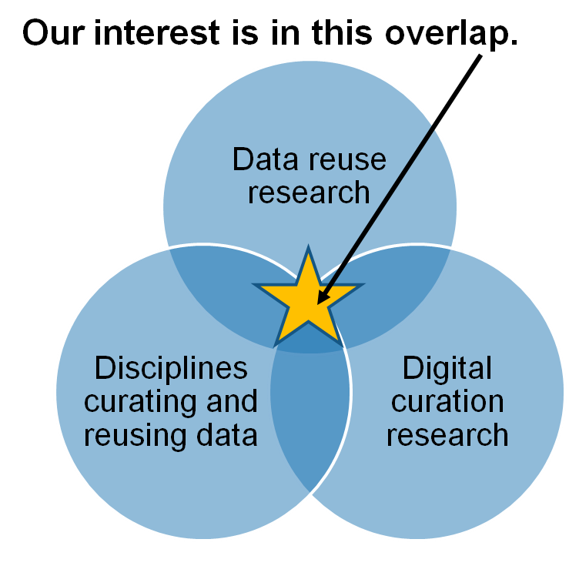
DIPIR: Overview & Objectives
What are the significant properties of quantitative social science, archaeological, and zoological data that facilitate reuse?
2. How can these significant properties be expressed as representation information to ensure the preservation of meaning and enable data reuse?
Faniel & Yakel 2011

Slide 4
DIPIR: Methods Overview
 | ICSPR | Open Context | UMMZ
Phase 1: Project Start up
Interviews Staff | 10 Winter 2011 | 4 Winter 2011 | 10 Spring 2011
Phase 2: Collecting and analyzing user data
Interviews data consumers | 43 Winter 2012 | 22 Winter 2012 | 27 Fall 2012
Survey data consumers | 2000 Summer 2012
Web analytics data consumers |  | Server logs Winter 2014
Observations data consumers |  |  | 11 Fall 2013
Phase 3: Mapping significant properties as representation information

Slide 5
Interviews and Observations
Data Collection
92 interviews via phone
11 observations at the University of Michigan Museum of Zoology
Data Analysis
1st cycle coding
based on interview protocol
more codes added as necessary
2nd cycle coding for context
Detailed context needed
Place get context
Reason need context

Slide 6
What are the significant properties of quantitative social science, archaeological, and zoological data that facilitate reuse?

Slide 7
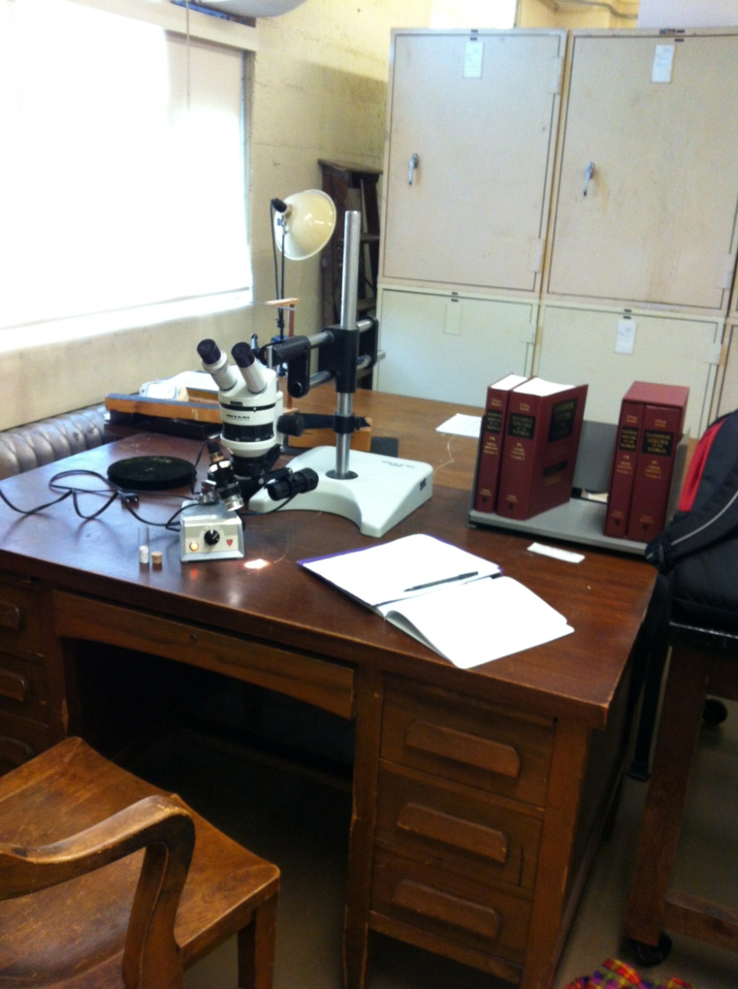
Findings
Detailed context reuser needed
Place reuser went to get context
Reason reuser needed context
Image: DIPIR Team

Slide 8
Detailed Context Reuser Needed
3rd Party Source
Advice Tips on Reuse
Data Analysis Information
Data Collection Information
Data Producer Information
Digitization or Curation Information
General Context Information
Missing Data
Prior Reuse
Rationale
Research Objectives
Specimen or Artifact Information
Terms of Use

Slide 9
Percentage of mentions by discipline
Detailed context reuser needed | Social Scientists | Zoologists | Archaeologists
3rd Party Source | 42%⁴ | 34%⁵ | 18%⁴
Data Analysis Information | 63%² | 26% | 14%⁵
Data Collection Information | 100%¹ | 76%² | 77%¹
Data Producer Information | 63%² | 55%³ | 14%⁵
Digitization or Curation Information | 9% | 37%⁴ | 9%
General Context Information | 19% | 11% | 23%³
Missing Data | 37%⁵ | 5% | 0%
Prior Reuse | 58%³ | 24% | 0%
Specimen or Artifact Information | 2% | 100%¹ | 50%²
¹⁻⁵Top 5 rank ordered
(n=43)
(n=38)
(n=22)

Slide 10
Places Reuser Went to Get Detailed Context
Additional 3rd Party Records
Bibliography of Data Related Literature
Codebook
Data Producer Generated Records
Documentation
Miscellaneous
People
Specimen or Artifact

Slide 11
Percentage of mentions by discipline
Place reuser went to get detailed context | Social Scientists | Zoologists | Archaeologists
Additional 3rd Party Records | 44%³ | 95%¹ | 45%²
Bibliography of Data Related Literature | 63%¹ | 74%² | 41%³
Codebook | 63%¹ | 0% | 0%
Data Producer Generated Records | 30%⁵ | 47%⁴ | 59%¹
Documentation | 58%² | 16% | 5%⁵
Miscellaneous | 7% | 3% | 5%⁵
People | 40%⁴ | 34%⁵ | 27%⁴
Specimen or Artifact | 0% | 55%³ | 5%⁵
¹⁻⁵Top 5 rank ordered
(n=43)
(n=38)
(n=22)

Slide 12
Reasons Reuser Needed Detailed Context
Assess Data Accessibility
Assess Data Completeness
Assess Data Credibility
Assess Data Producer Reputation
Assess Data Ease of Operation
Assess Data Interpretability
Miscellaneous
Assess Data Provenance
Assess Data Quality
Assess Data Relevance
Assess Trust in the Data

Slide 13
Percentage of mentions by discipline
Reason reuser needed context | Social Scientists | Zoologists | Archaeologists
Assess Data Completeness | 26% | 42%⁵ | 9%
Assess Data Credibility | 40% | 53%³ | 41%²
Assess Data Ease of Operation | 53%⁴ | 47%⁴ | 18%⁵
Assess Data Interpretability | 60%³ | 42%⁵ | 50%¹
Miscellaneous | 42%⁵ | 55%² | 27%³
Assess Data Quality | 21% | 42%⁵ | 23%⁴
Assess Data Relevance | 81%¹ | 68%¹ | 18%⁵
Assess Trust in the Data | 63%² | 68%¹ | 41%²
¹⁻⁵Top 5 rank ordered
(n=43)
(n=38)
(n=22)

Slide 14
Implications
Context internal and external to data’s production process is important to capture
Researchers go to common places to retrieve context
Researchers evaluate common data quality attributes, but those reusing longer may have clearer sense of attributes needed

Slide 15
Acknowledgements
Institute of Museum and Library Services
Co-PI: Elizabeth Yakel, Ph.D. (University of Michigan)
Partners: Nancy McGovern, Ph.D. (MIT), Eric Kansa, Ph.D. (Open Context), William Fink, Ph.D. (University of Michigan Museum of Zoology)
OCLC Fellow: Julianna Barrera-Gomez
Doctoral Students: Rebecca Frank, Adam Kriesberg, Morgan Daniels, Ayoung Yoon
Master’s Students: Jessica Schaengold, Gavin Strassel, Michele DeLia, Kathleen Fear, Mallory Hood, Annelise Doll, Monique Lowe
Undergraduates: Molly Haig

Slide 16
Questions

Slide 17
Ixchel M. Faniel, Ph.D.
Associate Research Scientist
OCLC Research
fanieli@oclc.org

