Slide 1
Beyond the Silos of the LAM’s: Time to Speak Up Collaborative and Open Software Development Directions for Libraries, Archives and Museums
James Michalko, Moderator Vice President, OCLC Research OCLC, Inc.
David A. Greenbaum Director, Data Services University of California, Berkeley
Beth Sandore Associate Dean
Associate University Librarian for IT Planning and Policy University of Illinois at Urbana-Champaign Robert H. McDonald Associate Dean for Library Technologies
Executive Director, Kuali OLE Indiana University
tag US #CNI10s #LAM

Slide 2
Background: Silos of LAM’s
Libraries, archives, museums’ content lives in separate and inaccessible silos
Disservice to scholars & publics
Long-term obstacles for management
Cost-prohibitive technology infrastructure
Insufficient support within LAM’s for separate systems and infrastructures

Slide 3
Foundation work
Beyond the Silos of the LAM’s: Collaboration among libraries, archives, and museums.
Diane M. Zorich; Gunter Waibel, and Ricky Erway. 2008: OCLC Research
http://www.oclc.org/research/publications/library/2008/2008-05.pdf

Slide 4
The Key Questions for LAM’s
Mellon Foundation supporting development of three open source software products:
Kuali OLE for libraries
ArchivesSpace: the Next Generation Archival Management Tool for archives
CollectionSpace for museums
A new opportunity for coordination? collaboration? convergence?
On what dimensions? With what degrees of difficulty? Payoffs? To whom?

Slide 5
Archivesspace: Background
Next generation archival management and access system
Archivist’s Toolkit + Archon = access & management
Users: archivists and researchers, all types & sizes
Approach: access & management
“By archivists, for archivists”
Planning: 2010 – re-conceptualize AT & Archon
Development: 2011-2012
Notes:
Luc Declerck (UCSD), David Millman (NYU), Susan Harum, and Beth Sandore (UIUc)
1. Archival management and access software systems pre-2010:
* Disparate proprietary systems
* Archivist's Tookit (UCSD, NYU) and Archon (UIUC) were frontrunners and developed as open source; Both supported by Mellon. AT focused on support of rich description and management and excelled in back-office activities; Archon focused on Web access and support for small-to-medium sized archives; both employed EAD standard.
* Both systems are deployed with reasonably strong user base and both had garnered awards and recognition for superior design and service support.
* A background study done in 2008 showed that market too small to support two systems, and doubtful it could support one system with a traditional market approach.
2. June 2009: planning for union
* June 2009: Andrew Mellon Foundation asks Archon and AT to consider merging the two software systems;
* Summer 2009: team from UCSD, NYU, UIUC propose to design best-of-breed archival access and management system, including workable business and goernance models.
* January 2010: Andrew Mellon Foundation awards 1-year planning grant.
3. Planning:
* January- March 2010: High-level functional specifications developed; led by archivists Westbrook, Schwartz, Prom and involving community input; more detailed spec's to follow.
* March - June 2010: technical design conversations and planning; participants from archives and technology communities;
* April - July: business model and governance-sustainability plan developed with interested institutions participating.
* August - October 2010: proposal for development of system.
* January 2011 - Dec. 2012: software developed and introduced to community.
4. Opportunities for partnerships and interoperability:
* Libraries and museums
* Academic library groups (Kuali and OLE)

Slide 6
Archivesspace: Collaboration & connection
Partners: UC San Diego, New York University, Univ. of Illinois and AT, Archon communities
Partnerships with communities:
Academic
Cultural heritage
Technology
Content
Challenges:
Governance; sustainable business model
Balance: archival management : integrated content access
Notes:
Three institutions were invited by Mellon to spearhead the archivesSpace effort: the University of California San Diego is in the lead, along with New York University and the University of Illinois
ArchivesSpace is somewhat unique in that it seeks to take the best elements of two already-developed software systems and build a robust, extensible (or integratable) system using the experience base and the community we now have as a springboard to a stronger unified community and product
We are seeking partnerships to emerge with a solid and sustainable technology platform—the common technology foundation used by Kuali has a strong appeal to us because it has the potential to support the core of cultural heritage systems; that could carry a strong potential for long-term sustainability. There would be a larger community of developers. There would also be a built-in governance model and a larger umbrella organization.
One considerable challenge stems from the fact that there is a significant community of small-to-medium-sized archives and hundreds if not thousands of “lone arrangers”—archivists and curators who are one-person operations and cannot afford to support a software system with a consistent financial investment. Any solution that we provide will need to incorporate and welcome free riders, as it will need to identify and gain commitment from institutions that can support a regular investment in the long-term growth of this tool.

Slide 7
Kuali OLE: mission
The mission of Kuali OLE is to develop a sustainable Kuali system that provides academic library management services for higher education. It will use the legal umbrella of the Kuali Foundation, adhere to the Kuali licensing guidelines, and use the Kuali middleware, infrastructure, tools and processes.

Slide 8
Kuali OLE: BAckground
OLE Project lead by Duke with 15 partners Universities, Consortiums & National Libraries
Community engagement & participation effort – over 300 participants from more than 100 institutions
Described a service registry of library business process
Surfaced sufficient need & ability to go forward with a build project for a community-sourced library system
Led to Kuali OLE Build initiative with 9 core partners.
JISC Report – ILS Systems and the Shared Services Survey (http://www.jisc.ac.uk/publications/briefingpapers/2008/librarymanagementbp.aspx)

Slide 9
Kuali Ole: Collaboration and Connection

Slide 10
Kuali OLE: Timeline
Design project – Sept 2008 – July 2009
Develop build partnership – Fall 2009
Kuali Charter
Proposal for Mellon funding
Commitment by partners
Build – 2010 – 1212
phase 1 – hiring, governance & design review
phase 2 – infrastructure & data flows
phase 3 – integration & testing
phase 4 – implementation & extension

Slide 11
CNI Spring Forum 2010
David A. Greenbaum
Director, IST-Data Services, UC Berkeley
Co-Director, CSpace
Co-Director, Project Bamboo
www.collectionspace.org
CSpace is being developed with the generous support of the
Andrew W. Mellon Foundation

Slide 12
CollectionSpace is an open-source, services-based software platform for the description, management, and dissemination of museum collections information – from artifacts and archival materials to exhibitions and storage. CSpace 1.0 will be released June 2010.

Slide 13
Project Partners
Museum of the Moving Image, New York
University of California, Berkeley, Information Services and Technology Division
University of Cambridge, Centre for Applied Research in Educational Technologies
University of Toronto, Adaptive Technology Resource Centre, Fluid Project

Slide 14
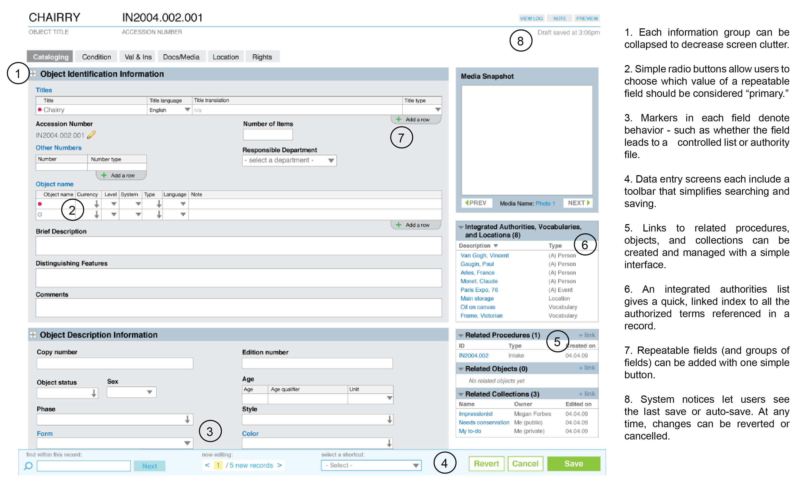
How We’re Making it Easy
Notes:
Focus on user experience. Alot of museum systems in the past were quite primitive.
On museum end-users, across museums and disciplines.
On a highly configurable application.

Slide 15
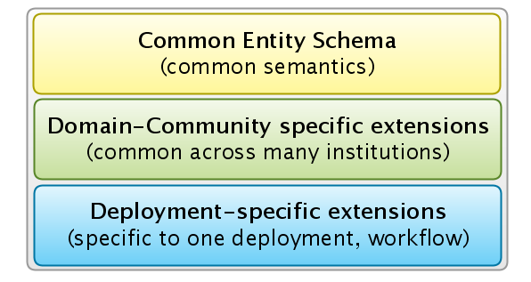
Schema Extension Model
Schema model to support museums across disciplines: art through zoology
Notes:
From Art to Zoology ...
The value play for us at Berkeley is to move from 5 platforms across to One!
But must respect the unique data models

Slide 16
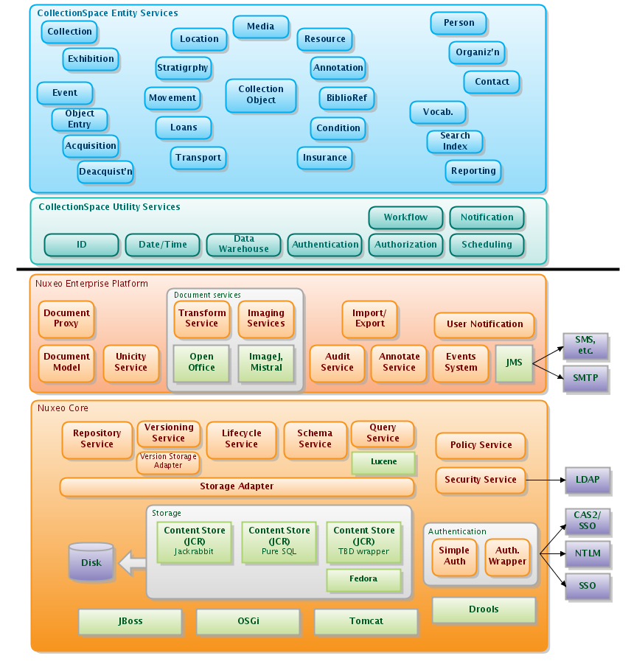
Services Stack
Platform for applications
Services-based
REST focused
Platform on a Enterprise Content Mang. Platform (ECM)
Built to integrate with other tools and data sources
Multi-tenant for hosted support

Slide 17
Collaboration and Connections
Sustainability of: (1) software development, (2) deployments, and (3) operations. Each with different dimensions.
A Community of communities...
Archives, libraries, and other key content technologies
Local: Berkeley Campus Collections Community
Disciplinary: Integrated with multiple disciplinary-based, consortia in/outside of campuses (e.g, Herbaria)
Global: Strong interest in a Foundation structure
Who and how to align? FoundationSpace?

Slide 18
The Good, the bad & the ugly
End-user Experience
Technical Architecture
Organizational/Consortial
Notes:
End-User experience
Convenient/efficient discovery of content
Exposure of metadata to multiple systems
Aggregation of metadata
Options to use social networking to enhance access, discovery and description
Technology:
Name, subject authorities
Authentication/Authorization
Management reports
Discovery: front-end integrated or federated
Metadata management
Workflow
Payment systems
Object ingest and management
Integrate data streams from various sources
Sustainability:
Shared foundation (non-profit business model)
Challenges to establish sustainable business model across diverse user community (e.g., small, medium, large, “lone arrangers,” government, private)
Shared administrative infrastructure (leadership, vision, legal, governance)
Technical infrastructure—software and database development critical technical mass
Communication/interaction infrastructure
Integrated delivery point for LAM’s software tools
LAM’s tools could be packaged together (shrink-wrap)
Challenges:
Common middleware development
Metadata schema and management
Functionality and audience focus
Mutliple Discovery and Access Layers
Business / sustainability across communities
Enterprise adoption across multi-type institutions

Slide 19
Audience Participation
http://app.sliderocket.com/app/FullPlayer.aspx?id=d38f28a5-44da-4d60-8ca1-4d3f21a3b8e4

Slide 20
Project Links
CollectionSpace - http://www.collectionspace.org
ArchivesSpace –
http://www.archiviststoolkit.org/
http://www.archon.org/
Kuali OLE – http://www.kuali.org/ole

