Slide 1
MOOCs
& Libraries
Massive Opportunity or Overwhelming Challenge?
Jim Michalko, OCLC Research
With ample borrowings from Lorcan Dempsey, Brian Lavoie, Chris Galvin and Tam Dalrymple of OCLC

Slide 2
MEDIA FRENZY
Individual personal attention
Any schedule
Any place
Tutorial relationship – takes into account individual differences in learning
Better than the crowded classroom of the ordinary American University

Slide 3
MEDIA FRENZY
Individual personal attention
Any schedule
Any place
Tutorial relationship – takes into account individual differences in learning
Better than the crowded classroom of the ordinary American University
University of Chicago’s Home-Study Department regarding their correspondence courses

Slide 5
At least as daunting as the technical challenges will be the existential questions that online instruction raises for universities. Whether massive open courses live up to their hype or not, they will force college administrators and professors to reconsider many of their assumptions about the form and meaning of teaching. For better or worse, the Net's disruptive forces have arrived at the gates of academia.
Nicholas Carr, MIT Technology Review 27 September 2012

Slide 6
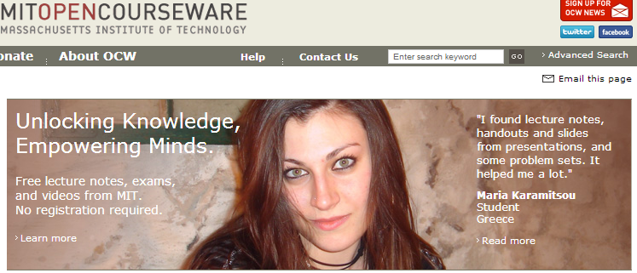
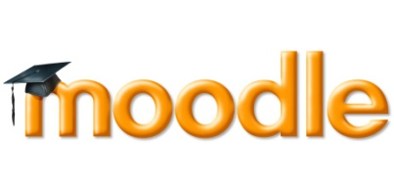
(Various precursor strands in online education …. )

Slide 7
(Various precursor strands in online education …. )

Slide 8
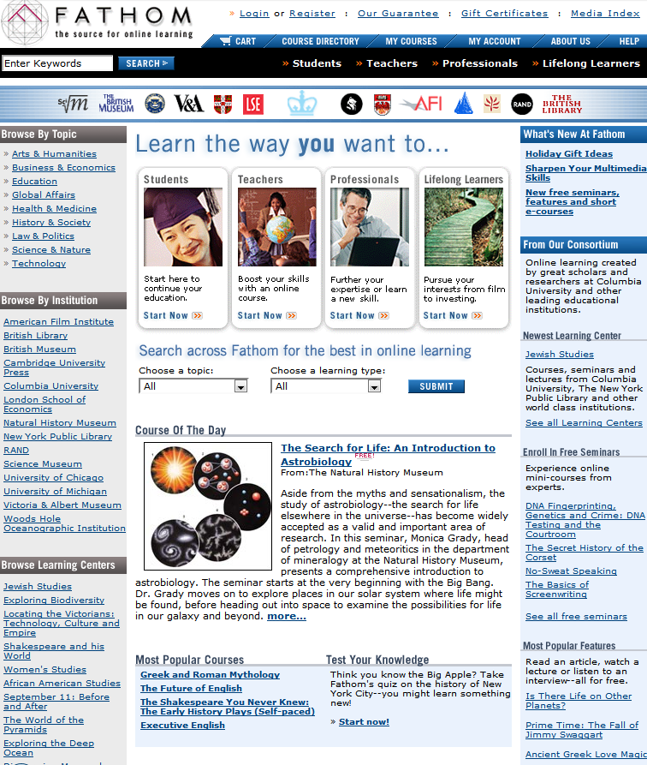
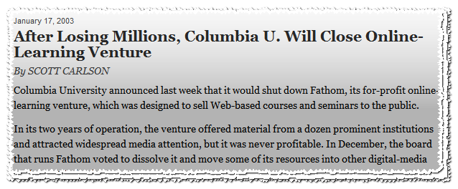

Slide 9
Massive Open Online Course

Slide 10
Massive Open Online Course
Scalable to large numbers …
Free, accessible … collaborative,
Reimagined for network
environment …
Not just materials …

Slide 11
April 2012

Slide 12
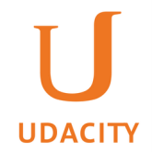
April 2012

Slide 13
NAME | TYPE | FUNDING | BUSINESS MODEL | PARTNERS | COURSES
EdX (April 2012) | Academic | MIT, Harvard: $30m each U. of Tex: $5m Gates: $1m | Non-profit; Plans to charge fee for certificates of completion | 12 including MIT Harvard UC Berkeley U. Of Texas | 26 courses at at March 2013; 500,000 reg. 370,000 users
Coursera (April 2012) | Academic | VC: $16m (KPCB, NEA) Add’l equity $6m (including Cal Tech, Penn) | For-profit; Plans to charge for certification, testing, sale of student info | 62 University partners, including: Columbia U. Of Toronto U. of Washington | 328 courses at March 2013 ; 1.5 m reg. 680,000 users (July 2012)
Udacity (April 2012) | Academic | VC: $22m (Andreesen Horowitz, Charles River, Steve Blank) | For-profit; In-person proctored exam $89; Job placement; Plans for fee-based online secure exams | Notables: Sebastian Thrun Peter Norvig Steve Huffman | 22 courses 750,000 users (January 2012)
Khan Academy | General | O’Sullivan Foundation:$5m; Gates, Google: $2m; Private donors | Non-profit; No revenue | Nearly all content created by Salmon Khan; 2 addt’l faculty hired; plans to hire more | 3,500 videos; 200m lessons delivered; 1.4m reg. (Dec. 2011)
Notes:
62 Universities Have Partnered With Coursera (16 outside US)
Berklee College of Music
Brown University
California Institute of Technology
California Institute of the Arts
Case Western Reserve University
Columbia University
Curtis Institute of Music
Duke University
École Polytechnique
École Polytechnique Fédérale de Lausanne
Emory University
Georgia Institute of Technology
Hebrew University of Jerusalem
IE Business School
Icahn School of Medicine at Mount Sinai
Johns Hopkins University
Ludwig-Maximilians-Universität München
National Taiwan University
National University of Singapore
Northwestern University
Ohio State University
Pennsylvania State University
Princeton University
Rice University
Rutgers University
Sapienza University of Rome
Stanford University
Technical University of Denmark (DTU)
Technische Universität München (Technical University of Munich)
Tecnológico de Monterrey
The Chinese University of Hong Kong
The Hong Kong University of Science and Technology
The University of British Columbia
The University of Edinburgh
The University of North Carolina at Chapel Hill
The University of Tokyo
Universidad Nacional Autónoma de México
Universitat Autònoma de Barcelona
Universiteit Leiden
University of California, Irvine
University of California, San Diego
University of California, San Francisco
University of California, Santa Cruz
University of Colorado Boulder
University of Copenhagen
University of Florida
University of Geneva
University of Illinois at Urbana-Champaign
University of London International Programmes
University of Maryland, College Park
University of Melbourne
University of Michigan
University of Minnesota
University of Pennsylvania
University of Pittsburgh
University of Rochester
University of Toronto
University of Virginia
University of Washington
University of Wisconsin–Madison
Vanderbilt University
Wesleyan University

Slide 14
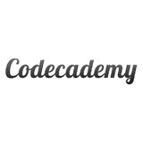
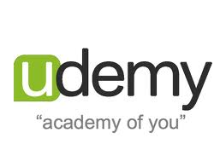
A few more …
Funding from Hewlett, Shuttleworth, Mozilla
Incubated at UC Irvine
Classes set up as challenges to be solved collaboratively
Non-profit
Funding from Hewlett, Gates, Kresge, NSF, others
Some courses free; some have maintenance fees
Some courses used by universities/colleges to
support classroom instruction
Platform available for others to design and
deploy new courses
Owned by Ampush Media
Aggregates online open courses form universities
around the world within a single interface, with
additional services layered on top
Bisk Education and Embanet+Compass, along with Pearson, are perhaps the most visible players, but Academic Partnerships, Deltak, 2tor and Learning House have also built successful businesses doing online program development for colleges
Etc. Etc.
$12. 5m venture capital funding
Online training for programmers
Business model unclear; possibly
corporate recruitment
$4m venture capital funding
Online learning platform which instructors can
use to host courses
Free and paid courses available
30% cut of fees for paid courses

Slide 15
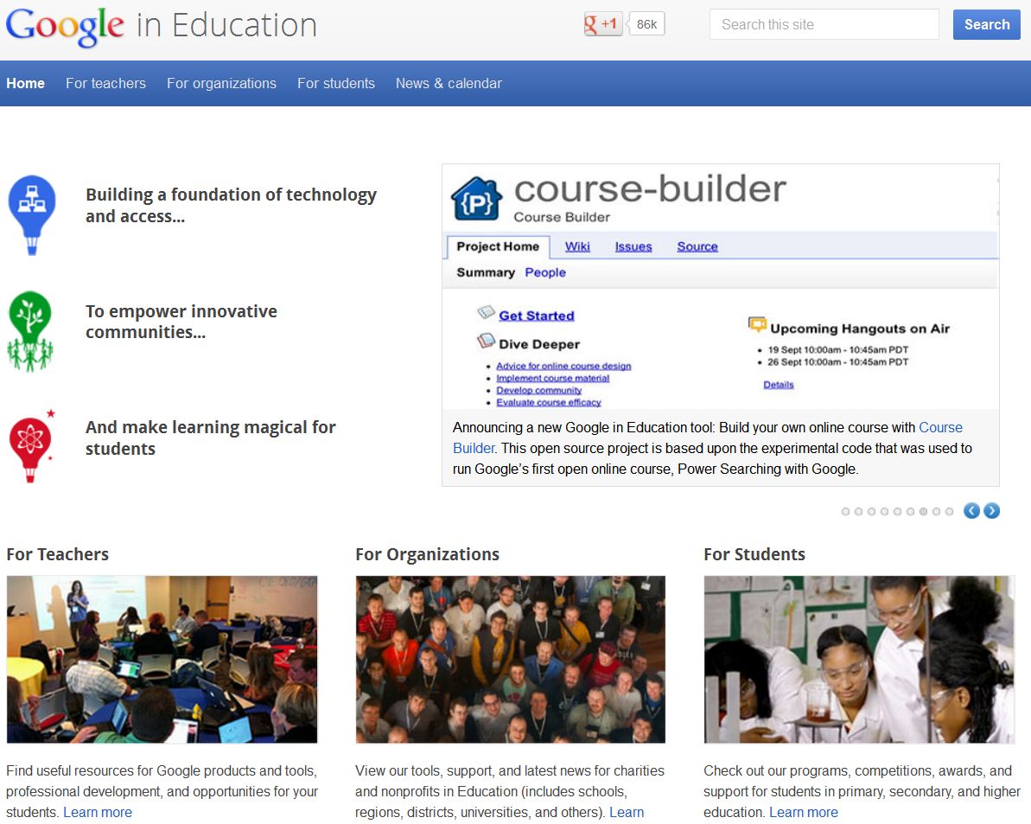

Slide 16
Why now?

Slide 17
MOOCs have become a flashpoint for discussion
of higher ed because they represent an easily
graspable, almost parodic version of what was
previously invisible : elite university education.
They have a unique power to drive public
perception of the entire sector.
Alyson Byerly. Formerly known as students. Inside Higher Ed. October 29 2012.

Slide 18
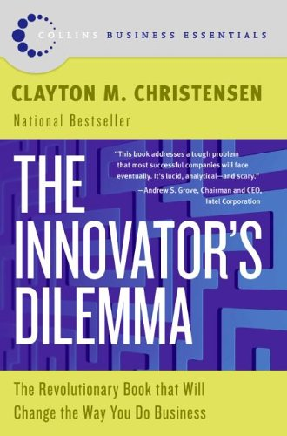
Broken University Business Model
plus
Disruptive Technologies
Notes:
Uncontrolled cost increases
Critical skills not learned
Resistance to innovation
Irrelevant Scholarship
Tenure and accountability
Tuition subsidizes research
Prestige arms race
Change the value proposition
Lower performance relative to desired attributes from mainstream customers
Have attributes valued by fringe (new) customers
Cheaper, smaller, simpler, more convenient
Experience and investment improve them so they eventually take over old market
Quality at scale
Competing on cost
Integration of career and academic preparation
Problem-focused research
Is there a crisis in higher ed? (subset of culture and global crises)
What’s an education? (Newman vs. Utilitarians) What’s it for?
What do we know about teaching and learning? (Metrics and assessment)
What’s a university? (Bologna/Paris, Nostalgia/History, Faculty Governance)
Same questions with
the inclusion of women and minorities;
the advent of technical colleges, community colleges and land-grant universities;
and the implementation of the G.I. Bill.
The running battle of abstract thinking and applied knowledge
Is this time different?

Slide 20
PLATFORM WAR…
Network level disruption
Aspirational: Systemwide transformation
Entrepreneurial
Highly computational
Attack costs and benefits at same time
Early …. but “growing faster than Facebook”

Slide 21
Bisk Education and Embanet+Compass, along with Pearson, are perhaps the most visible players, but Academic Partnerships, Deltak, 2tor and Learning House have also built successful businesses doing online program development for colleges
Etc. Etc.
PLATFORM WAR…
Network level disruption
Aspirational: Systemwide transformation
Entrepreneurial
Highly computational
Attack costs and benefits at same time
Early …. but “growing faster than Facebook”

Slide 22
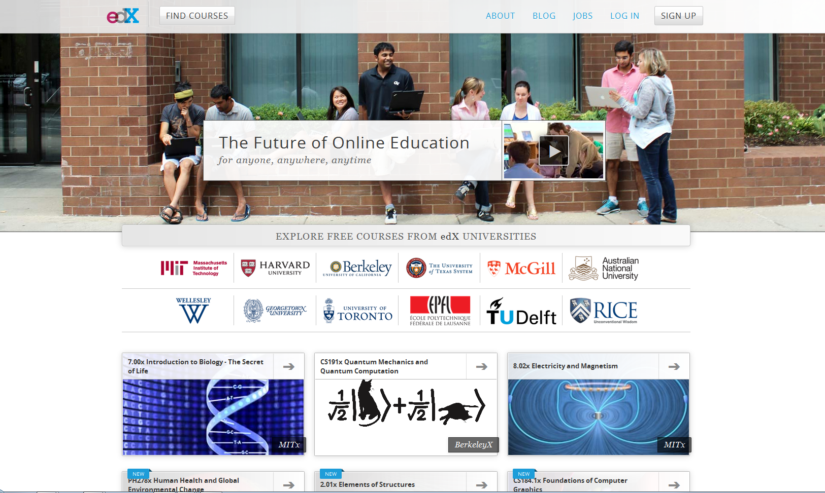

Slide 23
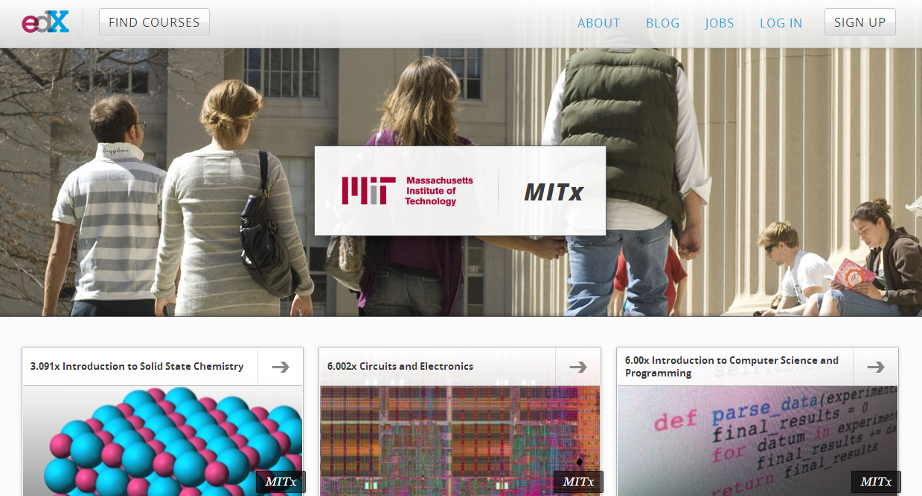

Slide 24
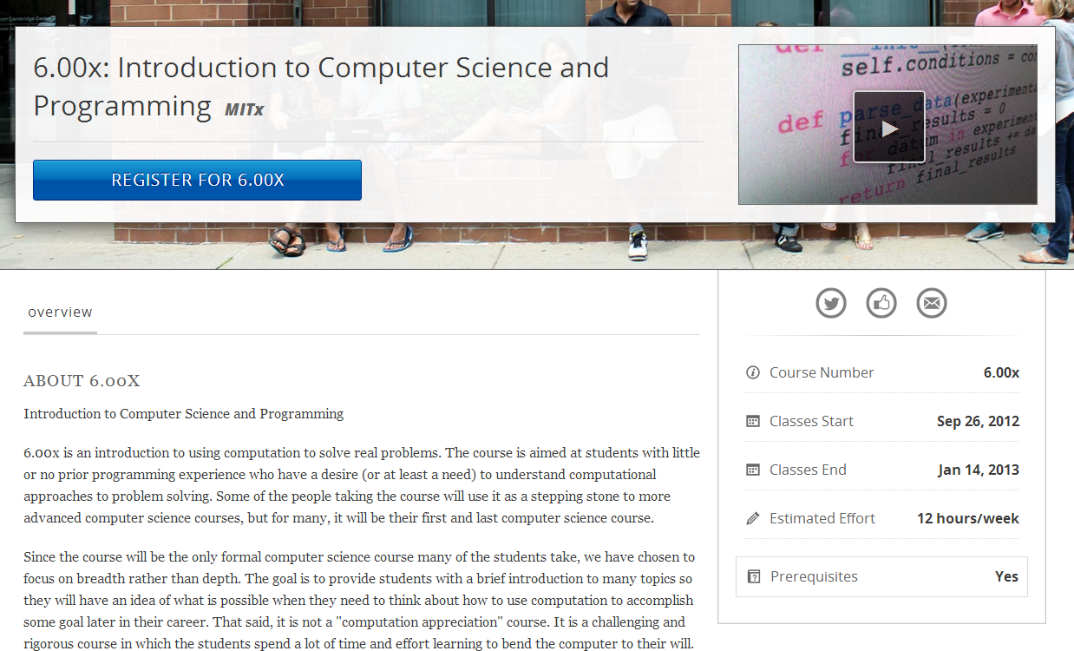

Slide 25
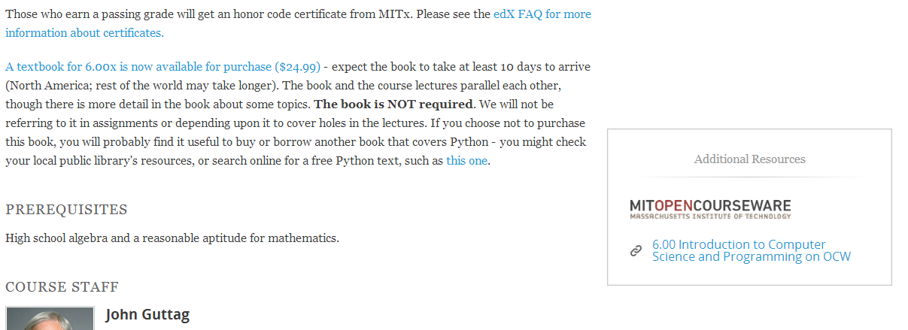

Slide 26
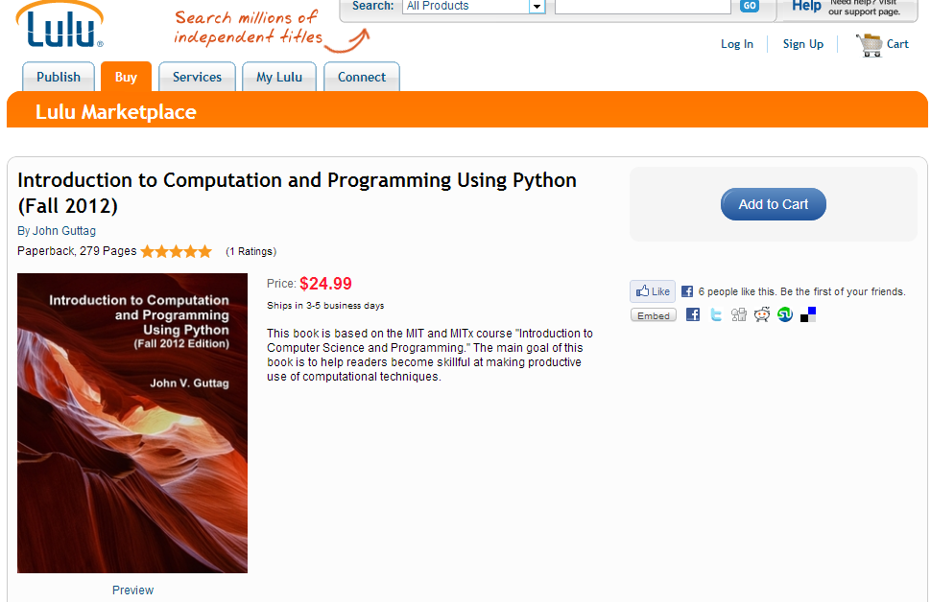

Slide 27
Where’s the library?

Slide 28
Where’s the library?
MOOCs
& Libraries
Massive Opportunity or Overwhelming Challenge?

