Slide 1
Coursera Course “An Introduction to Operations Management”: Lessons Learnt and Reflections on Future Coursera Offerings
Christian Terwiesch
Andrew M. Heller Professor at The Wharton School
terwiesch@wharton.upenn.edu

Slide 2
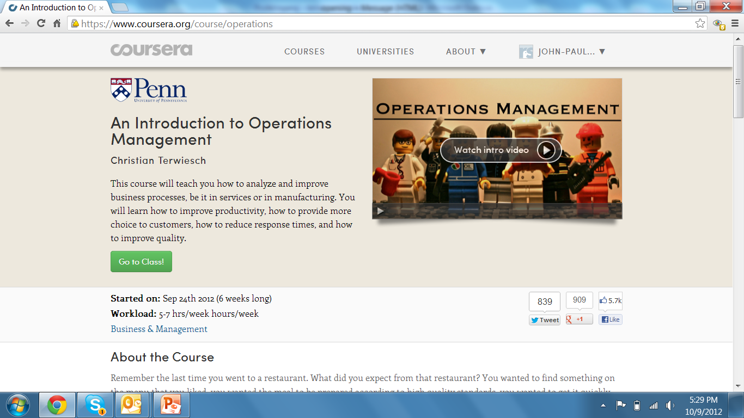
An Introduction to Operations Management

Slide 3
Some Raw Data
87,000 Users signed up
58,000 Users watched at least some videos
37,500 Users responded to in-video quizzes
10,000 Users did at least one homework
7,000 Users took the final exam
7,000 Users active in forum

Slide 4
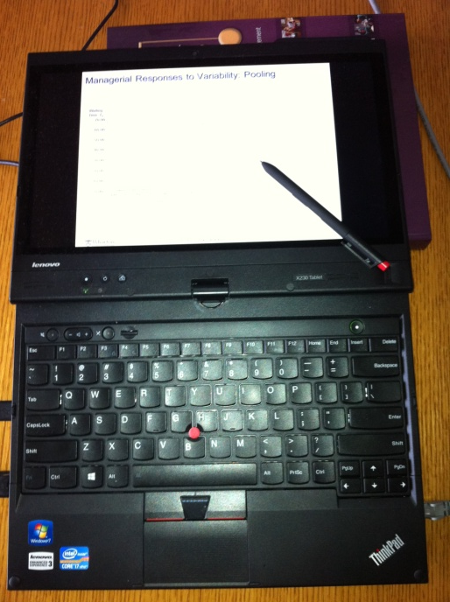
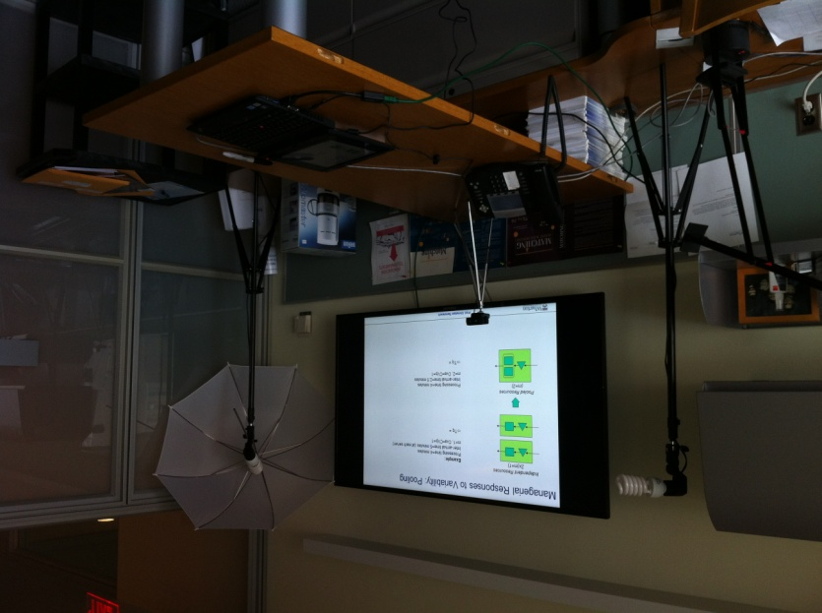
Production Process
Old
Tablet PC with microphone; studio lights
Do-it-yourself: video editing and recording
All videos specifically produced for the purpose
New
Exact same process
About $2k in studio (office) improvement
Take Away #1
Rapid, decentralized production Need for somebody to understand the process and the technology

Slide 5
Some High Level Reflections
Coursera and the Efficient Frontier
Student Learning
High
Office hours
Coursera
Many traditional schools and universities
Khan Academy
Low
Old frontier
New frontier
High tuition
Low tuition
Student payments
Low productivity
High productivity
Faculty productivity
New service delivery models in education have shifted the frontier
We can “cash-in” by:
(a) better learning (a smarter world) or by (b) saving money holding learning constant

Slide 6
A Slightly More Accurate Picture
Student Learning
High
Office hours
Coursera
Many traditional schools and universities
Low
Old frontier
New frontier
Free
Student payments
Future innovations will not make Coursera cheaper to the user
Being honest, we did sacrifice some learning
In the future, focus needs to be on better outcome

Slide 7
The Next Frontier will Move us UP
Student Learning
High
Office hours
Coursera
Many traditional schools and universities
Low
Old frontier
New frontier
Free
Student payments
Implications for today
Leveraging user generated content
Rethinking the publishing / library ecosystem

Slide 8
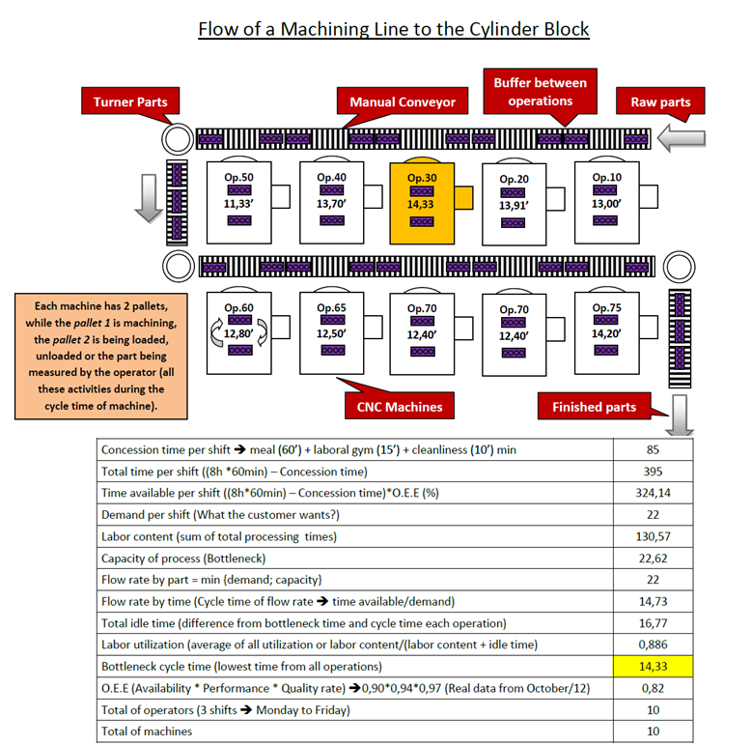
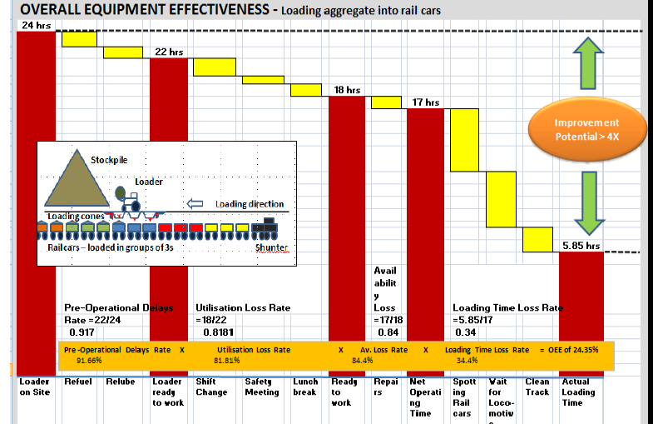
Letting Others Do the Work – User Generated Content
And the Coursera Operations Challenge
Started because of the vision to have documentary quality content of actual businesses

Slide 9
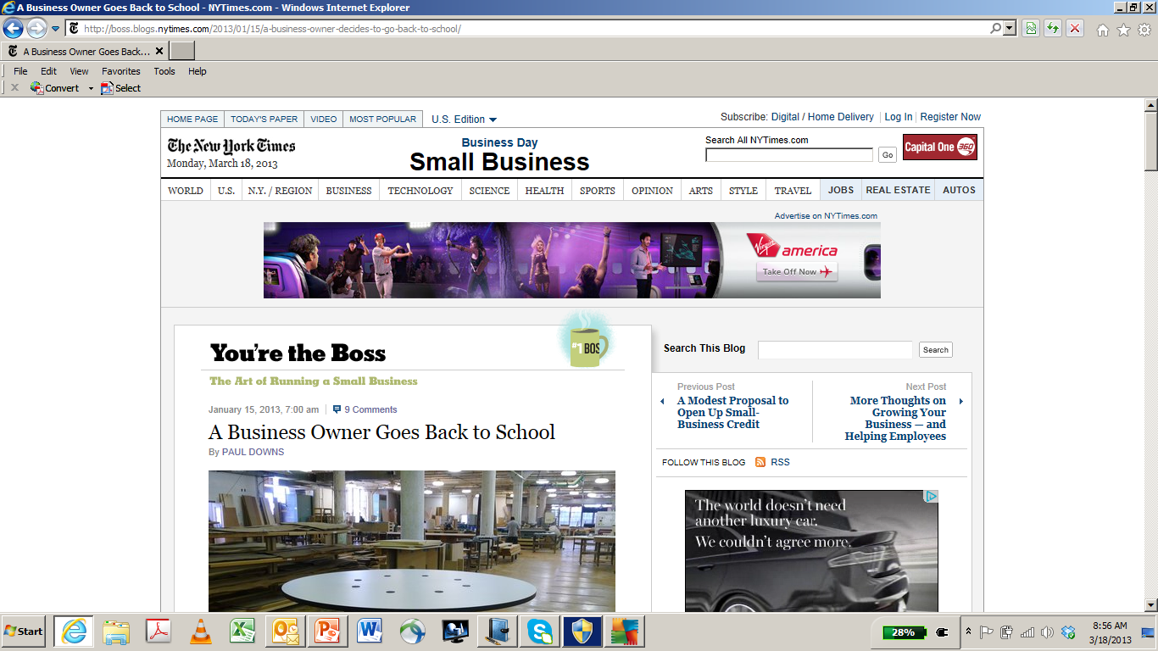
Letting Others Do the Work – User Generated Content
The Coursera Operations Project
Show case how the course applies to the lives/work places of the students
Enable students to post their own deliverables / learn from each other
=> Structure that information to make it accessible for future students (and the world)
Take Away #2:
MOOCs are not a broadcasting machine but will generate huge amount of new content
Great for libraries / not just true in business courses (think poetry)

Slide 10
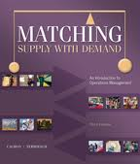
What Will Happen to Text Books et al?
Old model:
Professor
Publishers
Case writers / HBS
Tutors
Simulation licenses
…..
$15-40k per CU
$100 per student
per session
We could not teach without this EcoSystem in the past…
… why do we think we can do it now?
Plus: tons of new start-ups offering their products and services
Take Away #3
Enormous opportunity for libraries to create / package bundles of learning experiences
Faculty are domain experts, somebody needs to understand the system

Slide 11
Conclusion
Take Away #1
Rapid, decentralized production Need for somebody to understand the process and the technology
Take Away #2:
MOOCs are not a broadcasting machine but will generate huge amount of new content
Great for libraries / not just true in business courses (think poetry)
Take Away #3
Enormous opportunity for libraries to create / package bundles of learning experiences
Faculty are domain experts, somebody needs to understand the system

