Slide 1
Open Learning
@
PENN
Deirdre Woods, Interim Executive Director
Open Learning Initiative
1

Slide 2
Opening Thoughts
Our goals as early adopters of MOOCs:
Create and disseminate knowledge
Knowledge commitment in service to society
Drive teaching innovation
Expand our global reach
@
@
@
@
Open Learning
2
@
PENN

Slide 3
Coursera Demographics
Open Learning
3
@
PENN

Slide 4
MOOC Trends
-Nature online science journal
March 2013

Slide 5
Penn Numbers to Date
Aggregate
Over 840,000 enrollments
courses completed
13 new courses Spring/Summer ’13
+ 10 reoffers
Pipeline of courses for 2014
@
11
@
@
@
Open Learning
5
@
PENN

Slide 6
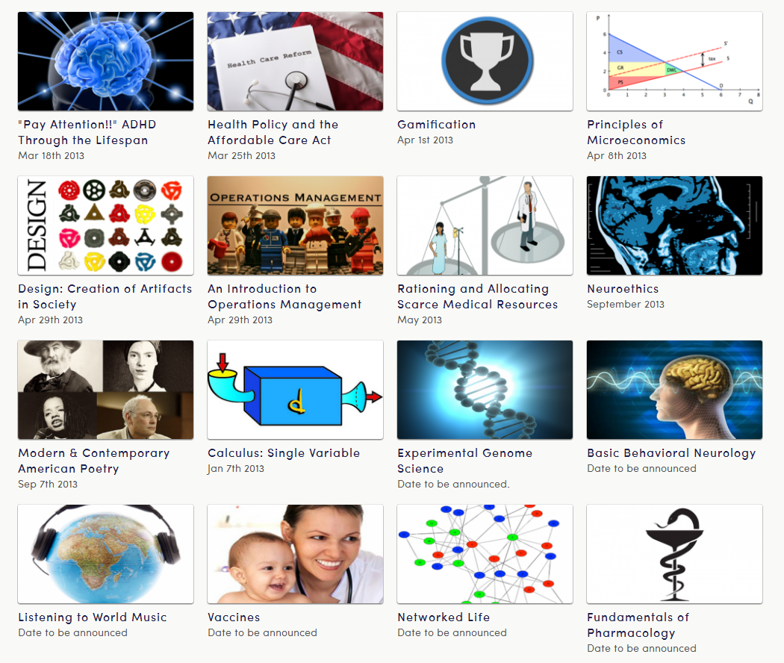
Current Listed Courses

Slide 7
Penn Numbers to Date
Sampling of Student Demographics (Design Course)
Sample Size: ~5,900
Have you ever
taken a Coursera
Course before?
Gender
Age
continued

Slide 8
Penn Numbers to Date
Sampling of Student Demographics (Design Course)
Sample Size: ~5,900
Occupational Status

Slide 9
Penn Numbers to Date
Sampling of Student Demographics (World Music Course)
Sample Size: ~17,400
Gender
Age
continued

Slide 10
Penn Numbers to Date
Sampling of Student Demographics (World Music Course)
Sample Size: ~17,400
Occupational Status

Slide 11
Penn Numbers to Date
Sampling of Student Demographics (Modern Poetry Course)
Sample Size: ~8,600
Gender
Age

Slide 12
Penn Numbers to Date
Sampling of Student Distribution by Country
Design: Creation of Artifacts in Society
138 countries represented
Listening to World Music:
146 countries represented
Remaining countries: 0% - 1%
Remaining countries: 0% - 1%
Open Learning
12
@
PENN

Slide 13
Penn Numbers to Date
Preliminary Aggregate Engagement Data (Excerpt)

Slide 14
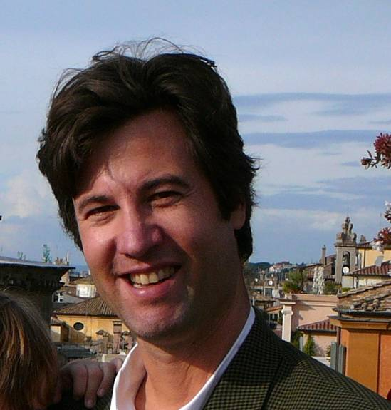
Faculty Testimonials
“Coursera is upsetting more apple carts in higher ed than anything that's come along in recent decades.”
-Professor Peter Struck, Greek and Roman Mythology
“…one of the best and most capable students in ModPo visited us...and I was honored to meet him.”
-Tweet from Professor Al Filreis, Modern and Contemporary American Poetry
Open Learning
14
@
PENN

Slide 15
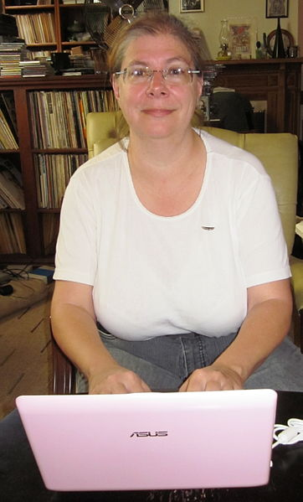
Student Testimonials
“Took ModPo & loved it. Al is the BEST. His amazing acceptance of everything that is interesting rivets my attention. It excites my creativity bones and I like that feeling”
-to Open_Learning@upenn.edu
“I wanted feedback on my project idea and I got forum responses from students
in over 13 different countries –
the multiple
perspectives made my project
even better!”
-final Design course evaluation
Open Learning
15
@
PENN

Slide 16
Student Testimonials…
“Thank you so much for this opportunity to relearn things I have forgotten from 45 years ago. I could never afford this otherwise. This time around, I am learning for the pleasure it brings me not for money or pressure from my colleagues or employers.”
I want to voice my enthusiastic support for Penn's involvement in open courses offered through Coursera. In the last year, I have taken Coursera courses. Both left me with a particular feeling of pride in that these classes originated at my alma mater”
“Thank you for your commitment to service the needs of the many people around the world hungry of high-level learning experiences.
Thanks, thanks, thanks…
Great you consider us as part of your community.”
Open Learning
16
@
PENN

Slide 17
On the Horizon
Leverage What We Learn
Data
gathering:
engagement, retention
Data
usage:
marketing
Data analysis: predict trends
Make courses more efficient and effective
Open Learning
17
@
PENN

Slide 18
Generating Enthusiasm
Hosting Coursera’s Inaugural Partners’ Conference
Building long-term
relationships with students
Joint presentations and collaborations with other institutions
New Penn Open
Learning website
Open Learning
18
@
PENN

Slide 19
Learn More
Deirdre Woods
woods@upenn.edu
Penn’s Open Learning Website
http://provost.upenn.edu/initiatives/openlearning
Twitter
@PennOpenCourses
Open Learning
19
@
PENN

