Slide 1
UK team presentation
EMEA Innovation Survey
Merrilee Proffitt & Titia van der Werf
Senior Program Officers, OCLC Research

Slide 2
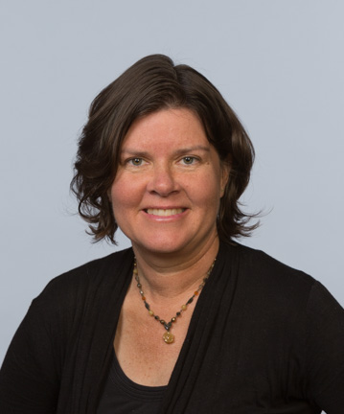
Your colleagues, Merrilee (San Mateo), Titia (Leiden) and Peggy Gallagher (Dublin)

Slide 3
What is this?
A survey of libraries at 238 research universities in the UK, the Netherlands, Germany, Austria, Switzerland, Denmark, Spain, France, and Italy
Spearheaded by EMEA Regional Council
Gain intelligence regarding trends, capacities and priorities within the European research library community.
Scope the opportunity space for OCLC Research, and the OCLC Research Library Partnership.

Slide 4
UK survey results

Slide 5
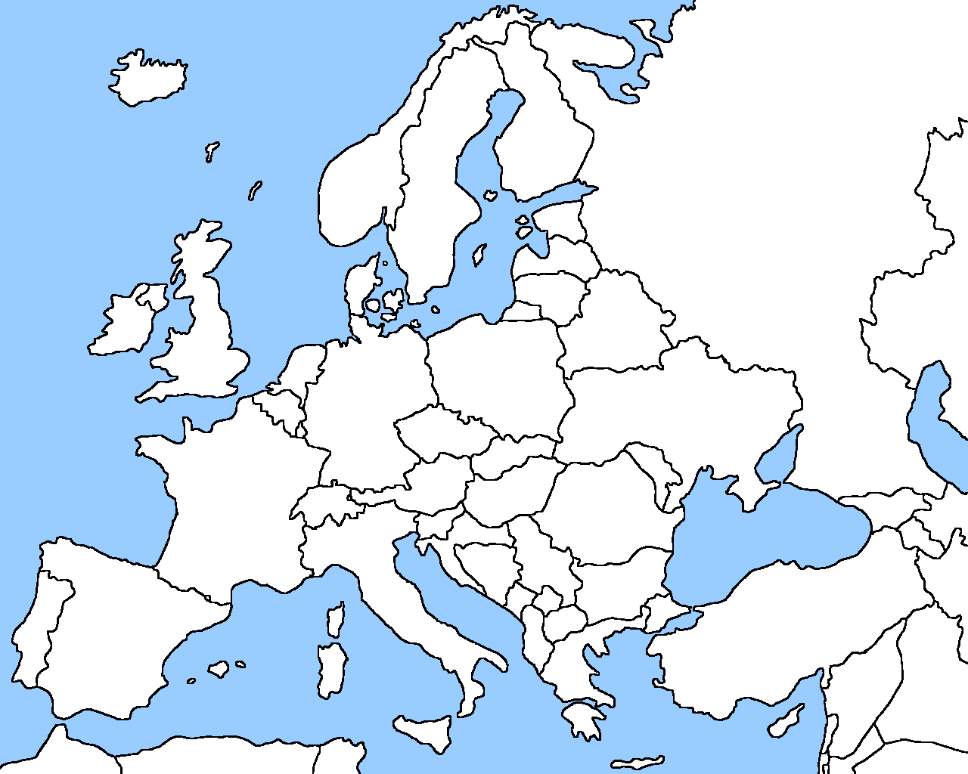
26 UK survey respondents
Country
Country
26

Slide 11
UK Results: Priorities & Challenges

Slide 13
Library Thought Leaders
Organisation Thought Leaders
Most Relevant Funding Bodies for Libraries

Slide 14
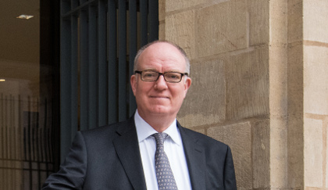
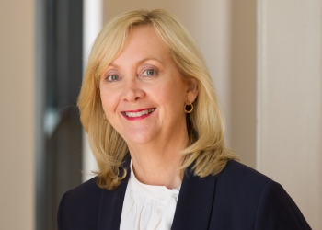
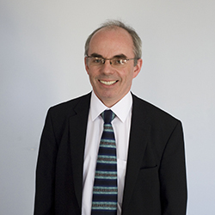
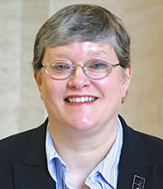
Ann Horn, Sheffield
Richard Ovenden, Oxford
Jan Wilkinson, Manchester
Christine Wise, SOAS
John MacColl, St Andrews

Slide 15
Observations
Succession planning: RLUK / SCONUL are key networks. Value of non UK perspective (provided by RLP) may be valued.
Uptick in use of libraries: increased enrollment rebirth of the library as place Libraries continue to invest heavily in electronic resources and in promoting e-resources, including digitized special collections.
Library as technology center: did not resonate
Discussion of technology with those that we interviewed centered around faculty research support (Research Data Management, GIS, Research Data Planning, etc.), which relates to findings elsewhere.

Slide 16
Observations
Support for researchers: high interest in getting staff / faculty skilled up. Opportunity to highlight good work we’ve already done.
Library as place: endless discussion points
Special collections: still seen as being central even if they may have fallen below the fold in terms of the “top three” priorities
Linked data: not being well understood by library leadership (and it may even be viewed with skepticism).
Open access: good area for further exploration and discussion.

Slide 17
Observations
Future of shared print: UKRR is likely to be their shared future although people would like to also have regional solutions
Collaboration: UK research libraries see themselves as inward looking and will collaborate with the usual suspects.
Library leadership: a grab bag of institutions.

Slide 18
Next steps
Present findings at OCLC EMEA Regional Council Meeting (20-21 February 2018, Edinburgh)
Host a discussion at the RLP meeting in London (14 March 2018, in conjunction with RLUK Conference)
Explore repeating survey in US, in Canada and in Australia
Thank you! Merrilee Proffitt proffitm@oclc.org
Titia van der Werf titia.vanderwerf@oclc.org

