Slide 1
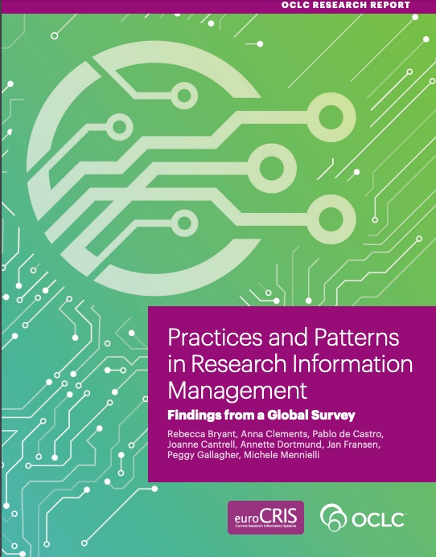
Practices and Patterns:
the Convergence of Repository and CRIS Functions
Open Repositories 2019 * Hamburg, Germany * 11 June 2019
Rebecca Bryant, PhD, Senior Program Officer, OCLC Research
bryantr@oclc.org @RebeccaBryant18
https://orcid.org/0000-0002-2753-3881
Pablo de Castro, Open Access Advocacy Librarian, University of Strathclyde
euroCRIS Secretary
pablo.de-castro@strath.ac.uk @pcastromartin
https://orcid.org/0000-0001-6300-1033
Dr. Annette Dortmund, Research Consultant, OCLC
Annette.Dortmund@oclc.org @libsum
https://orcid.org/0000-0003-1588-9749
Michele Mennielli, International Membership and Partnership Manager, DuraSpace mmennielli@duraspace.org @micmenn
https://orcid.org/0000-0002-4968-906X
Notes:
Start with introducing ourselves.

Slide 2
Today’s presentation
Introduction to OCLC Research, euroCRIS, and our collaborative research
The background: evolution of repository-CRIS convergence
Survey findings

Slide 3
Devoted to challenges facing libraries and archives since 1978
Community resource for shared Research and Development (R&D)
Engagement with OCLC members and the community around shared concerns
Learn more
oc.lc/research
Hangingtogether.org blog
Notes:
OCLC Research is a division of OCLC, established in 1978 to scale research and learning on behalf of libraries. I’m part of the OCLC Research division, where we conduct research on behalf of libraries, to report on rapid changes in the library ecosystem, and to inform decision making.
You can learn more at oc.lc./research and follow us on Hangingtogether.org.

Slide 4
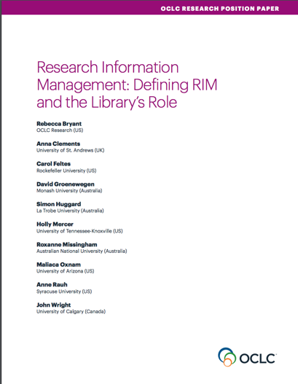
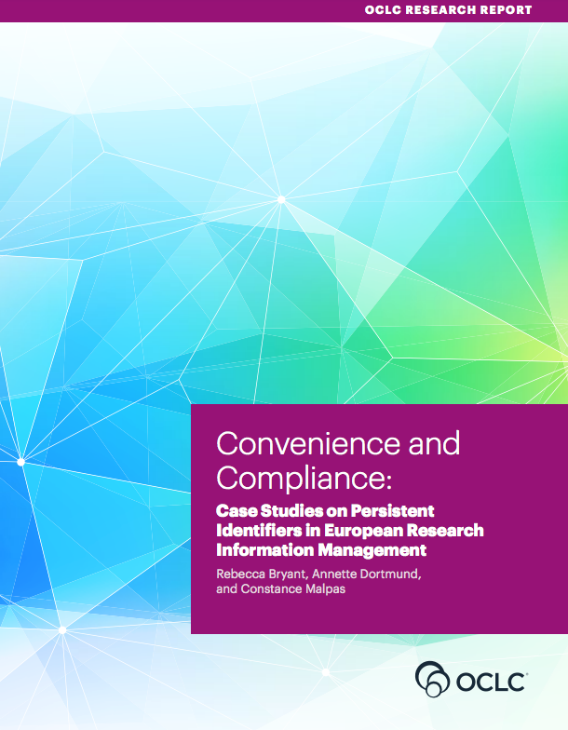
oc.lc/rim

Slide 5
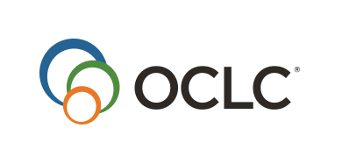
An international not-for-profit association founded in 2002 to bring together experts on research information in general and research information systems (CRIS) in particular
45 Countries
>200 Members
15 Strategic Partners
Notes:
euroCRIS is an not for profit global association for research information experts, technology and best practice. Founded in 2002 – euroCRIS now has over 200 institutional and individual members in 45 countries – including Europe of course, but also North and South America, Australia / NZ, Middle East, China, Japan and India

Slide 6
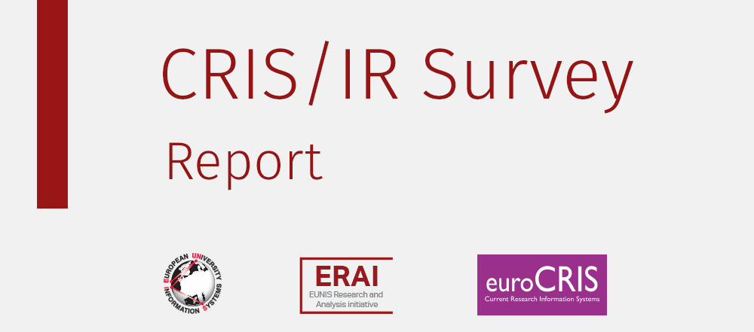
Building on previous research
Lígia Maria Ribeiro, lmr@fe.up.pt
Universidade do Porto – FEUP & EUNIS
Pablo de Castro, pablo.decastro@kb.nl
Stichting LIBER& euroCRIS
Michele Mennielli, m.mennielli@cineca.it
CINECA & EUNIS & euroCRIS
http://www.eunis.org/blog/2016/03/01/crisir-survey-report/
http://www.eunis.org/wp-content/uploads/2016/03/cris-report-ED.pdf

Slide 7
Practices and Patterns in Research Information Management: Findings from a Global Survey
Rebecca Bryant, PI, OCLC Research
Pablo de Castro, Strathclyde University and euroCRIS
Anna Clements, University of St. Andrews and euroCRIS
Annette Dortmund, OCLC EMEA
Jan Fransen, University of Minnesota, Twin Cities
Michele Mennielli, DuraSpace and euroCRIS
Plus a number of valuable collaborators at OCLC
oc.lc/rimsurvey
Notes:
euroCRIS and OCLC entered into a strategic partnership in 2017. One of our goals is to conduct research together on research information management practices, including this survey on research information management practices.
Our main goal was to identify some global trends and to lay the foundation for future quantitative research in the field.

Slide 8
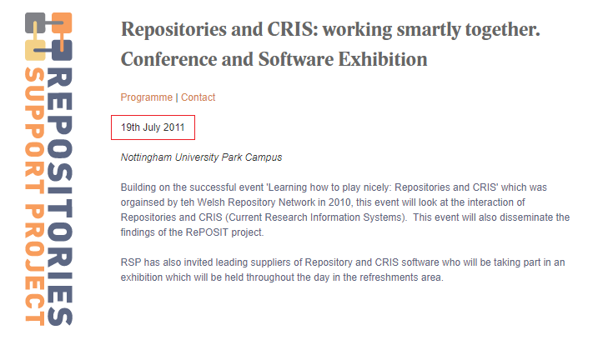
Repository/CRIS interoperability: background
Designed as a mechanism to get repositories populated
Original workflow CRIS metadata records → repositories
http://www.rsp.ac.uk/events/repositories-and-cris-systems-working-smartly-together/

Slide 9
CRISes and OARs
Slide by Mark Cox (KCL & euroCRIS Board, July 2011)
http://www.rsp.ac.uk/documents/get-uploaded-file/?file=rspnottingham190711_embed.ppt
CRISes and OARs developed substantially separately
OARs primarily developed as discovery tools
Public facing
Generally populated via individual deposit
Development usually led by library staff
CRISes mainly used as (data) management tools
Used within institutions, with little or no public interface
Often built to integrate with other systems to allow import of data
Most implementations led by institution’s research offices
Considerable overlap in the data that is collected by each

Slide 10
Integration of CRISes and OARs
Slide by Mark Cox (KCL & euroCRIS Board, July 2011)
Increasing realisation in institutions that there is benefit from streamlining OAR and CRIS development
Several potential ways of doing this
Can use a CRIS for gathering all research related information, including research output, and feed/link to repository
Can expand repository to be able to cover a wider range of research related information
Can use portal functionality of sophisticated CRIS systems to mimic repository functionality
10

Slide 11
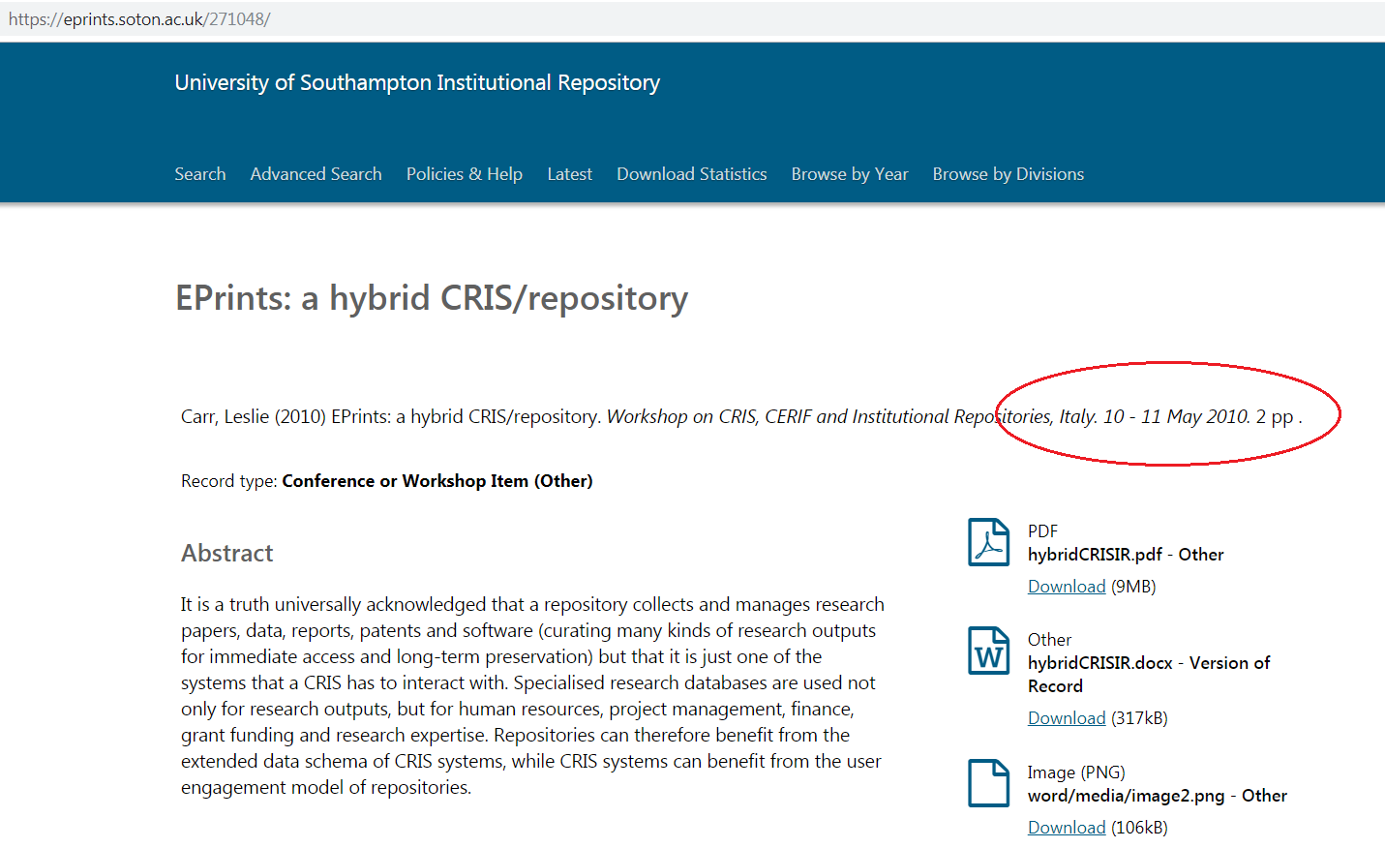
“Several potential ways of doing this”: IR-as-a-CRIS

Slide 12
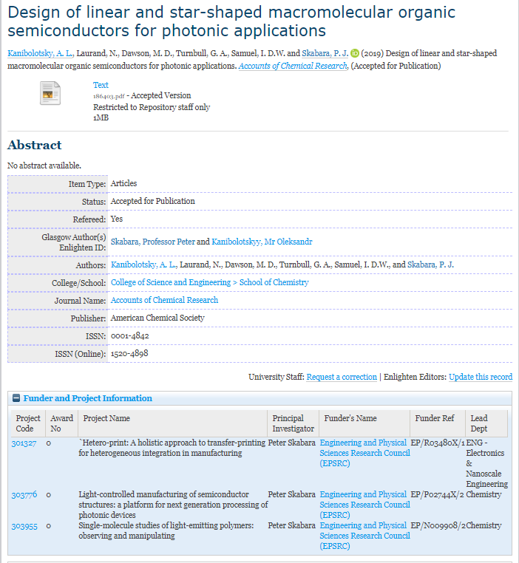
Eprints-based IR-as-a-CRIS model operating at eg the University of Glasgow Enlighten repository, http://eprints.gla.ac.uk/
Collection of additional info on funding sources requires connection to (interoperability with) project database
http://eprints.gla.ac.uk/186403/

Slide 13
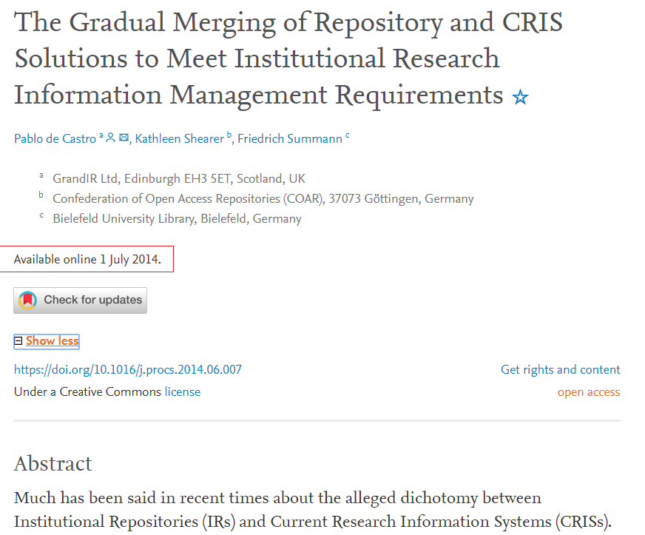
An early attempt at describing the CRIS/IR landscape (2014)
Interoperability
CRIS and IR
Integration
CRIS-as-IR
IR-as-CRIS

Slide 14
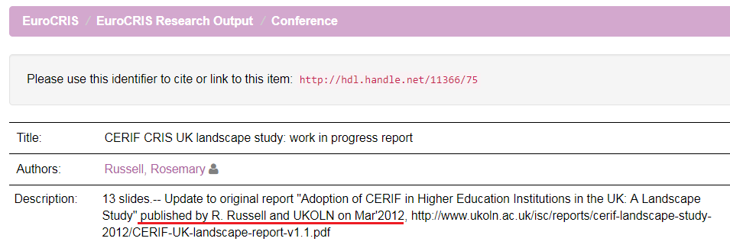
Elusive landscape to pin down due to swiftly evolving character, esp w/ widespread arrival of commercial CRISs to the UK in the wake of REF2014
Research assessment exercises identified in the OCLC/euroCRIS survey as one of the main drivers for CRIS implementation worldwide

Slide 15
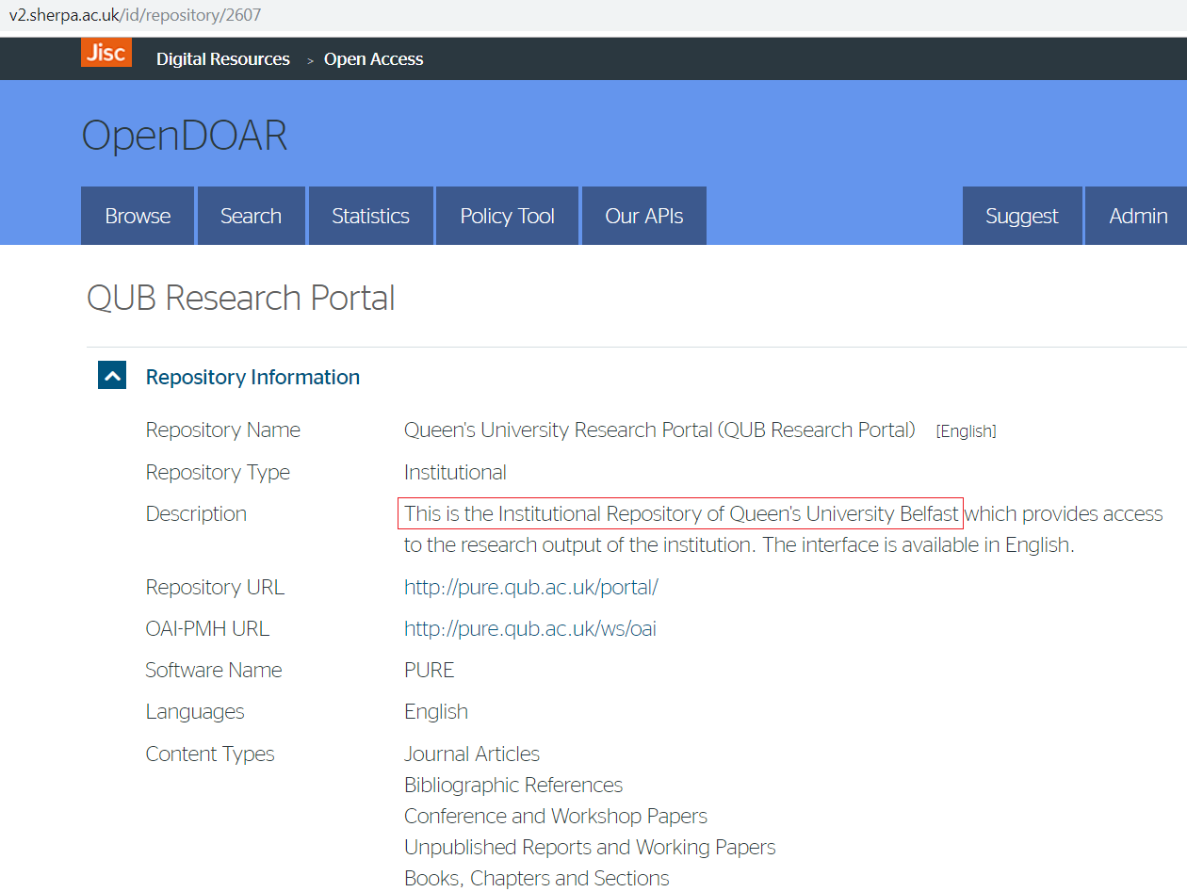
Commercial CRISs start trying to operate as repositories – which they were not originally designed to do
Sense of technologies, workflows and institutional units at odds with each other (while warnings were issued on the 'false dichotomy‘ between IRs and CRISs, http://www.ukcorr.org/2012/09/26/three-perennial-questions/)
IT’S IMPORTANT TO KEEP COLLECTING UP-TO-DATE SNAPSHOTS OF THIS SWIFTLY EVOLVING LANDSCAPE

Slide 16
OCLC/euroCRIS Survey: Methodology and promotion
Online survey data collection: Oct 2017 – Jan 2018
English and Spanish versions
Convenience sample
Report is explanatory and descriptive in nature
Survey promotion through:
OCLC and euroCRIS communications channels and events worldwide
Communications by CRIS vendors and user communities
Listservs, social media, and announcements to research & library organizations
Notes:
Convenience sample. This survey is a starting point for our understanding of global trends.
The biggest challenge is getting the survey in front of the right person within an institution—and to get everyone aware of this undertaking.

Slide 17
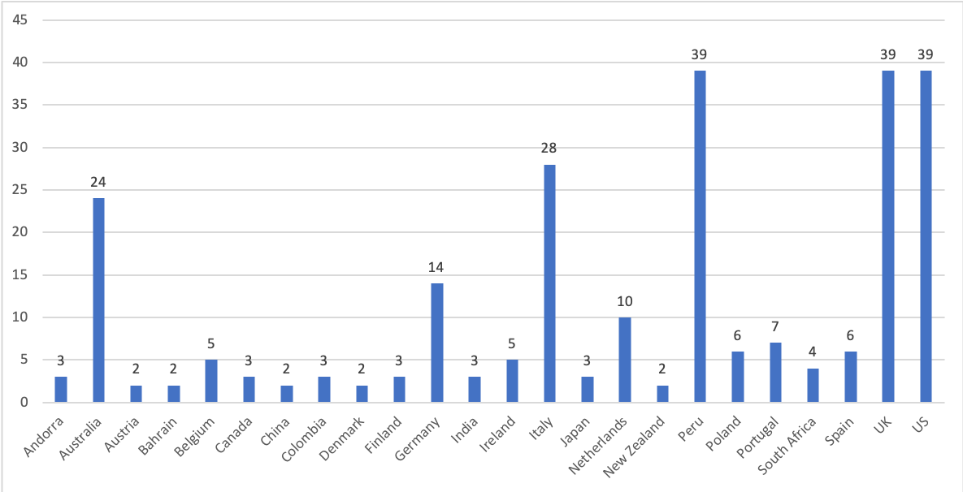
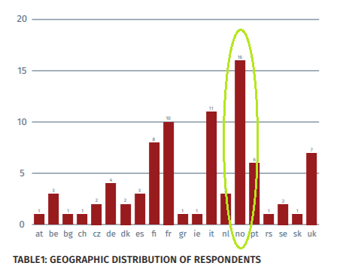
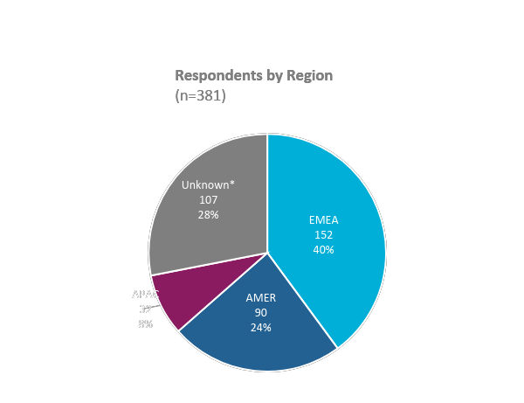
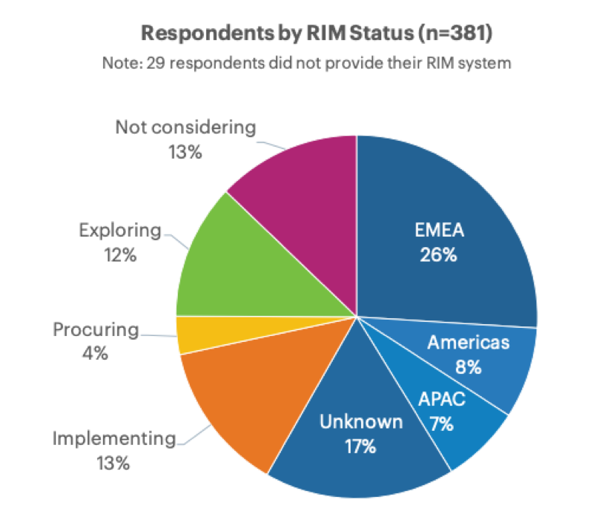
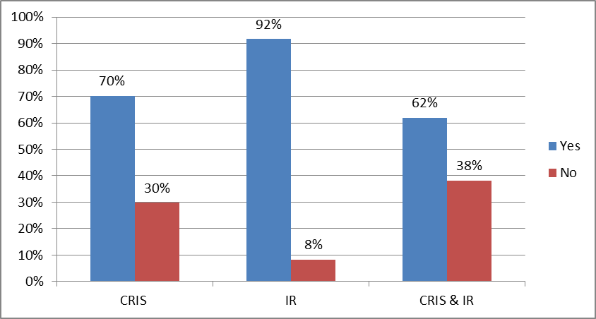
The Surveys
44 countries
381 institutions
20 Countries
84 Institutions
70% with a CRIS
58% with a CRIS

Slide 18
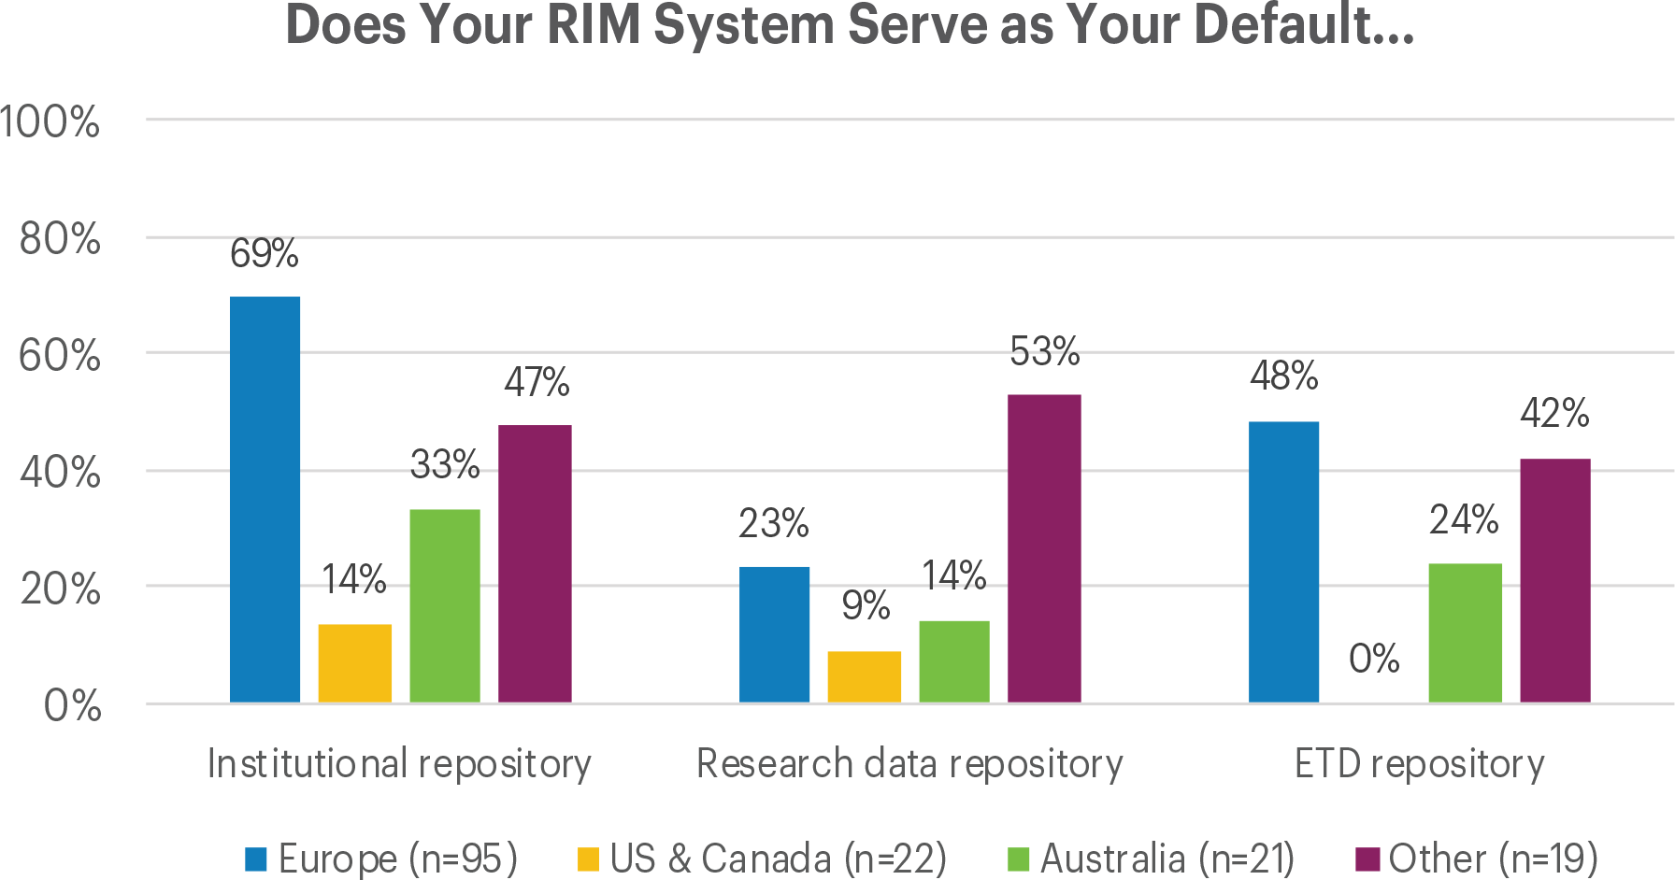
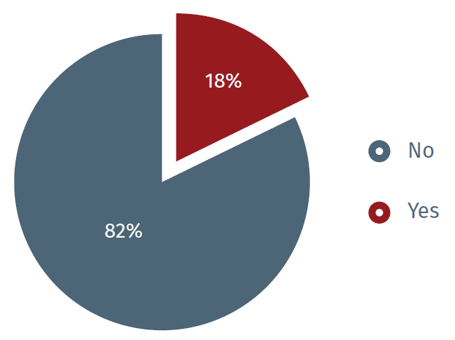
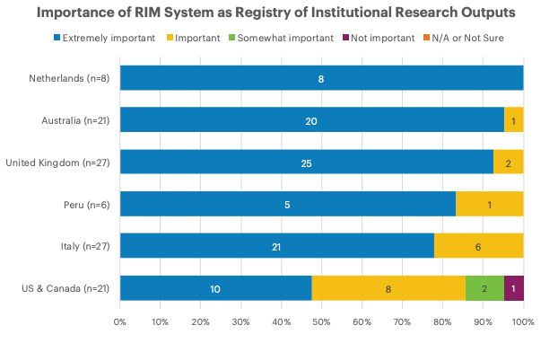
How many systems?
In the 18% of the cases where both CRIS and IR systems are available a single software platform is used for both

Slide 19
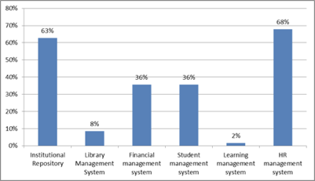
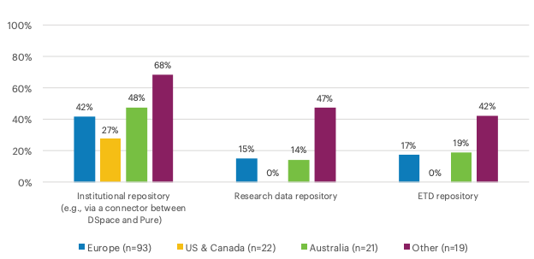
CRIS-IR Interoperability
Which of the following internal systems interoperate with your RIM System(s)?

Slide 20
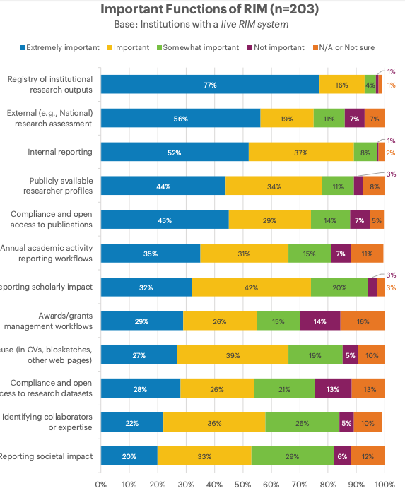
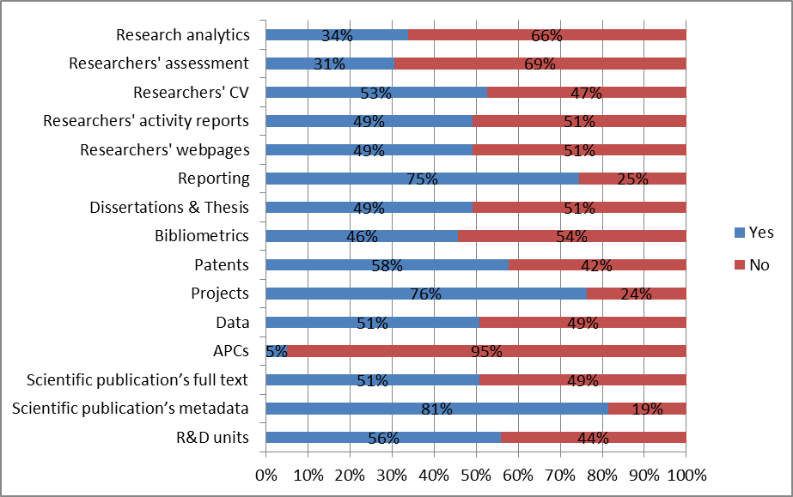
Content and Functions

Slide 21
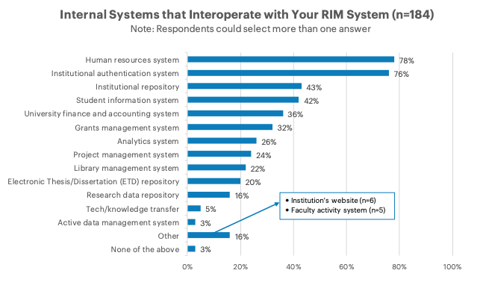
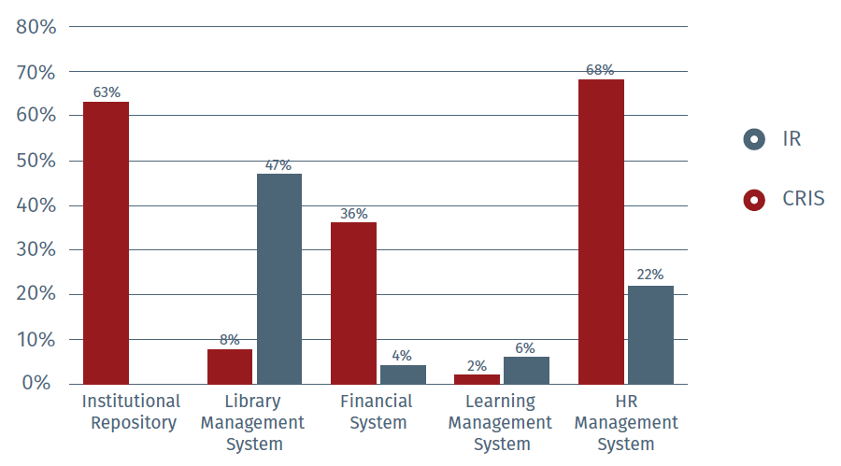
Internal Systems Interoperability
Institutional Repository: 63%
43%
Library Management System: 8%
22%
Financial: 36%
36%
HR: 68%
78%

Slide 22
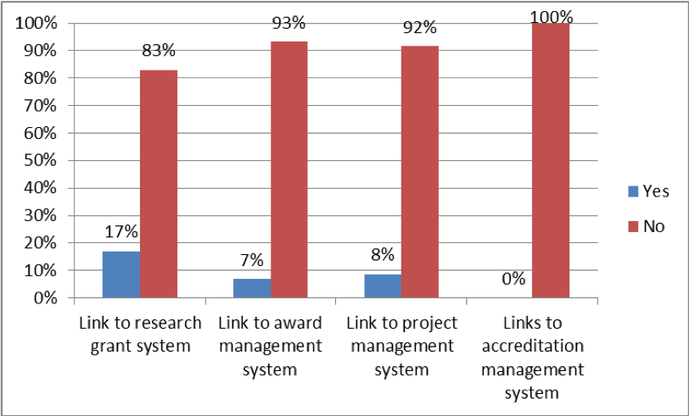
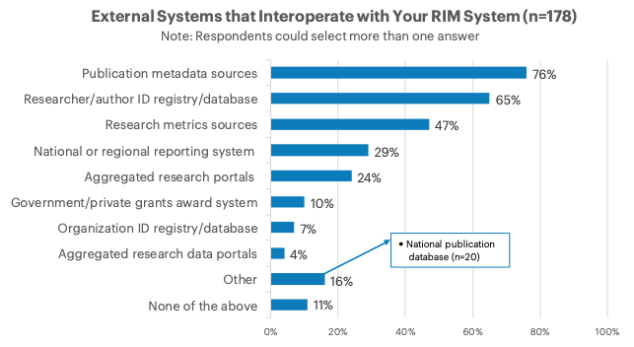
External Systems Interoperability
The two surveys tracked different external systems interoperability

Slide 23
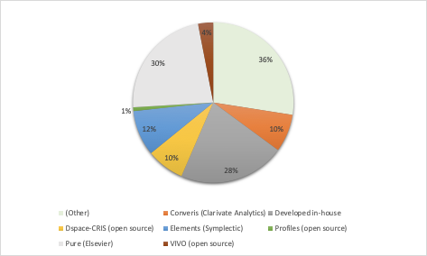
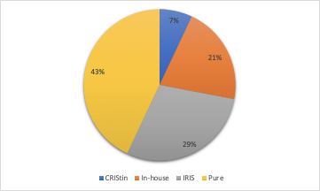
Technologies

Slide 24
Fast forward to June 10th OR19 WS on repo/CRIS interoperability/integration
Attempt to capture an up-to-date snapshot for the evolved repository/CRIS co-existence & merging
Case study for Haplo-based integration where repo & CRIS are one and the same (open source) platform
Seamless Worktribe/DSpace integrations
Case study for Pure-based interoperability
Best practice (integrated) DSpace-CRIS implementation at UnityFVG
More importantly: the application of integrated/interoperable systems to areas like Open Science implementation, reporting for research assessment, research data management surpasses the functionality achieved by repository-only or CRIS-only solutions

Slide 25
References
Bryant, Rebecca, Anna Clements, Carol Feltes, David Groenewegen, Simon Huggard, Holly Mercer, Roxanne Missingham, Maliaca Oxnam, Anne Rauh and John Wright. 2017. Research Information Management: Defining RIM and the Library’s Role. Dublin, OH: OCLC Research. doi:10.25333/C3NK88
Bryant, Rebecca, Annette Dortmund, and Constance Malpas. 2017. Convenience and Compliance: Case Studies on Persistent Identifiers in European Research Information. Dublin, Ohio: OCLC Research. doi:10.25333/C32K7M
Bryant, Rebecca, Anna Clements, Pablo de Castro, Joanne Cantrell, Annette Dortmund, Jan Fransen, Peggy Gallagher, and Michele Mennielli. 2018. Practices and Patterns in Research Information Management: Findings from a Global Survey. Dublin, OH: OCLC Research. https://doi.org/10.25333/BGFG-D241
Bryant, Rebecca, Anna Clements, Pablo de Castro, Joanne Cantrell, Annette Dortmund, Jan Fransen, Peggy Gallagher, and Michele Mennielli. 2018. Data Set: Practices and Patterns in Research Information Management: Findings from a Global Survey. Dublin, OH: OCLC Research. https://doi.org/10.25333/QXR6-D439
Carr, Leslie (2010) EPrints: a hybrid CRIS/repository. Workshop on CRIS, CERIF and Institutional Repositories, Italy. 10 - 11 May 2010. 2 pp . https://eprints.soton.ac.uk/271048/
de Castro, Pablo, Kathleen Shearer, and Friedrich Summann. 2014. “The Gradual Merging of Repository and CRIS Solutions to Meet Institutional Research Information Management Requirements.” Procedia Computer Science 33: 39–46. https://doi.org/10.1016/j.procs.2014.06.007.
Ribeiro, Lígia, Pablo De Castro, and Michele Mennielli. “EUNIS-EuroCRIS Joint Survey on CRIS and IR,” 2016. http://www.eurocris.org/news/cris-ir-survey-report.

Slide 26
Discussion
Rebecca Bryant, PhD, Senior Program Officer, OCLC Research
bryantr@oclc.org @RebeccaBryant18
https://orcid.org/0000-0002-2753-3881
Pablo de Castro, Open Access Advocacy Librarian, University of Strathclyde
euroCRIS Secretary
pablo.de-castro@strath.ac.uk @pcastromartin
https://orcid.org/0000-0001-6300-1033
Dr. Annette Dortmund, Research Consultant, OCLC
Annette.Dortmund@oclc.org @libsum
https://orcid.org/0000-0003-1588-9749
Michele Mennielli, International Membership and Partnership Manager, DuraSpace mmennielli@duraspace.org @micmenn
https://orcid.org/0000-0002-4968-906X
oc.lc/rimsurvey

