Slide 1
Dublin, Ohio * April 24, 2019
Digging into the research:
An overview of models and networks
Brian Lavoie
Rebecca Bryant
Merrilee Proffitt
Senior Research Scientist
lavoie@oclc.org
Senior Program Officer
bryantr@oclc.org
Senior Manager
proffitm@oclc.org
Notes:
Something about Stanley's work – we are not the only ones doing impactful research
OCLC Research has the capacity to develop models to help research libraries (and others) with sensemaking
We strive for our models to be useful and to facilitate big picture thinking
Our work frequently has a long arc as demonstrated by Brian's portion of this presentation
We love to draw inspiration from the RLP
These models may be useful in following discussions but should not constrain thinking

Slide 2
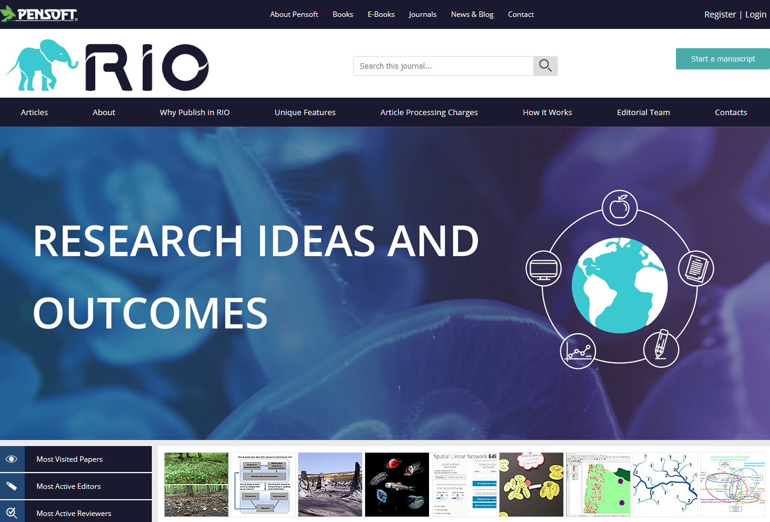
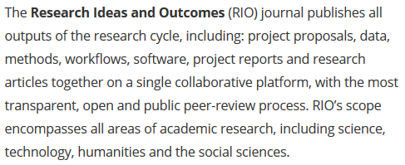
Formats changing …
Features
shifting …
The Evolving
Scholarly Record
Boundaries
extending …
Stakeholders
reconfiguring …

Slide 3
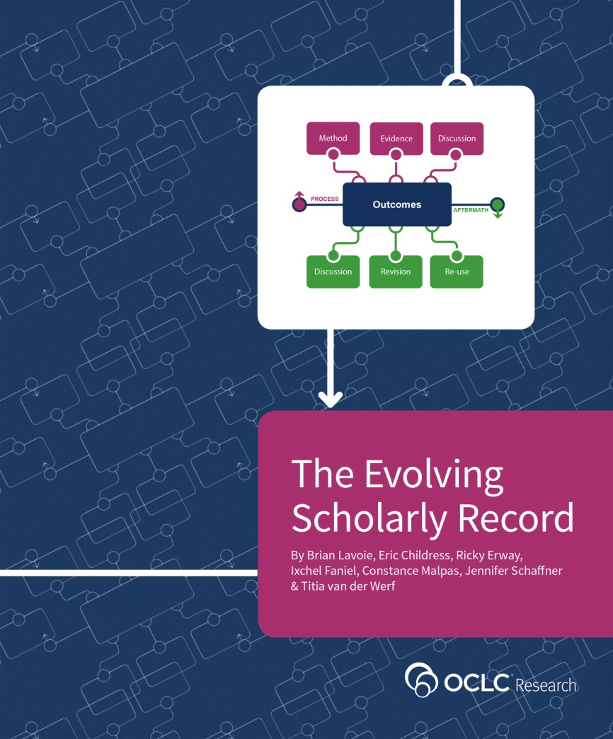
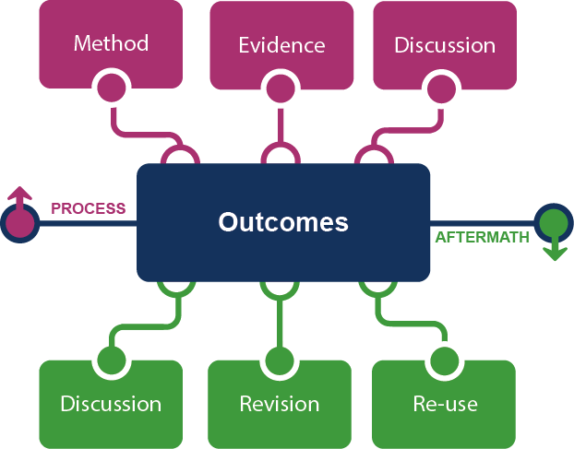
http://oc.lc/esr

Slide 4
Stakeholder eco-system
Fix
Collect
Create
Use

Slide 5
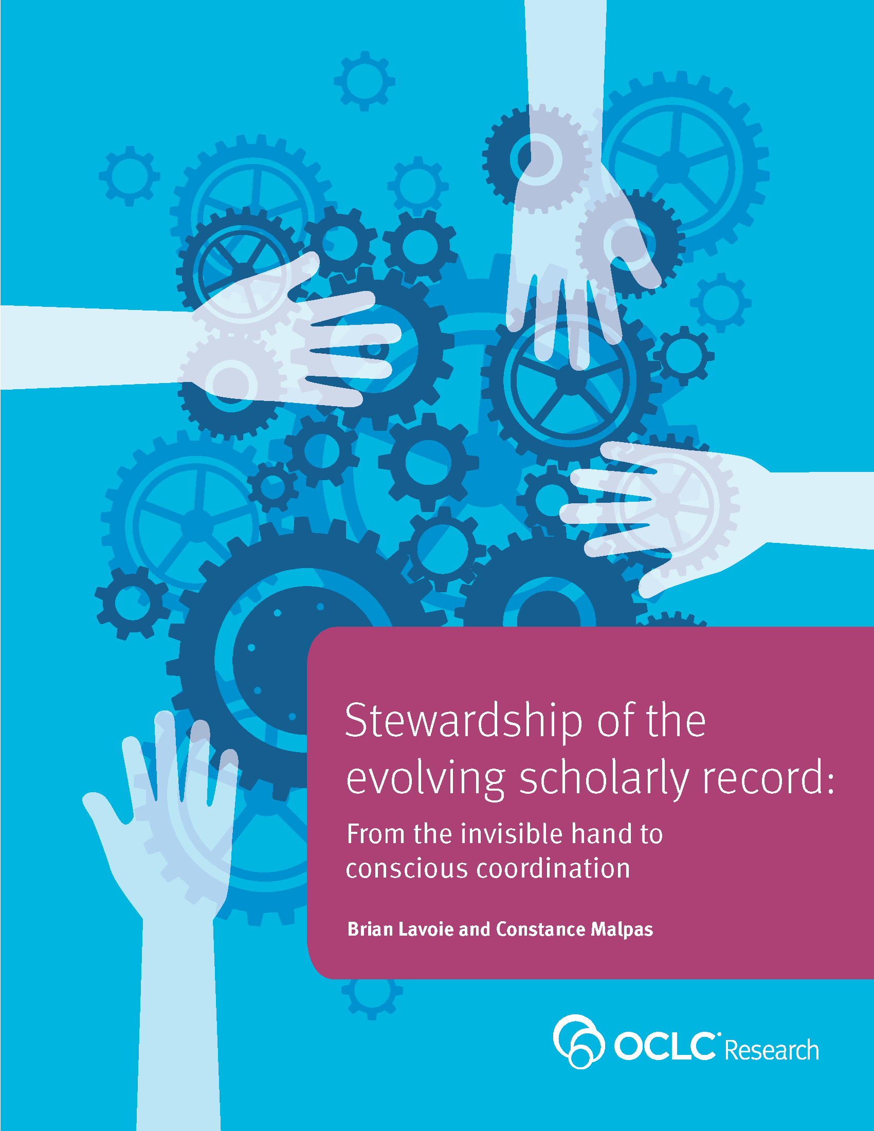
Evolving stewardship of the scholarly record
Historically a byproduct of uncoordinated, highly distributed, and duplicative process of managing local print collections
Sum of local stewardship efforts resulted in aggregate library resource that was relatively complete record of published (print) outputs
Features of scholarly record changing: growing in size, complexity, distribution of custodial responsibility
Scholarly record now imperfectly approximated in library collections
Stewardship models evolving to conscious coordination
http://oc.lc/esr-stewardship

Slide 6
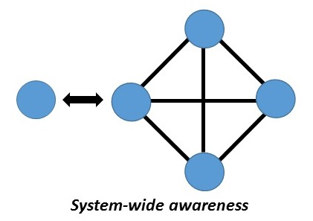
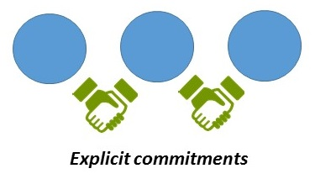
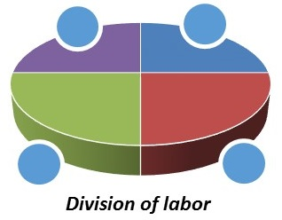
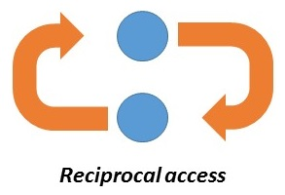
Four elements of conscious coordination
“Align local action with collective effort”
“Move commitments above the institution”
“Collect more of less”
“Curate locally, share globally”

Slide 7
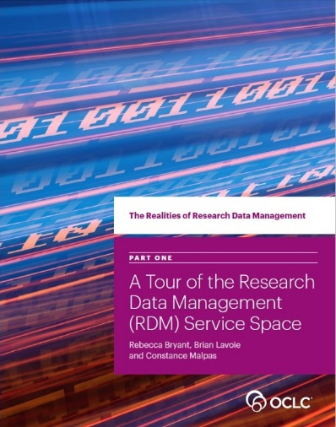
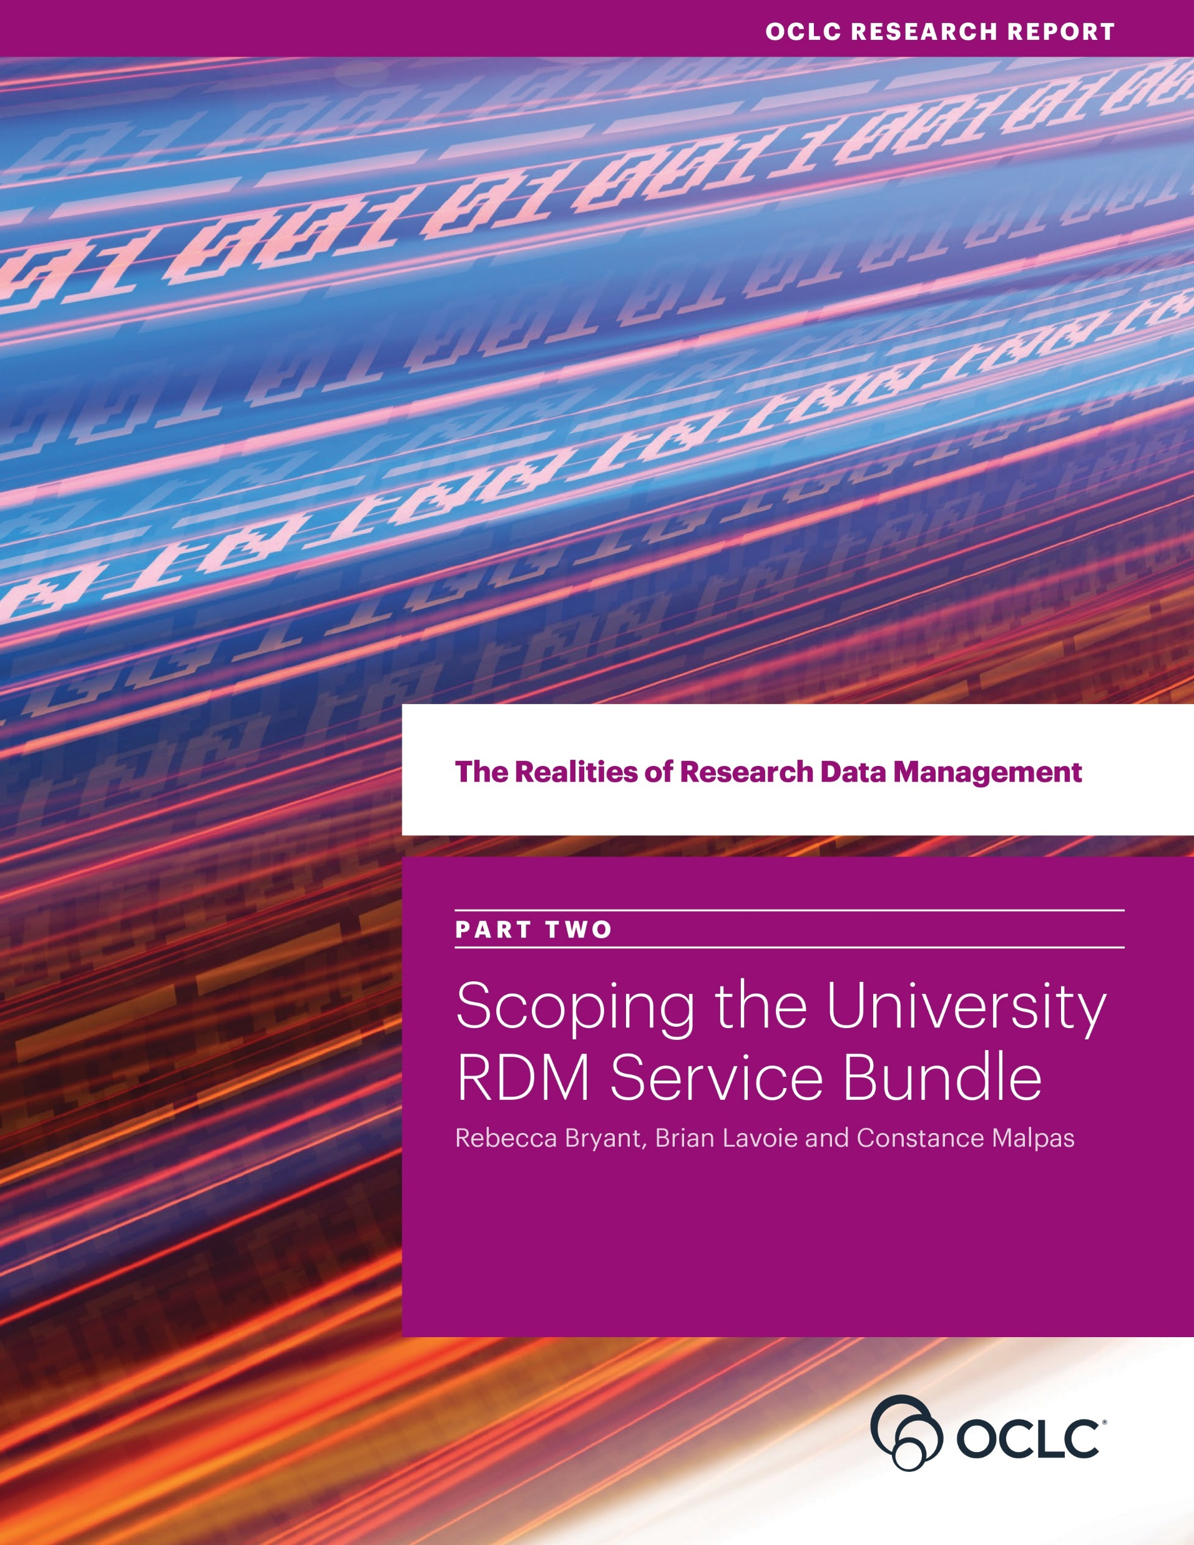
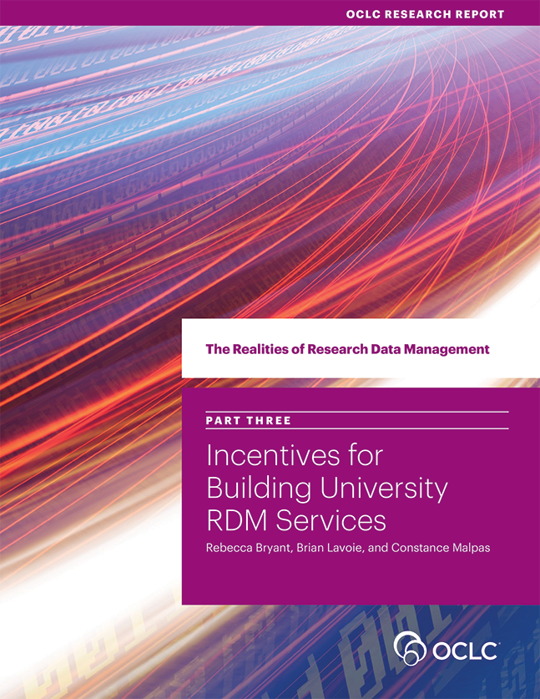
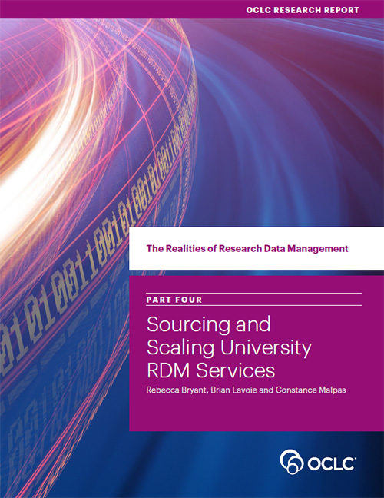
oc.lc/rdm
Realities of Research Data Management
Scoping the
RDM Service Bundle
Sourcing & Scaling
Choices
Incentives to Acquire
RDM Capacity
RDM Service Space

Slide 8
The RDM Service Space

Slide 9
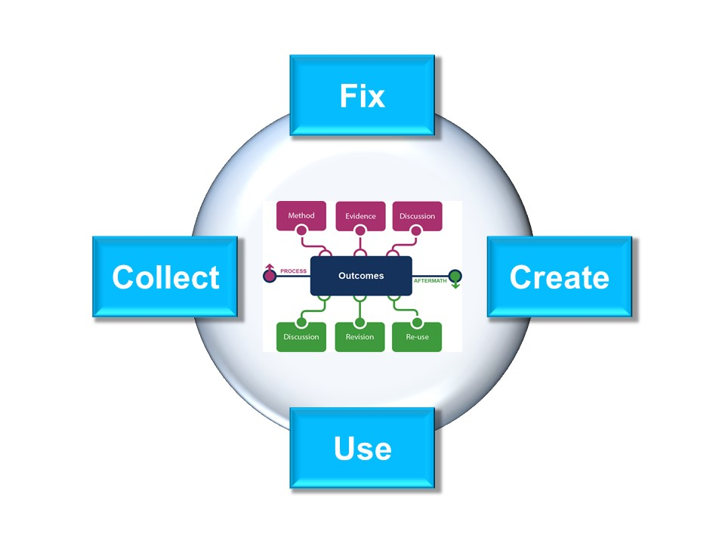
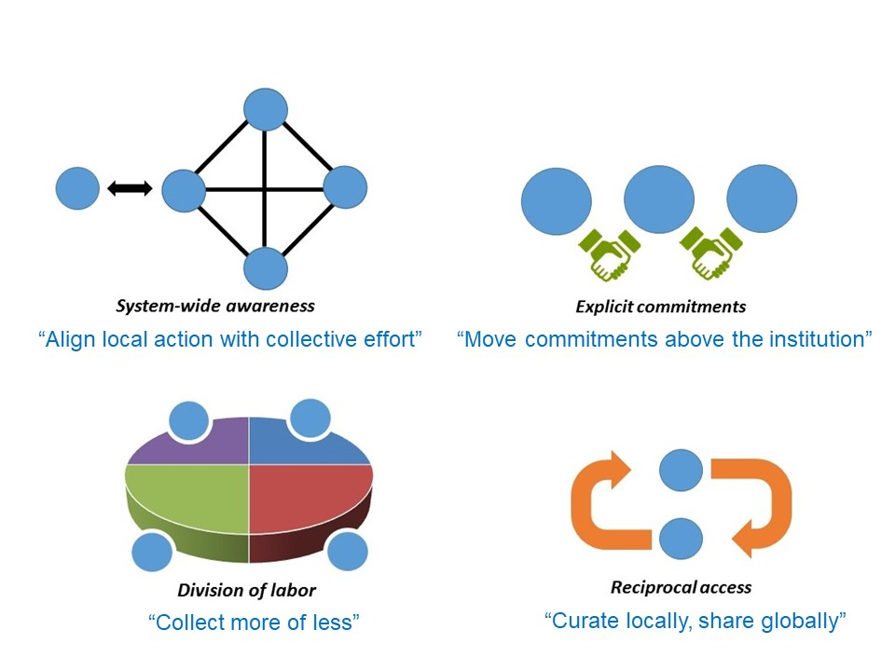
All together …
Identify
patterns & trends …
… impacting library
interests & mission …
… and transforming
library services

Slide 10
All together …
Identify
patterns & trends …
… impacting library
interests & mission …
… and transforming
library services

Slide 11
Institutional Stakeholders
VP Research
Tech Transfer
Proposal development
Sponsored research
Research ethics & compliance
Provost/Academic Affairs
Colleges & departments
Graduate College
Undergrad research
Center for teaching & learning
Institutional research
Registrar
HR
Medical center
RDM
RIM
CIO
Data Warehouse
Shared IT services
Digital scholarship
LIBRARY
Advancement
Corporate relations
Corporate communications
IR
User education & training
Colleges & depts
Graduate College
Undergrad research
Postdoc affairs
Diagram prepared by Rebecca Bryant, OCLC Research, 2018
Notes:
This previous work that Brian has describe has helped us to appreciate how important institution-wide collaboration is becoming, particularly to ensure success for efforts to support research data management, research information management, and open access.
This ”model” is an example of a work in progress for us here at OCLC—and it’s not yet in its final form or published.

Slide 12
Examining institutional “social interoperability”
Upcoming RLP effort
Examine stakeholders' goals and pain points in order to better understand how libraries can collaborate successfully
Webinars/interviews with other institutional stakeholders
Proposal development, pre- and post-award, compliance
Academic affairs, Graduate College, registrar
Institutional research
Campus communications, advancement
Synthesize

Slide 13
Examining collaboration
Above the institution
Below the institution

Slide 14
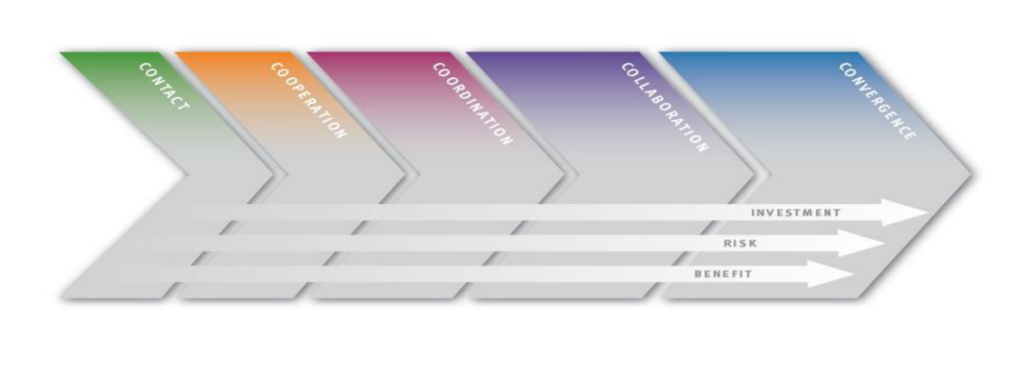
Collaboration Continuum
Zorich, et al, "Beyond the Silos of the LAMs: Collaboration in Libraries, Archives and Museums," OCLC Research 2008.

Slide 15
Catalysts
Vision - "What can we do together"
Mandate
Incentives
Change Agents
Mooring (administrative home)
Resources (technology, funding, staffing)
Flexibility
External catalysts (audience, peer institutions, funding organizations, professional organizations)
Trust

Slide 16
Questions?

