Slide 1

Experimenting with computational uses of AV materials at The Library of Congress
Jaime Mears and Laurie Allen
March 10, 2020

Slide 2
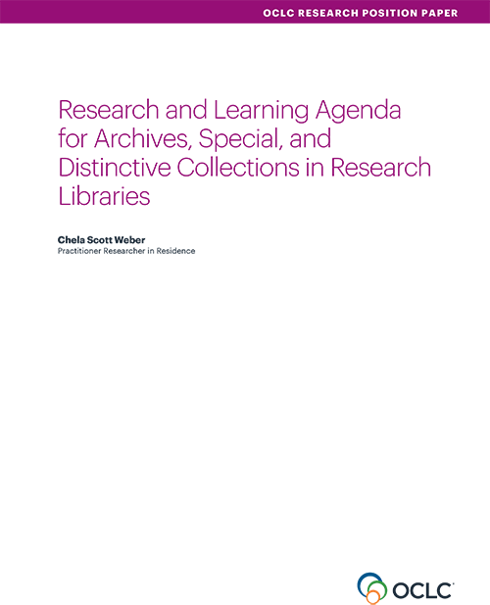
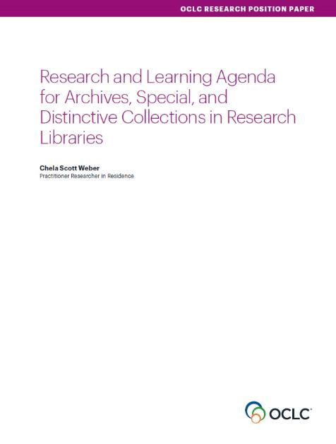
Our Work in Archives, Special, and
Distinctive Collections:
oc.lc/rlp-agenda
Notes:
OCLC Research has a long history of work in the area of archives, special, and distinctive collections in research libraries. We work in special collections because they are an important sight of knowledge creation, made possible by library’s commitment to the stewardship of their distinctive collections. The unique nature of material in special collections can make scaling a challenge, and we work to identify areas of common need and patterns of innovation to help libraries scale learning and expertise with these collections.
In October, we released the Research & Learning Agenda for Archives, Special, and Distinctive Collections.
articulates the shared challenges and opportunities research libraries are are facing in this sphere, and suggests approaches for working on them together.
The agenda will guide OCLC Research work in this area in the future, and we hope it will also serve to frame larger conversations and spur action across the field
This year, OCLC RLP will be presenting a number of webinars that respond to issue surfaced during our work on the agenda.

Slide 3
Prioritizing A/V Collections
“Recorded sound and moving image, or audiovisual (A/V), holdings continue to be a top concern for archival repositories, where they are found throughout modern collections. Changes in scholarship have led to increased interest in the content documented in A/V collections, and preservation concerns about A/V formats push them further up the priority list.”
Notes:
Addressing Audio-Visual Collections
A/V holdings continue to be a top concern in archival repositories, both because of evolving modes of scholarship in which these are increasingly valuable and sought-after sources, and because of preservation concern that many a/v formats are at or near end of life.
The volume of A/V holdings is staggering, and exceeds the ability to do preservation reformatting in many institutions. Additionally, legacy poor practice in collections management for these formats means that many a/v collections are not well enough managed or understood to make informed decisions about their care.

Slide 4



Addressing A/V Collections Needs in the RLP
Survey in Spring 2019
Community Conversations in Summer 2019
Blog posts in Fall 2019
  Assessing Needs of A/V in Special Collections
  Scale & Risk: Discussing Challenges of Managing A/V in the RLP
Series of A/V related webinars throughout 2020
Notes:
We’ve been working over the last year to better understand needs in this area, beyond our initial conversations in the creation of the agenda.
Survey of 275 colleagues in the Spring 2019
Community Conversations in Summer 2019
Assessing Needs of A/V in Special Collections: http://hangingtogether.org/?p=7405
Scale & Risk: Discussing Challenges of Managing A/V in the RLP: http://hangingtogether.org/?p=7479
Now we’re doing a series of webinars throughout 2020

Slide 5
Working at Scale
(requires a) Shift in Mindset
Notes:
The preservation risks of these formats, coupled with the large numbers of AV in our holdings and short time window, means that we must work on our A/V collections at scale. Working at scale amplifies the challenges of A/V materials like uncertain copyright or lack of detailed descriptive information, and also creates new challenges.
The different ways that a shift in mindset will be necessary to addressing the challenges of stewarding these collections at scale.
So for our AV webinar series, we’re presenting work at partner institutions who are working at scale in different aspects of working with AV, and the ways that has challenged and shifted their mindset and ways of working.

Slide 6
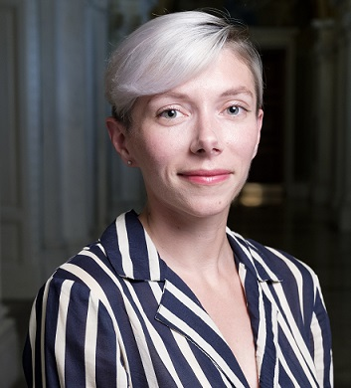
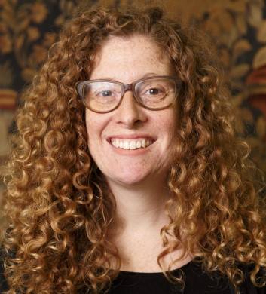
Jaime Mears
Senior Innovation Specialist
LC Labs
Laurie Allen
Program Analyst
Digital Strategy

Slide 7
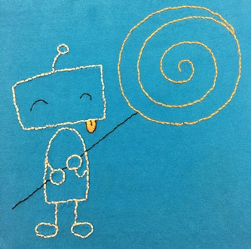
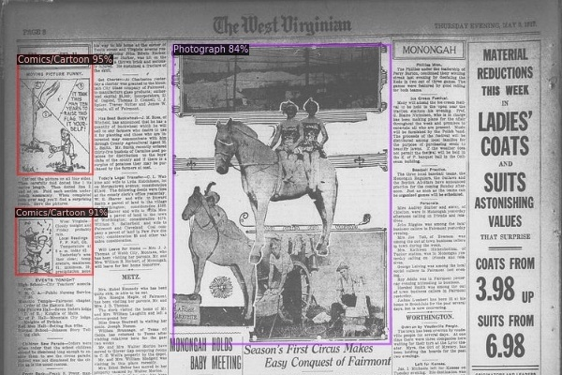
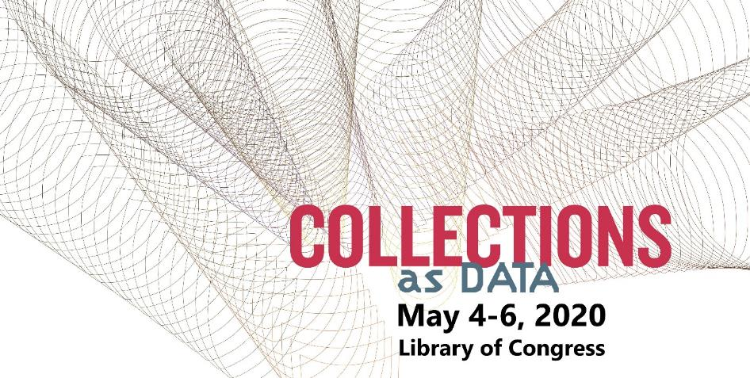

Slide 8
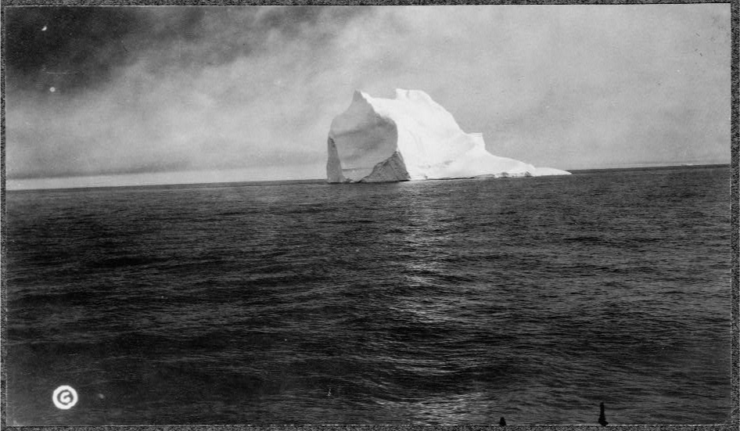
Iceberg surrounded by water in the Arctic. Arctic Ocean, ca. 1913. Photograph. https://www.loc.gov/item/90709450/.

Slide 9
Underwater…
The vast majority of materials are not digital and not online
Iceberg surrounded by water in the Arctic. Arctic Ocean, ca. 1913. Photograph. https://www.loc.gov/item/90709450/.

Slide 10
Some materials are digital but not online, or not computationally available
Underwater…
The vast majority of materials are not digital and not online
Iceberg surrounded by water in the Arctic. Arctic Ocean, ca. 1913. Photograph. https://www.loc.gov/item/90709450/.

Slide 11
Some materials are digital but not online, or not computationally available
Available for research use
Underwater…
The vast majority of materials are not digital and not online
Iceberg surrounded by water in the Arctic. Arctic Ocean, ca. 1913. Photograph. https://www.loc.gov/item/90709450/.

Slide 12
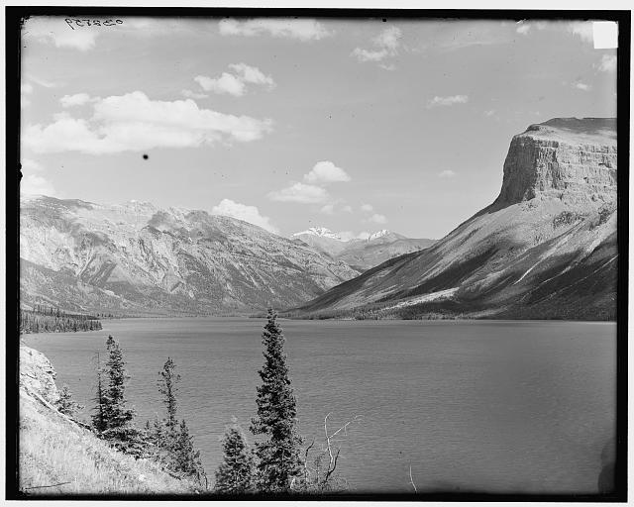

Data moves from LC servers into cloud
Researchers are supported in using data
We identify costs and service models to support large scale access to collections
Detroit Publishing Co. Lake Minnewanka, Alberta, Canada. Minnewanka Minnewanka, Lake, ca. 1902./.

Slide 13
Grant funds will
Help the Library develop models for large computational research on Library Collections
  Library Digital Collections (large subset) will be made available
  Four big data experiments using Amazon infrastructure (aka “cloud”)
  Supported by three grant-funded staff members
  Documented and shared to support further learning

Slide 14
What Collections?
Low-hanging fruit (i.e. already on labs pages)
Non-rights restricted
Collections with big potential

Slide 15
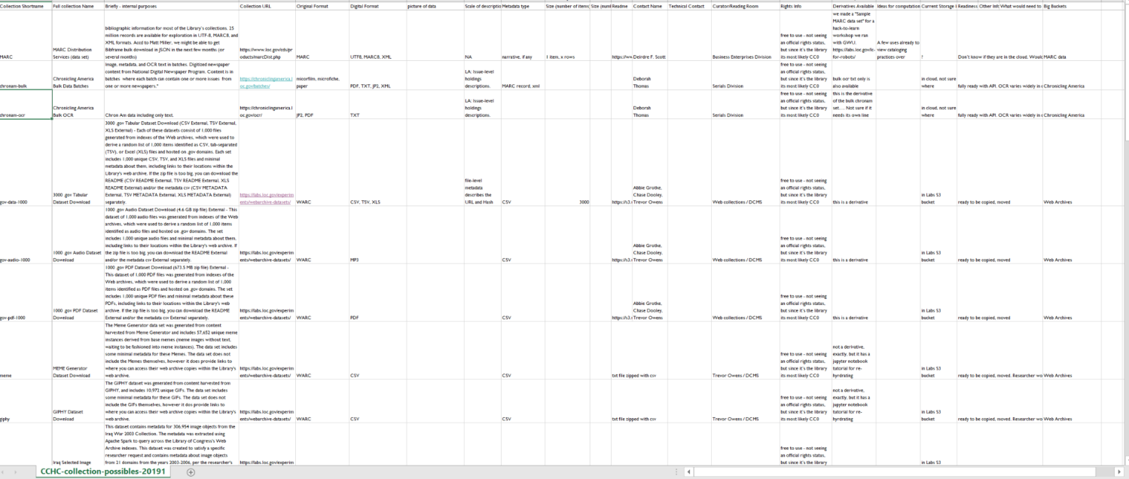
Collection possibilities – how to identify?

Slide 16
What do we need to know in order to make data available?
Rights information at the item and at the collection level
Technical feasibility of moving to the cloud
Curators perspectives on use
Other risks?

Slide 17
What do researchers need to know in order to use data?
What is the data about?
What kind of data is it?
What does it look like?
What is missing?

Slide 18
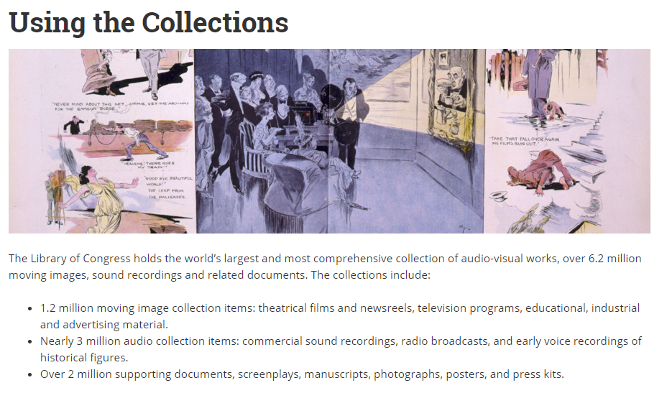

Slide 19
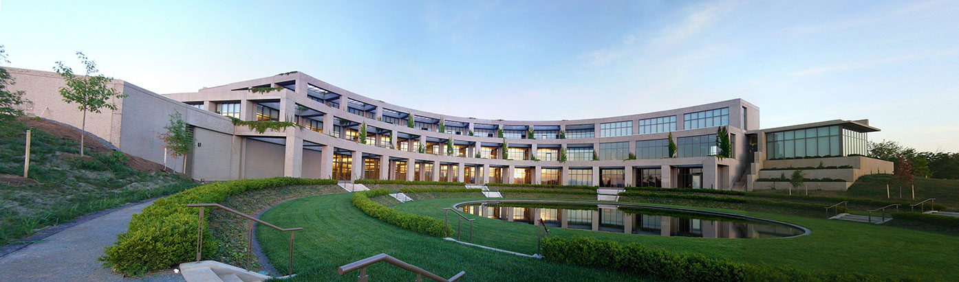
Library of Congress Packard Campus of the National Audio-Visual Conservation Center, Culpeper Va.

Slide 20
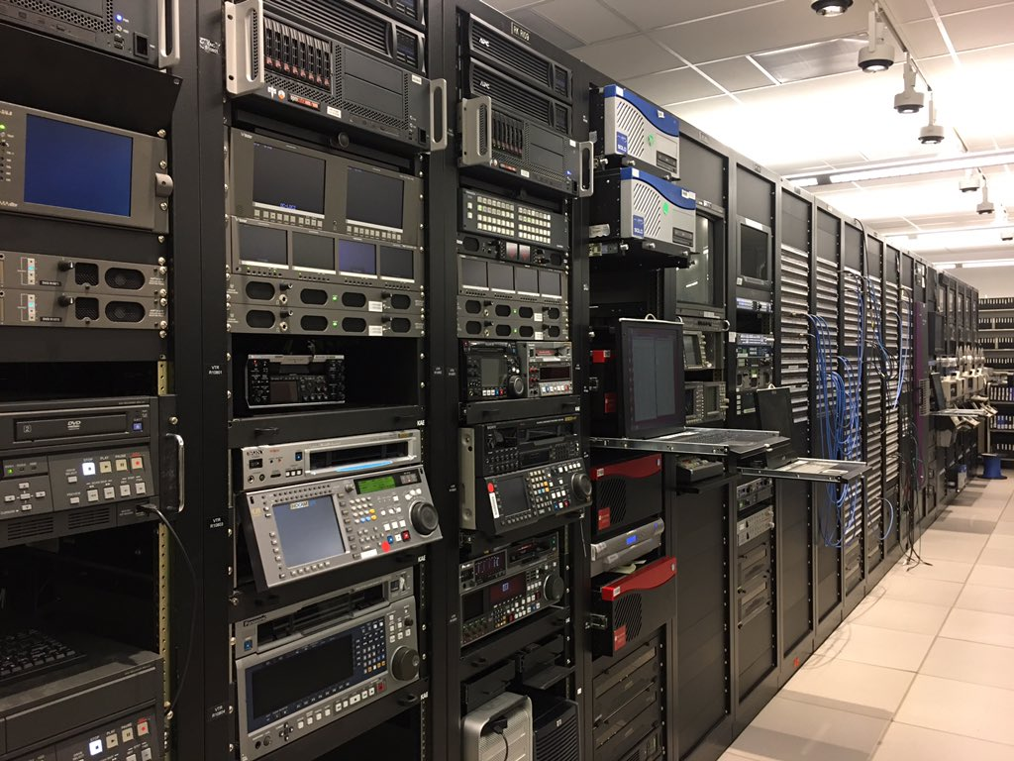
Library of Congress Packard Campus Photo credit: Jaime Mears

Slide 21
Some materials are digital but not online, or not computationally available
Available for research use
Underwater…
The vast majority of materials are not digital and not online
Iceberg surrounded by water in the Arctic. Arctic Ocean, ca. 1913. Photograph. https://www.loc.gov/item/90709450/.

Slide 22
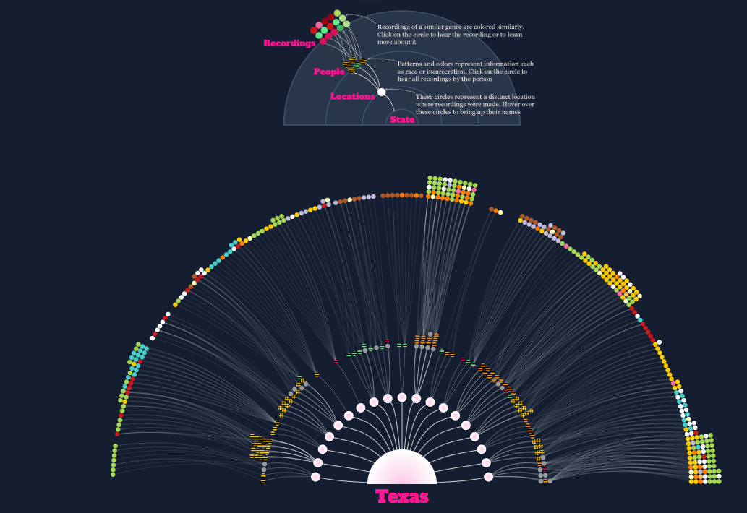
Aditya Jain. Southern Mosaic.2017. Data visualization. https://labs.loc.gov/experiments/southern-mosaic/

Slide 23
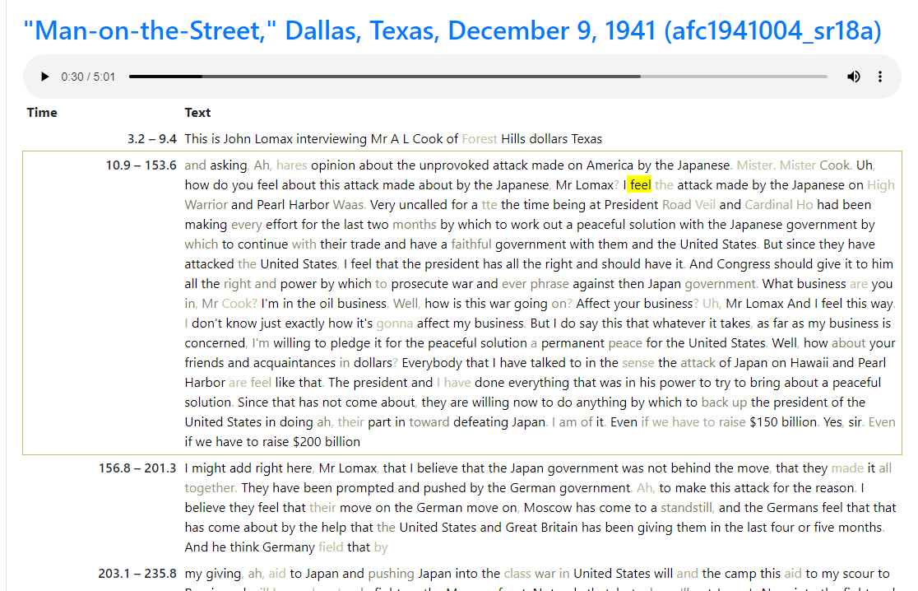
http://speechtotextviewer.s3-website.us-east-2.amazonaws.com/

Slide 24
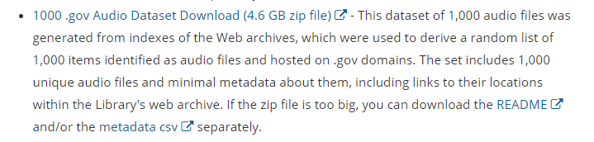
https://labs.loc.gov/experiments/webarchive-datasets/

Slide 25
Available for commercial use
Some materials are digital but not online, or not computationally available
Available for research use
Underwater…
The vast majority of materials are not digital and not online
Iceberg surrounded by water in the Arctic. Arctic Ocean, ca. 1913. Photograph. https://www.loc.gov/item/90709450/.

Slide 26
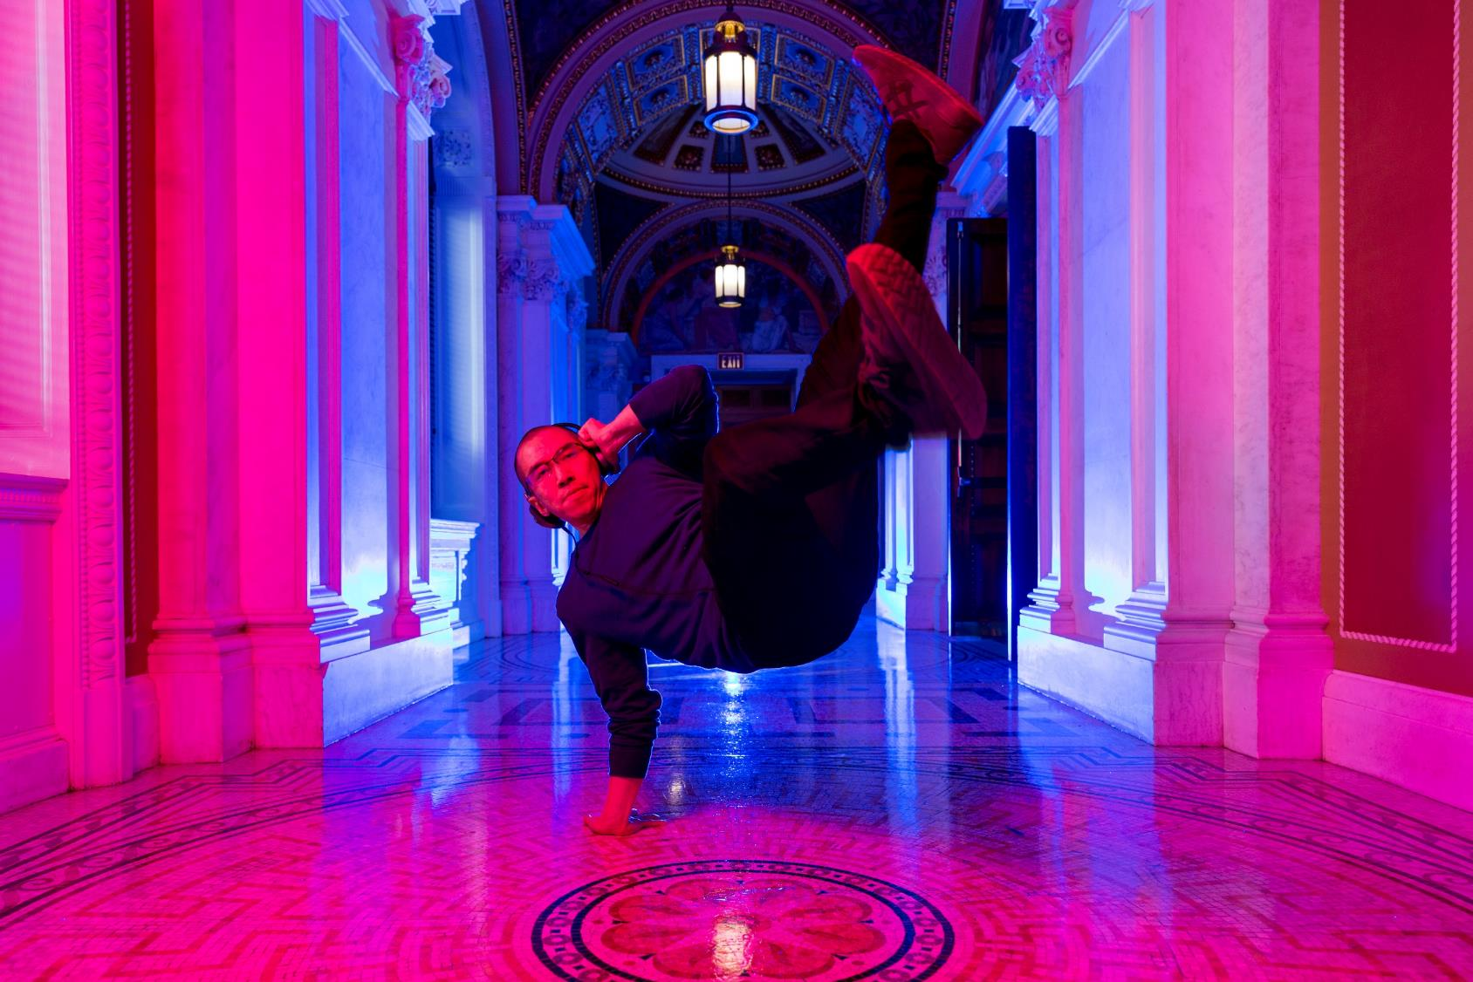
Brian Foo, Library of Congress 2020 Innovator in Residence Photo Credit: Shawn Miller

Slide 27
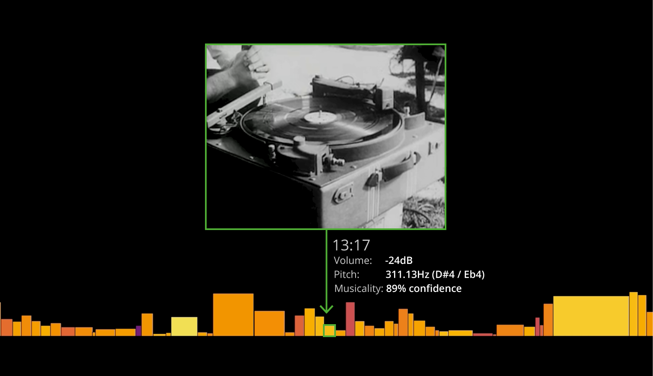

Slide 28
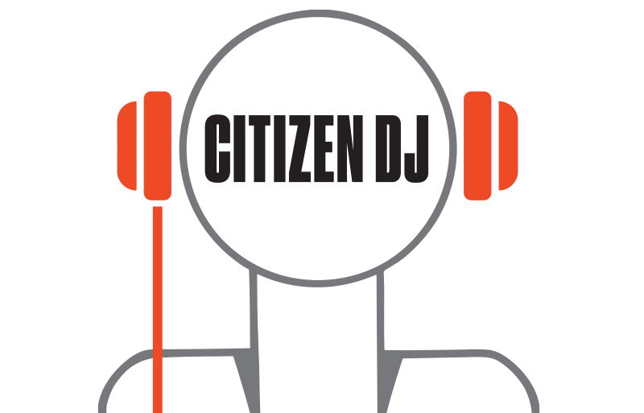
[jump to Citizen DJ demo]

Slide 29
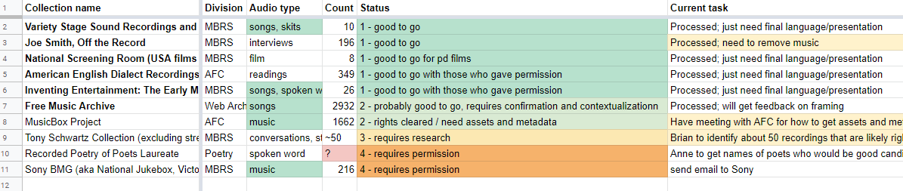

Slide 30
What’s Next?
2020 - A/V experiment
2020- A/V summit
2022 – CCHC Report
  Join us March 17, 2020 for the next quarterly update

Slide 31
Questions?

