Slide 1
Level Up!
Lessons Learned from
Six Years of Collaborative
Technical Skills Development

Slide 2
Land Acknowledgement
As the archives of the University of Michigan, the Bentley Historical Library acknowledges that the historical origins and present locations of the University were made possible by cession of lands by Anishinaabe and Wyandot peoples under coercive treaties common in the colonization and expansion of the United States. These lands continue to be the homeland of indigenous people, and we seek to reaffirm and respect their contemporary and ancestral ties to the land and to recognize their contributions to the University.

Slide 3
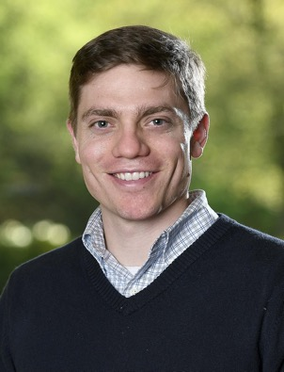
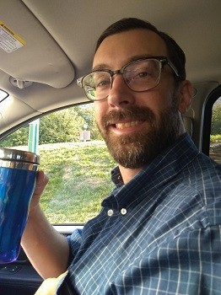
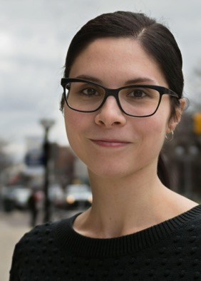
Presenters
Max Eckard
Assistant Director for Curation Bentley Historical Library
(he/him/his)
Mike Shallcross
Associate Archivist
Inter-university Consortium for
Political and Social Research
(he/him/his)
Elizabeth Gadelha
Archivist for Digitization Services Bentley Historical Library
(she/her/hers)

Slide 4
Introduction
Technical “upskilling” is the process of acquiring and expanding technical skills
Staff increasingly need general technical literacy to work efficiently with digital information
How do we encourage staff to approach such upskilling, especially as a group?
Collaboration

Slide 5
Outline
1. Institutional
Context
2. Overview of Initiatives
3. Outcomes of Initiatives
4. Lessons Learned
5. Exploring Upskilling Projects

Slide 6
Institutional Context

Slide 7
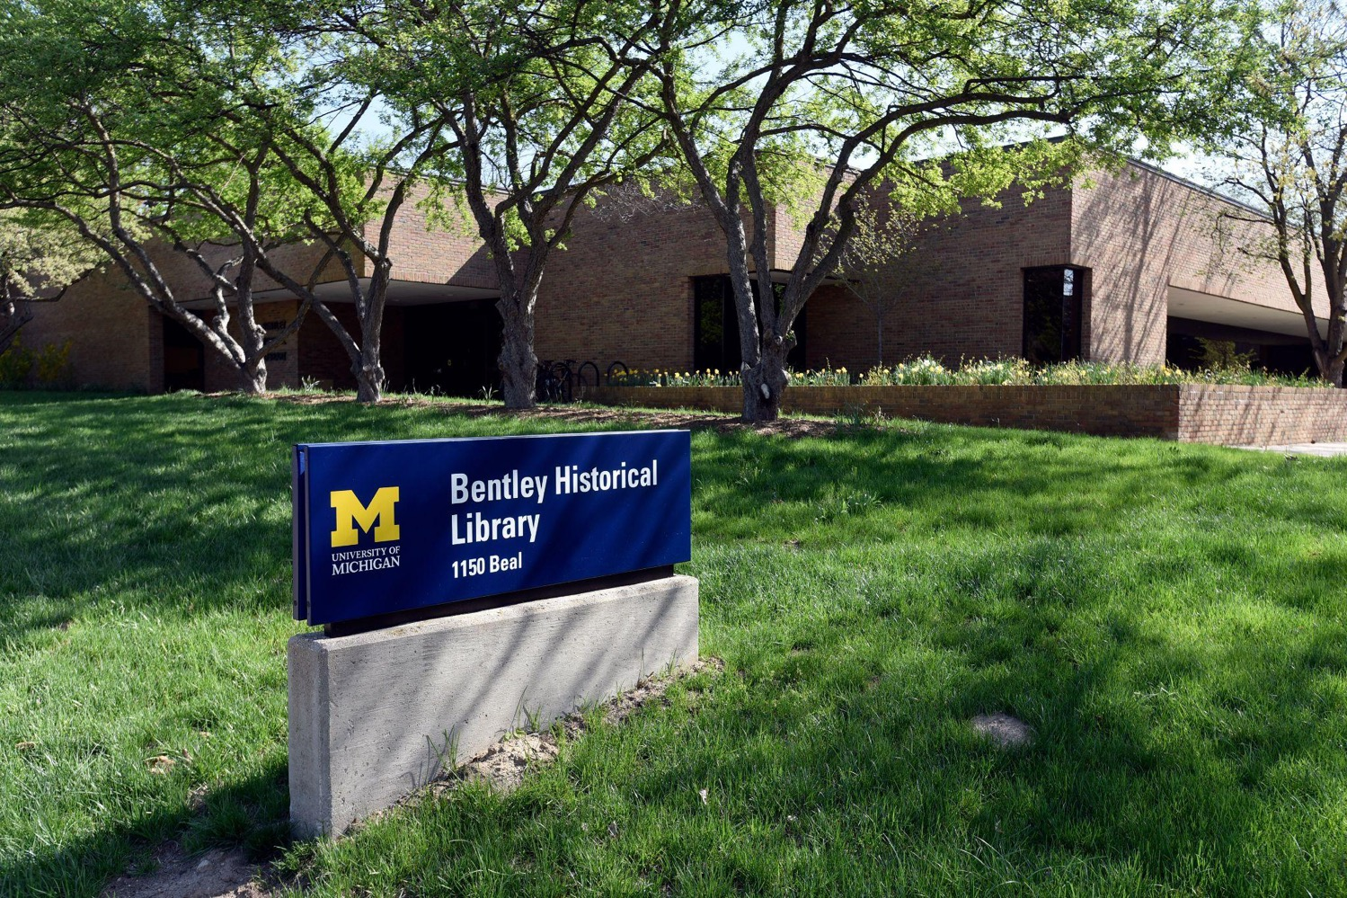
Exterior View of the
Bentley Historical Library

Slide 8
Overview of Initiatives

Slide 9
Bentley Collaborative Technical Upskilling Initiatives
2014-2016: ASpace-Archivematica-DSpace Workflow Integration Project
2015: Curation Team Workshops
2017-2018: Curation Team Technical Skills Pilot Project
2019: Bentley Audiovisual Quality Control Utility Project (BAroQUe)

Slide 10
2014-2016 Workflow Integration Project Overview
Funded by a grant from the Andrew W. Mellon Foundation
Involved three Curation team members (working with consultants from Artefactual Systems and IT staff at UM Libraries)
Project goals:
Integrate functionality of ArchivesSpace, Archivematica, and DSpace to produce an end-to-end digital archives workflow (e.g., from deposit to dissemination)
Introduce efficiencies in the creation and reuse of metadata across archival management, preservation, and access systems
Did not fully anticipate the range of potential learning opportunities!
Notes:
NOTE: projected outcomes did not include the numerous learning opportunities that would be afforded by the project

Slide 11
Workflow Integration Project Learning Opportunities
Agile software development methodology
Communication with IT staff: what’s effective and what’s not
Python:
Learned basics (terminology, methods, string and file manipulation, etc.) with bi-weekly half-hour sessions
Collaborated with an experienced grad student developer to clean data in 3,000+ EAD XML files (e.g., names, dates, subjects, extents, physical facet terms, etc.)
Wrote Python scripts to interact with platform APIs
Notes:
Integration of ArchivesSpace, Archivematica, and DSpace was successfully completed in October 2016
Unexpected–but highly beneficial–outcomes:
Archivists exposed to new terminology and concepts
Raised awareness of opportunities for automation and efficiencies
Shared knowledge and awareness provides opportunities for collaboration and inspiration

Slide 12
2015 Curation Team Workshops
Inspired by learning opportunities in 2014-2016 Workflow Integration project; intentionally inclusive: welcomed the entire Curation team
A series of informal workshops; basic structure:
Experienced team member introduced technology and relevant user scenarios
Attendees participated in small-group hands-on exercises
Topics included:
Simple operations with the Windows command line interface (CMD.EXE)
Using the Audacity audio editor to analyze and edit sound recordings
Cleaning messy data with OpenRefine

Slide 13
2017-2018 Technical Skills Pilot Overview
Participants met during regularly scheduled, weekly sessions that were led by a planning committee of three project archivists
Built upon previous workshops, but covered a broader range of topics with more emphasis on peer-to-peer learning
Assessed outcomes through surveys and a report to help identify directions for future initiatives
More formalized approach to developing technical literacy and introducing skills and tools that could be used by participants in their work

Slide 14
Technical Skills Pilot Learning Opportunities
Python Sessions
Fourteen sessions covered fundamentals and relied on free online resources
Problem sets, readings, and videos were assigned before each session
During sessions participants continued problem sets, shared answers, and asked questions
Rotating Topic Sessions
Eight sessions covered specific programs and platforms as well as more general topics
Some sessions featured presentations, demonstrations, and workshops
Other sessions fostered discussions, solved problems, and followed tutorials

Slide 15
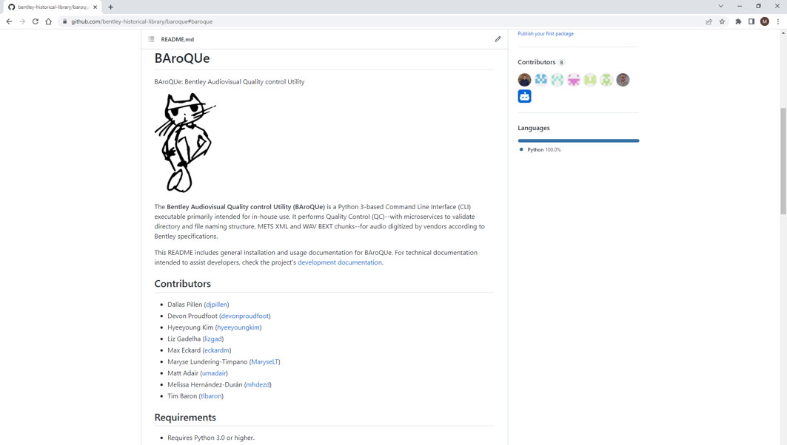
2019 Bentley Audiovisual Quality Control Project
Screenshot of the BAroQUe GitHub Repository and Command-Line Interface

Slide 16
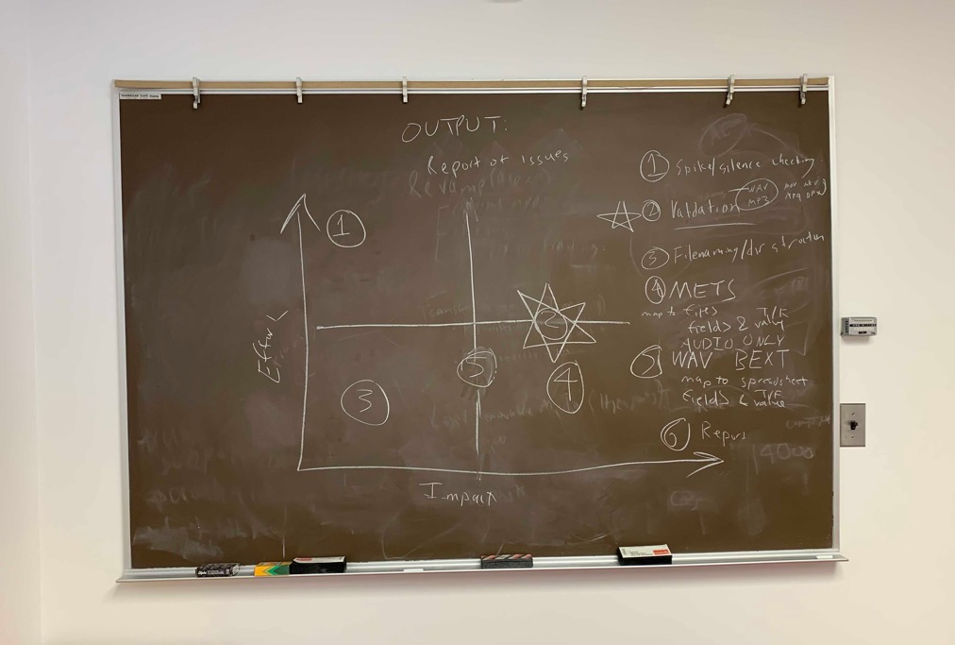
Impact-Effort Matrix

Slide 17
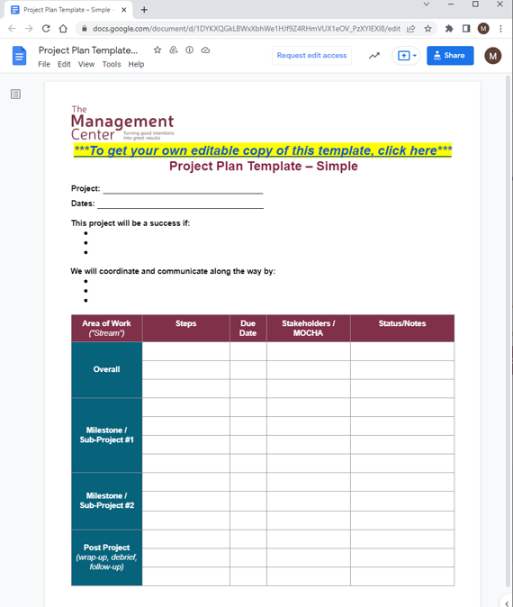
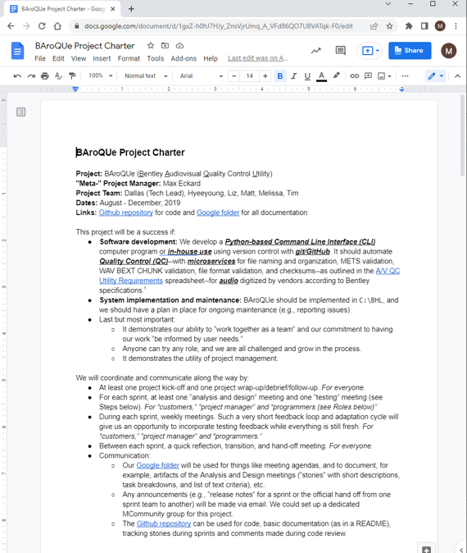
“BAroQUe Project Charter,”
based on the “Project Plan Template” from The Management Center

Slide 18
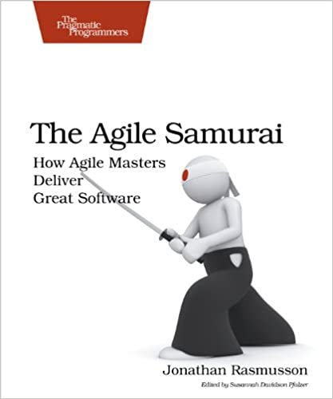
Agile Practices
Iterative and incremental development for time-bound software development projects
Large tasks are broken down into smaller components
Addressed in short one to two week time frames (“sprints”)
Regular, face-to-face communication among team members as well as meetings with a “product owner”
The Agile Samurai
by Jonathan Rasmusson

Slide 19
Other Key Learning Opportunities
Introducing the entire project team to Git and GitHub
Demonstrating the importance of iterative and incremental development and the agile execution of project plans
Realizing that everyone--regardless of technical ability--has a part to play
Dedicating time during the project to think about how the team would later maintain it

Slide 20
Specific Outcomes of Initiatives

Slide 21
Identifying Outcomes of Upskilling Initiatives
Measuring impact:
First two initiatives did not articulate learning outcomes or employ assessment protocols
Second two initiatives were more intentional in identifying and assessing outcomes
Based upon the available assessments and informal observations, all four initiatives led to:
Improved Efficiency and Throughput
Increased Team Cohesion and Collaboration
Enhanced Professional Development

Slide 22
Outcome # 1: Improved Efficiency & Throughput
Example: cleaning and normalizing metadata in 3,000+ EAD finding aids for import to ArchivesSpace
Python to parse/extract data
OpenRefine to clean/normalize data
Reduced time/labor around frequent and repetitive tasks
Deployment of computer scripts to automate workflow steps without human intervention
Focused human judgement & attention for greatest impact and value
Screenshot of OpenRefine

Slide 23
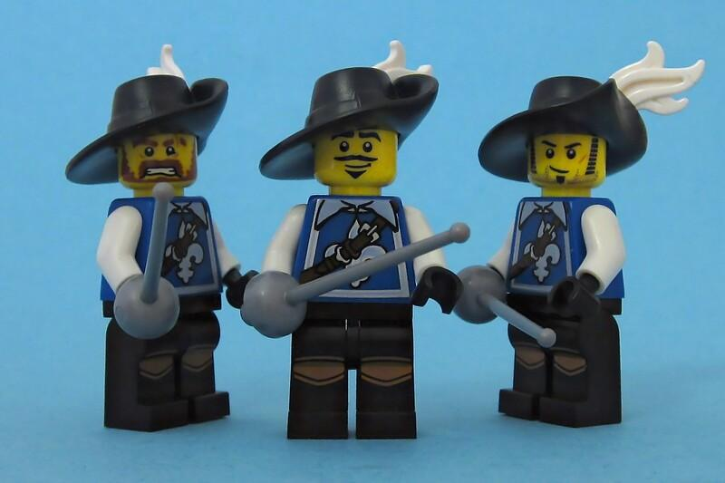
Outcome #2: Increased Team Cohesion & Collaboration
Example: Curation team pivot to remote work during COVID-19 pandemic
Team-wide support network
Rapid adoption of virtual meetings and collaboration tools, etc.
Shared experiences (esp. failures and vulnerabilities) led to team building
Broader recognition of how everyone contributes to projects (technical or not)
Increased “technical literacy” helped demystify solutions and strategies
The Three Musketeers

Slide 24
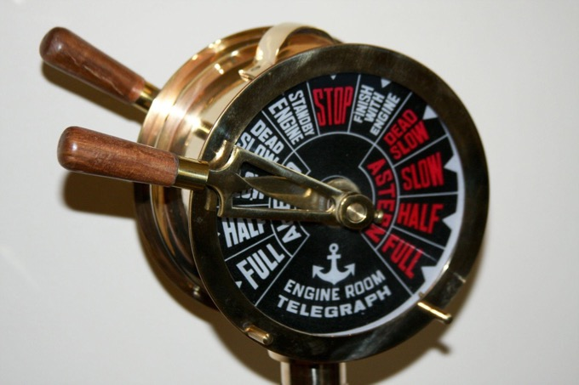
Outcome #3: Enhanced Professional Development
Example: regular application of skills to work responsibilities; three Curation team members transitioned to IT or data-focused jobs
“Upskilling” topics filled gaps in library and archives professional development offerings
In-house initiatives lowered development barriers:
On-site; no travel
Regular work hours (with supervisor approval!)
Staff-led: no cost
The focus on practical applications laid a foundation for future growth
Engine Room Telegraph

Slide 25
Lessons Learned From Initiatives

Slide 26
Lessons Learned…
Team members are significant assets for group skill development
Well-defined deliverables enhance personal outcomes
Actionable assessments improve planning and implementation

Slide 27
Team Members are Significant Assets for Groups
Involving a team member with experience applying a technical skill created an efficient learning environment that was beneficial to the overall initiative
Team members do not need to have technical expertise to contribute to a group’s skill development
Involving individuals not only increases their engagement but gives them an opportunity for professional development and peer recognition
Successful Teamwork

Slide 28
Well-Defined Deliverables Enhance Personal Outcomes
Social aspects of initiatives and professional development opportunities are important motivating factors for participation and positive outcomes
But an even more important factor was having a well-defined and practical deliverable associated with the learning opportunity
While raising awareness of workflows and tools is important, the absence of relevant deliverables may limit individuals’ overall engagement
Defined Deliverable

Slide 29
Assessments Improve Planning and Implementation
Regular and actionable assessments help tailor learning initiatives to the actual needs of individual team members and their daily work responsibilities
Assessment helps demonstrate the outcomes and impacts of initiatives in a clear manner
Utilizing a variety of assessment methods can also accommodate differences in individual communication preferences
Team Meeting

Slide 30
Things to Consider When Exploring Technical Upskilling Projects

Slide 31
Things to Consider…
Making the Case for Initiatives
Time and Resource Constraints
Approaches to Team Inclusivity and Equity
Building a Culture that Values Technical Upskilling
Considerations

Slide 32
Making the Case for Initiatives
To administration…
Frame initiatives and intended outcomes with an awareness of organizational culture, structure, and values
Connect efforts with the library’s core strategic goals
To staff…
Align with individuals’ varied motivations for acquiring new skills and knowledge
Connect the acquisition of technical skills to an urgent work need or longstanding pain point
Help staff take ownership of initiatives and defining expectations

Slide 33
Time and Resource Constraints
Initiatives faced time and resource constraints, as participation took place in addition to existing duties and responsibilities
They are not the only constraints:
What is the scope of the project?
What is the timeline of the project?
What are the available human or financial resources to support the project?
How important is the quality of the final product?
It can be helpful to think of these as trade-offs, as in the Agile Samurai

Slide 34
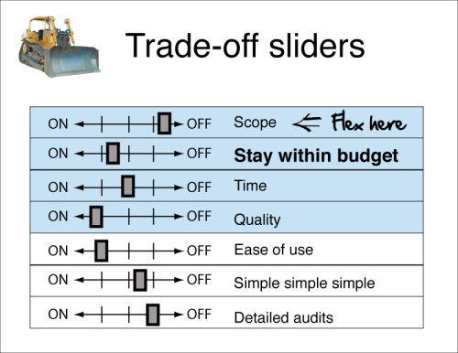
“Trade-off sliders” from the “Agile Inception Deck”

Slide 35
Approaches to Team Inclusivity and Equity
Seek to involve people who might otherwise have been excluded from these conversations
Consider “multi-level” or “differentiated” instruction to accommodate diverse learning styles
Mandatory “inclusion” is not useful; nor should staff feel that lack of participation will negatively impact performance reviews, etc.

Slide 36
Building a Culture that Values Technical Upskilling
Adam Grant: Conflict is “one of the ways that a team of people can be creative and make good decisions.”
“...failed groups tended to have much more relationship conflict…”
“In contrast, high performing groups experienced more on task conflict…”
Camille Fournier: “Understand what your company’s values are, understand what your team’s values are… write the values down if they aren’t already written, and try to be explicit.”
Bryan Walker and Sarah A. Soule: “While a leader such as a director or dean is often in a position of authority, they are not as effective as a ‘movement maker’ in leading such a cultural movement.”

Slide 37
Conclusion

Slide 38
Organizational culture is more effective than project-based or individual efforts.

Slide 39
The American Archivist nameplate

Slide 40
Thank you!
Questions?
Max Eckard
eckardm@umich.edu
Elizabeth Gadelha
gadelha@umich.edu
Mike Shallcross
shallcro@umich.edu

Slide 41
Image Credits
“The Agile Inception Deck,” The Agile Warrior (blog), last modified November 6, 2010, https://agilewarrior.wordpress.com/2010/11/06/the-agile-inception-deck/.
Pascal, “The Three Musketeers,” April 7, 2011, https://www.flickr.com/photos/pasukaru76/5597863793, CC0 1.0 Universal.

