Slide 1
Why don't research impact LibGuides include bias-related resources? Sheila Craft-Morgan, JD, MLS Research Impact Librarian and Assistant Professor Ohio State University July 25, 2023

Slide 2
Agenda
Introduction
Project Overview
Methodology
Results
Implications and Next Steps

Slide 3
My Background
MLS from Kent State in 2000
20+ years in Institutional Research
JD from Capital University in 2010
August 2022: Research Impact Librarian and Assistant Professor in University Libraries at Ohio State

Slide 4
Literature Review
Research Impact as a Library Service
Case studies, awareness/familiarity
Responsible Metrics
Leiden Manifesto, DORA, Metric Tide

Slide 5
Research Agenda
People, Content and Systems
Rethinking What Counts
Address implicit and explicit biases in relation to research metrics

Slide 6
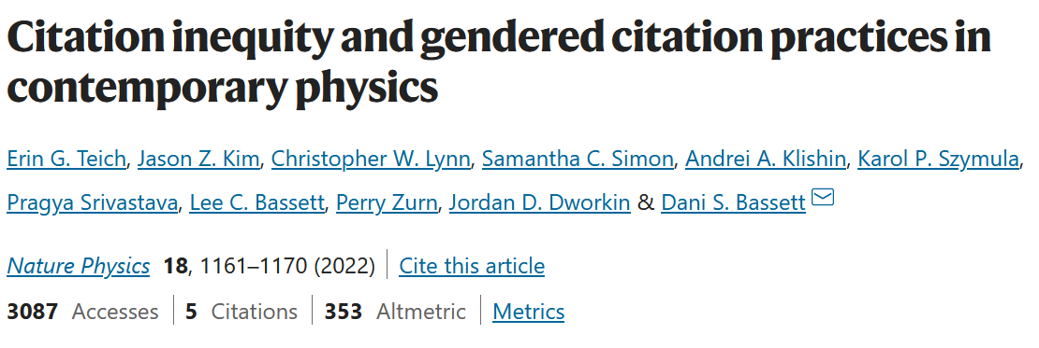
Research on Bias/DEIJ and Research Metrics in Other Disciplines

Slide 7
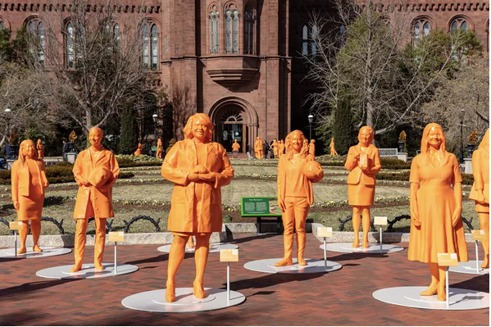
Why is this important?
Narrative of Scholar/Researcher/Scientist
Serving our users

Slide 8
Research Questions
How prevalent are research impact or scholarly impact librarians at the top 50 ARL libraries according to the ARL Investment Index?
What are the most common reporting units of research impact services librarians?
What percentage of scholarly metrics guides or websites refer to bias or DEIJ?

Slide 9
Methodology
Identify peer group
Compile data
Visualize the data

Slide 10
Traditional Methods
Peer Group Construction
Predetermined
Developed

Slide 11
Predetermined Peer Group
Association of Research Libraries is a “nonprofit membership organization of research libraries and archives in major public and private universities, federal government agencies, and large public institutions in Canada and the US (United States).”
The ARL Investment Index is a “summary measure of relative size” calculated using four variables:
Total expenditures
Salary expenditures
Materials expenditures
Professional plus support staff

Slide 12
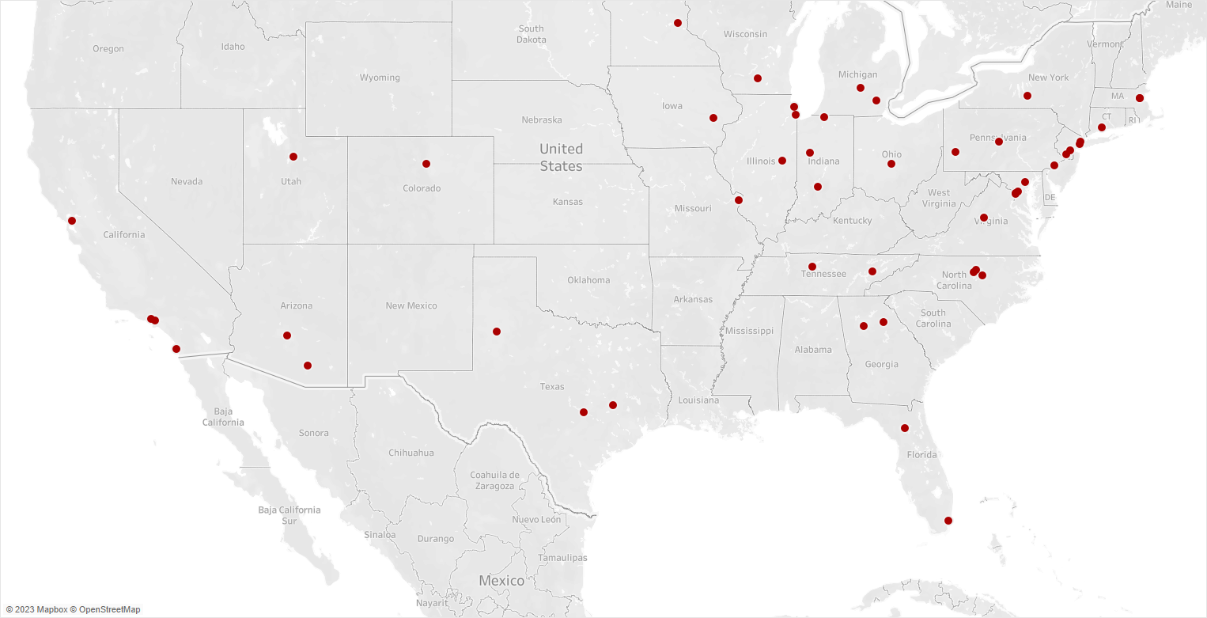
Top 50 ARL Libraries by Investment Index

Slide 13
Top 50 ARL Libraries by Investment Index
58%
40%
$913M
Public Universities
Land Grant Institutions
Median NSF 2021 R&D Expenditures

Slide 14
Methodology
Identify peer group
Compile data
Visualize and analyze the data

Slide 15
Methodology
Keyword search and close review of the following resources:
Library directories and library websites
Research Guides (LibGuides or websites)
February/March 2023

Slide 16
Why LibGuides?
Research libraries are increasingly using LibGuides to provide resources and services
Types of LibGuides

Slide 17
Content Analysis
Research Impact Librarian
Research Impact LibGuides or Website
Identifiers or Researcher Profiles
Research Impact
Impact
Scholarly Research
Impact Factor
Metrics
Research Impact
Citations
ORCID
Scopus ID
ResearcherID

Slide 18
Content Analysis
Responsible Metrics
Article/Journal/Author Metrics
Bias/DEIJ
Leiden Manifesto
DORA
Metric Tide
Responsible Use
Journal Impact Factor
Citation Counts/Times Cited
h-index
Altmetrics
Bias
Diversity or Equity
Citational Justice
Gender or Ethnicity

Slide 19
Content Analysis Matrix

Slide 20
Methodology
Identify peer group
Compile data
Visualize and analyze the data

Slide 21
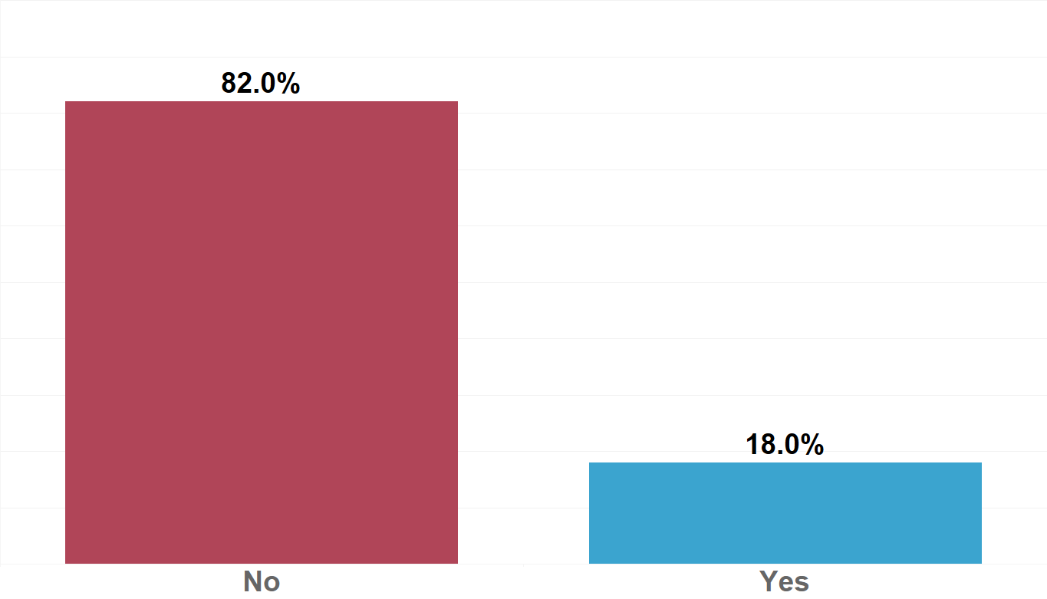
Does the Library employ a Research Impact Librarian?

Slide 22
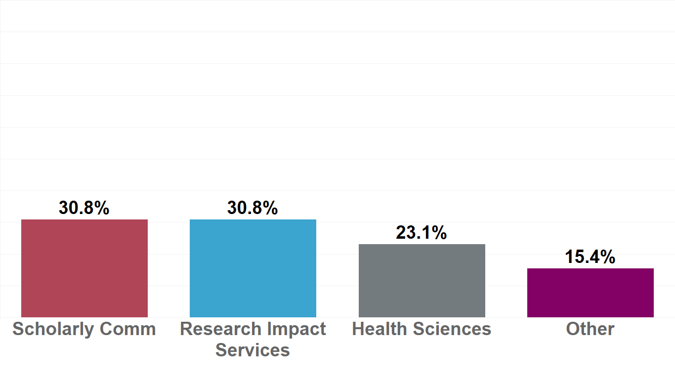
Organizational Home of Research Impact Librarian

Slide 23
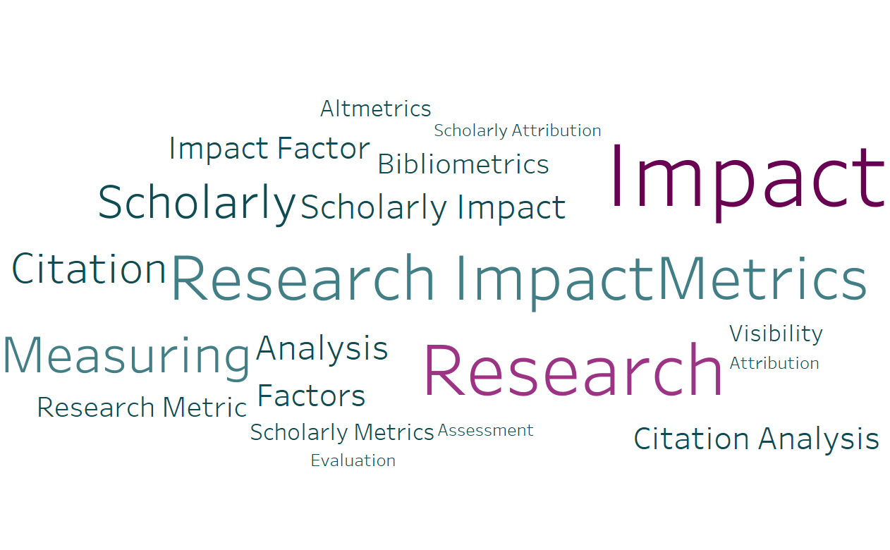
Title of Research Impact LibGuides or Website

Slide 24
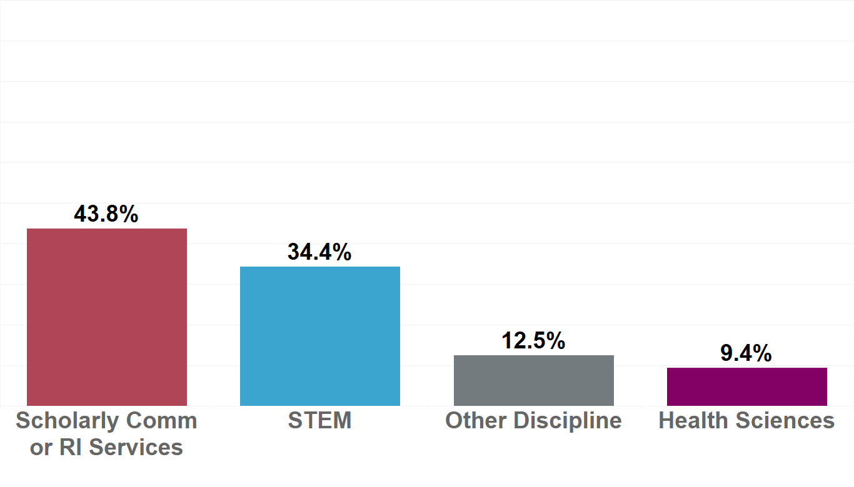
Title of Research Impact LibGuides or Website Author

Slide 25
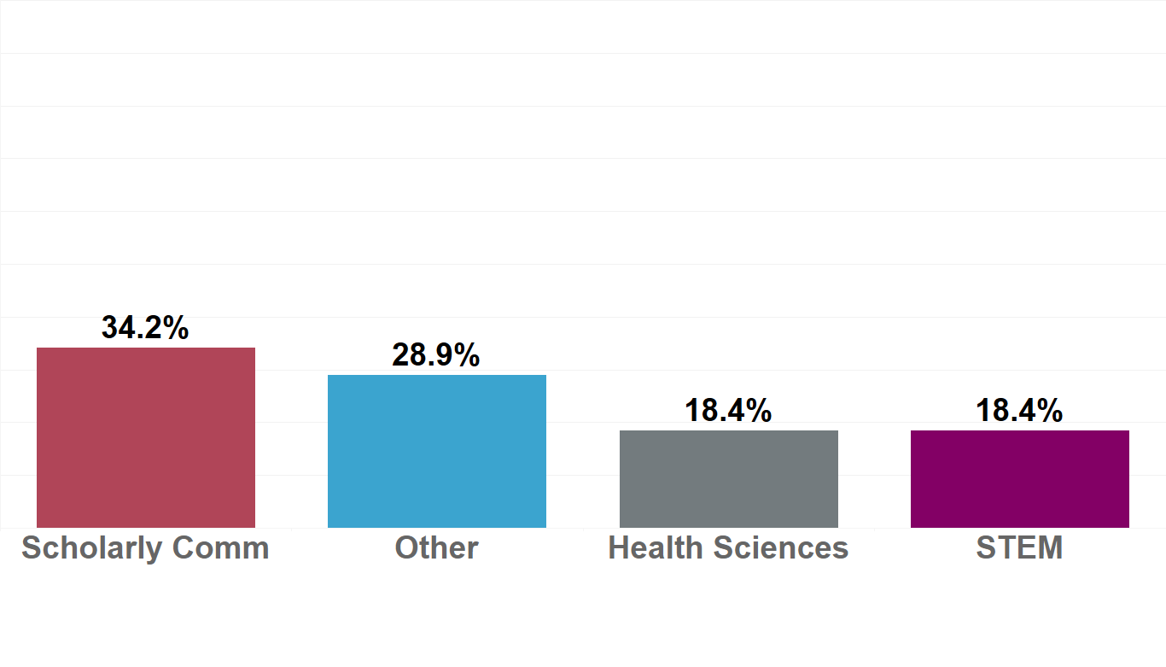
Organizational Home of Research Impact LibGuides or Website Author

Slide 26
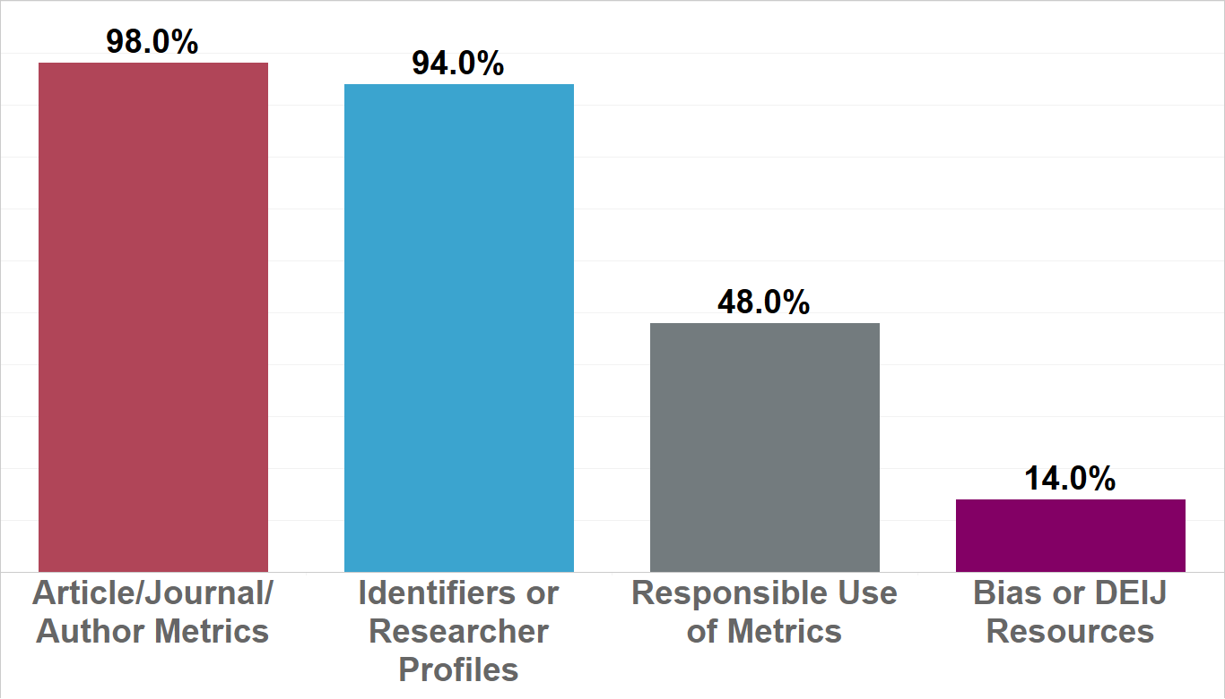
Research Impact LibGuides or Website Content

Slide 27
Implications
Librarians from Scholarly Communications, Health Sciences, STEM, and other areas are developing research impact resources and providing services to users
There seems to be a relatively agreed upon list of information that belongs on a Research Impact or Scholarly Metrics guide
Research impact or scholarly metrics LibGuides for this group of institutions did not include discussions of bias

Slide 28
Exemplars
Disclaimer about citations counts and Journal Impact Factors
"inherently biased"

Slide 29
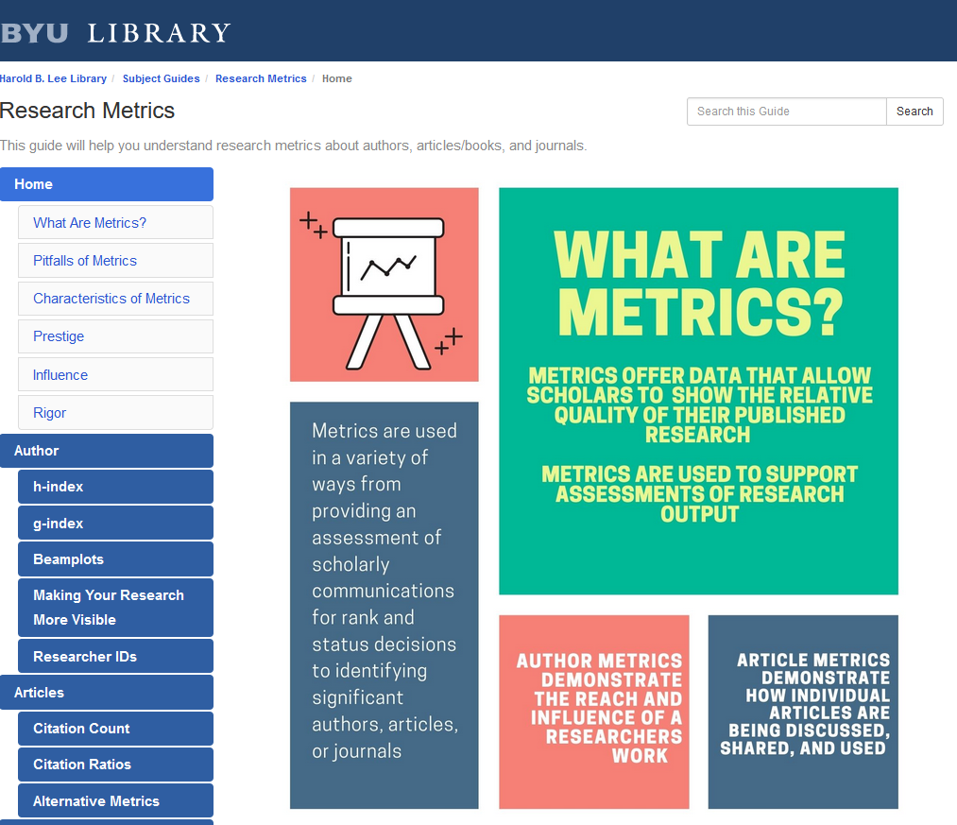
Exemplars
"Pitfalls" of Metrics
Subjectivity
Discipline differences
Data differences
Inherent bias
Manipulation

Slide 30
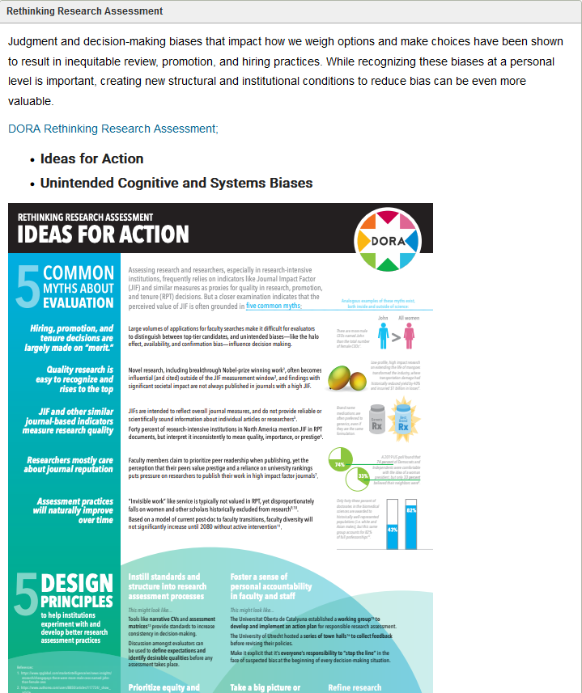
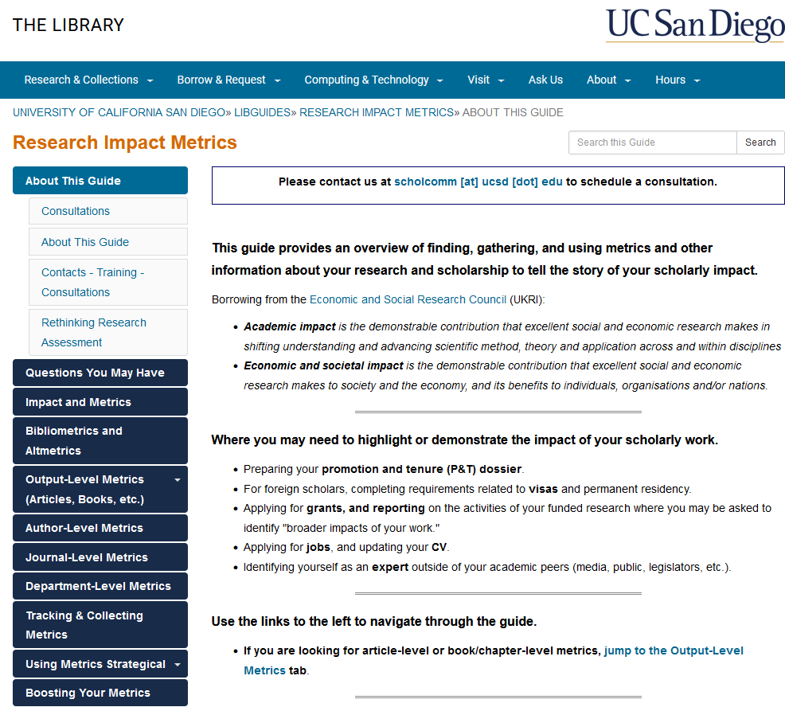
Exemplars

Slide 31
ACRL Scholarly Communications Toolkit
Created as a resource for librarians
Recently updated in 2016
The Measuring Impact section provides resources to help librarians to think “critically about traditional metrics” but does not address bias

Slide 32
How do we incorporate discussions of bias into RI LibGuides as a best practice?
Create educational resources (webinars, toolkits, etc.)
Partner with other areas (teaching and learning, scholarly communications)
Begin a global conversation
Start.....

Slide 33
LibGuides Review Framework
What information would helpful/relevant for my constituents?
How is your institution addressing this?
What structure is most appropriate?
Separate LibGuides, Full page or Section in a page, or Incorporated into description of resources
At what Level?
Overview or by Discipline

Slide 34
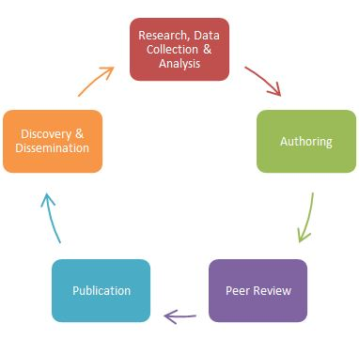
LibGuides Review Framework
Keep in mind:
Bias is systemic and institutionalized
Bias is present in other areas of scholarship
Acknowledge power and privilege
Bias
Bias
Bias
Bias
Bias

Slide 35
What topics should be included?
Citational Justice/Inclusive Citation
Ethics in Peer Review
Composition of Editorial boards

Slide 36
What topics should be included?
Language bias
Predatory Publishing
Global North/Global South

Slide 37
What types of resources should be included?
Organizations that are studying these issues
Blogs
Webinars and OERs
Links to articles, books, websites, and other resource guides

Slide 38
Questions?
Sheila Craft-Morgan
craft-morgan.1@osu.edu

Slide 39
Bibliography
Slide 4
Bakker, Caitlin J.; McBurney, Jenny. (2017). Big Splashes & Ripple Effects: Research Impact Services Across University Libraries. Retrieved from the University of Minnesota Digital Conservancy, https://hdl.handle.net/11299/188632.
Bredahl, Laura. (2022). “The Current and Evolving Landscape of Bibliometric Tools and Technologies,” Library Technology Reports 58(8).
Bryant, Rebecca. “Convening the OCLC RLP around bibliometrics and research impact (BRI)” February 9, 2022. https://hangingtogether.org/convening-the-oclc-rlp-around-bibliometrics-and-research-impact-bri/
Miles, R.A., Konkiel, S., & Sutton, S. (2018). Scholarly Communication Librarians’ Relationship with Research Impact Indicators: An Analysis of a National Survey of Academic Librarians in the United States. Journal of Librarianship and Scholarly Communication, 6(General Issue), eP2212. https://doi.org/10.7710/2162-3309.2212
Si L, Zeng Y, Guo S et al. (2019). Investigation and analysis of research support services in academic libraries. Electronic Library, 281-301, 37(2).
Tavernier, W., & Jamieson, L.M. (2022). Value Added: A Case Study of Research Impact Services. portal: Libraries and the Academy 22(4), 919-942. doi:10.1353/pla.2022.0047.

Slide 40
Bibliography
Slide 5
Association of College and Research Libraries. Open and Equitable Scholarly Communications: Creating a More Inclusive Future. Prepared by Nancy Maron and Rebecca Kennison with Paul Bracke, Nathan Hall, Isaac Gilman, Kara Malenfant, Charlotte Roh, and Yasmeen Shorish. Chicago: Association of College and Research Libraries, 2019. https://doi.org/10.5860/acrl.1
https://hangingtogether.org/addressing-bias-in-research-analytics-a-call-to-action/
Roh, Charlotte, & Vanessa Gabler. "Systemic barriers and allyship in library publishing: A case study reminder that no one is safe from racism." College & Research Libraries News [Online], 81.3 (2020): 141. Web. 16 Feb. 2023 https://crln.acrl.org/index.php/crlnews/article/view/24321/32136
Håkanson M, Håkanson M (2005). The Impact of Gender on Citations: An Analysis of College & Research Libraries, Journal of Academic Librarianship, and Library Quarterly College & Research Libraries, (2005), 312-323, 66(4)
Inefuku, Harrison, and Roh, Charlotte. Agents of Diversity and Social Justice: Librarians and Scholarly Communication. Ed. Smith, Kevin and Dickson, Katherine A. Open Access and the Future of Scholarly Communication: Policy and Infrastructure Rowman and Littlefield (2016).

Slide 41
Bibliography
Slide 6
Chawla, D. Men cite themselves more than women do. Nature (2016). https://doi.org/10.1038/nature.2016.20176
Kahalon, R., Klein, V., Ksenofontov, I., Ullrich, J., & Wright, S. C. (2022). Mentioning the Sample’s Country in the Article’s Title Leads to Bias in Research Evaluation. Social Psychological and Personality Science, 13(2), 352–361. https://doi.org/10.1177/19485506211024036
Liu, F., Holme, P., Chiesa, M. et al. Gender inequality and self-publication are common among academic editors. Nat Hum Behav (2023). https://doi.org/10.1038/s41562-022-01498-1
Ross, M.B., Glennon, B.M., Murciano-Goroff, R. et al. Women are credited less in science than men. Nature 608, 135–145 (2022). https://doi.org/10.1038/s41586-022-04966-w
Skopec, M., Issa, H., Reed, J. et al. The role of geographic bias in knowledge diffusion: a systematic review and narrative synthesis. Res Integr Peer Rev 5, 2 (2020). https://doi.org/10.1186/s41073-019-0088-0
Teixeira da Silva, J.A. The Matthew effect impacts science and academic publishing by preferentially amplifying citations, metrics and status. Scientometrics 126, 5373–5377 (2021). https://doi.org/10.1007/s11192-021-03967-2
Teich, E.G., Kim, J.Z., Lynn, C.W. et al. Citation inequity and gendered citation practices in contemporary physics. Nat. Phys. 18, 1161–1170 (2022). https://doi.org/10.1038/s41567-022-01770-1
Escobar Jones, Cherice, Reid, Gwendolynne, Poe, Mya."Leading American medical journal continues to omit Black research, reinforcing a legacy of racism in medical knowledge" — https://theconversation.com/leading-american-medical-journal-continues-to-omit-black-research-reinforcing-a-legacy-of-racism-in-medical-knowledge-185111

Slide 42
Bibliography
Slide 7
https://www.southernliving.com/travel/washington-dc/smithsonian-unveils-120-statues-of-women-in-stem
Slide 10
Brinkman, P. T., & Teeter, D. J. (1987). Methods for selecting comparison groups. New Directions for Institutional Research, 53, 5–23
Chatman, Steve. (2017) Constructing a Peer Institution: A New Methodology. AIR Professional File, Article 143, (55-66).
Slide 11
https://www.arl.org/who-we-are/
Mian, Anam, and Gary Roebuck. ARL Statistics 2020. Washington, DC: Association of Research Libraries, 2022. https://doi.org/10.29242/stats.2020

Slide 43
Bibliography
Slide 12
Mian, Anam, and Gary Roebuck. ARL Statistics 2020. Washington, DC: Association of Research Libraries, 2022. https://doi.org/10.29242/stats.2020
Slide 13
https://nces.ed.gov/ipeds/use-the-data
https://ncses.nsf.gov/surveys/higher-education-research-development/2021#data
Slide 18
https://springshare.com/libguides/

Slide 44
Bibliography
Slide 29
https://guides.libraries.psu.edu/bibliometrics
Slide 30
https://guides.lib.byu.edu/c.php?g=1123631&p=8195662
Slide 31
https://ucsd.libguides.com/impact/about
Slide 32
https://acrl.libguides.com/scholcomm/toolkit

Slide 45
Bibliography
Slide 34
Hodge, Twanna (2020). “Using LibGuides to support racial justice & create inclusive communities. Springy News. https://buzz.springshare.com/springynews/news-49/libguides-tricks
Porrata, Stephanie (2022). “LibGuides for Social Justice Limitations and Opportunities.” In Practicing Social Justice in Libraries, edited by Alyssa Brissett and Diana Moronta, 40-51. New York: Taylor and Francis Group.
Slide 36
https://www.citeblackwomencollective.org/our-praxis.html
Slide 38
https://civiclaboratory.nl/citational-politics/

