Slide 1
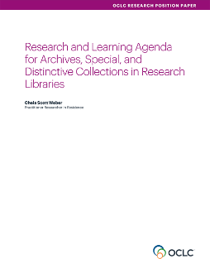
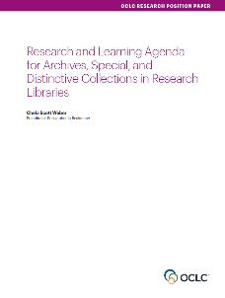
Our Work in Archives, Special, and
Distinctive Collections:
oc.lc/rlp-agenda
Notes:
Research and Learning Agenda https://doi.org/10.25333/C3C34F
Total Cost of Stewardship https://doi.org/10.25333/zbh0-a044

Slide 2
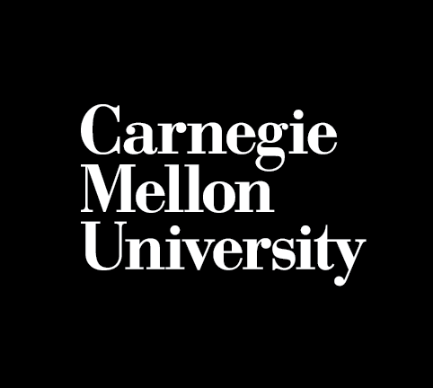
G E A R S &
G I G A B Y T E S
Preserving Multimodal
Robotics Collections
at Carnegie Mellon University

Slide 3
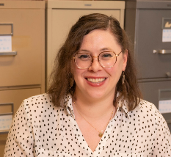
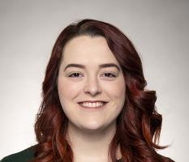
Julia Corrin
A S S O C I A T E D E A N F O R D I S T I N C T I V E C O L L E C T I O N S
Kathleen Donahoe
I N T E R I M L E A D A R C H I V I S T F O R T H E R O B O T I C S P R O J E C T

Slide 4
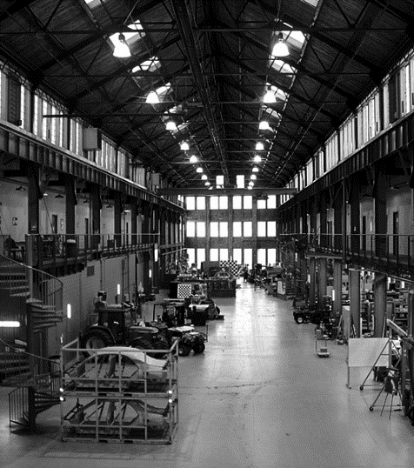
T H E R O B O T I C S I N S T I T U T E
“Of all the hopes I could have for the Robotics Institute, the one that is most precious to me…is that it provide the place where some fundamental advances will occur in our scientific understanding of intelligent action.”
– Allen Newell, 1988
The Scientific Relevance of Robotics

Slide 5
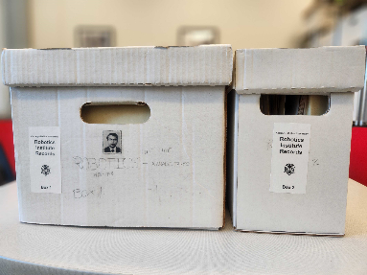
The Robotics Project
2 0 1 8 C O L L E C T I O N S U R V E Y
1.5 linear feet of robotics records
Current records were very dispersed,
and were primarily lab and project based

Slide 6
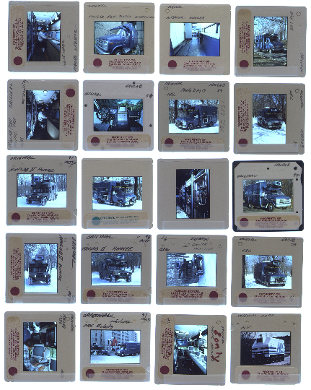
P H A S E N O. 1
Can we get one
person’s papers?
Maybe? But they’re not the complete story.
These are not your typical faculty papers or department records
AV heavy (¼ petabyte)
Not part of the traditional research ecosystem
Use, Reuse and iteration

Slide 7
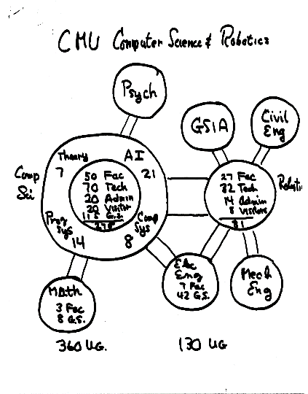
“Science does not fit any single mold”
– Allen Newell
Allen Newell Papers, Folder 8916

Slide 8
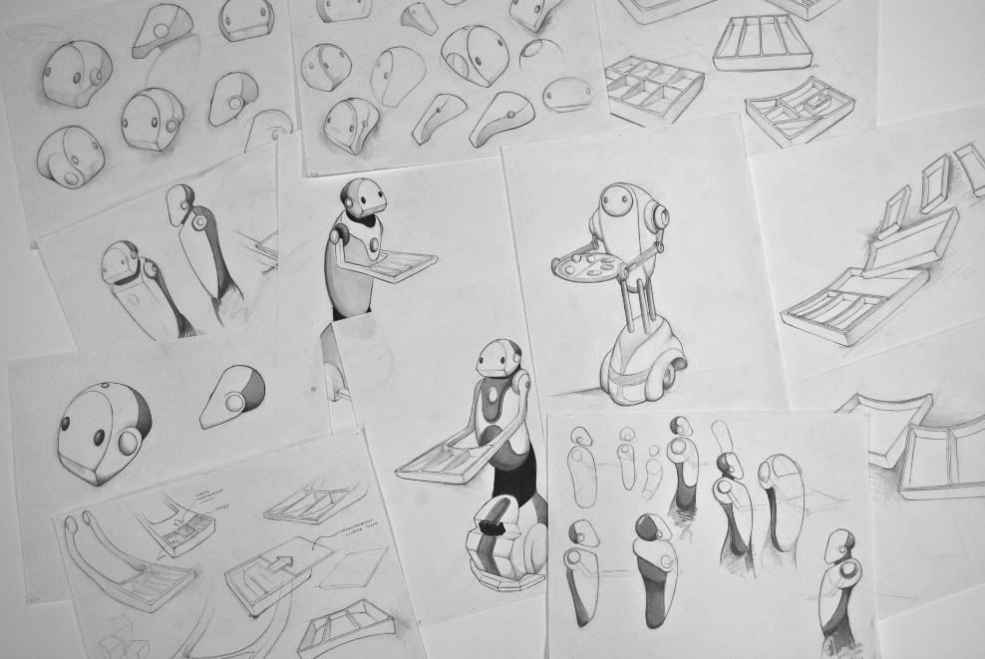
Is this an archive, or a museum?

Slide 9
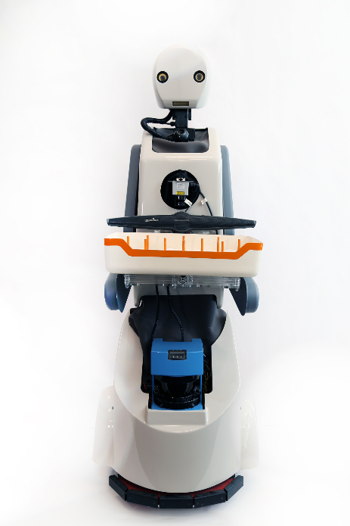
A R C H I V E O R M U S E U M ?
Target audience is more familiar with museums than archives
“Dusty shelf” stereotype is a core concern
The physical object is the core output of research

Slide 10
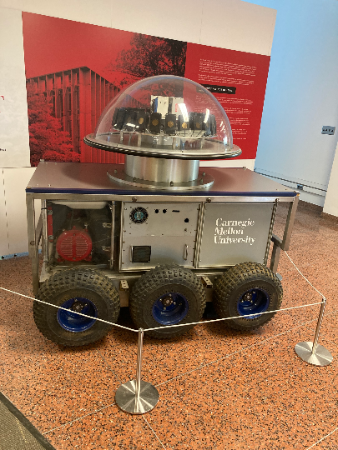
W H A T I S T H E “ F I N A L “ V E R S I O N ?
The research process is iterative
Parts are repurposed for different purposes
Different portions of a project reflect the final product for different labs and researchers

Slide 11
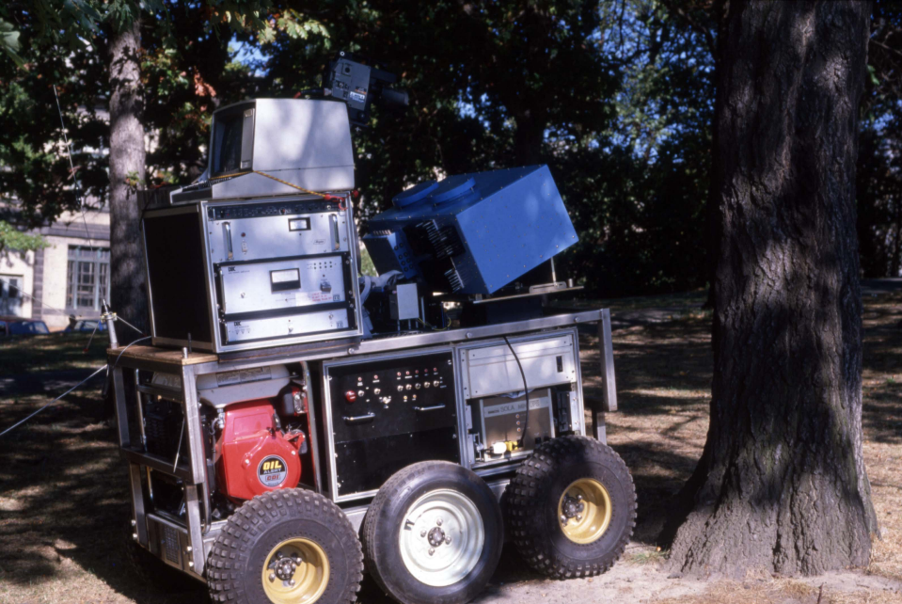

Slide 12
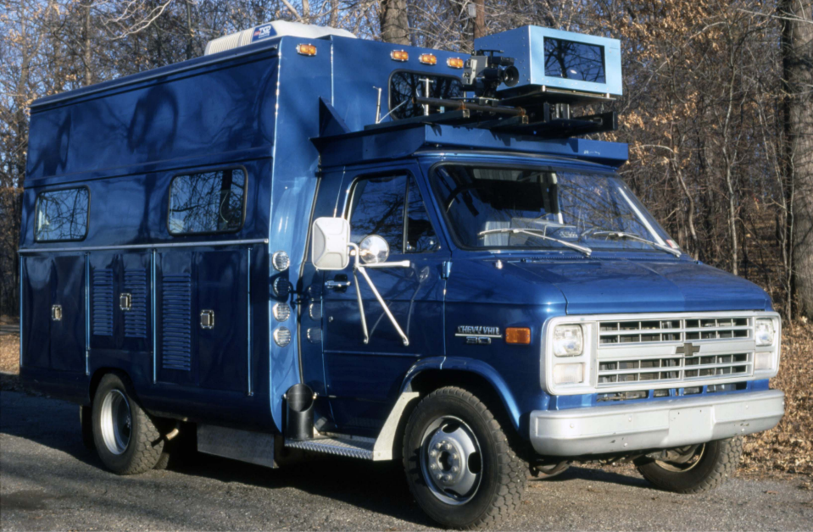

Slide 13
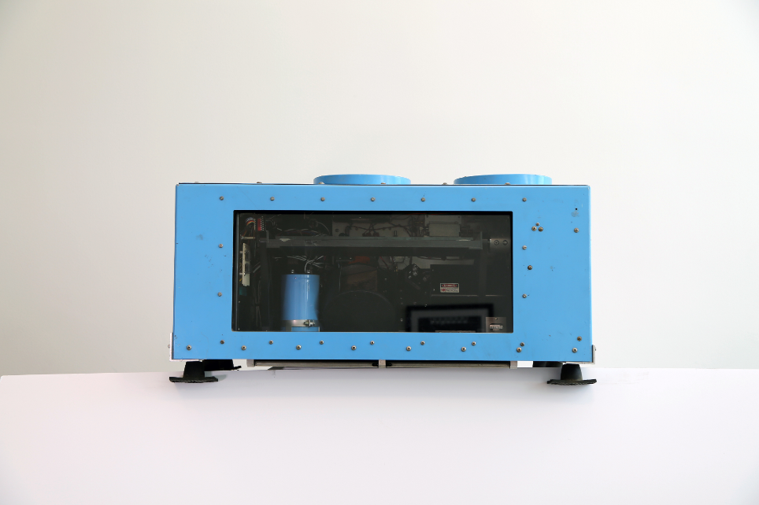

Slide 14
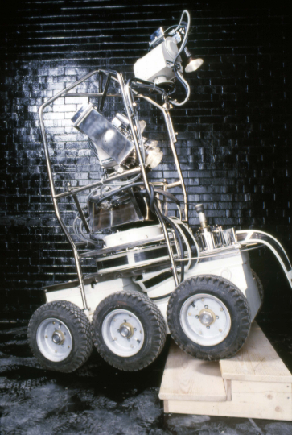
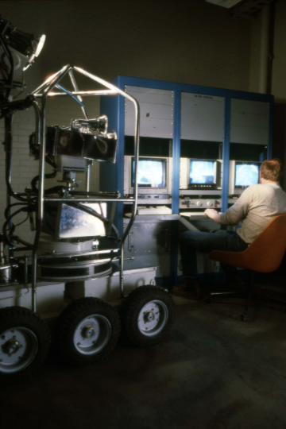

Slide 15
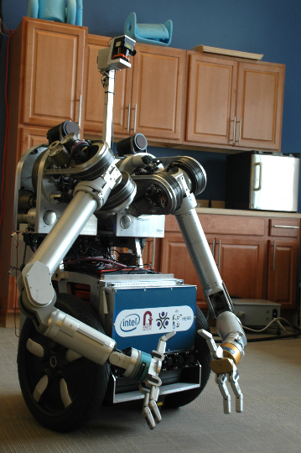
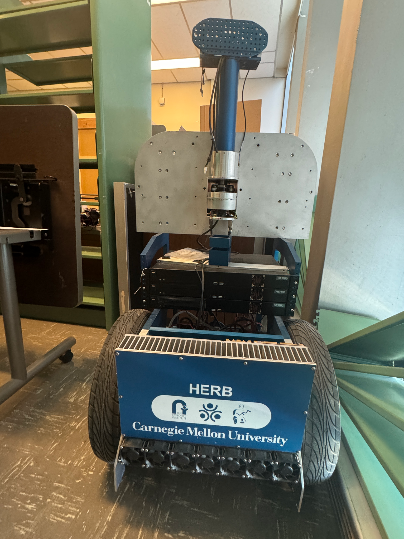

Slide 16
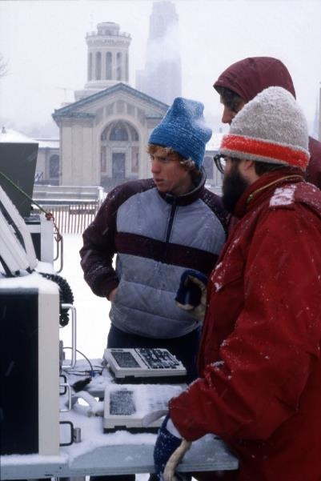
P H A S E N O. 2
Sloan Grant
Alfred P. Sloan Foundation provided a year of funding to investigate
Deliverables included a white paper and digital collections site
Start with research – professional literature, investigating other archival practices
Working with consultants in relevant fields

Slide 17
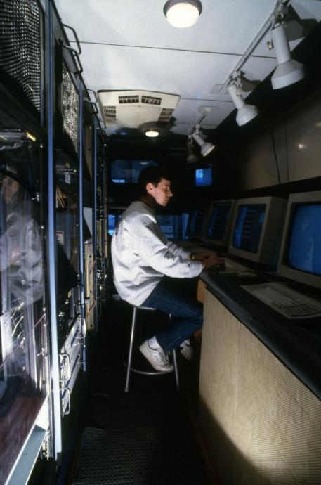
S U R V E Y I N G T H E L A B S
Ethnographic survey of robotics labs at CMU
Started with three labs – narrowed samples to cover multiple bases, i.e. one lab had existed for a long time, one was relatively new
Also chose labs based on different levels of people working there (faculty, staff, student)
Learning how to communicate with people outside the archival profession
Overcoming their assumptions about archives

Slide 18
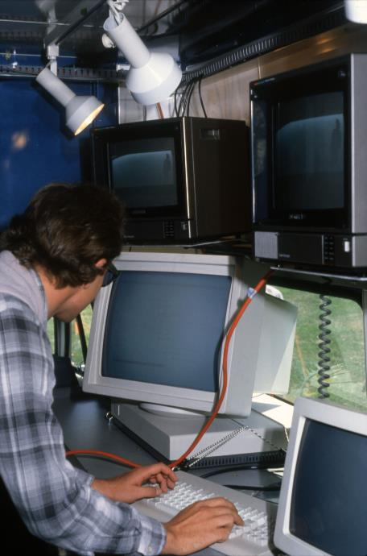
D A T A A N A L Y S I S
Working with our colleague to transform data into usable information
Robotics faculty, staff, and students focused their ideas of documentation on reports, data sets, conference proceedings, and professional literature
Differences in how labs operate – lack of standardization across all of the Robotics Institute
Early research, consultant conversations, and the data from the survey all helped shape writing in the white paper

Slide 19
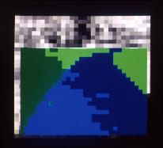
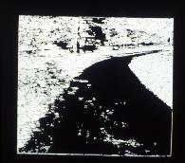
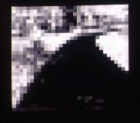
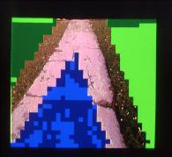
T O O L K I T / W H I T E P A P E R
Multimodal Archives: A Toolkit for Collecting Robotics and Other Complex Material in a Research Ecosystem
Available via CMU’s digital repository, KiltHub
Open, adaptable guidelines for dealing with complex collections
Conversation guide for working with donors
ROBOTS - Research, Outreach, Build, Offer, Transfer, Steward

Slide 20
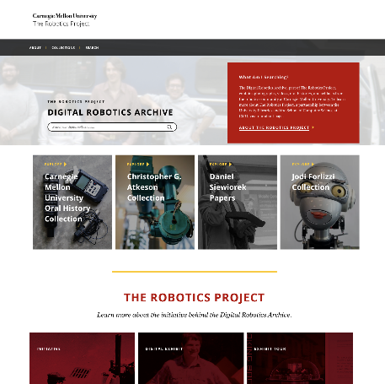
D I G I T A L R O B O T I C S A R C H I V E
CMU upgraded to Islandora 8
Selection of 65 items – images, artifacts, video, research reports

Slide 21
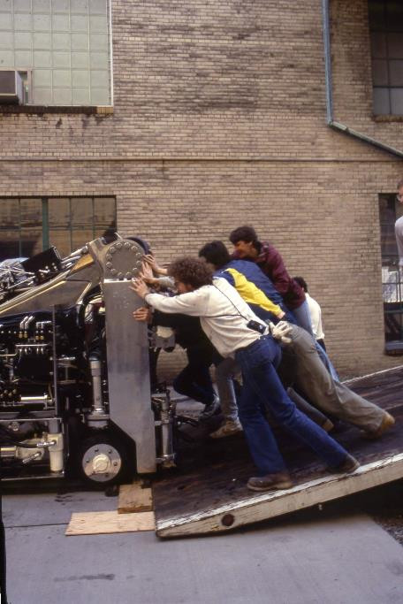
D O C U M E N T I N G T H E C O M M U N I T Y
Robotics projects have an extensive community
Inter-lab collaboration is common
How do we demonstrate these networks via Islandora?
Trial case – use the objects to set boundaries of who/what would be included
Authors of research reviews – subjects of a photograph – narrator of a video

Slide 22
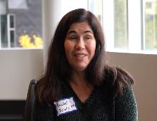
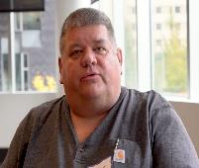
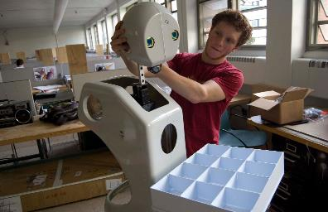
W H E R E T O N E X T
Expanded a bit since 2019
Now working with about 8 separate collections
Adding materials from alum, former staff members as we go
Increasing collecting on students
Oral history as a vital tool moving forward

Slide 23
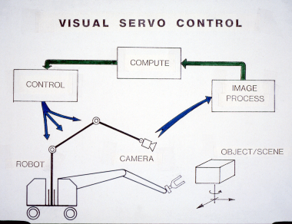
P H A S E N O. 3
New Challenges,
Old Challenges
Sustainability
Stakeholder needs and expectations
IP, ownership, and industry
Intersections with other library collections

Slide 24
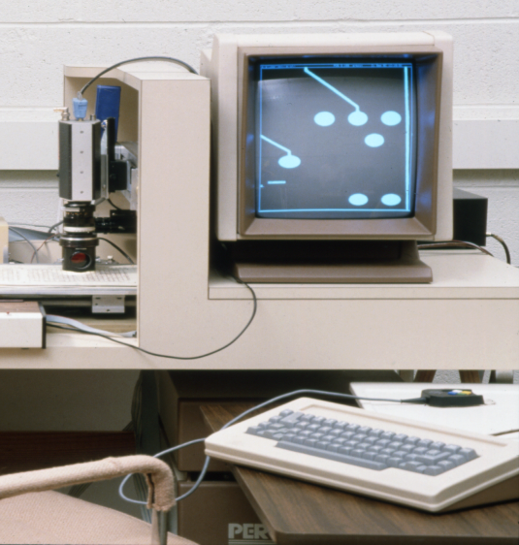
P R O J E C T S U S T A I N A B I L I T Y
Managing objects
Space implications
Skill gaps
Managing complex digital objects
Complex dependencies
Scope and scale
Managing community engagement

Slide 25
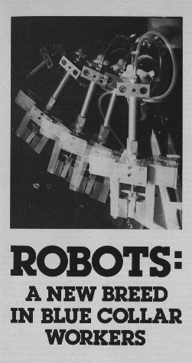
C O M P L E X O W N E R S H I P
Collaborations with government
Security clearances
Collaborations with industry
Who owns the output?
Archives vs. IRs vs. Data Repositories
Which library unit is responsible for the curation of which parts of the research lifecycle?
Where is it most accessible?
How do we align retention policies?

Slide 26
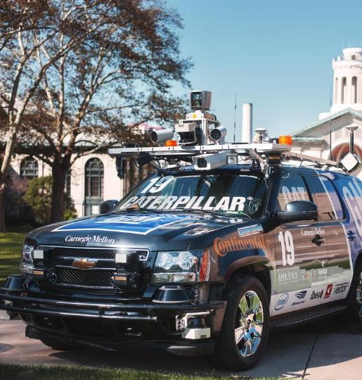
A U D I E N C E M A N A G E M E N T
Different realities in regards to
Resources
Technology
Different values
Maintaining vs. innovating
Cutting edge vs. accepted
standards and practices
Donors vs. users

Slide 27
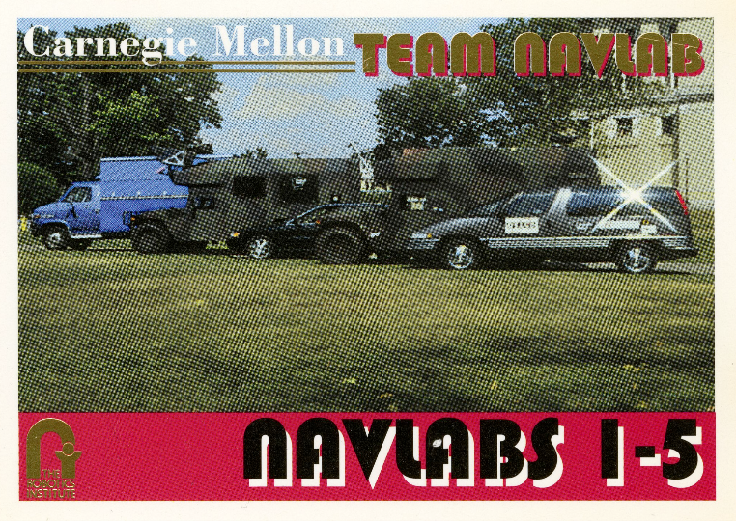
Questions?

Slide 28
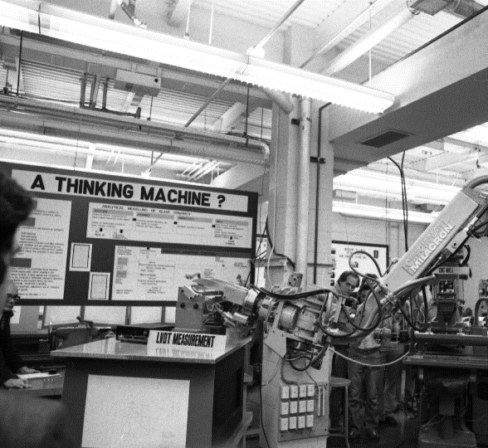
ADDITIONAL RESOURCES
Multimodal Archives Toolkit
https://doi.org/10.1184/R1/22232692.v1
Digital Robotics Archive
https://roboticsarchive.library.cmu.edu/
Notes:
Multimodal Archives Toolkit
https://doi.org/10.1184/R1/22232692.v1
Digital Robotics Archive
https://roboticsarchive.library.cmu.edu/

